Slide 1
Series: Life in the Son.
Part 4. “Strengthened.”
John Staiger
Morningside Church of Christ
Sunday 17 October 2021
AM Sermon
Broadcast on Facebook Live from
Massey, Auckland, Aotearoa/NZ.

Slide 2
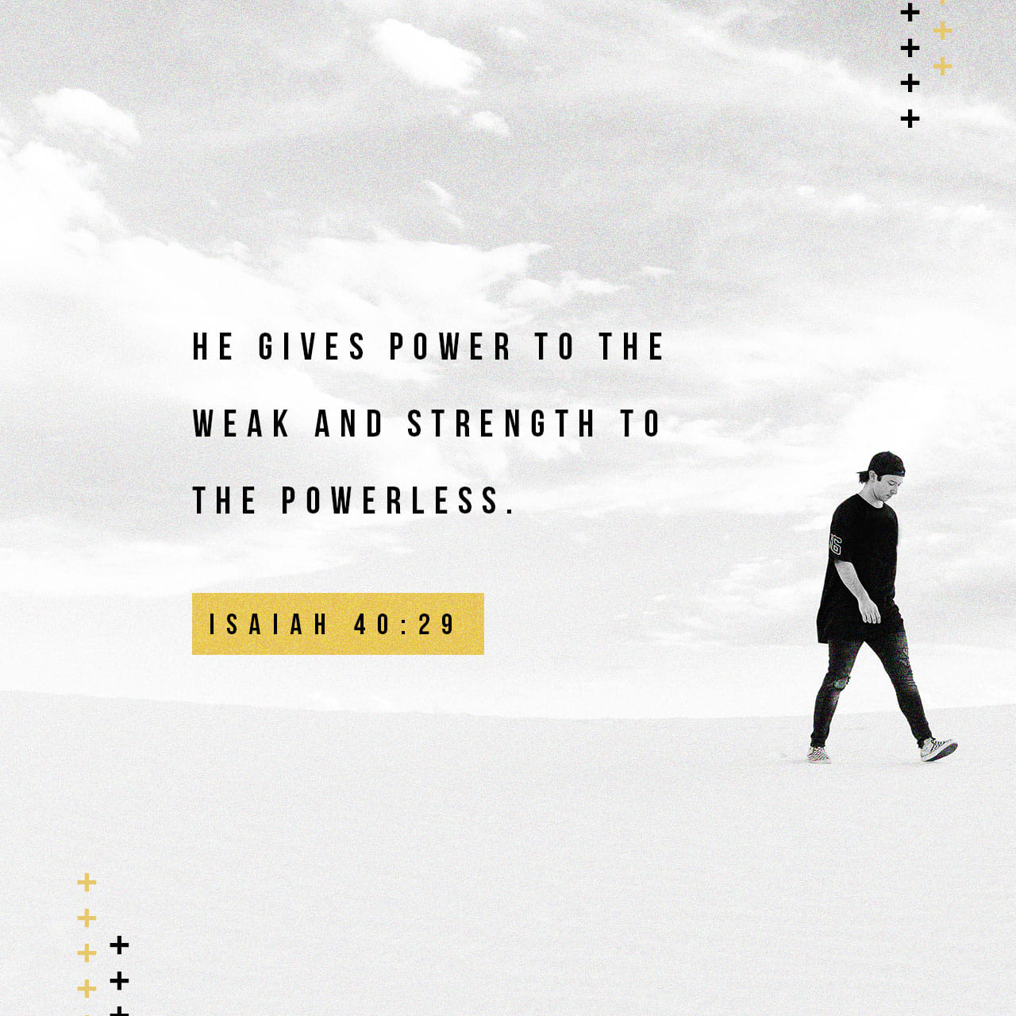
Life in the Son.
4. Strengthened…

Slide 3
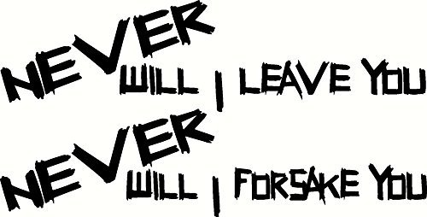
1. Strengthened—
But Challenged…
2 Timothy 4:16-17—
Hebrews 13:5

Slide 4
1. Strengthened—
But Challenged…
2 Timothy 4:16-17—
Hebrews 13:5
¹⁶At my first defense no one supported me,…
A. Alone—

Slide 5
1. Strengthened—
But Challenged…
2 Timothy 4:16-17—
Hebrews 13:5
¹⁶At my first defense no one supported me,…
A. Alone—
No one willing to stand with him.

Slide 6
1. Strengthened—
But Challenged…
2 Timothy 4:16-17—
Hebrews 13:5
¹⁶At my first defense no one supported me,…
A. Alone—
No one willing to stand with him.
No one offering strength.

Slide 7
1. Strengthened—
But Challenged…
2 Timothy 4:16-17—
Hebrews 13:5
¹⁶At my first defense no one supported me,…
A. Alone—
No one willing to stand with him.
No one offering strength.
No one around to care.

Slide 8
1. Strengthened—
But Challenged…
(2 Timothy 4:16-17)
Hebrews 13:5
¹⁶…but all
deserted me;…
B. Abandoned—

Slide 9
1. Strengthened—
But Challenged…
(2 Timothy 4:16-17)
Hebrews 13:5
¹⁶…but all
deserted me;…
B. Abandoned—
All unavailable?

Slide 10
1. Strengthened—
But Challenged…
(2 Timothy 4:16-17)
Hebrews 13:5
¹⁶…but all
deserted me;…
B. Abandoned—
All unavailable?
All afraid?

Slide 11
1. Strengthened—
But Challenged…
(2 Timothy 4:16-17)
Hebrews 13:5
¹⁶…but all
deserted me;…
B. Abandoned—
All unavailable?
All afraid?
All too weak?

Slide 12
1. Strengthened—
But Challenged…
(2 Timothy 4:16-17)
Hebrews 13:5
¹⁶…may it not be counted against them.
C. Concerned

Slide 13
1. Strengthened—
But Challenged…
(2 Timothy 4:16-17)
Hebrews 13:5
¹⁶…may it not be counted against them.
C. Concerned
For their lack of strength.

Slide 14
1. Strengthened—
But Challenged…
(2 Timothy 4:16-17)
Hebrews 13:5
¹⁶…may it not be counted against them.
C. Concerned
For their lack of strength.
For their witness to faith.

Slide 15
1. Strengthened—
But Challenged…
(2 Timothy 4:16-17)
Hebrews 13:5
¹⁶…may it not be counted against them.
C. Concerned
For their lack of strength.
For their witness to faith.
For their standing in Judgement ahead.

Slide 16
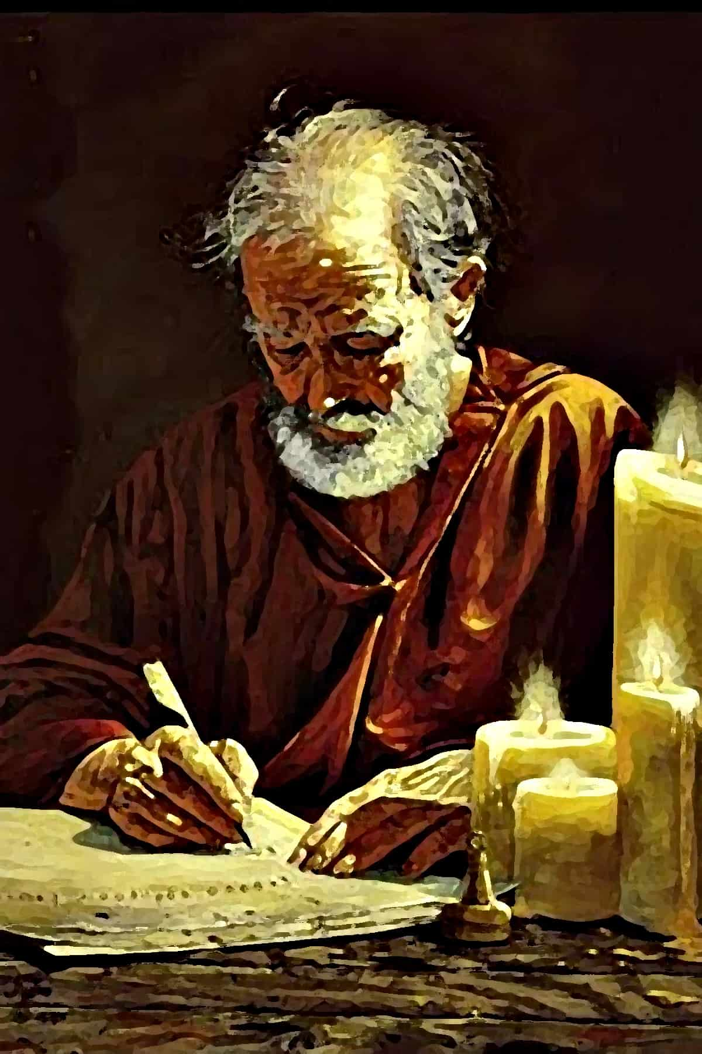
2. Strengthened—
Divine solidarity…
(2 Timothy 4:16-17)

Slide 17
2. Strengthened—
Divine solidarity…
(2 Timothy 4:16-17)
¹⁷But the Lord stood with me and strengthened me,
A. God looks after His own:

Slide 18
2. Strengthened—
Divine solidarity…
(2 Timothy 4:16-17)
Hebrews 13:5
¹⁷But the Lord stood with me and strengthened me,
A. God looks after His own:
Power from without.

Slide 19
2. Strengthened—
Divine solidarity…
(2 Timothy 4:16-17)
Hebrews 13:5
¹⁷But the Lord stood with me and strengthened me,
A. God looks after His own:
Power from without.
Power to endure.

Slide 20
2. Strengthened—
Divine solidarity…
(2 Timothy 4:16-17)
Hebrews 13:5
¹⁷But the Lord stood with me and strengthened me,
A. God looks after His own:
Power from without.
Power to endure.
Power to wait on the Lord.

Slide 21
2. Strengthened—
Divine solidarity…
(2 Timothy 4:16-17)
Hebrews 13:5
¹⁷…so that through me the proclamation might be fully accomplished,
B. God looks to His Mission:

Slide 22
2. Strengthened—
Divine solidarity…
(2 Timothy 4:16-17)
Hebrews 13:5
¹⁷…so that through me the proclamation might be fully accomplished,
B. God looks to His Mission:
An Apostle is “One Sent.”

Slide 23
2. Strengthened—
Divine solidarity…
(2 Timothy 4:16-17)
Hebrews 13:5
¹⁷…so that through me the proclamation might be fully accomplished,
B. God looks to His Mission:
An Apostle is “One Sent.”
An Apostle is one who Went and Did!

Slide 24
2. Strengthened—
Divine solidarity…
(2 Timothy 4:16-17)
Hebrews 13:5
¹⁷…and that all the Gentiles might hear;
C. His greatest Joy:

Slide 25
2. Strengthened—
Divine solidarity…
(2 Timothy 4:16-17)
¹⁷…and that all the Gentiles might hear;
C. His greatest Joy:
He Preached Christ.

Slide 26
2. Strengthened—
Divine solidarity…
(2 Timothy 4:16-17)
¹⁷…and that all the Gentiles might hear;
C. His greatest Joy:
He Preached Christ.
He Planted Churches, but…

Slide 27
2. Strengthened—
Divine solidarity…
(2 Timothy 4:16-17)
Hebrews 13:5
¹⁷…and I was rescued out of the lion’s mouth.
D. Deliverance:

Slide 28
2. Strengthened—
Divine solidarity…
(2 Timothy 4:16-17)
Hebrews 13:5
¹⁷…and I was rescued out of the lion’s mouth.
D. Deliverance:
Always at hand.

Slide 29
2. Strengthened—
Divine solidarity…
(2 Timothy 4:16-17)
Hebrews 13:5
¹⁷…and I was rescued out of the lion’s mouth.
D. Deliverance:
Always at hand.
Always uplifted.

Slide 30
2. Strengthened—
Divine solidarity…
(2 Timothy 4:16-17)
Hebrews 13:5
¹⁷…and I was rescued out of the lion’s mouth.
D. Deliverance:
Always at hand.
Always uplifted.
Always from Satan.

Slide 31
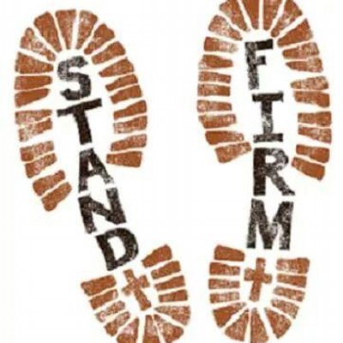
Strengthened
for the Day
James 5:8
⁸You too be
patient;
strengthen your
hearts,
for the coming of
the Lord is near.
(NASB95)

Slide 32
Strengthened
for the Day
James 5:8
⁸You too be
patient;
strengthen your
hearts,
for the coming of
the Lord is near.
(NASB95)

Slide 33
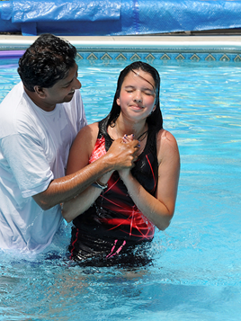
“Baptism now saves you” (1Pet.3:21).
²¹Corresponding to that, baptism now saves you—not the removal of dirt from the flesh, but an appeal to God for a good conscience— through the resurrection of Jesus Christ, (NASB95)

