Slide 1
“Pain and Suffering Part 1.”
John Staiger
Morningside Church of Christ
Sunday 31 October 2021
PM Sermon
Broadcast on Facebook Live from Massey, Auckland, Aotearoa/NZ.
www.morningsidechurchofchrist.org.nz

Slide 2
Pain and Suffering Part 1

Slide 3
Pain—Hard questions…

Slide 4
Pain—Hard questions…
Is pain consistent with an all knowing and all powerful God?
  We are in a fallen world.
  With Sin came pain and death.
    Childbirth (Gen.3:16)
    Earth was cursed (Gen.3:17-18).
    Man would work by the sweat of his brow (Gen.3:19).
  We remain creatures of choice.

Slide 5
Pain—Hard questions…
Is pain consistent with an all knowing and all powerful God?
  We are in a fallen world.
  With Sin came pain and death.
    Childbirth (Gen.3:16)
    Earth was cursed (Gen.3:17-18).
    Man would work by the sweat of his brow (Gen.3:19).
  We remain creatures of choice.

Slide 6
Pain—Hard questions…
Is pain consistent with an all knowing and all powerful God?
  We are in a fallen world.
  With Sin came pain and death.
    Childbirth (Gen.3:16)
    Earth was cursed (Gen.3:17-18).
    Man would work by the sweat of his brow (Gen.3:19).
  We remain creatures of choice.

Slide 7
Pain—Hard questions…
Is pain consistent with an all knowing and all powerful God?
  We are in a fallen world.
  With Sin came pain and death.
    Childbirth (Gen.3:16)
    Earth was cursed (Gen.3:17-18).
    Man would work by the sweat of his brow (Gen.3:19).
  We remain creatures of choice.

Slide 8
Pain—Hard questions…
Is pain consistent with an all knowing and all powerful God?
  We are in a fallen world.
  With Sin came pain and death.
    Childbirth (Gen.3:16)
    Earth was cursed (Gen.3:17-18).
    Man would work by the sweat of his brow (Gen.3:19).
  We remain creatures of choice.

Slide 9
Pain—Hard questions…
Is pain consistent with an all knowing and all powerful God?
  We are in a fallen world.
  With Sin came pain and death.
    Childbirth (Gen.3:16)
    Earth was cursed (Gen.3:17-18).
    Man would work by the sweat of his brow (Gen.3:19).
  We remain creatures of choice.

Slide 10
Pain—Hard questions…
Is pain consistent with an all knowing and all powerful God?
  We are in a fallen world.
  With Sin came pain and death.
    Childbirth (Gen.3:16)
    Earth was cursed (Gen.3:17-18).
    Man would work by the sweat of his brow (Gen.3:19).
  We remain creatures of choice.

Slide 11

1 Chronicles 4:9-10
⁹Jabez was more honourable than his brothers, and his mother named him Jabez saying, “Because I bore him with pain.” ¹⁰Now Jabez called on the God of Israel, saying, “Oh that You would bless me indeed and enlarge my border, and that Your hand might be with me, and that You would keep me from harm that it may not pain me!” And God granted him what he requested. (NASB95)

Slide 12
1 Chronicles 4:9-10
⁹Jabez was more honourable than his brothers, and his mother named him Jabez saying, “Because I bore him with pain.” ¹⁰Now Jabez called on the God of Israel, saying, “Oh that You would bless me indeed and enlarge my border, and that Your hand might be with me, and that You would keep me from harm that it may not pain me!” And God granted him what he requested. (NASB95)

Slide 13
1 Chronicles 4:9-10
Jabez:
  Named for his mother’s pain.
  Did not want to live according to that name.
  Called upon God to bless him with obvious signs of His favour.
  Remove pain from his future.

Slide 14
1 Chronicles 4:9-10
Jabez:
  Named for his mother’s pain.
  Did not want to live according to that name.
  Called upon God to bless him with obvious signs of His favour.
  Remove pain from his future.

Slide 15
1 Chronicles 4:9-10
Jabez:
  Named for his mother’s pain.
  Did not want to live according to that name.
  Called upon God to bless him with obvious signs of His favour.
  Remove pain from his future.

Slide 16
1 Chronicles 4:9-10
Jabez:
  Named for his mother’s pain.
  Did not want to live according to that name.
  Called upon God to bless him with obvious signs of His favour.
  Remove pain from his future.

Slide 17
1 Chronicles 4:9-10
Jabez:
  Named for his mother’s pain.
  Did not want to live according to that name.
  Called upon God to bless him with obvious signs of His favour.
  Remove pain from his future.

Slide 18
Pain—A Friend in Need!

Slide 19
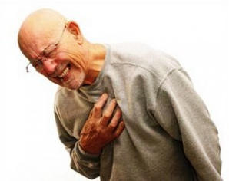
Pain—A Friend in Need!
1. Warning—
We might
ignore
a serious
problem.

Slide 20
Pain—A Friend in Need!
1. Warning—
We might
ignore
a serious
problem.

Slide 21
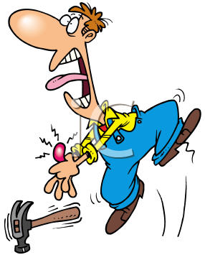
Pain—A Friend in Need!
2. Intervention—
Something
is
wrong!

Slide 22
Pain—A Friend in Need!
2. Intervention—
Something
is
wrong!

Slide 23
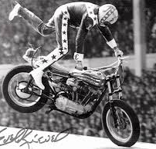
Pain—A Friend in Need!
3. Protection—
Against
foolish
risks.

Slide 24
Pain—A Friend in Need!
3. Protection—
Against
foolish
risks.

Slide 25
Pain—A Friend in Need!
What they don’t tell you at Stuntman School

Slide 26
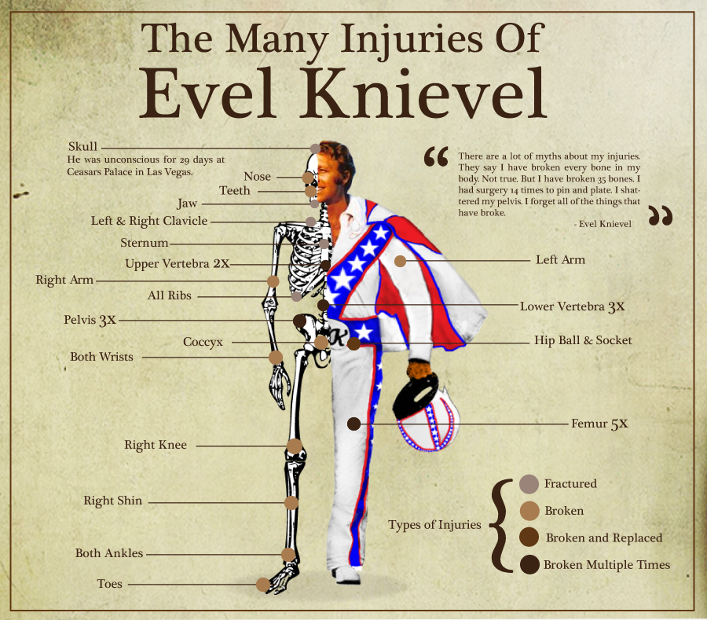

Slide 27
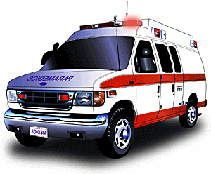
Pain—A Friend in Need!
4. Makes you seek help.

Slide 28
Reactions to pain!

Slide 29
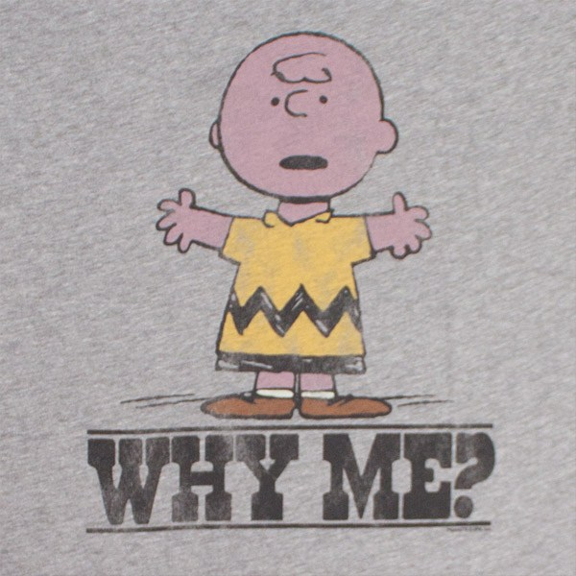
Reactions to pain!
1. Its not fair!
I don’t
deserve
this.

Slide 30
Reactions to pain!
1. Its not fair!
I don’t
deserve
this.

Slide 31
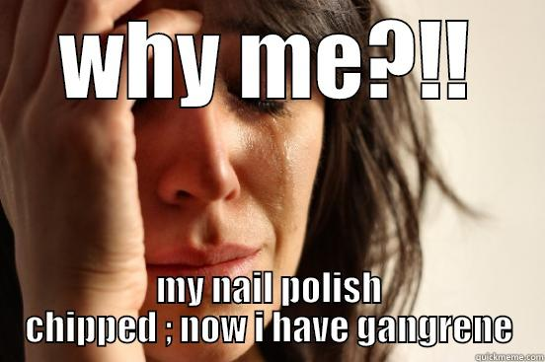
Reactions to pain!
2. Overreaction—
These are real
and show
great
immaturity.

Slide 32
Reactions to pain!
2. Overreaction—
These are real
and show
great
immaturity.

Slide 33
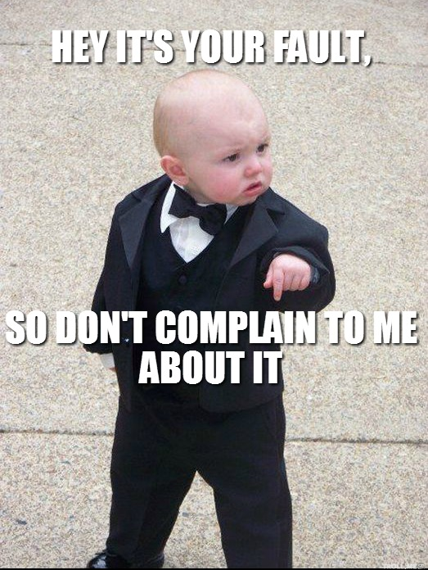
Reactions to pain!
3. It’s your fault!
Job’s friends accused him of bringing God’s wrath upon him.

Slide 34
Reactions to pain!
3. It’s your fault!
Job’s friends accused him of bringing God’s wrath upon him.

Slide 35

Reactions to pain!
4. Bring it on!

Slide 36
Reactions to pain!
4. Bring it on!
No pain,
No gain…!

Slide 37
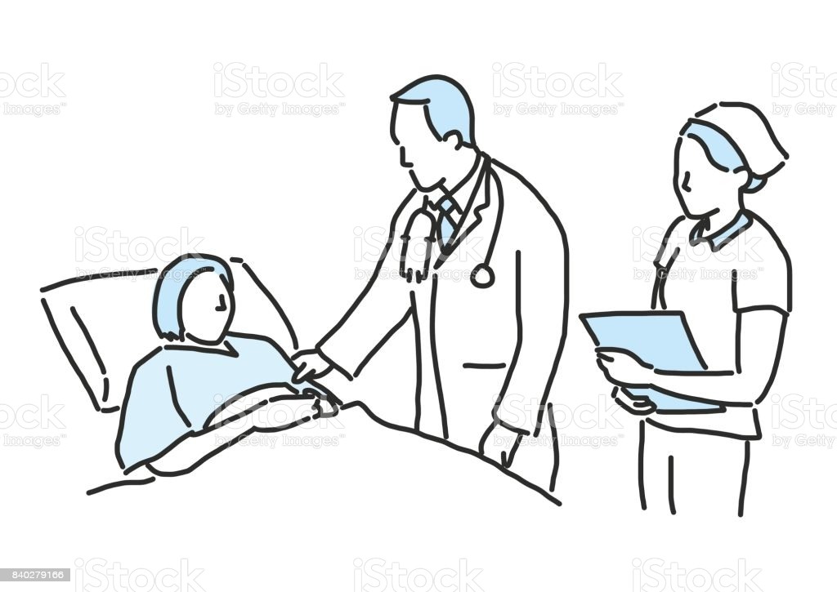
Reactions to pain!
5. This needs to be healed.

Slide 38
Reactions to pain!
5. This needs to be healed.
Others are needed in the process.

Slide 39
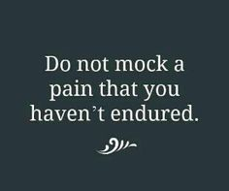

Slide 40
How can I grow?
1. Faith.

Slide 41
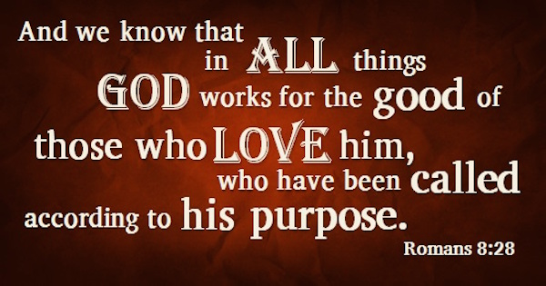
How can I grow?
1. Faith.

Slide 42
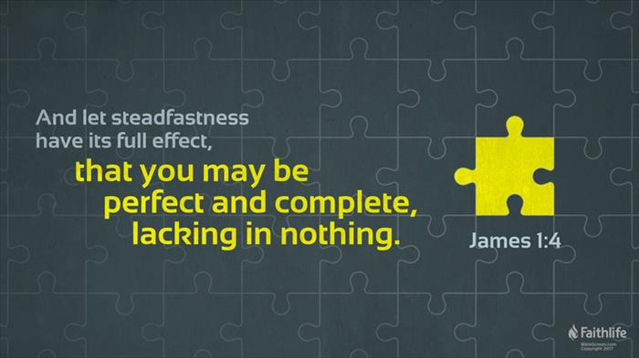
How can I grow?
2. Endurance.

Slide 43

How can I grow?
3. Providence

Slide 44
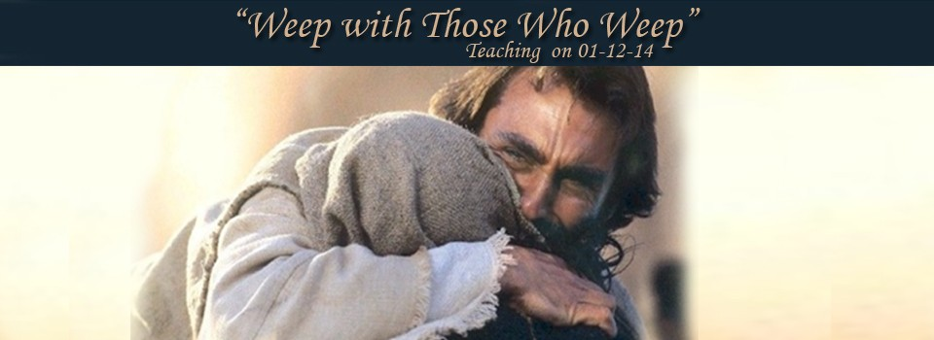
How can I grow?
4. Empathy

Slide 45
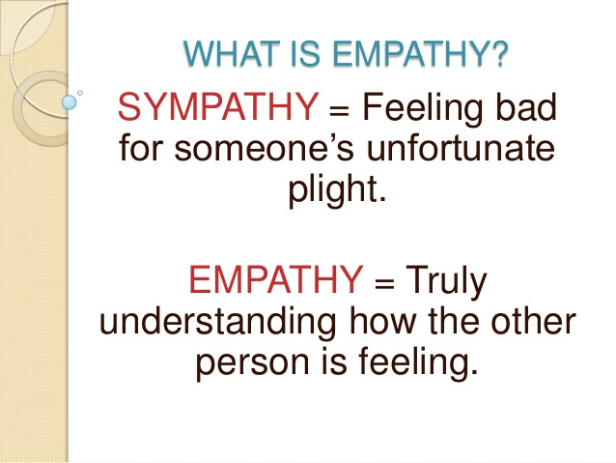
How can I grow?
4. Empathy

Slide 46
How can I grow?
5. Jesus removed pain…
Matthew 4:24—
²⁴The news about Him spread throughout all Syria; and they brought to Him all who were ill, those suffering with various diseases and pains, demoniacs, epileptics, paralytics; and He healed them. (NASB95)

Slide 47
How can I grow?
5. Jesus removed pain…
Matthew 4:24—
²⁴The news about Him spread throughout all Syria; and they brought to Him all who were ill, those suffering with various diseases and pains, demoniacs, epileptics, paralytics; and He healed them. (NASB95)

Slide 48
How can I grow?
6. Jesus has been there…
Hebrews 4:15—
For we do not have a high priest who cannot sympathize with our weaknesses, but One who has been tempted in all things as we are, yet without sin. (NASB95)

Slide 49
How can I grow?
6. Jesus has been there…
Hebrews 4:15—
For we do not have a high priest who cannot sympathize with our weaknesses, but One who has been tempted in all things as we are, yet without sin. (NASB95)

Slide 50
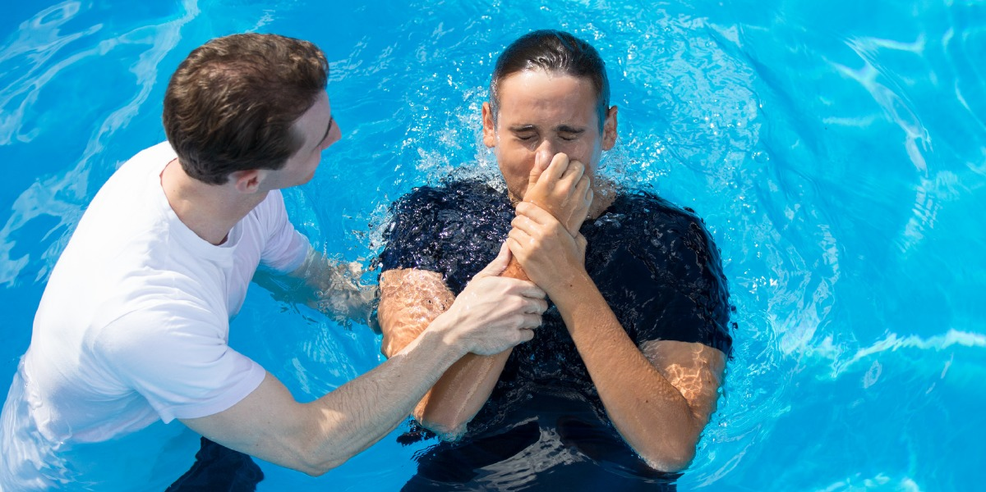
Eternal pain stops here!
Galatians 3:27—²⁷For all of you who were baptized into Christ have clothed yourselves with Christ. (NASB95)

