Slide 1
“Same three moves.”
John Staiger
Morningside Church of Christ
Sunday 10 October 2021
PM Sermon
Broadcast on Facebook Live from Massey, Auckland, Aotearoa/NZ.
www.morningsidechurchofchrist.org.nz

Slide 2
Three same moves
Satan’s schemes…

Slide 3
1 John 2:16—
¹⁶For all that is in the world,
the lust of the flesh
and the
lust of the eyes
and the
boastful pride of life,
is not from the Father,
but is from the world.
(NASB95)

Slide 4
1 John 2:16—
¹⁶For all that is in the world,
the lust of the flesh
and the
lust of the eyes
and the
boastful pride of life,
is not from the Father,
but is from the world.
(NASB95)
1.
2.
3.

Slide 5
1 John 2:16—
¹⁶For all that is in the world,
the lust of the flesh
and the
lust of the eyes
and the
boastful pride of life,
is not from the Father,
but is from the world.
(NASB95)
1.
2.
3.

Slide 6
1 John 2:16—
¹⁶For all that is in the world,
the lust of the flesh
and the
lust of the eyes
and the
boastful pride of life,
is not from the Father,
but is from the world.
(NASB95)
1.
2.
3.

Slide 7
1 John 2:16—
¹⁶For all that is in the world,
the lust of the flesh
and the
lust of the eyes
and the
boastful pride of life,
is not from the Father,
but is from the world.
(NASB95)
1.
2.
3.

Slide 8
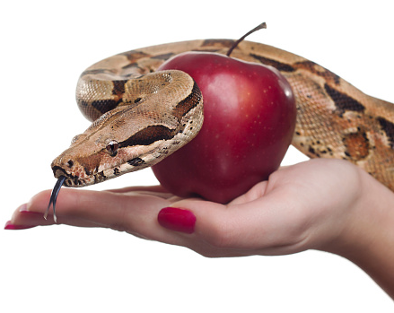
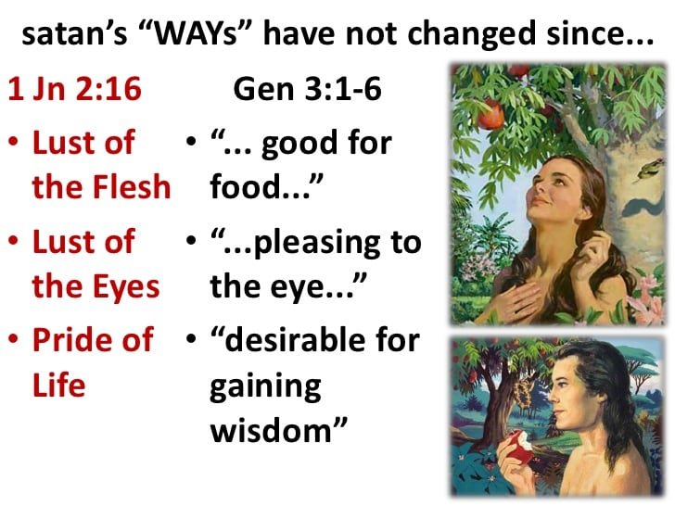
Nothing has changed…

Slide 9
Nothing has changed…

Slide 10
Nothing has changed…

Slide 11
Nothing has changed…

Slide 12

We are not ignorant of his schemes…
2 Cor.2:11—¹¹so that no advantage would be taken of us by Satan, for we are not ignorant of his schemes. (NASB95)

Slide 13
We are not ignorant of his schemes…
2 Cor.2:11—¹¹so that no advantage would be taken of us by Satan, for we are not ignorant of his schemes. (NASB95)
Satan—

Slide 14
We are not ignorant of his schemes…
2 Cor.2:11—¹¹so that no advantage would be taken of us by Satan, for we are not ignorant of his schemes. (NASB95)
Satan—
We can know what goes on in his mind.

Slide 15
We are not ignorant of his schemes…
2 Cor.2:11—¹¹so that no advantage would be taken of us by Satan, for we are not ignorant of his schemes. (NASB95)
Satan—
We can know what goes on in his mind.
Intentions.

Slide 16
We are not ignorant of his schemes…
2 Cor.2:11—¹¹so that no advantage would be taken of us by Satan, for we are not ignorant of his schemes. (NASB95)
Satan—
We can know what goes on in his mind.
Intentions.
Plans.

Slide 17
We are not ignorant of his schemes…
2 Cor.2:11—¹¹so that no advantage would be taken of us by Satan, for we are not ignorant of his schemes. (NASB95)
Satan—
We can know what goes on in his mind.
Intentions.
Plans.
Keep this in mind when…

Slide 18
We are not ignorant of his schemes…
2 Cor.2:11—¹¹so that no advantage would be taken of us by Satan, for we are not ignorant of his schemes. (NASB95)
Satan—
Tempter (1Thess.3:5).
Father of lies (Jn.8:44).
Fills hearts with lies (Acts 5:3)
Prowls like a lion (1Pet.5:8).
Flaming arrows (Eph.6:16)

Slide 19
We are not ignorant of his schemes…
2 Cor.2:11—¹¹so that no advantage would be taken of us by Satan, for we are not ignorant of his schemes. (NASB95)
Satan—
Tempter (1Thess.3:5).
Father of lies (Jn.8:44).
Fills hearts with lies (Acts 5:3)
Prowls like a lion (1Pet.5:8).
Flaming arrows (Eph.6:16)

Slide 20
We are not ignorant of his schemes…
2 Cor.2:11—¹¹so that no advantage would be taken of us by Satan, for we are not ignorant of his schemes. (NASB95)
Satan—
Tempter (1Thess.3:5).
Father of lies (Jn.8:44).
Fills hearts with lies (Acts 5:3)
Prowls like a lion (1Pet.5:8).
Flaming arrows (Eph.6:16)

Slide 21
We are not ignorant of his schemes…
2 Cor.2:11—¹¹so that no advantage would be taken of us by Satan, for we are not ignorant of his schemes. (NASB95)
Satan—
Tempter (1Thess.3:5).
Father of lies (Jn.8:44).
Fills hearts with lies (Acts 5:3)
Prowls like a lion (1Pet.5:8).
Flaming arrows (Eph.6:16)

Slide 22
We are not ignorant of his schemes…
2 Cor.2:11—¹¹so that no advantage would be taken of us by Satan, for we are not ignorant of his schemes. (NASB95)
Satan—
Tempter (1Thess.3:5).
Father of lies (Jn.8:44).
Fills hearts with lies (Acts 5:3)
Prowls like a lion (1Pet.5:8).
Flaming arrows (Eph.6:16)

Slide 23

No surprises…
2 Corinthians 11:14-15—¹⁴No wonder, for even Satan disguises himself as an angel of light. ¹⁵Therefore it is not surprising if his servants also disguise themselves as servants of righteousness, whose end will be according to their deeds. (NASB95)

Slide 24
No surprises…
2 Corinthians 11:14-15—¹⁴No wonder, for even Satan disguises himself as an angel of light.

Slide 25
No surprises…
2 Corinthians 11:14-15—¹⁵Therefore it is not surprising if his servants also disguise themselves as servants of righteousness, whose end will be according to their deeds. (NASB95)

Slide 26
No surprises…

Slide 27
No surprises…
Stop wasting time.
Stop stealing.
Stop wasting money.
Stop Lusting.
Stop Hating.
Stop Blaspheming.
Stop Lying.

Slide 28
No surprises…
Stop wasting time.
Stop stealing.
Stop wasting money.
Stop Lusting.
Stop Hating.
Stop Blaspheming.
Stop Lying.

Slide 29
No surprises…
Stop wasting time.
Stop stealing.
Stop wasting money.
Stop Lusting.
Stop Hating.
Stop Blaspheming.
Stop Lying.

Slide 30
No surprises…
Stop wasting time.
Stop stealing.
Stop wasting money.
Stop Lusting.
Stop Hating.
Stop Blaspheming.
Stop Lying.

Slide 31
No surprises…
Stop wasting time.
Stop stealing.
Stop wasting money.
Stop Lusting.
Stop Hating.
Stop Blaspheming.
Stop Lying.

Slide 32
No surprises…
Stop wasting time.
Stop stealing.
Stop wasting money.
Stop Lusting.
Stop Hating.
Stop Blaspheming.
Stop Lying.

Slide 33
No surprises…
Stop wasting time.
Stop stealing.
Stop wasting money.
Stop Lusting.
Stop Hating.
Stop Blaspheming.
Stop Lying.

Slide 34

Too busy reconstructing…
Romans 13:14—
¹⁴But put on the Lord Jesus Christ, and make no provision for the flesh in regard to its lusts. (NASB95)

Slide 35
Too busy with the church…
Galatians 6:10—
¹⁰So then, while we have opportunity, let us do good to all people, and especially to those who are of the household of the faith. (NASB95)

Slide 36
Too busy thinking…
Think on these things…

Slide 37

nnnnnn
Phil.4:8—
…whatever is:
True
Honourable
Right
Pure
Lovely
Of good repute
If there is any excellence
If anything worthy of praise
Dwell on these things. (NASB95)
My mind is made up of…

Slide 38

John 3:5—
⁵Jesus answered, “Truly, truly, I say to you, unless one is born of water and the Spirit he cannot enter into the kingdom of God. (NASB95)

