Slide 1
“Strengthened again!”
John Staiger
Morningside Church of Christ
Sunday 17 October 2021
PM Sermon
Broadcast on Facebook Live from Massey, Auckland, Aotearoa/NZ.
www.morningsidechurchofchrist.org.nz

Slide 2

Strengthened…
“Serving by the strength which God supplies.”
(1 Peter 4:11)

Slide 3

1. Strength—It always Starts in Prayer
Colossians 1:9-11—

Slide 4
1. Strength—It always Starts in Prayer
Colossians 1:9-11—
⁹For this reason also,
since the day we
heard of it, we have not
ceased to pray for you…
A. Prayer activated:

Slide 5
1. Strength—It always Starts in Prayer
Colossians 1:9-11—
⁹For this reason also,
since the day we
heard of it, we have not
ceased to pray for you…
A. Prayer activated:
Their faith switched on Paul’s intercession.

Slide 6
1. Strength—It always Starts in Prayer
Colossians 1:9-11—
⁹For this reason also,
since the day we
heard of it, we have not
ceased to pray for you…
A. Prayer activated:
Their faith switched on Paul’s intercession.
Ceaseless supplication.

Slide 7

2. Strength’s—Quantity Specified…
Colossians 1:9-11—

Slide 8
2. Strength’s—Quantity Specified…
Colossians 1:9-11—
⁹…and to ask that you may be filled with the knowledge of His will…
A. No half measures:

Slide 9
2. Strength’s—Quantity Specified…
Colossians 1:9-11—
⁹…and to ask that you may be filled with the knowledge of His will…
A. No half measures:
Average Bible knowledge quota?

Slide 10
2. Strength’s—Quantity Specified…
Colossians 1:9-11—
⁹…and to ask that you may be filled with the knowledge of His will…
A. No half measures:
Average Bible knowledge quota?
Hours or reading/study per week.

Slide 11
2. Strength’s—Quantity Specified…
Colossians 1:9-11—
⁹…and to ask that you may be filled with the knowledge of His will…
A. No half measures:
Average Bible knowledge quota?
Hours or reading/study per week.
“His Will is His Word!”

Slide 12
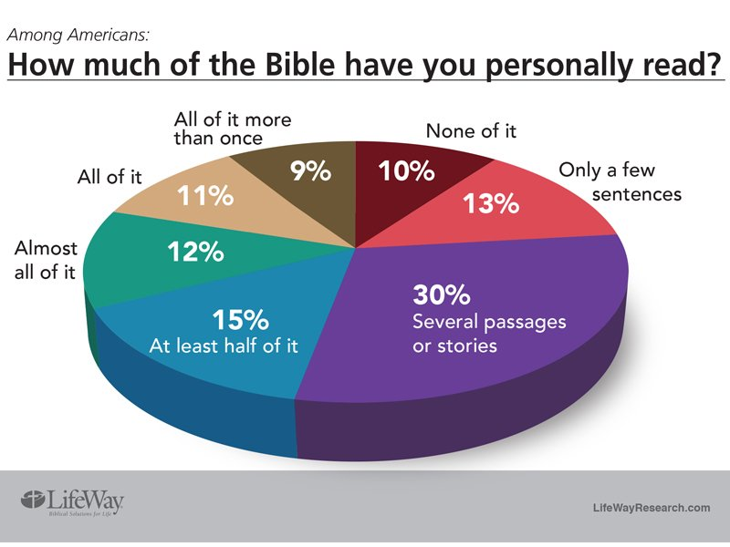

Slide 13
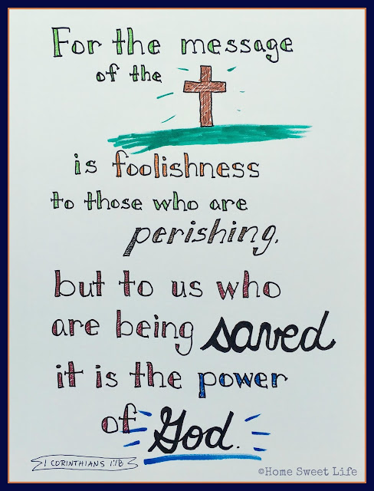
3. Strength’s—Spiritual insight beyond facts…
Colossians 1:9-11—
(1Cor.1:18).

Slide 14
3. Strength’s—Spiritual insight beyond facts…
Colossians 1:9-11—
⁹…in all spiritual wisdom and understanding,
A. Opposed to the World:
(1Cor.1:18).

Slide 15
3. Strength’s—Spiritual insight beyond facts…
Colossians 1:9-11—
⁹…in all spiritual wisdom and understanding,
A. Opposed to the World:
Remember…“Filled.”
(1Cor.1:18).

Slide 16
3. Strength’s— Spiritual insight beyond facts…
Colossians 1:9-11—
⁹…in all spiritual wisdom and understanding,
A. Opposed to the World:
Remember…“Filled.”
“For the wisdom of this world is foolishness before God” (1Cor.3:19).
(1Cor.1:18).

Slide 17
3. Strength’s— Spiritual insight beyond facts…
Colossians 1:9-11—
⁹…in all spiritual wisdom and understanding,
A. Opposed to the World:
Remember…“Filled.”
“For the wisdom of this world is foolishness before God” (1Cor.3:19).
It’s “understood” when applied.
(1Cor.1:18).

Slide 18
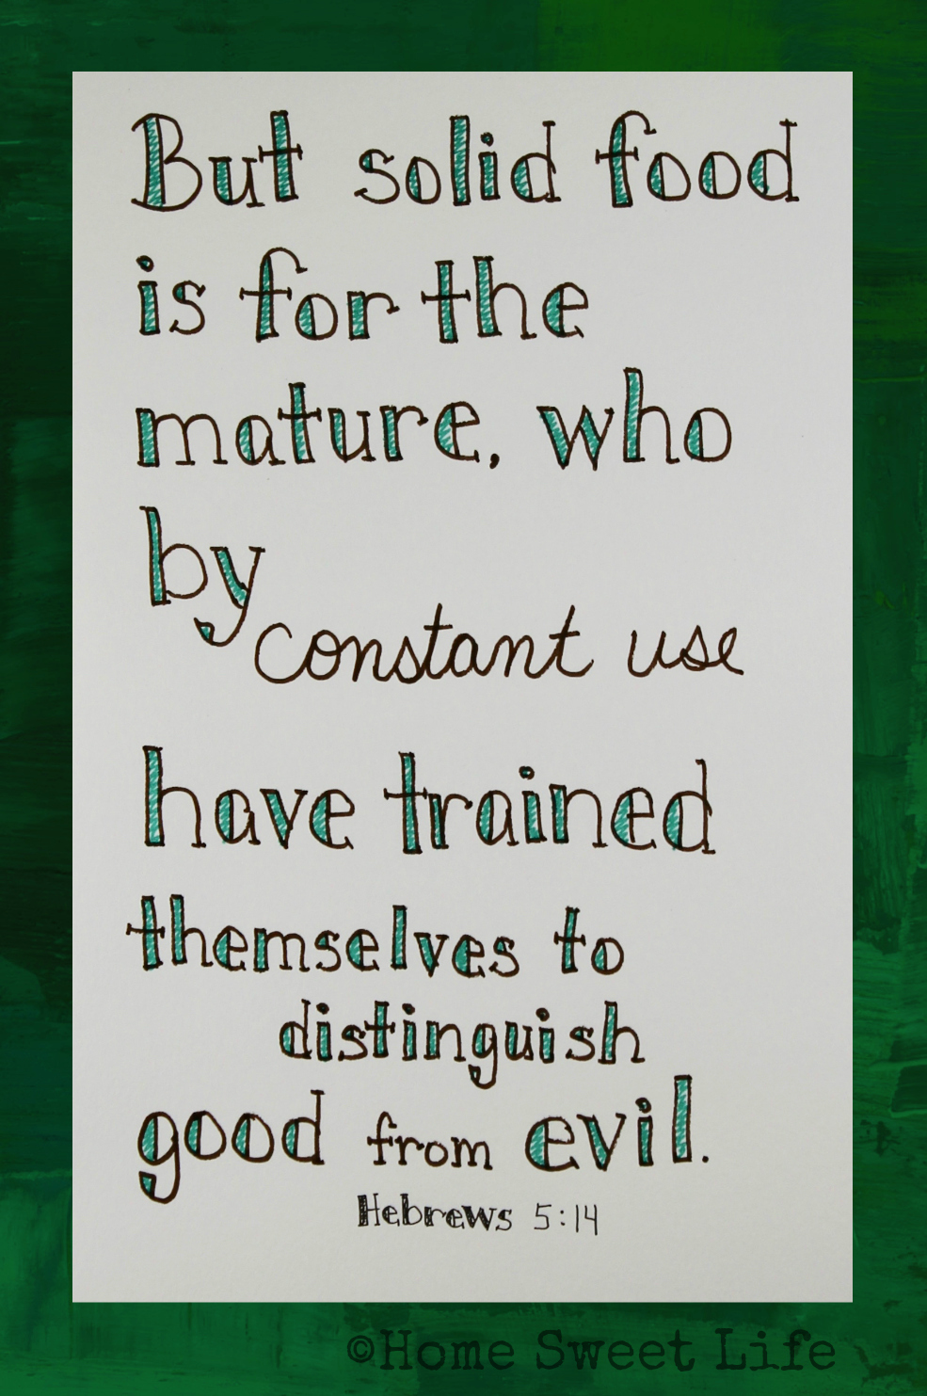
4. Strength’s— Practical out-workings
Colossians 1:9-11—

Slide 19
4. Strength’s— Practical out-workings
Colossians 1:9-11—
¹⁰so that you will walk in a manner worthy of the Lord,
A. Progress in mind:

Slide 20
4. Strength’s— Practical out-workings
Colossians 1:9-11—
¹⁰so that you will walk in a manner worthy of the Lord,
A. Progress in mind:
Everyone has a philosophy to live by.

Slide 21
4. Strength’s— Practical out-workings
Colossians 1:9-11—
¹⁰so that you will walk in a manner worthy of the Lord,
A. Progress in mind:
Everyone has a philosophy to live by.
Christians look to divine worth.

Slide 22
4. Strength’s—Practical out-workings
Colossians 1:9-11—
¹⁰so that you will walk in a manner worthy of the Lord,
A. Progress in mind:
Everyone has a philosophy to live by.
Christians look to divine worth.
“His will” defines our worthiness.

Slide 23

5. Strength’s—Ambition
Colossians 1:9-11—

Slide 24
5. Strength’s—Ambition
Colossians 1:9-11—
¹⁰…to please Him in all respects,
A. All else subordinate:

Slide 25
5. Strength’s—Ambition
Colossians 1:9-11—
¹⁰…to please Him in all respects,
A. All else subordinate:
In every way:
  Saint
  Spouse
  Scholar
  Staff
  Soldier
  Supervisor…

Slide 26

6. Strength’s—Product and Process
Colossians 1:9-11—

Slide 27
6. Strength’s—Product and Process
Colossians 1:9-11—
¹⁰…bearing fruit
in every good work
A. The Gospel’s impact:

Slide 28
6. Strength’s—Product and Process
Colossians 1:9-11—
¹⁰…bearing fruit
in every good work
A. The Gospel’s impact:
Through the church.
Light in the darkness.
Guide to the lost.
Spiritual needs met.
Physical needs met.
Transformed society.

Slide 29

7. Strength’s Growth
Colossians 1:9-11—

Slide 30
7. Strength’s Growth
Colossians 1:9-11—
¹⁰…and increasing in the knowledge of God;
A. Understanding God:

Slide 31
7. Strength’s Growth
Colossians 1:9-11—
¹⁰…and increasing in the knowledge of God;
A. Understanding God:
Are you Walking as a man or woman of God?

Slide 32

8. Strength’s Might
Colossians 1:9-11—

Slide 33
8. Strength’s Might
Colossians 1:9-11—
¹¹strengthened with all power, according to His glorious might
Ephesians 3:20-21—

Slide 34
8. Strength’s Might
Colossians 1:9-11—
¹¹strengthened with all power, according to His glorious might
Ephesians 3:20-21—²⁰Now to Him who is able to do far more abundantly beyond all that we ask or think, according to the power that works within us, ²¹to Him be the glory in the church and in Christ Jesus to all generations forever and ever. Amen.

Slide 35

John 3:5—
⁵Jesus answered, “Truly, truly, I say to you, unless one is born of water and the Spirit he cannot enter into the kingdom of God. (NASB95)

