Slide 1
What the church is as God sees it.
The church doing its work…

Slide 2
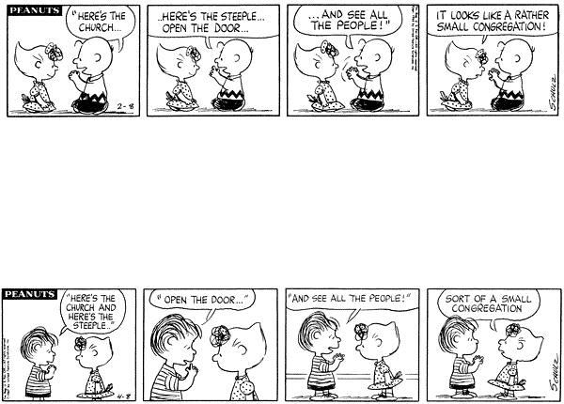

Slide 6


Slide 7
The people turned up to church
to work.
The work was theirs.

Slide 8
The people turned up to worship.
They came to share in praise…
And they came to share in sacrifice.

Slide 9


Slide 10

Around the world there are still places where the church is growing as it once did.

Slide 11
But in our society many things are falling apart that we could once rely on…

Slide 12
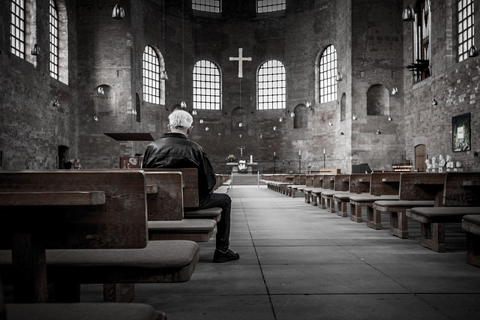
Open the church house doors…?

Slide 13
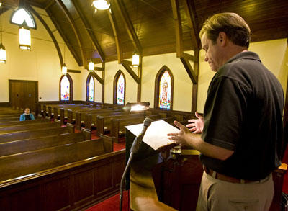
…and where are the people?

Slide 14
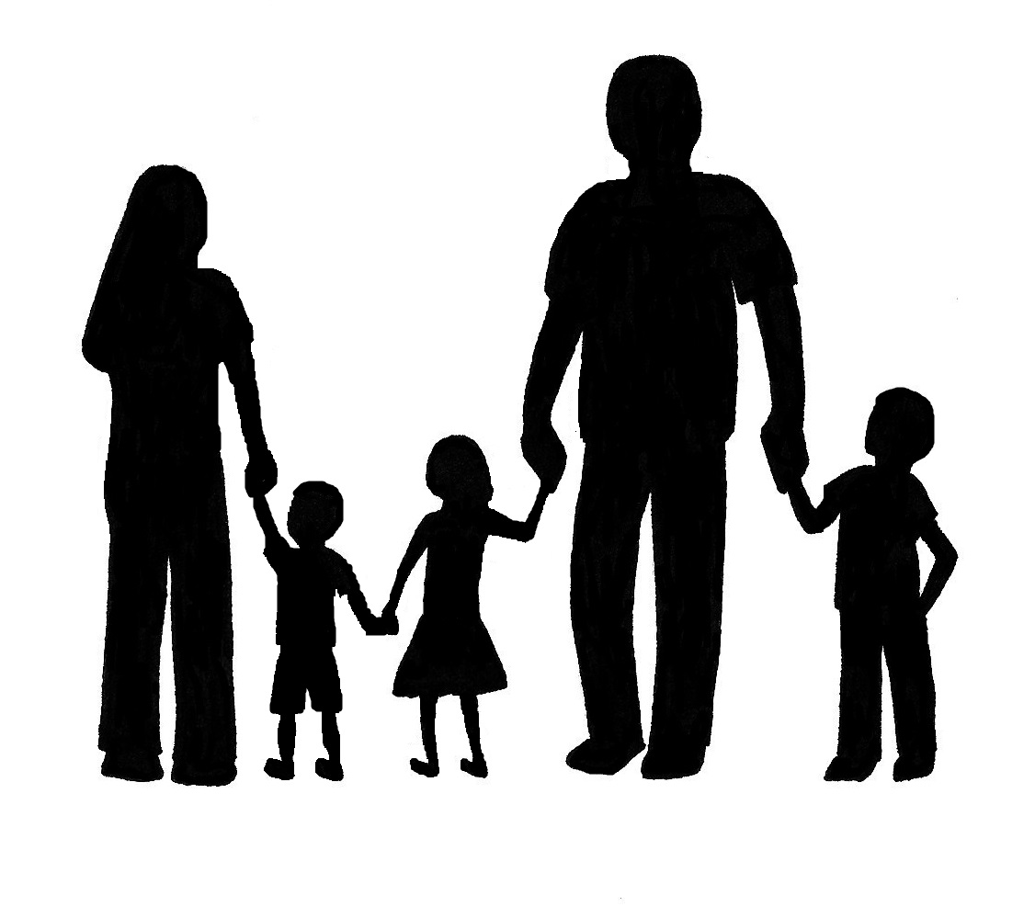
Open the family doors…?

Slide 15
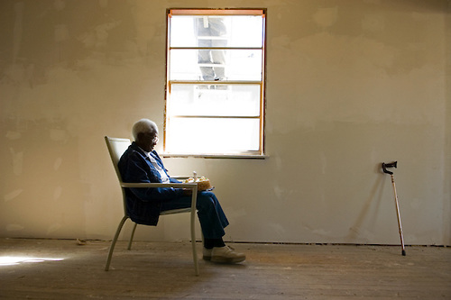
…What will we find?

Slide 16
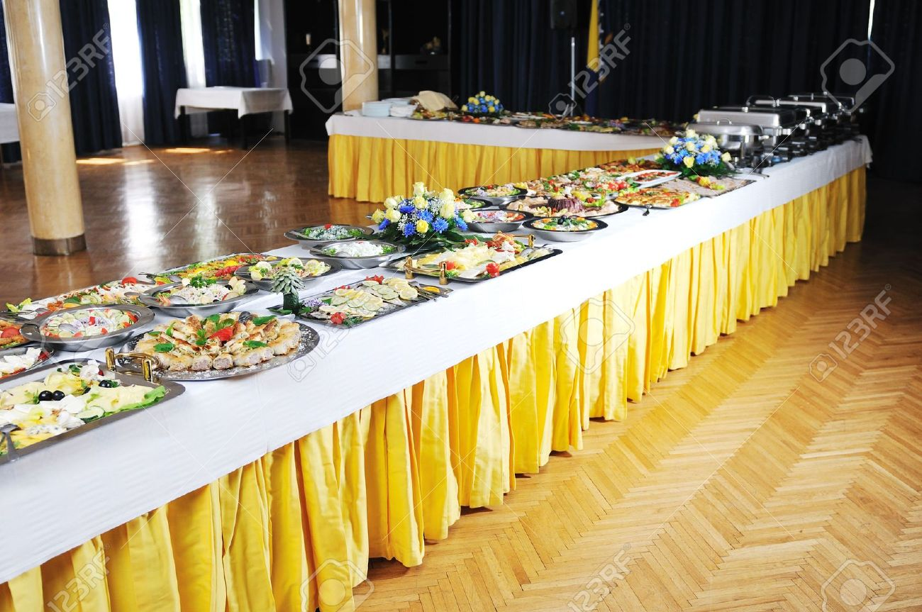
How to “pick n’ choose” a church.

Slide 17
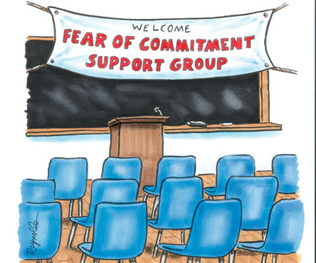
The commitment at any/ no cost church…

Slide 18
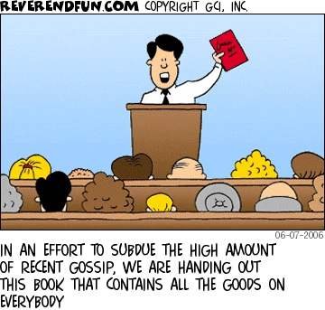
The secret society church

Slide 19
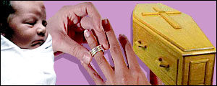
The family traditions church
Hatch ’em
      Match ’em
            And dispatch ’em.

Slide 20

Some church that I used to know…
When a man was rescued from an island his rescuers noticed a hut and two other rather nice structures. When asked what they were he said, “O, that’s where I worship on Sundays.” When they asked him what the other building was, he said, “Well,…

Slide 21
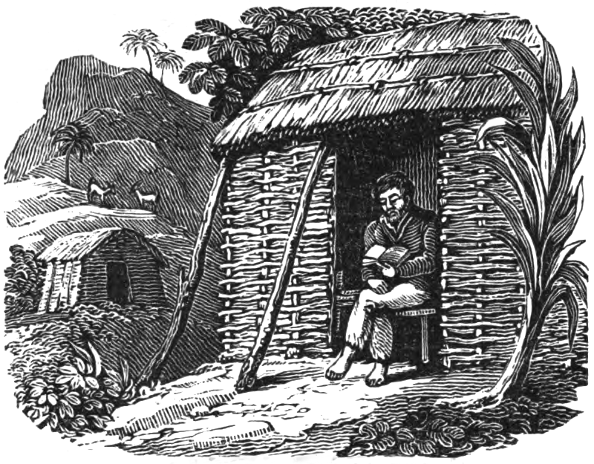
Some church that I used to know…
“…That’s the church I used to go to!”

Slide 22
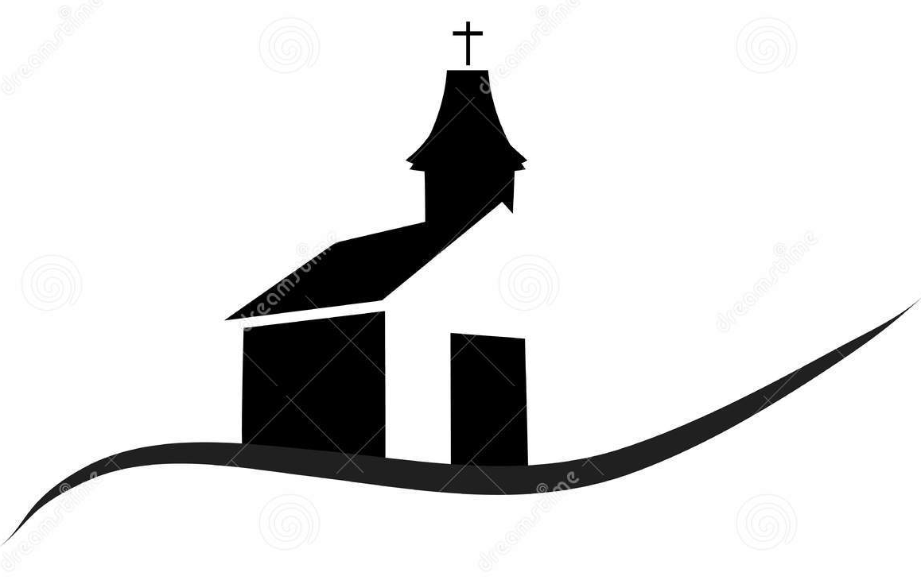
The church is not doors and steeples— its God and His people!
Ephesians 2:19-22
¹⁹So then you are no longer
strangers and aliens,
but you are
fellow citizens with the saints,
and are of God’s household,
(NASB95)

Slide 23
The church is not doors and steeples— its God and His people!
Ephesians 2:19-22
²⁰having been built on the foundation of the apostles and prophets, Christ Jesus Himself being the corner stone,
(NASB95)

Slide 24
The church is not doors and steeples— its God and His people!
Ephesians 2:19-22
²¹in whom the whole building, being fitted together, is growing into a holy temple in the Lord,
(NASB95)

Slide 25
The church is not doors and steeples— its God and His people!
Ephesians 2:19-22
²²in whom you also are being built together into a dwelling of God in the Spirit.
(NASB95)

Slide 26
The church is not doors and steeples— its God and His people!
Built on love and sacrifice.

Slide 27
The church is not doors and steeples— its God and His people!
Built on love and sacrifice.
Built on truth-teachings of apostles and prophets.

Slide 28
The church is not doors and steeples— its God and His people!
Built on love and sacrifice.
Built on truth-teachings of apostles and prophets.
Built as a house for all…all are invited.

Slide 29
The church is not doors and steeples— its God and His people!
Built on love and sacrifice.
Built on truth-teachings of apostles and prophets.
Built as a house for all…all are invited.
Built as a house for God-

Slide 30
The church is not doors and steeples— its God and His people!
Built on love and sacrifice.
Built on truth-teachings of apostles and prophets.
Built as a house for all…all are invited.
Built as a house for God-
This is how God has
chosen to live among people.

Slide 31
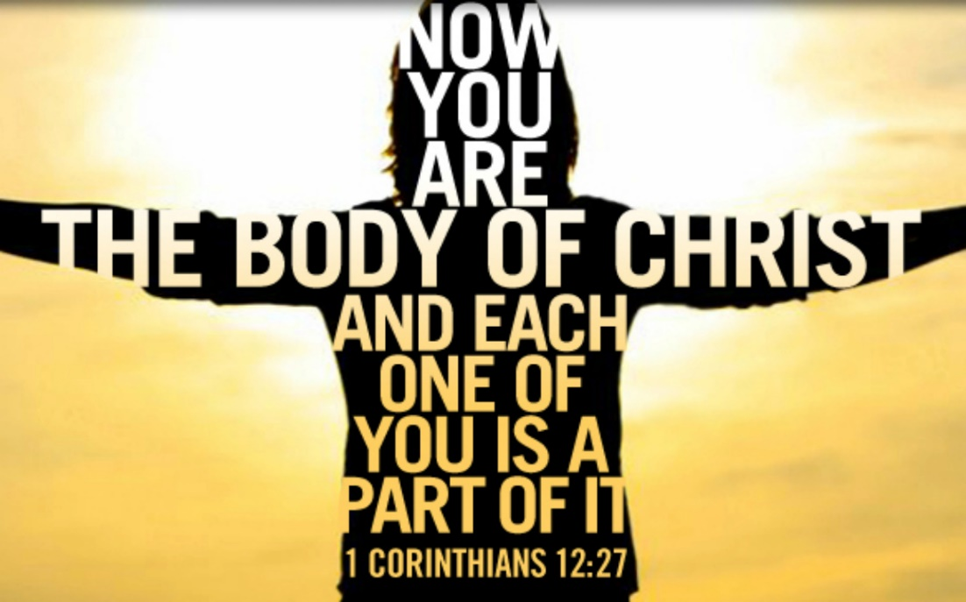
Ephesians 5:29-30
We are
Members
one of another!

Slide 32
Ephesians 5:29-30
²⁹After all,
no one ever hated
their own body,
but they
feed and care
for their body,
just as Christ does
the church—
³⁰ for we are
members of his
body.
We are
Members
one of another!

Slide 33
All of us are important.
We are
Members
one of another!

Slide 34
All of us are important.
He counts you as significant-just as we count every part of our body as vital.
We are
Members
one of another!

Slide 35
All of us are important.
He counts you as significant-just as we count every part of our body as vital.
Every part has a role to fulfil.
We are
Members
one of another!

Slide 36
All of us are important.
He counts you as significant-just as we count every part of our body as vital.
Every part has a role to fulfil.
When we leave the body, we leave life.
We are
Members
one of another!

Slide 37

All of us are important.
He counts you as significant-just as we count every part of our body as vital.
Every part has a role to fulfil.
When we leave the body, we leave life.
We are
Members
one of another!
To
the
work…

