Slide 1
Series: Heavenward Bound.
Part 3. “Thinking Ahead.”
John Staiger
Morningside Church of Christ
Sunday 7 November 2021
AM Sermon
Broadcast on Facebook Live from
Massey, Auckland, Aotearoa/NZ.

Slide 2
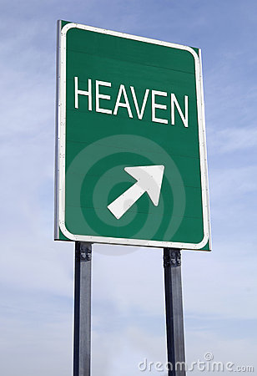
Heavenward Bound.
Part 3. Thinking Ahead…

Slide 3
Thinking Ahead—
Colossians 3:1-4
Therefore if you have been raised up with Christ, keep seeking the things above, where Christ is, seated at the right hand of God. ²Set your mind on the things above, not on the things that are on earth. ³ For you have died and your life is hidden with Christ in God. ⁴ When Christ, who is our life, is revealed, then you also will be revealed with Him in glory. (NASB95)

Slide 4
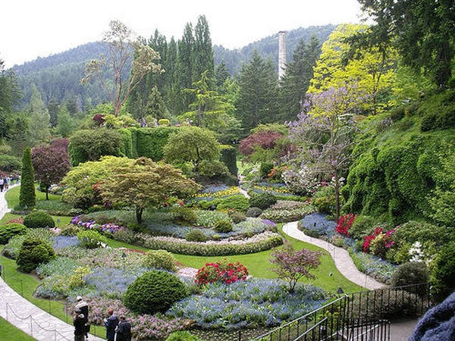
Thinking Ahead—
Made for this world…

Slide 5
Thinking Ahead—
Made for this world…
  Eden was made for man to walk with God.

Slide 6
Thinking Ahead—
Made for this world…
  Eden was made for man to walk with God.
    God spoke directly with them.

Slide 7
Thinking Ahead—
Made for this world…
  Eden was made for man to walk with God.
    God spoke directly with them.
    Ideal living conditions.

Slide 8
Thinking Ahead—
Made for this world…
  Eden was made for man to walk with God.
    God spoke directly with them.
    Ideal living conditions.
    Until sin…

Slide 9
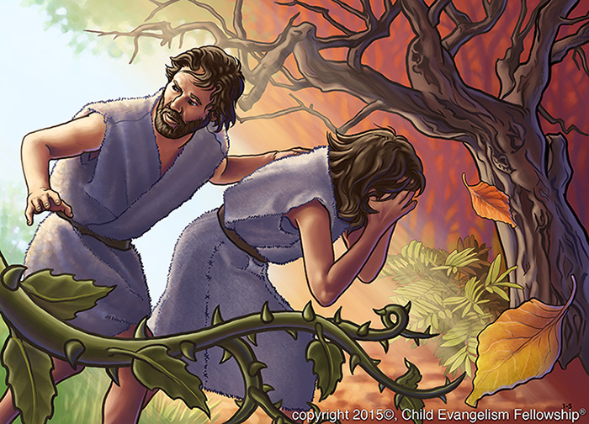
Thinking Ahead—
Made for this world…no more!
  “So God drove the man out” (Gen.3:24).

Slide 10
Thinking Ahead—
Our world today:

Slide 11
Thinking Ahead—
Our world today:
  Everybody wants their own Eden.

Slide 12
Thinking Ahead—
Our world today:
  Everybody wants their own Eden.
  It is available…

Slide 13
Thinking Ahead—
Our world today:
  Everybody wants their own Eden.
  It is available.
  But…inside of you.

Slide 14
Thinking Ahead—
Our world today:
  Everybody wants their own Eden.
  It is available
  But…inside of you.
  The church is where we walk with God.

Slide 15
Thinking Ahead—
Our world today:
  Everybody wants their own Eden.
  It is available
  But…inside of you.
  The church is where we walk with God.
  It is HERE (Luke 17:20-21)

Slide 16
Thinking Ahead—
Luke 17:20-21—
²⁰Now having been questioned by the Pharisees as to when the kingdom of God was coming, He answered them and said, “The kingdom of God is not coming with signs to be observed; ²¹ nor will they say, ‘Look, here it is!’ or, ‘There it is!’ For behold, the kingdom of God is in your midst.”

Slide 17
Thinking Ahead—
Cognitive Reset:

Slide 18
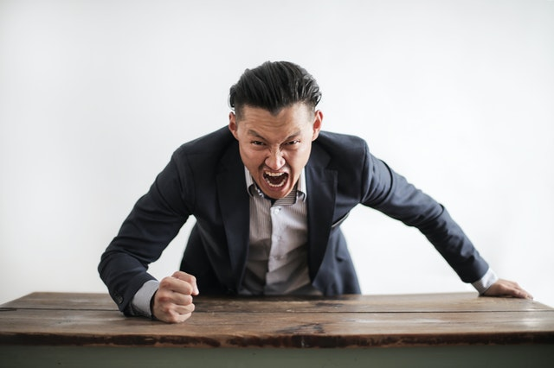
Thinking Ahead—
Cognitive Reset:
  I do not want this…

Slide 19
Thinking Ahead—
Cognitive Reset:
  I do not want this…
    Without God people fight for something that they can’t have.

Slide 20
Thinking Ahead—
Cognitive Reset:
  I do not want this…
    “The anger of man does not achieve the righteousness of God (Jm.1:20)

Slide 21
Thinking Ahead—
Cognitive Reset:
  Where righteousness abides…
    Thinking beyond this world…
    Colossians 3:1-4—
    ²Set your mind on the things above, not on the things that are on earth. (NASB95)

Slide 22
Thinking Ahead—
Cognitive Reset:
  Where righteousness abides
    Thinking beyond this world…
      There, not here
        Colossians 3:1-4—²Set your mind on the things above, not on the things that are on earth. (NASB95)

Slide 23
Thinking Ahead—
Cognitive Reset:
  Where righteousness abides
    Thinking beyond this world.
      THERE, not here.
        Colossians 3:1-4—²Set your mind on the things above, not on the things that are on earth. (NASB95)

Slide 24
Thinking Ahead—
Cognitive Reset:
  Where righteousness abides
    Thinking beyond this world
      THERE, not here:
        Colossians 3:2—²Set your mind on the things above, not on the things that are on earth. (NASB95)

Slide 25
Thinking Ahead—
Cognitive Reset:
  Where righteousness abides
    Thinking beyond this world.
      The presence of Christ…
        Colossians 3:1-4—Therefore if you have been raised up with Christ, keep seeking the things above, where Christ is, seated at the right hand of God.

Slide 26
Thinking Ahead—
Cognitive Reset:
  Where righteousness abides
    Thinking beyond this world
      The presence of Christ
        Colossians 3:1-4—Therefore if you have been raised up with Christ, keep seeking the things above, where Christ is, seated at the right hand of God. (NASB95)

Slide 27
Thinking Ahead—
Cognitive Reset:
  Too heavenly minded…?
    You have heard sayings like:
      “He is too heavenly minded to be of any earthly use.”

Slide 28
Thinking Ahead—
Cognitive Reset:
  Too heavenly minded…?
    You have heard sayings like:

Slide 29
Thinking Ahead—
Cognitive Reset:
  Too heavenly minded…?
    You have heard sayings like:
      “He is too heavenly minded to be of any earthly good.”

Slide 30
Thinking Ahead—
Cognitive Reset:
  Heaven or nothing…

Slide 31
Thinking Ahead—
Cognitive Reset:
  Heaven or nothing.
    C.S. Lewis is right:

Slide 32
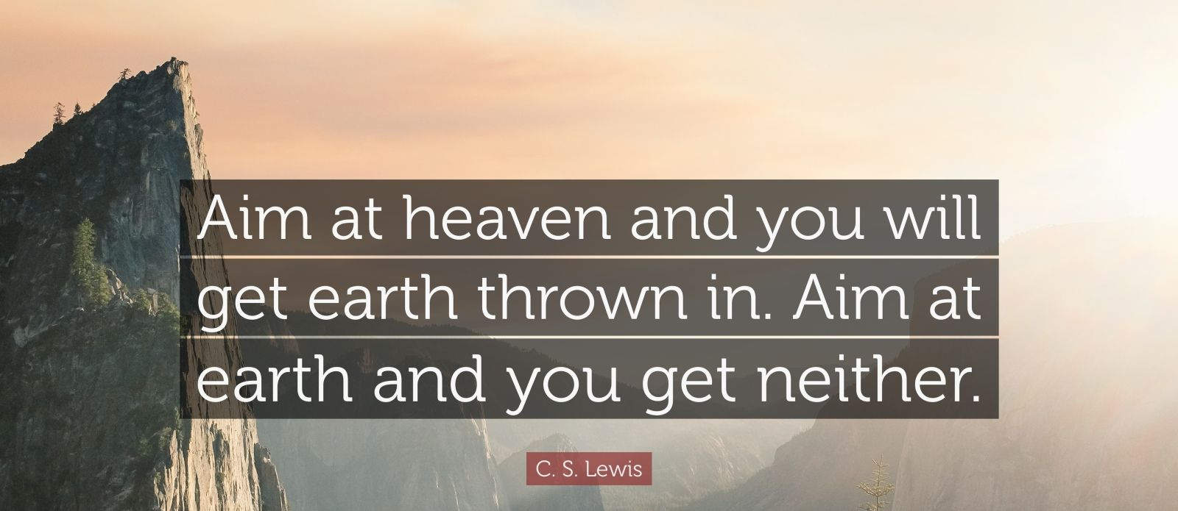
Thinking Ahead—
Cognitive Reset:
  Heaven or nothing.
    C.S. Lewis is right:

Slide 33
Thinking Ahead—
“O to be like Thee”:

Slide 34
Thinking Ahead—
“O to be like Thee”:
  A New Image.

Slide 35
Thinking Ahead—
“O to be like Thee”:
  A New Image.
    This one has to go.
Oh! to be like Thee, blessed Redeemer,
This is my constant longing and prayer;
Gladly I’ll forfeit all of earth’s treasures,
Jesus, Thy perfect likeness to wear.

Slide 36
Thinking Ahead—
“O to be like Thee”:
  A New Image.
    This earthly one has to go.
Oh! to be like Thee, blessed Redeemer,
This is my constant longing and prayer;
Gladly I’ll forfeit all of earth’s treasures,
Jesus, Thy perfect likeness to wear.

Slide 37
Thinking Ahead—
“O to be like Thee”:
  A New Image.
    Reflecting the Saviour.

Slide 38
Thinking Ahead—
“O to be like Thee”:
  A New Image.
    Reflecting the Saviour.
2 Corinthians 3:18—
¹⁸But we all, with unveiled face, beholding as in a mirror the glory of the Lord, are being transformed into the same image from glory to glory, just as from the Lord, the Spirit. (NASB95)

Slide 39
Thinking Ahead—
“O to be like Thee”:
  A New Image.
    What has to change?
      The wisdom from HERE:
James 3:15-16—¹⁵This is not the wisdom that comes down from above, but is earthly, unspiritual, demonic. ¹⁶For where jealousy and selfish ambition exist, there will be disorder and every vile practice. (ESV)

Slide 40
Thinking Ahead—
“O to be like Thee”:
  A New Image.
    What has to change?
      The wisdom from HERE:
James 3:15-16—¹⁵This is not the wisdom that comes down from above, but is earthly, unspiritual, demonic. ¹⁶For where jealousy and selfish ambition exist, there will be disorder and every vile practice. (ESV)

Slide 41
Thinking Ahead—
“O to be like Thee”:
  A New Image.
    What has to change?
      The wisdom from HERE:
James 3:15-16—¹⁵This is not the wisdom that comes down from above, but is earthly, unspiritual, demonic. ¹⁶For where jealousy and selfish ambition exist, there will be disorder and every vile practice. (ESV)

Slide 42
Thinking Ahead—
“O to be like Thee”:
  A New Image.
    What has to change?
      The wisdom from THERE:
James 3:17-18—¹⁷But the wisdom from above is first pure, then peaceable, gentle, open to reason, full of mercy and good fruits, impartial and sincere. ¹⁸And a harvest of righteousness is sown in peace by those who make peace. (NASB95)

Slide 43
Thinking Ahead—
“O to be like Thee”:
  A New Image.
    What has to change?
      The wisdom from THERE:
James 3:17-18—¹⁷But the wisdom from above is first pure, then peaceable, gentle, open to reason, full of mercy and good fruits, impartial and sincere. ¹⁸And a harvest of righteousness is sown in peace by those who make peace. (NASB95)

Slide 44
Thinking Ahead—
Distractions abound:

Slide 45
Thinking Ahead—
Distractions abound:
  Nothing new in that.

Slide 46
Thinking Ahead—
Distractions abound:
  Nothing new in that.
    Changing our daily habits

Slide 47
Thinking Ahead—
Distractions abound:
  Nothing new in that.
    Changing our daily habits
      Prayer, Bible and Fellowship.
      Remove the temptations.
      List those Spiritual plans.
      Clear away the past.
      Think ahead.

Slide 48
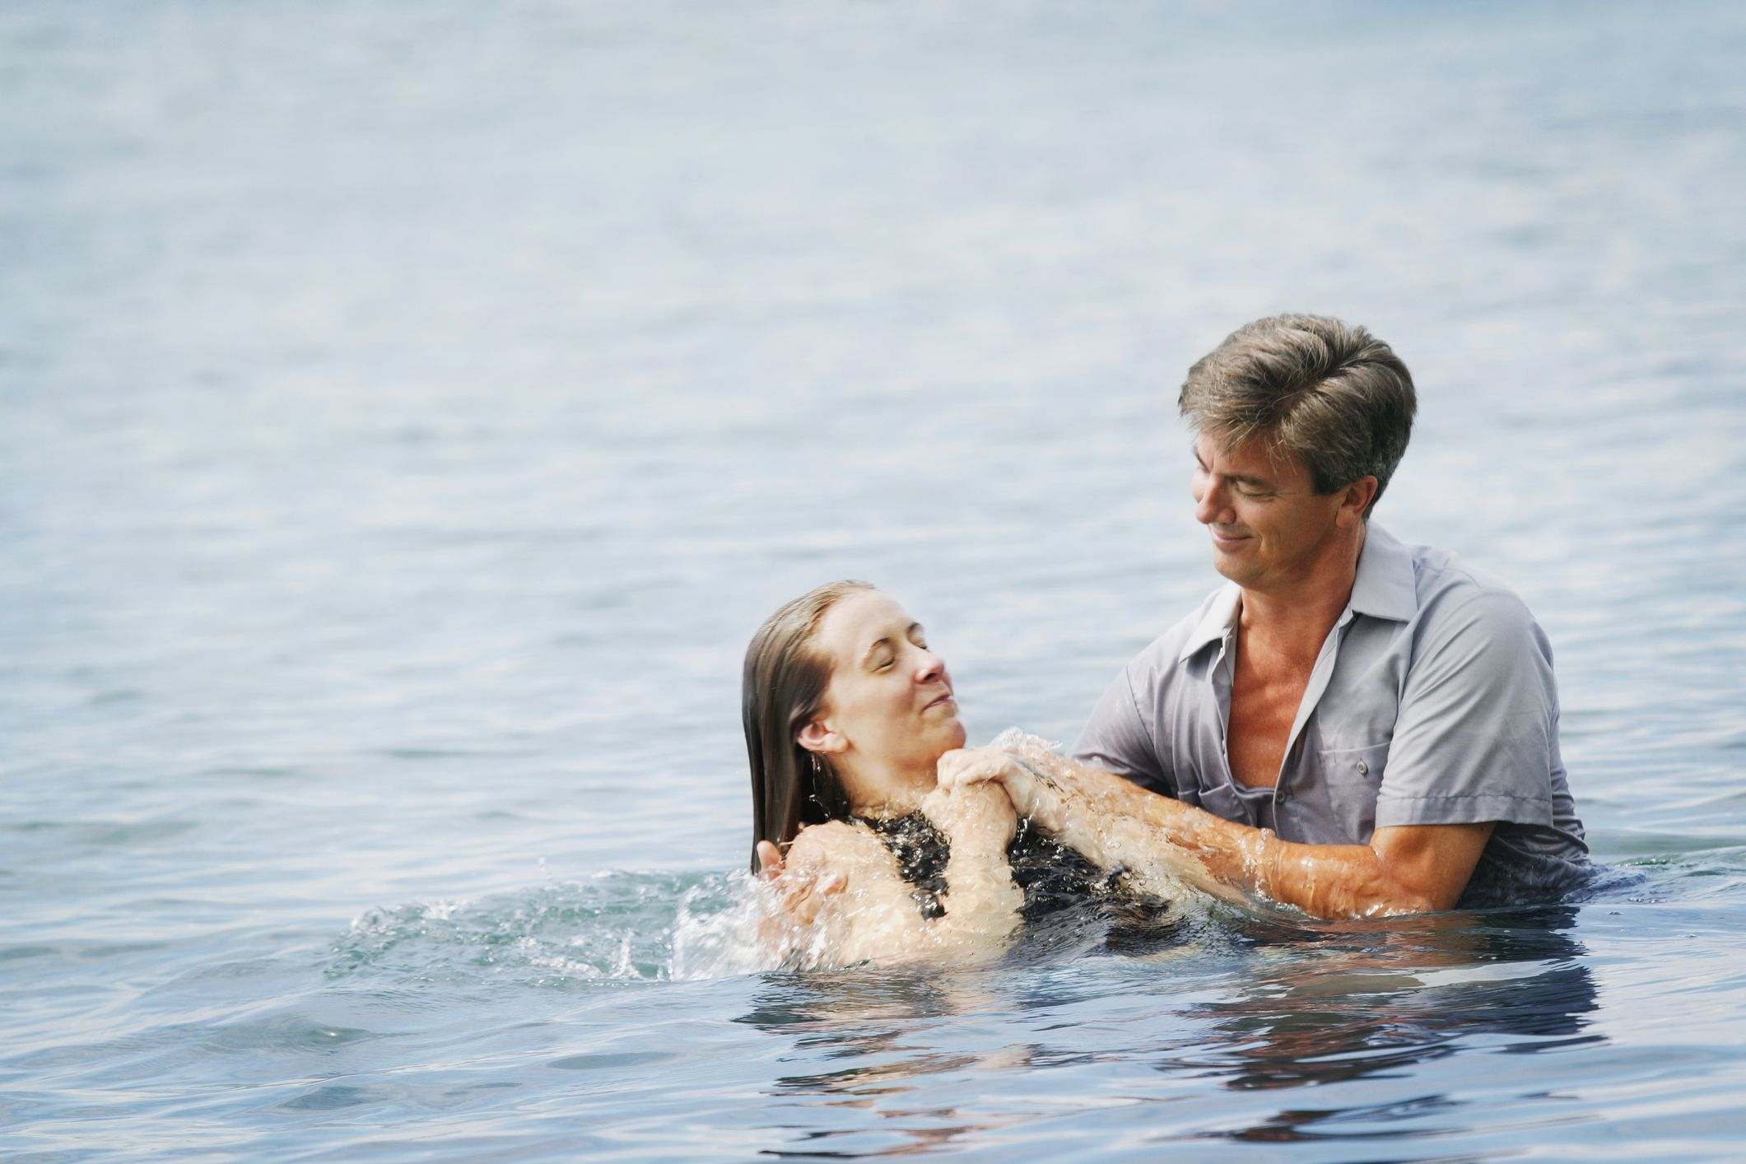
Acts 22:16—
Now why do you delay? Get up and be baptized, and wash away your sins, calling on His name.’

