Slide 1
“Pain and Suffering Part 2.”
John Staiger
Morningside Church of Christ
Sunday 7 November 2021
PM Sermon
Broadcast on Facebook Live from Massey, Auckland, Aotearoa/NZ.
www.morningsidechurchofchrist.org.nz

Slide 2
Pain and Suffering Part 2

Slide 3
Suffering is Real:
Everywhere…

Slide 4
Suffering is Real:
Everywhere…
Everyone…

Slide 5
Suffering is Real:
Everywhere…
Everyone…
To one degree or another…

Slide 6
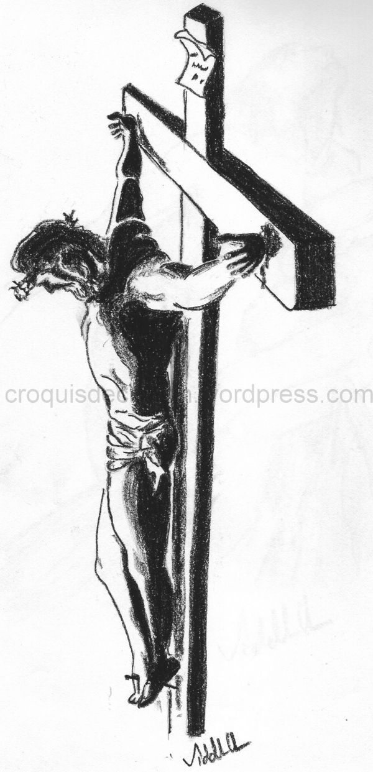
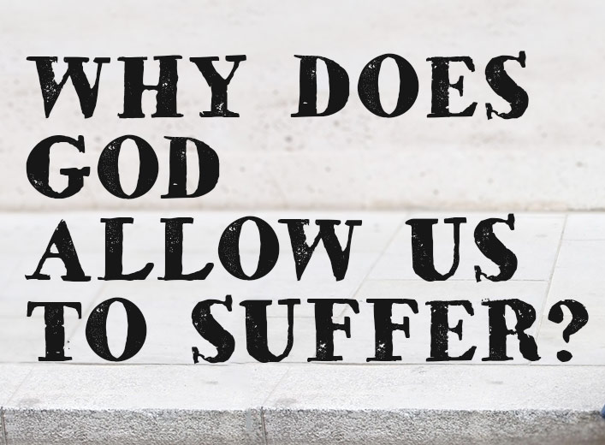
We are all affected:

Slide 7
We are all affected:
Personal.
Family.
Death.
Sickness.
Accident.
War.
Drought.
Theft.

Slide 8
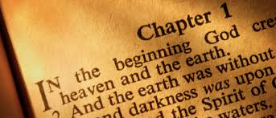

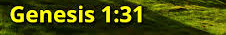
Back to the Beginning…

Slide 9

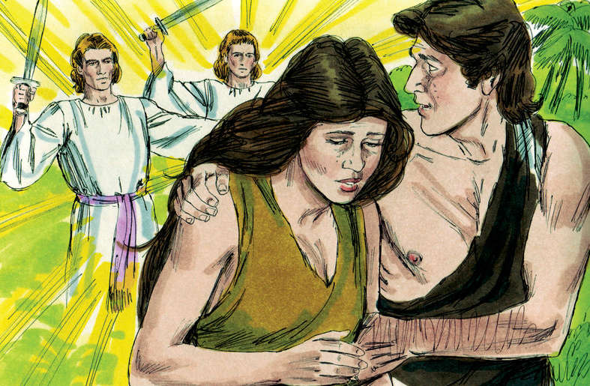
Sin had consequences

Slide 10
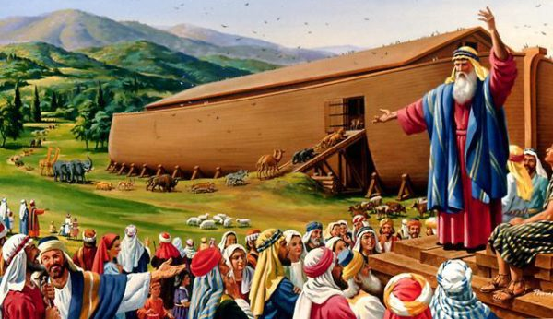
Genesis 6:5—⁵ Then the Lord saw that the wickedness of man was great on the earth, and that every intent of the thoughts of his heart was only evil continually. (NASB)

Slide 11
Psalm 10:1—
Why do You stand afar off, O Lord?
Why do You hide Yourself in times of trouble?

Slide 12
Psalm 10:1—
Why do You stand afar off, O Lord?
Why do You hide Yourself in times of trouble?
Not just you and me—
King David asked the same question in times of trouble.
Questions are good and to be encouraged.
If you are seeking the truth, you will find it.
David is asking, “God, where were you when I needed you most?”

Slide 13

Judges 6:13—
Questions

Slide 14
Judges 6:13—¹³ Then Gideon said to him, “O my lord, if the Lord is with us, why then has all this happened to us? And where are all His miracles which our fathers told us about, saying, ‘Did not the Lord bring us up from Egypt?’ But now the Lord has abandoned us and given us into the hand of Midian.” (NASB)
Questions

Slide 15
Gideon was simply pointing out his reality.
From where he was sitting things looked very bad.
Questions

Slide 16
God has given each one of us
free will…
We are neither Animals or Robots.

Slide 17

God has given each one of us
free will…
We are neither Animals or Robots.

Slide 18
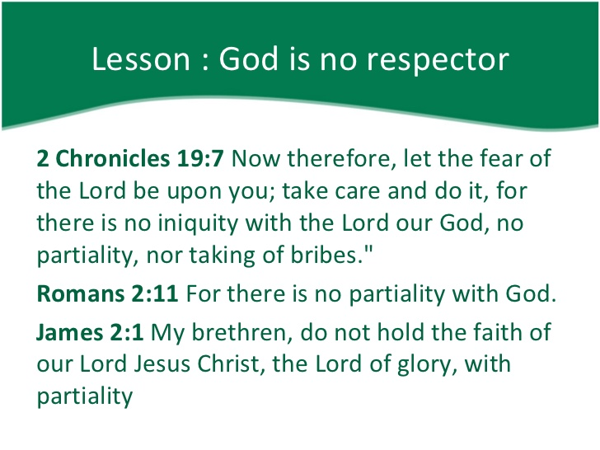

Slide 22
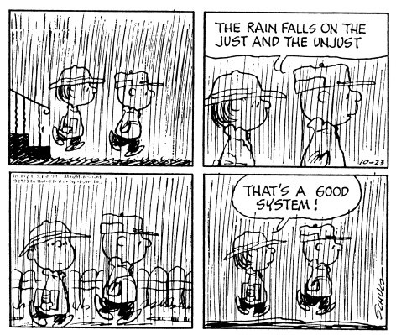
Matthew 5:44-45—

Slide 23
Matthew 5:44-45—
⁴⁴ But I say to you, love
your enemies and
pray for those who
persecute you,

Slide 24
Matthew 5:44-45—
⁴⁴ But I say to you, love
your enemies and
pray for those who
persecute you,
⁴⁵ so that you may be
sons of your Father
who is in heaven;

Slide 25
Matthew 5:44-45—
⁴⁴ But I say to you, love
your enemies and
pray for those who
persecute you,
⁴⁵ so that you may be
sons of your Father
who is in heaven;
for He causes His sun
to rise on the evil and
the good, and sends
rain on the righteous
and the unrighteous.

Slide 26
Some suffering comes from past generations…

Slide 27
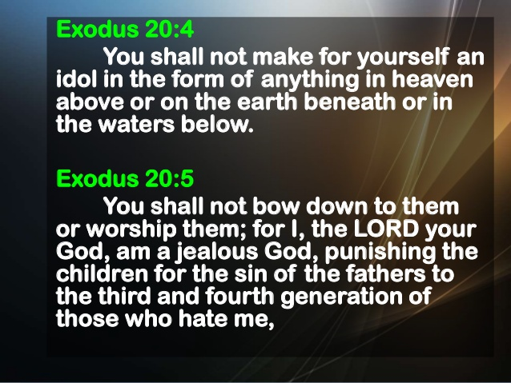
Some suffering comes from past generations…

Slide 28
Some suffering comes from past generations…

Slide 29
Some suffering comes from past generations…

Slide 30
Some suffering comes from past generations…
Faithlessness of our parents.
Asbestos.
Agent Orange.
Poor economic decisions.
Bad health choices.
Inherited physical problems.

Slide 31
Our own foolishness and mistakes

Slide 32
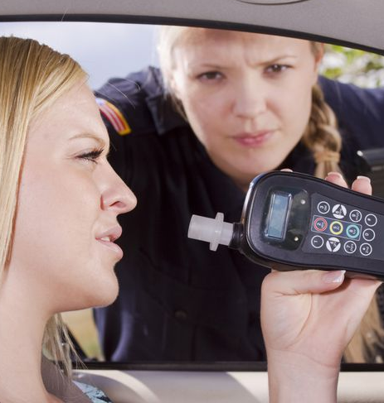
Our own foolishness and mistakes
Neglecting of God, church, Bible, prayer, fellowship, accountability…
Driving drunk.
Poor diet.
Wasteful living.
Promiscuousness.
Abuse of others.
Giving in to temptation.

Slide 33
Some suffering comes from our own doing…
Selfishness and Greed helps no one.

Slide 34
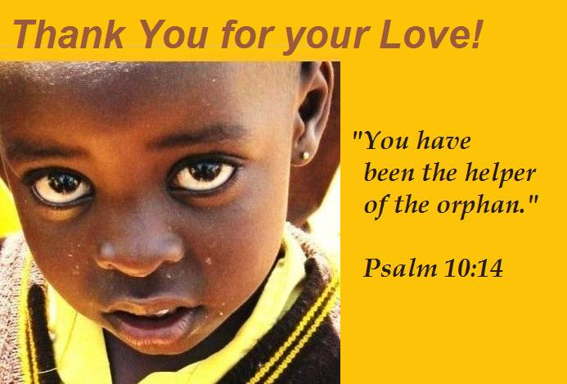
Some suffering comes from our own doing…
Selfishness and Greed helps no one.
We can alleviate suffering for others if we stop trying to ‘Keep up with the Joneses.’

Slide 35
Some suffering comes from the laws of nature…

Slide 36
Some suffering comes from the laws of nature…
God set laws in motion and doesn’t violate them.
The laws of gravity and motion affect us all equally.
God doesn’t suspend them in mid-air.
What works for one works for all.
Jesus uses the principle of rain and houses built on rock or sand (Mt.7).

Slide 37
Some suffering is beneficial…

Slide 38
Some suffering is beneficial…
Chest pains—fair warning.

Slide 39
Some suffering is beneficial…
Chest pains—fair warning.
Suffering can bring the best out of the human spirit—bravery, courage, generosity…

Slide 40
Some suffering is beneficial…
Chest pains—fair warning.
Suffering can bring the best out of the human spirit—bravery, courage, generosity…
Romans 5:3-4—³ And not only this, but we also exult in our tribulations, knowing that tribulation brings about perseverance; ⁴ and perseverance, proven character; and proven character, hope; (NASB)

Slide 41
Some suffering seems illogical…

Slide 42
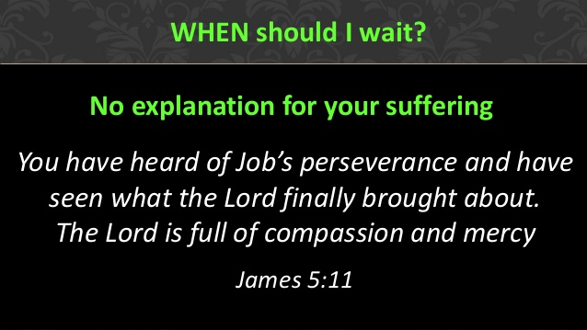
Some suffering seems illogical…

Slide 43
Some suffering seems illogical…
We don’t know why its happening.
We don’t know what its for.
We can’t see the big picture.
But God does!

Slide 44
Some suffering seems illogical…
Ecclesiastes 3:1—There is an appointed time for everything. And there is a time for every event under heaven— (NASB)
Esther 4:14—¹⁴ For if you remain silent at this time, relief and deliverance will arise for the Jews from another place and you and your father’s house will perish. And who knows whether you have not attained royalty for such a time as this?” (NASB)

Slide 45
The temptation to give up or give in, but God strengthens if we hold fast.

Slide 46
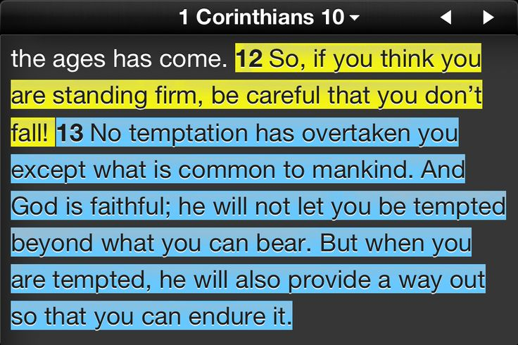
The temptation to give up or give in, but God strengthens if we hold fast.

Slide 47
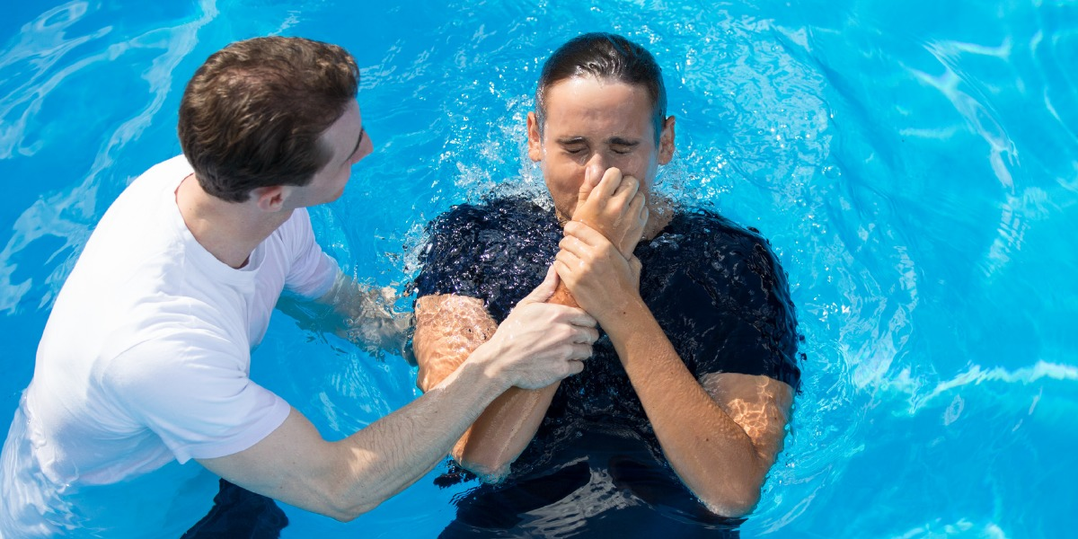
Eternal pain stops here!
Galatians 3:27—²⁷For all of you who were baptized into Christ have clothed yourselves with Christ. (NASB95)

