Slide 1
“Which Way?”
John Staiger
Morningside Church of Christ
Sunday 14 November 2021
PM Sermon
Broadcast on Facebook Live from Massey, Auckland, Aotearoa/NZ.
www.morningsidechurchofchrist.org.nz

Slide 2

Which way?

Slide 3
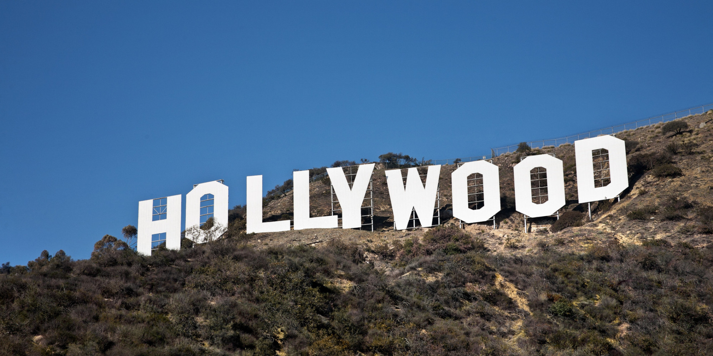
If you asked Hollywood…
“What is right for me?
“Where might my dreams take me?”
“Which way should I go?”

Slide 4
If you asked Hollywood…
“What is right for me?
“Where might my dreams take me?”
“Which way should I go?”

Slide 5
If you asked Hollywood…
“What is right for me?
“Where might my dreams take me?”
“Which way should I go?”

Slide 6
If you asked Hollywood…
“What is right for me?
“Where might my dreams take me?”
“Which way should I go?”

Slide 7


Slide 8

“Follow your heart”

Slide 9
“Follow your heart”
1. Become a ‘creed’ embraced by billions of people.

Slide 10
“Follow your heart”
2. A ‘statement of faith’ of a great pop cultural myth of the Western world.

Slide 11
“Follow your heart”
3. A ‘gospel’ proclaimed in many of our stories, movies, and songs.

Slide 12
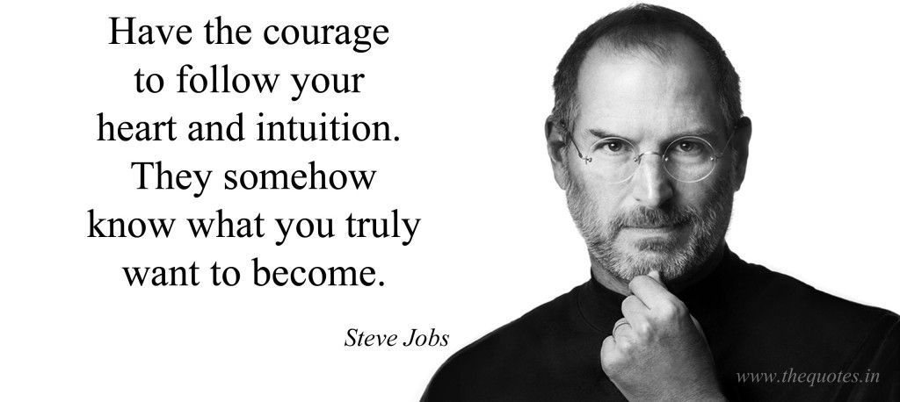
This creed can sound so:
So simple
So beautiful
So liberating
For lost people it’s a tempting gospel to believe.

Slide 13
This creed can sound inspiring:
So simple
So beautiful
So liberating
For lost people it’s a tempting gospel to believe.

Slide 14
This creed can sound inspiring:
So simple
So beautiful
So liberating
For lost people it’s a tempting gospel to believe.

Slide 15
This creed can sound inspiring:
So simple
So beautiful
So liberating
For lost people it’s a tempting gospel to believe.

Slide 16
This creed can sound inspiring:
So simple
So beautiful
So liberating
For lost people it’s a tempting gospel to believe.

Slide 17
This creed can sound inspiring:
So simple
So beautiful
So liberating
For lost people it’s a tempting gospel to believe.

Slide 18

BUT

Slide 19
BUT

Slide 20
What does your heart really tell you most of the time?
BUT

Slide 21
The average heart says:
1. “All of reality ought to serve my desires.”
2. “I think the best of me and worst of others.”
3. But Jesus says…

Slide 22

The average heart says:
1. “All of reality ought to serve my desires.”
2. “I think the best of me and worst of others.”
3. But Jesus says…

Slide 23
The average heart says:
1. “All of reality ought to serve my desires.”
2. “I think the best of me and worst of others.”
3. But Jesus says…

Slide 24
The average heart says:
1. “All of reality ought to serve my desires.”
2. “I think the best of me and worst of others.”
3. But Jesus says…

Slide 25
The average heart says:
1. “All of reality ought to serve my desires.”
2. “I think the best of me and worst of others.”
3. But Jesus says…
Matthew 15:19—For out of the heart come evil thoughts, murders, adulteries, fornications, thefts, false witness, slanders. (NASB95)

Slide 26
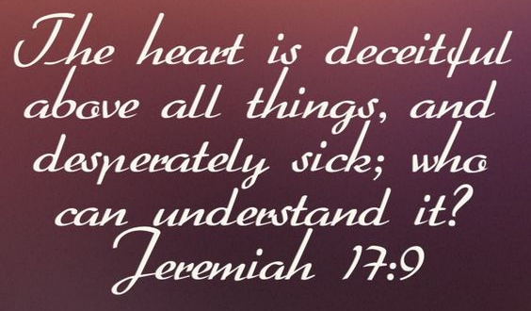

Slide 27
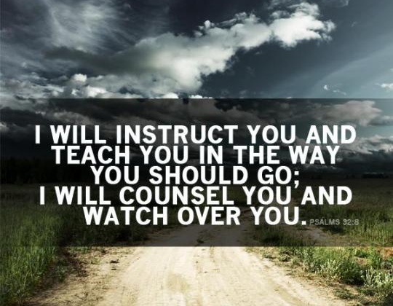
Psalm 32:8

Slide 28

In other words,…

Slide 29
Don’t believe in your heart.

Slide 30

Don’t believe in your heart.
1. Direct your heart to believe in God.

Slide 31
Don’t believe in your heart.
1. Direct your heart to believe in God.
2. Jesus did “NOT” say to his disciples,… “Let not your hearts be troubled, just believe in your hearts.”

Slide 32
Don’t believe in your heart.
1. Direct your heart to believe in God.
2. Jesus did “NOT” say to his disciples,… “Let not your hearts be troubled,
Just believe in your hearts.”

Slide 33
Don’t believe in your heart.
1. Direct your heart to believe in God.
2. Don’t follow your heart.
3. Jesus did “NOT” say to his disciples, “Let not your hearts be troubled, just believe in your hearts.”
4. He said:

Slide 34
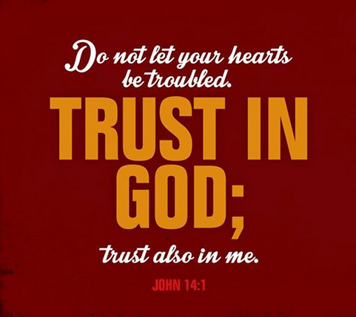

Slide 35

Choice of direction is yours to make

Slide 36
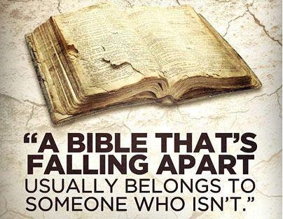
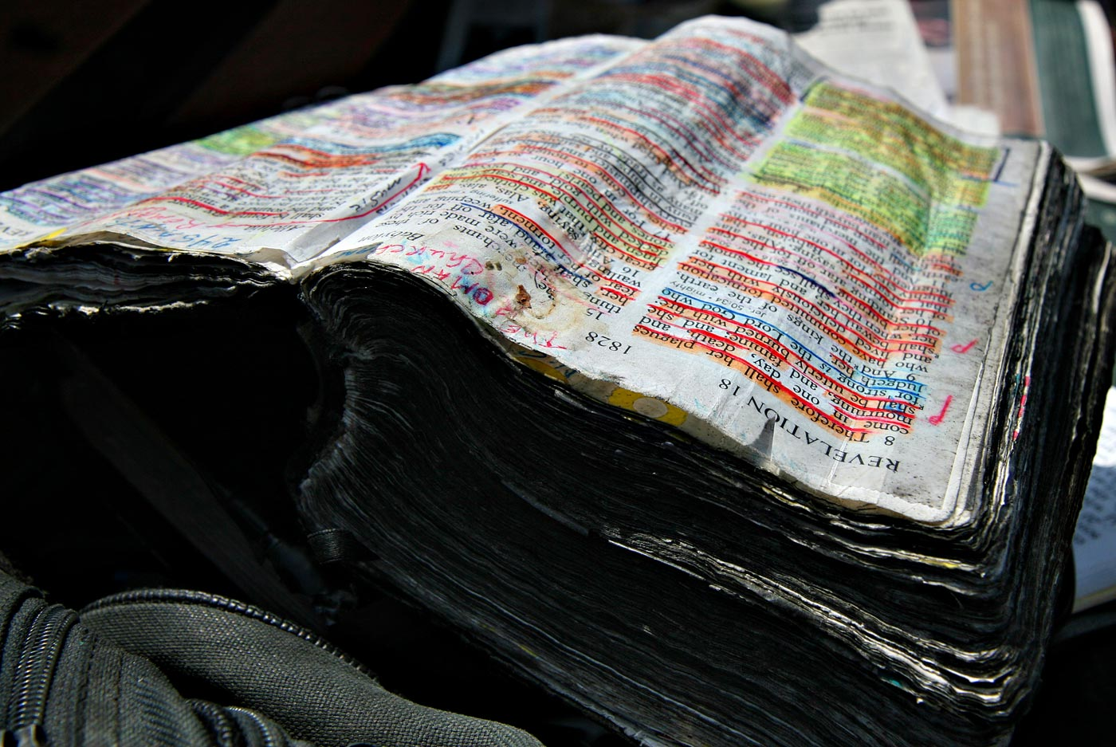
Hebrews 11:6—⁶ And without faith it is impossible to please Him, for he who comes to God must believe that He is and that He is a rewarder of those who seek Him. (NASB)

Slide 37

Jeremiah 29:13—You will seek Me and find Me when you search for Me with all your heart. (NASB)

Slide 38
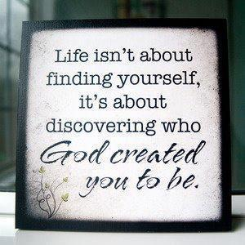

Slide 39
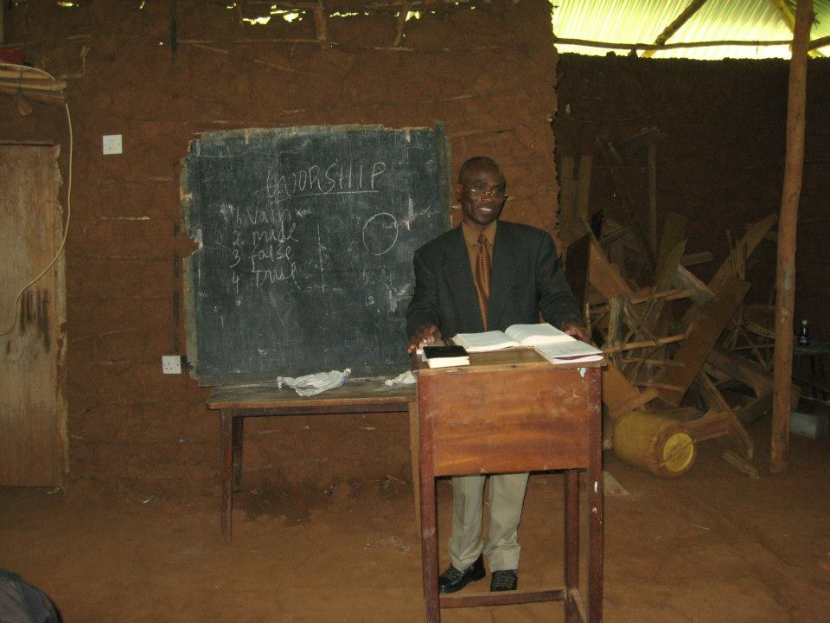
A good brother Preaching the Gospel in Kenya.

Slide 40
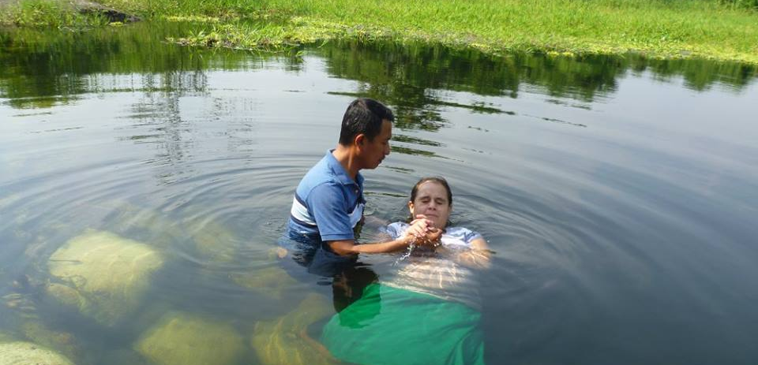
Mark 16:15-16—¹⁵And He said to them, “Go into all the world and preach the gospel to all creation. ¹⁶ He who has believed and has been baptized shall be saved; but he who has disbelieved shall be condemned. (NASB95)
Putting on Christ in Guatemala.

