Slide 1
Series: What on Earth…
Part 1. “Is Being Spiritual?”
John Staiger
Morningside Church of Christ
Sunday 14 November 2021
AM Sermon
Broadcast live from Massey, Auckland, Aotearoa/NZ.

Slide 2
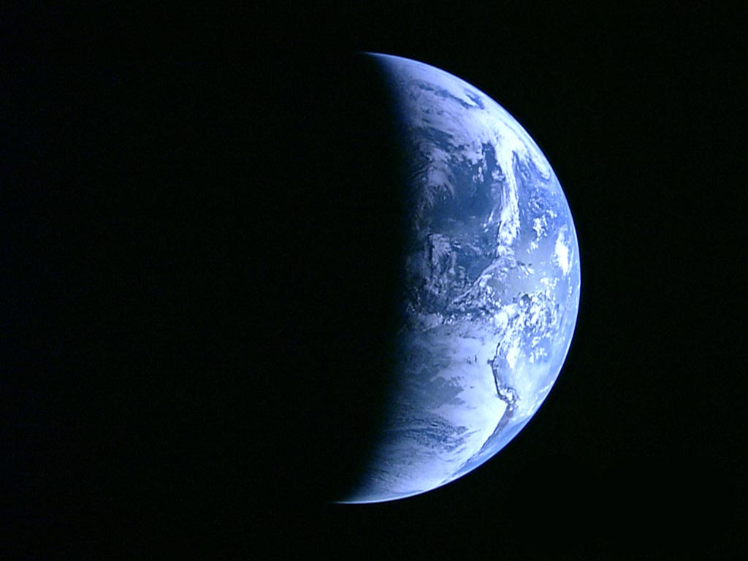
Series: What on Earth……
Part 1.
Is Being Spiritual?

Slide 3
Being Spiritual—
Variously defined…
  Many speak of Spirituality:

Slide 4
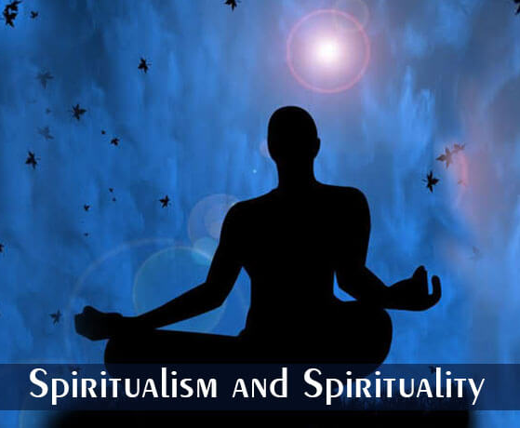
Being Spiritual—
Variously defined…
  Many speak of Spirituality:
Eastern
mysticism
in many forms…
“New Age.”

Slide 5
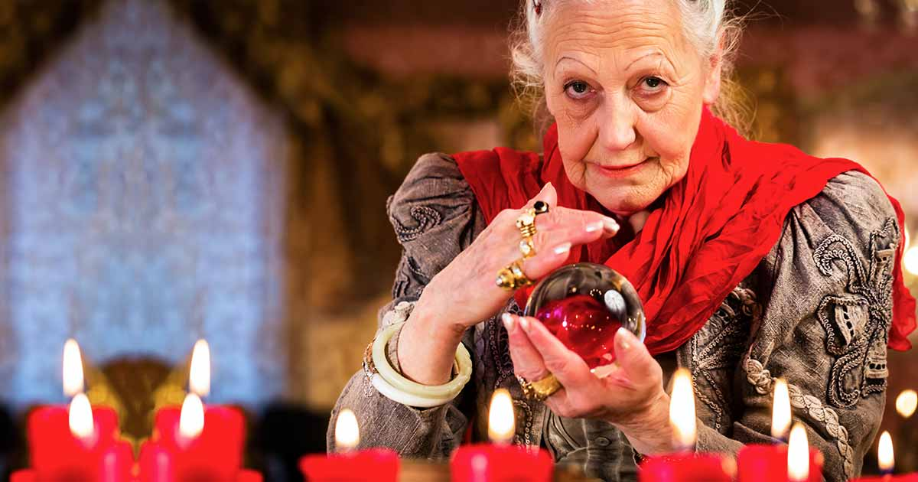
Being Spiritual—
Variously defined…
  Many speak of Spirituality:

Slide 6
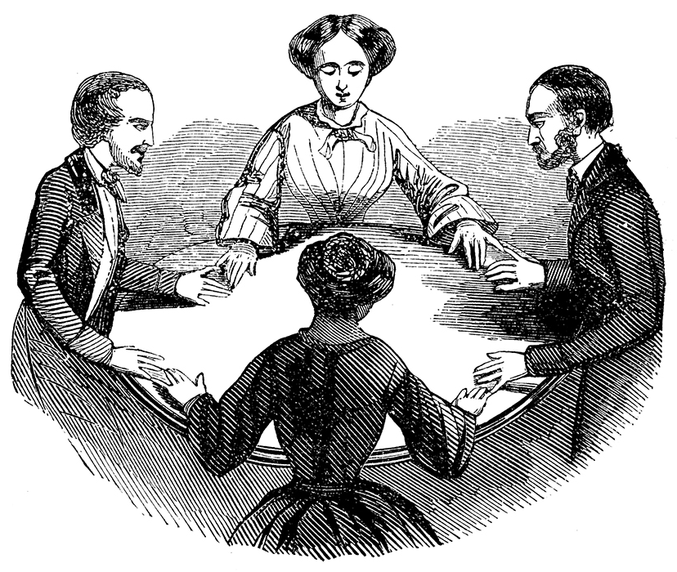
Being Spiritual—
Variously defined…
  Many speak of Spirituality:
Seances
were
popular in
Victorian
England.

Slide 7
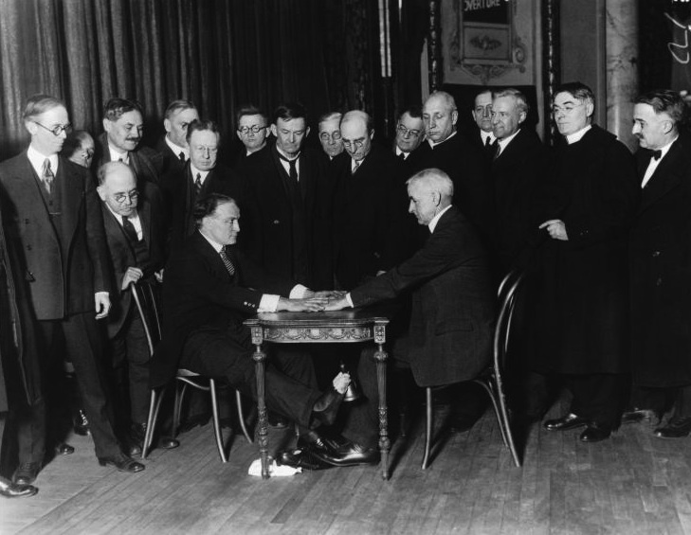
Being Spiritual—
Variously defined…
  Many speak of Spirituality:
Houdini
exposed
the
charlatans.

Slide 8
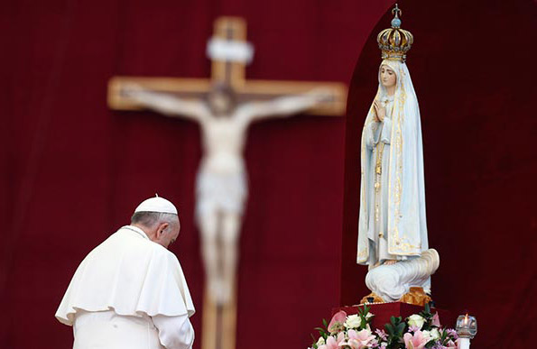
Being Spiritual—
Variously defined…
  Many speak of Spirituality:
Idols fill
many
churches.

Slide 9
Being Spiritual—
Variously defined…
  Many speak of Spirituality:
    Many perspectives.
    A sense of connection to something bigger than ourselves.

Slide 10
Being Spiritual—
Variously defined…
  Many speak of Spirituality:
    Many perspectives.
    A sense of connection to something bigger than ourselves.
    Involves a search for meaning in life.

Slide 11
Being Spiritual—
Variously defined…
  Many speak of Spirituality:
    Many perspectives.
    A sense of connection to something bigger than ourselves.
    Involves a search for meaning in life.
    As a universal human experience.

Slide 12
Being Spiritual—
Variously defined…
  Many speak of Spirituality:
    Many perspectives.
    A sense of connection to something bigger than ourselves.
    Involves a search for meaning in life.
    As a universal human experience.
    A spiritual experience as sacred or transcendent or simply a deep sense of aliveness and interconnectedness.

Slide 13
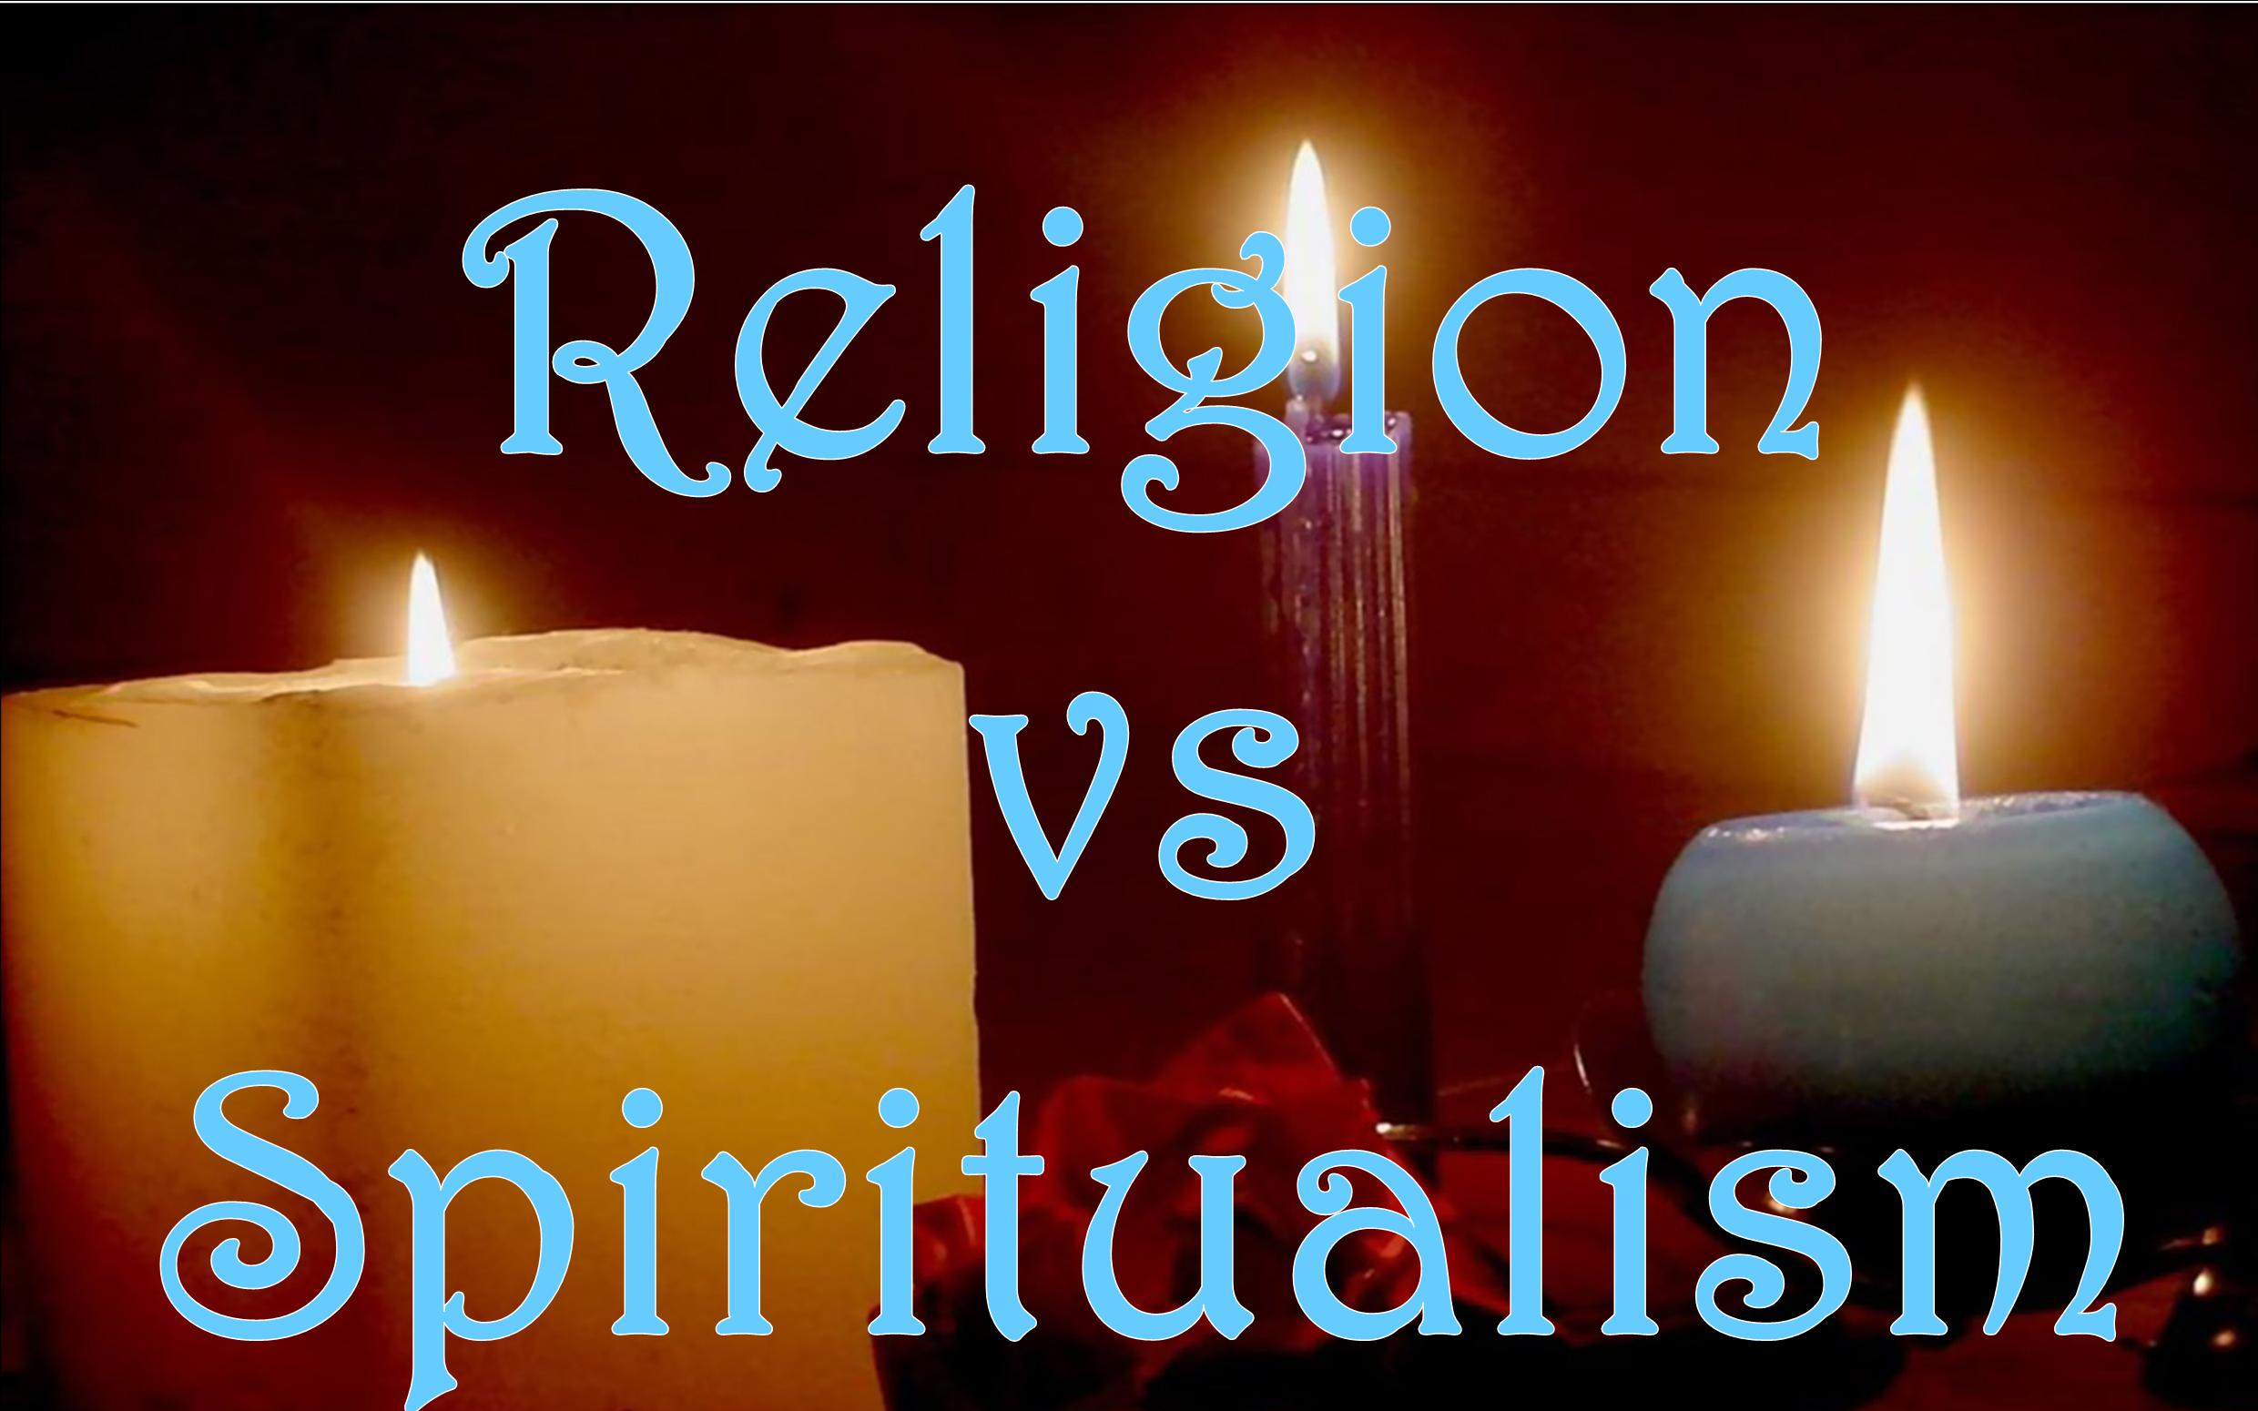
Being Spiritual—
Do the divisions matter?

Slide 14
Being Spiritual—
Do the divisions matter?
  Some have said:

Slide 15
Being Spiritual—
Do the divisions matter?
  Some have said:
    The #1 reason Millennials claim church attendance is not important is that…

Slide 16
Being Spiritual—
Do the divisions matter?
  Some have said:
    The #1 reason Millennials claim church attendance is not important is that…
    “I find God elsewhere”

Slide 17
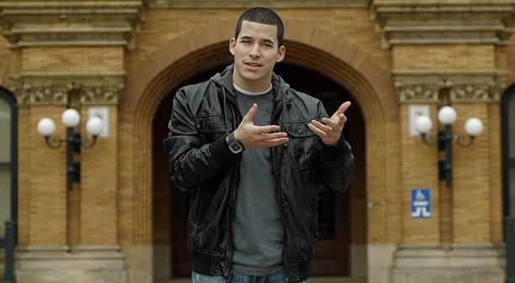
Being Spiritual—
Do the divisions matter?
  Some have said:
    In 2012, Jefferson Bethke’s poem Why I Hate Religion, But Love Jesus went viral racking up more than…

Slide 18
Being Spiritual—
Do the divisions matter?
  Some have said:
    In 2012, Jefferson Bethke’s poem Why I Hate Religion, But Love Jesus went viral racking up more than
35+ million
views

Slide 19
Being Spiritual—
Do the divisions matter?
  Some have said:
    About a quarter of U.S. adults (27%) now say they think of themselves as spiritual…

Slide 20
Being Spiritual—
Do the divisions matter?
  Some have said:
    About a quarter of U.S. adults (27%) now say they think of themselves as spiritual…
      But not religious.

Slide 21
Being Spiritual—
The Bible defines Religion:

Slide 22
Being Spiritual—
The Bible defines Religion
  James 1:26-27—

Slide 23
Being Spiritual—
The Bible defines Religion
  James 1:26-27—
  ²⁶If anyone thinks himself to be religious, and yet does not bridle his tongue but deceives his own heart, this man’s religion is worthless.
  ²⁷Pure and undefiled religion in the sight of our God and Father is this: to visit orphans and widows in their distress, and to keep oneself unstained by the world.

Slide 24
Being Spiritual—
The Bible defines Religion
  James 1:26-27—
    No room for:

Slide 25
Being Spiritual—
The Bible defines Religion
  James 1:26-27—
    No room for:
      Hypocrisy.

Slide 26
Being Spiritual—
The Bible defines Religion
  James 1:26-27—
    No room for:
      Hypocrisy.
      Saying what you like.

Slide 27
Being Spiritual—
The Bible defines Religion
  James 1:26-27—
    No room for:
      Hypocrisy.
      Saying what you like.
      Pride.

Slide 28
Being Spiritual—
The Bible defines Religion
  James 1:26-27—
    No room for:
      Hypocrisy.
      Saying what you like.
      Pride.
      Self-deception.

Slide 29
Being Spiritual—
The Bible defines Religion
  James 1:26-27—
    Religion lived:

Slide 30
Being Spiritual—
The Bible defines Religion
  James 1:26-27—
    Religion lived:
      Pure and undefiled is...

Slide 31
Being Spiritual—
The Bible defines Religion
  James 1:26-27—
    Religion lived:
      Pure and undefiled is:
      As defined “In God’s sight”…

Slide 32
Being Spiritual—
The Bible defines Religion
  James 1:26-27—
    Religion lived:
      Pure and undefiled is:
      As defined “In God’s sight”…
      Meets needs of the distressed:

Slide 33
Being Spiritual—
The Bible defines Religion
  James 1:26-27—
    Religion lived:
      Pure and undefiled is:
      As defined “In God’s sight”…
      Meets needs of the distressed:
        Visit orphans & widows.

Slide 34
Being Spiritual—
The Bible defines Religion
  James 1:26-27—
    Religion lived:
      Pure and undefiled is:
      As defined “In God’s sight”…
      Meets needs of the distressed:
        Visit orphans & widows.
        Keep oneself unstained by the world.

Slide 35
Being Spiritual—
God centred:

Slide 36
Being Spiritual—
God centred:
  Psalm 46:10—

Slide 37
Being Spiritual—
God centred:
  Psalm 46:10—
  ¹⁰“Cease striving and know that I am God;
  I will be exalted among the nations,
I will be exalted in the earth.” (NASB95)

Slide 38
Being Spiritual—
Private prayer, study and praise:

Slide 39
Being Spiritual—
Private prayer, study and praise:
  Matthew 6:6—

Slide 40
Being Spiritual—
Private prayer, study and praise:
  Matthew 6:6—
  ⁶But you, when you pray, go into your inner room, close your door and pray to your Father who is in secret, and your Father who sees what is done in secret will reward you. (NASB95)

Slide 41
Being Spiritual—
Private prayer, study and praise:
  Psalm 119:15—

Slide 42
Being Spiritual—
Private prayer, study and praise:
  Psalm 119:15—
  ¹⁵I will meditate on Your precepts
  And regard Your ways. (NASB95)

Slide 43
Being Spiritual—
Its all about being together:
  Acts 2:42—
  ⁴² They were continually devoting themselves to the apostles’ teaching and to fellowship, to the breaking of bread and to prayer. (NASB95)

Slide 44
Being Spiritual—
Jesus is our spiritual focus:

Slide 45
Being Spiritual—
Jesus is our spiritual focus:
  He is creator of all things.
  The is Saviour of the world.
  Thomas worshipped the risen Christ.
  We walk in a manner worth of our calling.

Slide 46
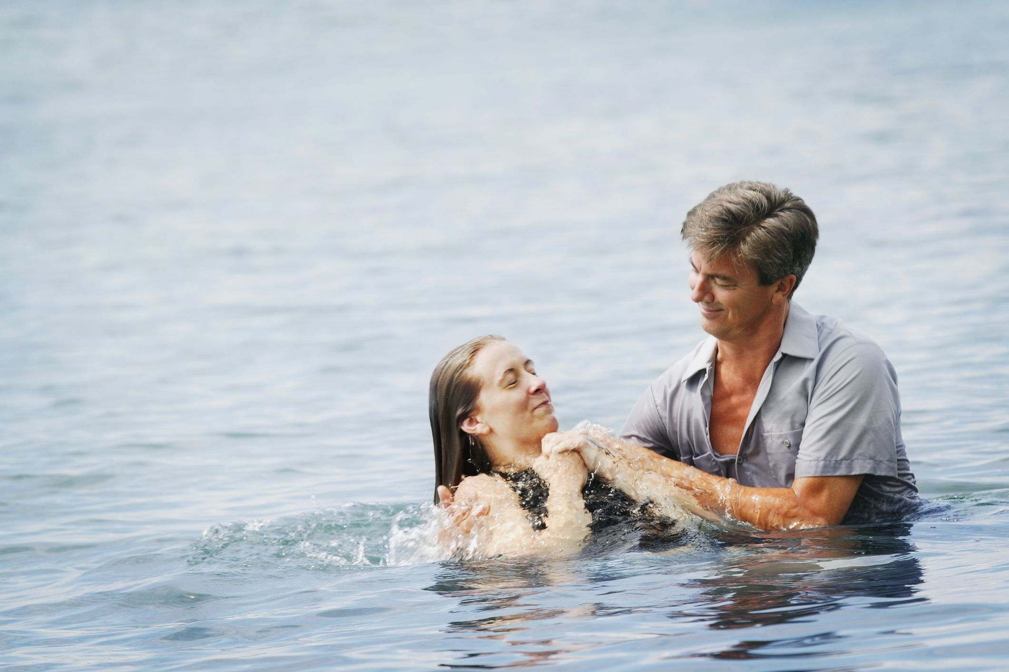
Acts 22:16—
Now why do you delay? Get up and be baptized, and wash away your sins, calling on His name.’

