Slide 1
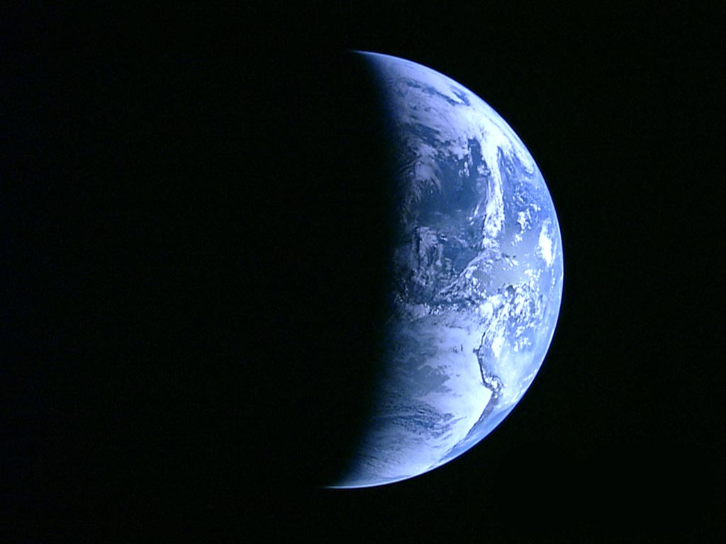
Series: What on Earth……
Part 2.
Is being Perfect?

Slide 2
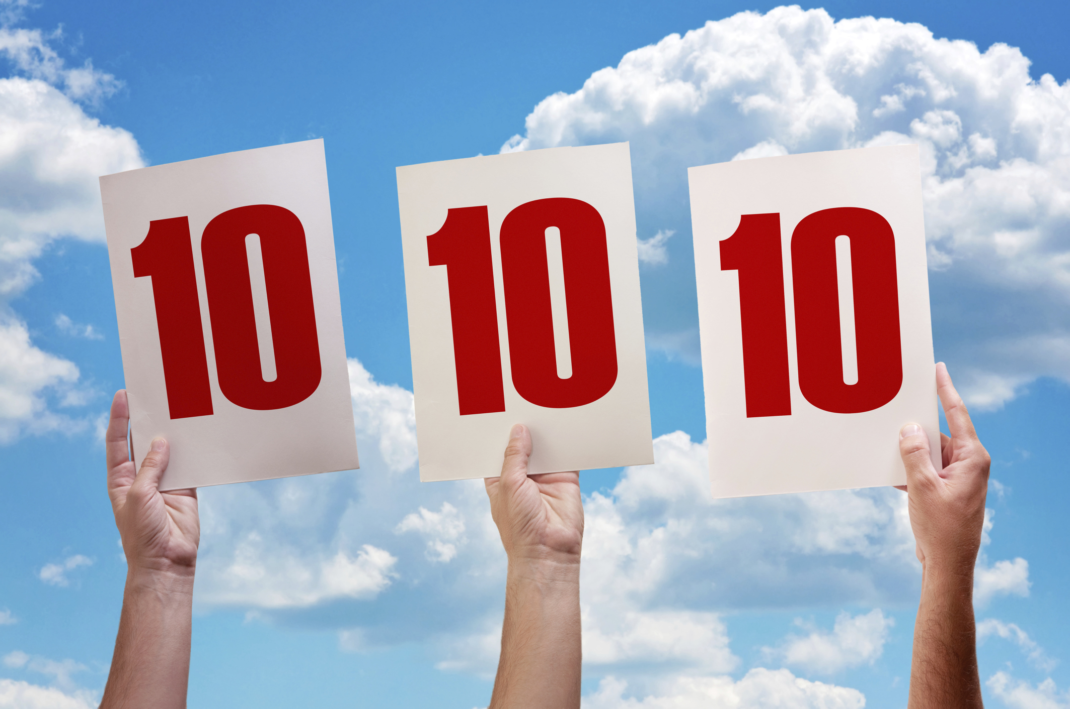
Being Perfect—
Some seek perfection though competition.
Sports, entertainment and beauty…

Slide 3
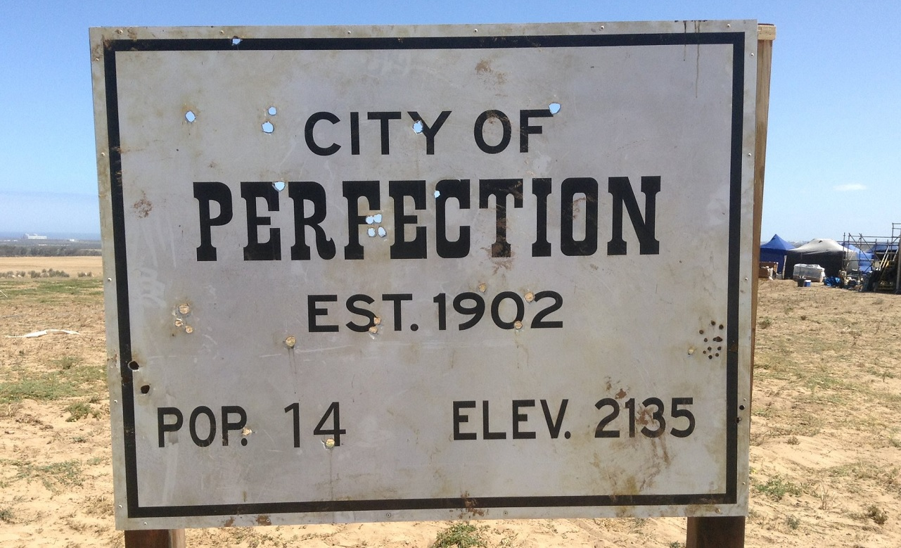
Being Perfect—
Some seek perfection in a location.
Sorry, cell phones don’t work…

Slide 4

Being Perfect—
Some seek perfection in order.
Having everything where it “should be.”

Slide 5

Being Perfect—
Some seek perfection in obedience.
Everyone forming to one person’s ideas.

Slide 6
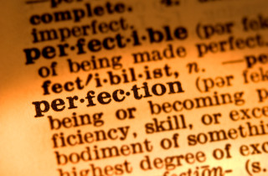
Being Perfect—
Dictionary Definition:
(a) being entirely without fault or defect
(b) satisfying all requirements
(c) corresponding to an ideal standard or abstract concept

Slide 7
Being Perfect—
Dictionary Definition:
(a) being entirely without fault or defect.
(b) satisfying all requirements
(c) corresponding to an ideal standard or abstract concept

Slide 8
Being Perfect—
Dictionary Definition:
(a) being entirely without fault or defect.
(b) satisfying all requirements.
(c) corresponding to an ideal standard or abstract concept

Slide 9
Being Perfect—
Dictionary Definition:
(a) being entirely without fault or defect.
(b) satisfying all requirements.
(c) corresponding to an ideal standard or abstract concept.

Slide 10
Being Perfect—
Dictionary Definition:
“NOT HELPFUL!”
(a) being entirely without fault or defect
(b) satisfying all requirements
(c) corresponding to an ideal standard or abstract concept

Slide 11
Being Perfect—
Dictionary Definition:
“NOT HELPFUL!”
Too many Christians have this view.

Slide 12
Being Perfect—
Dictionary Definition:
“NOT HELPFUL!”
They striving to be without fault.
Satisfy all the requirements
Living up to an ideal standard they have for themselves.

Slide 13
Being Perfect—
Dictionary Definition:
“NOT HELPFUL!”
They striving to be without fault.
To satisfy all the requirements.
Living up to an ideal standard they have for themselves.

Slide 14
Being Perfect—
Dictionary Definition:
“NOT HELPFUL!”
They striving to be without fault.
To satisfy all the requirements.
Living up to an ideal standard they have for themselves.

Slide 15
Being Perfect—
Dictionary Definition:
“NOT HELPFUL!”
Not a good idea!
It leaves you living in a constant cycle of trying to be “GOOD ENOUGH.”

Slide 16
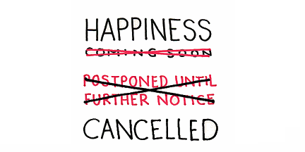
Being Perfect—
It leaves you living in a constant cycle of trying to be “GOOD ENOUGH.”

Slide 17
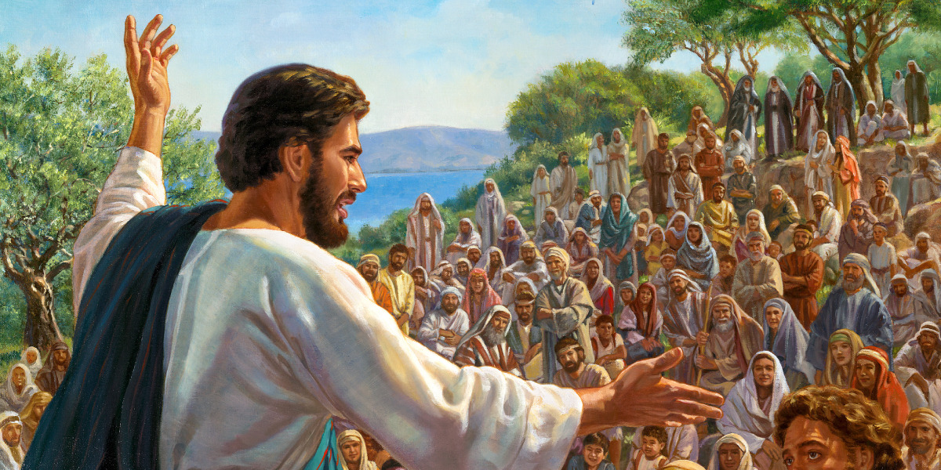
Being Perfect—
Jesus defines Christian Perfection:

Slide 18
Being Perfect—
Matthew 5:48—
⁴⁸Therefore you are to be perfect, as your heavenly Father is perfect. (NASB95)

Slide 19
Being Perfect—
God is “Perfect.”

Slide 20
Being Perfect—
God is “Perfect.”
Every aspect of His Being is FULLY—Loving, holy, just,…

Slide 21
Being Perfect—
God is “Perfect.”
He has compete power and knowledge.

Slide 22
Being Perfect—
God is “Perfect.”
No one can add to it.

Slide 23
Being Perfect—
What is Jesus’ view of religious “IMPERFECTION?”

Slide 24
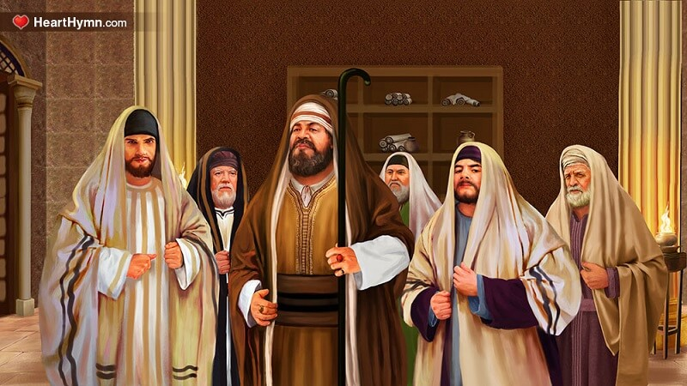
Being Perfect—
Matthew 5:20—²⁰“For I say to you that unless your righteousness surpasses that of the scribes and Pharisees, you will not enter the kingdom of heaven. (NASB95)

Slide 25
Being Perfect—
Theirs was the True God of holiness.
Given the perfect Law of God.
They abused their role as teachers…

Slide 26
Being Perfect—
Theirs was the True God of holiness.
Given the perfect Law of God.
They abused their role as teachers…

Slide 27
Being Perfect—
Theirs was the True God of holiness.
Given the perfect Law of God.
But, they abused their role as teachers…

Slide 28
Being Perfect—
They were prideful, arrogant, greedy, power hungry, vain, envious, unspiritual…and murderous. (Start with Matthew 23)

Slide 29
Being Perfect—
So…

Slide 30
Being Perfect—
Matthew 5:20—²⁰“For I say to you that unless your righteousness surpasses that of the scribes and Pharisees, you will not enter the kingdom of heaven. (NASB95)

Slide 31

Being Perfect—
Any real perfection we attain is a free gift of Christ.

Slide 32
Being Perfect—
In and of ourselves we are hopelessly lost.

Slide 33
Being Perfect—
The more perfect we think we are, the worse we become…

Slide 34
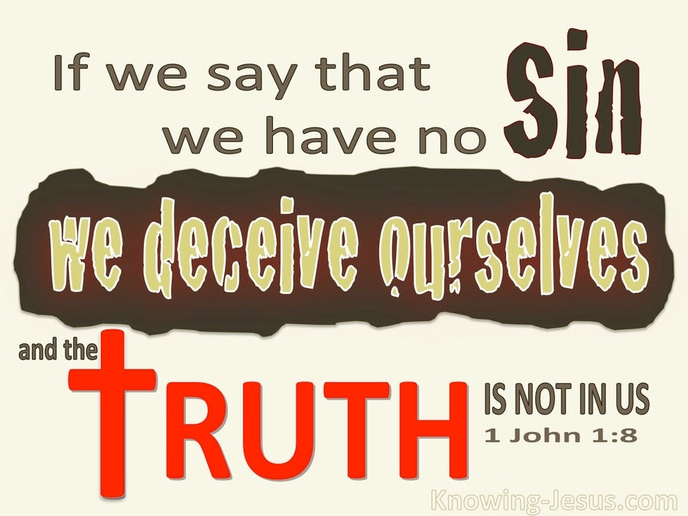
Being Perfect—

Slide 35
Being Perfect—
1 John 1:9—⁹ If we confess our sins, He is faithful and righteous to forgive us our sins and to cleanse us from all unrighteousness. (NASB95)

Slide 36
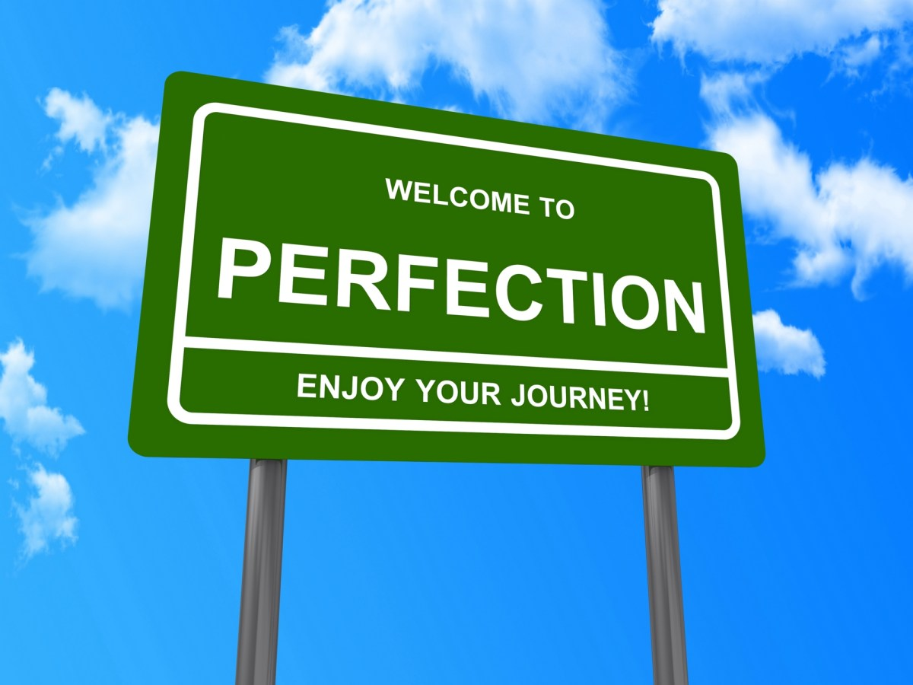
Being Perfect—
The road to perfection—

Slide 37
Being Perfect—
The road to perfection—
You are on it, but you’re not there yet…!

Slide 38
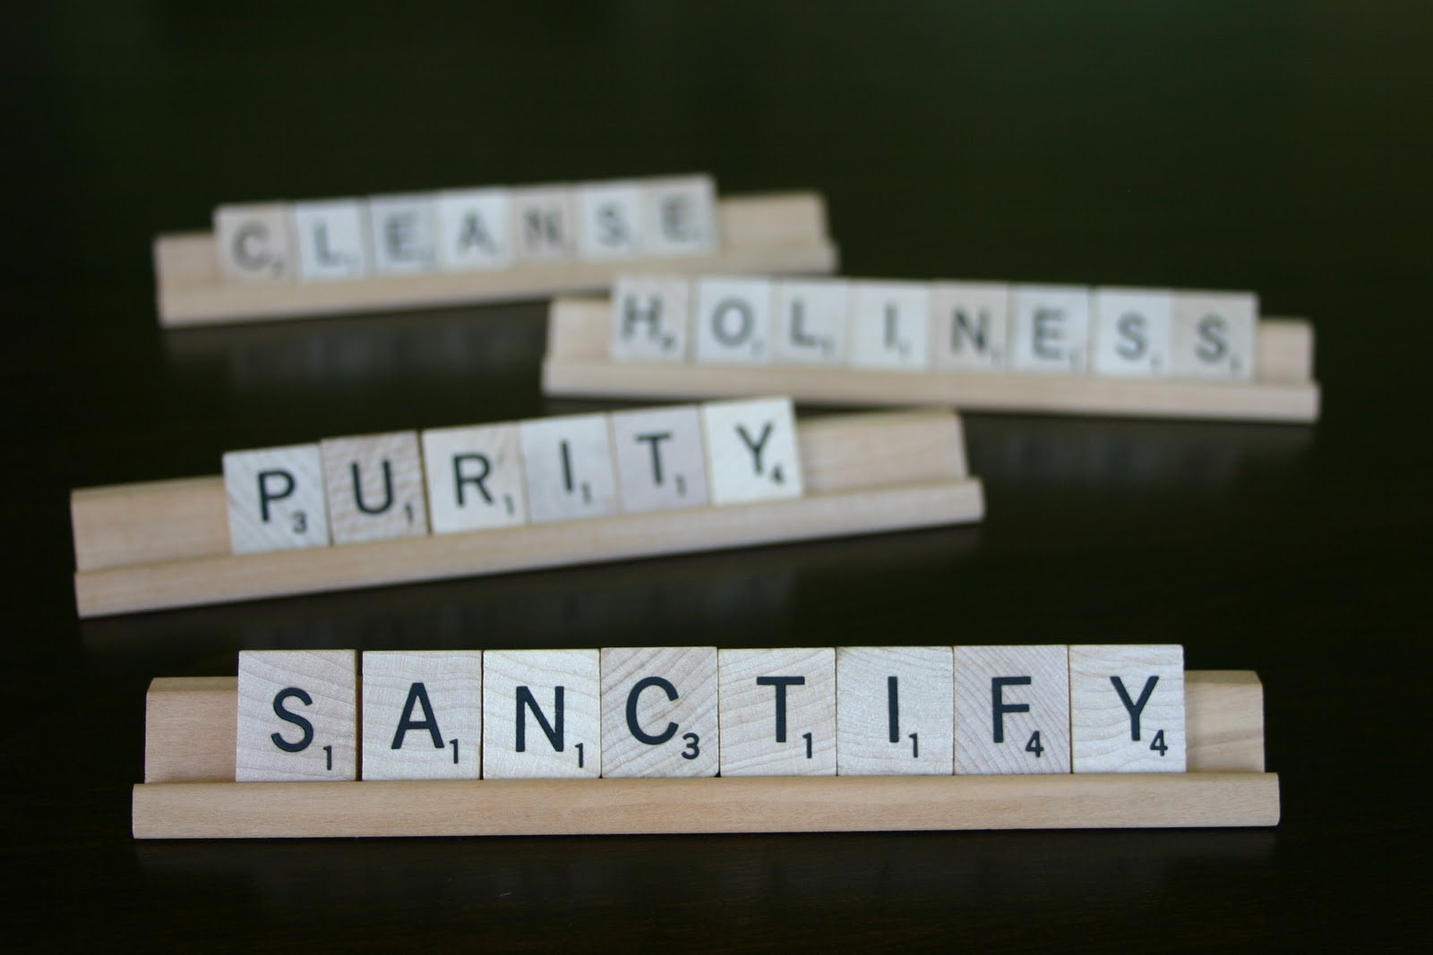
Being Perfect—
The road to perfection—
You are on it, but you’re not there yet…!
Christ is our Sanctification.
In Christ we reflect His mercy and Grace.
He character is reflected in our Integrity and sincerity.
We stand in need of fresh supplies of grace.

Slide 39

Being Perfect—
The road to perfection—
You are on it, but you’re not there yet…!
Christ is our Sanctification.
In Christ we reflect His mercy and Grace.
He character is reflected in our Integrity and sincerity.
We stand in need of fresh supplies of grace.

Slide 40

Being Perfect—
The road to perfection—
You are on it, but you’re not there yet…!
Christ is our Sanctification.
In Christ we reflect His mercy and Grace.
His character is reflected in our Integrity, Sincerity, and Lifestyle.
We stand in need of fresh supplies of grace.

Slide 41
Being Perfect—
The road to perfection—
You are on it, but you’re not there yet…!
Christ is our Sanctification.
In Christ we reflect His mercy and Grace.
His character is reflected in our Integrity, Sincerity, and Lifestyle.
We stand in need of fresh supplies of grace.

Slide 42
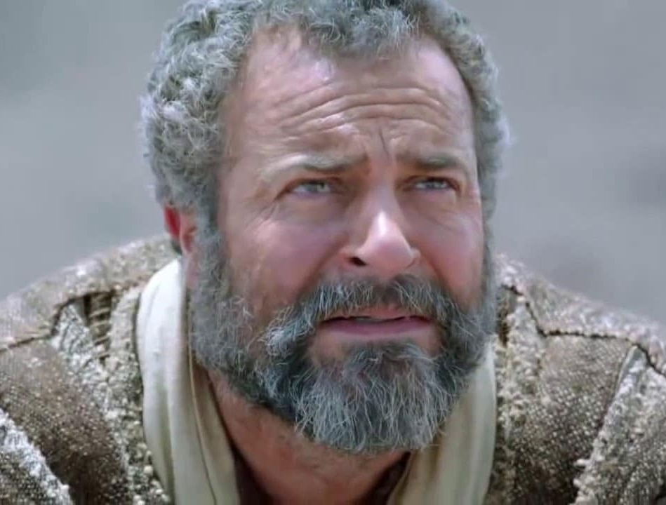
Being Perfect—
The road to perfection—
You are on it, but you’re not there yet…!
Abraham:
James 2:22—
²²You see that faith
was working with
his works, and as a
result of the works, faith was perfected; (NASB95)

Slide 43
Being Perfect—
The road to perfection—
You are on it, but you’re not there yet…!
Abraham:
James 2:22—
²²You see that faith
was working with
his works, and as a
result of the works, faith was perfected; (NASB95)

Slide 44

Being Perfect—
The road to perfection—
You are on it, but you’re not there yet…!
Saints:
1 Peter 5:10—
¹⁰After you have suffered for a little while, the God of all grace, who called you to His eternal glory in Christ, will Himself perfect, confirm, strengthen and establish you. (NASB95)

Slide 45
Being Perfect—
The road to perfection—
You are on it, but you’re not there yet…!
Saints:
1 Peter 5:10—
¹⁰After you have
suffered for a little
while, the God of all grace, who called you to
His eternal glory in Christ, will Himself
perfect, confirm, strengthen and establish
you. (NASB95)

Slide 46
Being Perfect—
The road to perfection—
You are on it, but you’re not there yet…!
Saints:
Philippians 1:6—
⁶For I am confident
of this very thing,
that He who began a good work in you will
perfect it until the day of Christ Jesus. (NASB95)

Slide 47
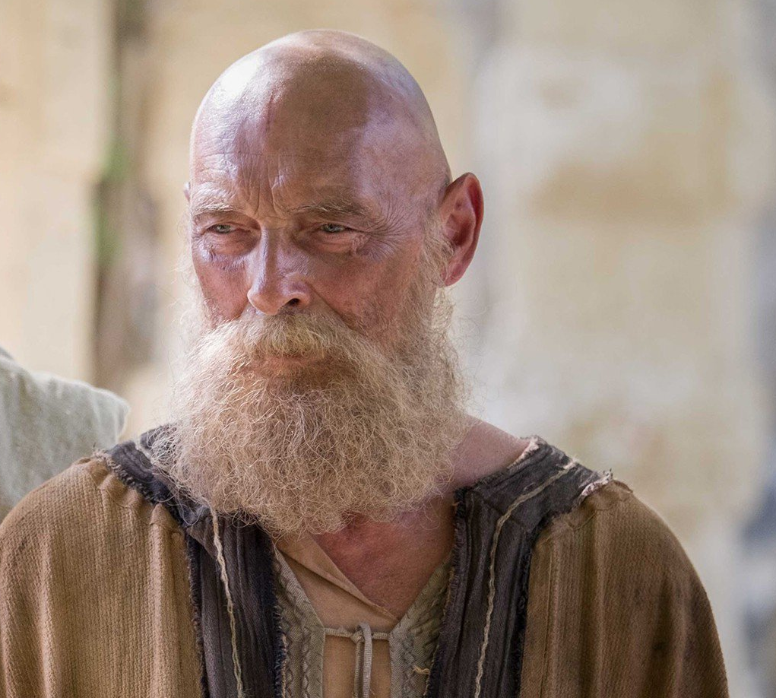
Being Perfect—
The road to perfection—
You are on it, but you’re not there yet…!
Apostle Paul:
Philippians 3:12—
¹²Not that I have already
obtained it or have
already become perfect,
but I press on so that I may lay hold of
that for which also I was laid hold of
by Christ Jesus. (NASB95)

Slide 48
Being Perfect—
The road to perfection—
You are on it, but you’re not there yet…!
Apostle Paul:
Philippians 3:12—
¹²Not that I have already
obtained it or have
already become perfect,
but I press on so that I may lay hold of
that for which also I was laid hold of
by Christ Jesus. (NASB95)

Slide 49

Being Perfect—
The road to perfection—
You are on it, but you’re not there yet…!
At the resurrection of
the dead, all of us who
are in Christ will
attain to perfection.

Slide 50
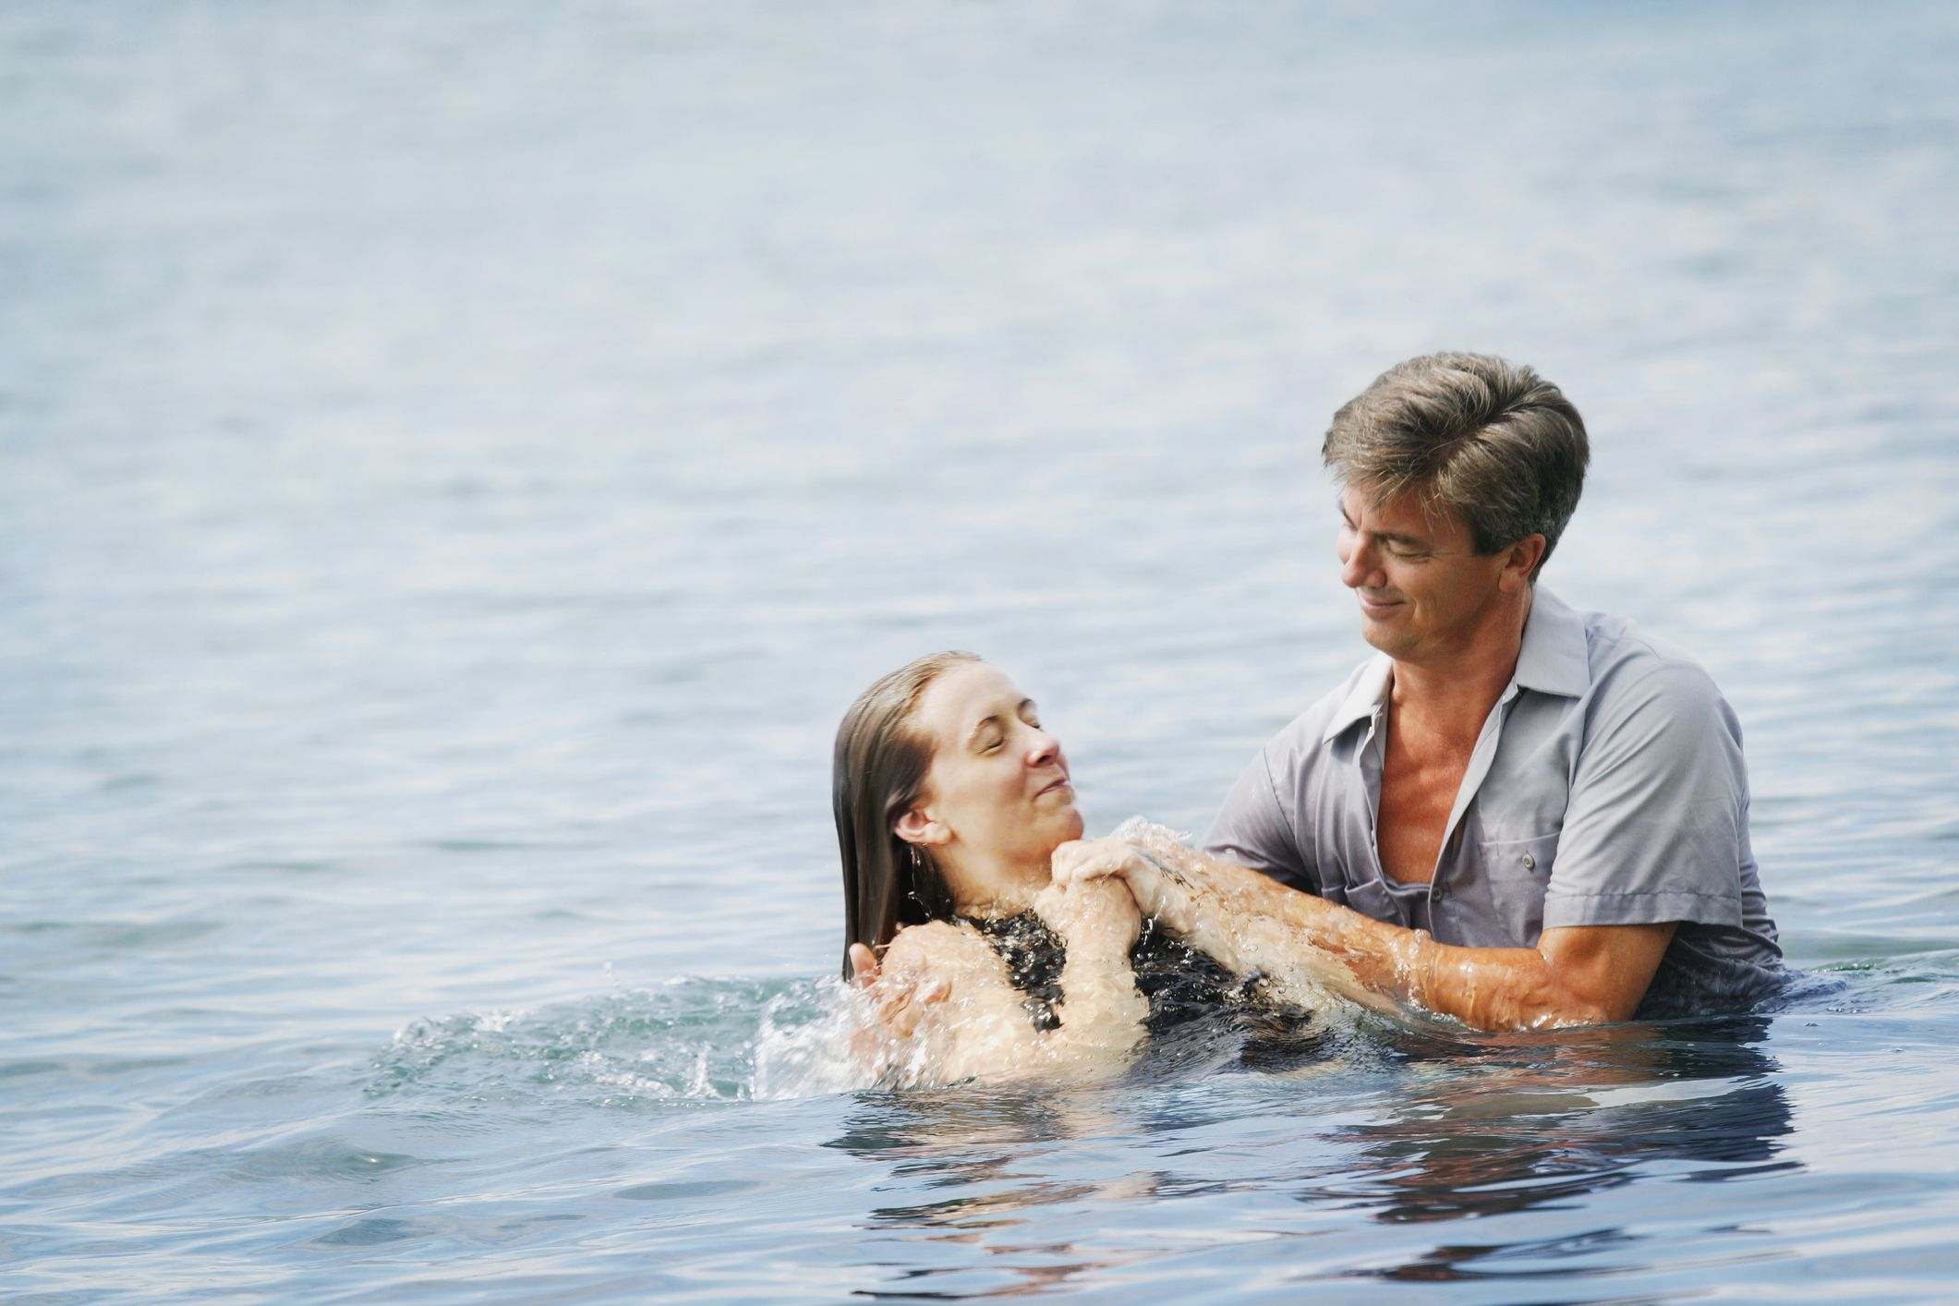
Acts 22:16—
Now why do you delay? Get up and be baptized, and wash away your sins, calling on His name.’

