Slide 1
Series: If the Lord wills…
Part 1.
John Staiger
Morningside Church of Christ
Sunday 26 December 2021
AM Sermon
Broadcast live from 42 Leslie Ave, Auckland, Aotearoa/NZ.

Slide 2
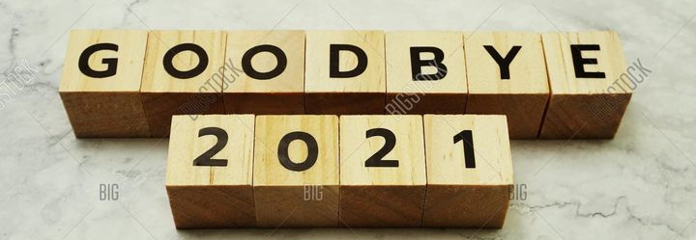
If the Lord wills…

Slide 3
If the Lord wills…
How many Christians…?

Slide 4
If the Lord wills…
How many Christians…?
  Will greet the new year expecting the same problems?

Slide 5
If the Lord wills…
How many Christians…?
  Will have forgotten about 2021’s RESOLUTIONS?

Slide 6
If the Lord wills…
How many Christians…?
  Will have forgotten about 2021’s RESOLUTIONS?
    What happened to:

Slide 7
If the Lord wills…
How many Christians…?
  Will have forgotten about 2021’s RESOLUTIONS?
    What happened to:
      That Bible reading plan?

Slide 8
If the Lord wills…
How many Christians…?
  Will have forgotten about 2021’s RESOLUTIONS?
    What happened to:
      That Bible reading plan?
      That better eating plan?

Slide 9
If the Lord wills…
How many Christians…?
  Will have forgotten about 2021’s RESOLUTIONS?
    What happened to:
      That Bible reading plan?
      That better eating plan?
      That exercise programme?

Slide 10
If the Lord wills…
How many Christians…?
  Will have forgotten about 2021’s RESOLUTIONS?
    What happened to:
      That Bible reading plan?
      That better eating plan?
      That exercise programme?
      Clearing away the clutter?

Slide 11
If the Lord wills…
How many Christians…?
  Will have forgotten about 2021’s RESOLUTIONS?
    What happened to:
      That Bible reading plan?
      That better eating plan?
      That exercise programme?
      Clearing away the clutter?
      Be nicer to everyone?

Slide 12
If the Lord wills…
It is The Lord’s will:

Slide 13
If the Lord wills…
It is The Lord’s will:
  That we look back with pride—I have fought the good fight.

Slide 14
If the Lord wills…
It is The Lord’s will:
  That we look back with pride—I have fought the good fight.
  That we build on the love that grew—and grow more.

Slide 15
If the Lord wills…
It is The Lord’s will:
  That we look back with pride—I have fought the good fight.
  That we build on the love that grew—and grow more.
  That the church gets back together.

Slide 16
If the Lord wills…
It is The Lord’s will:
  That we look back with pride—I have fought the good fight.
  That we build on the love that grew—and grow more.
  That the church gets back together.
  That we use the Lockdown to overcome our frustrations.

Slide 17
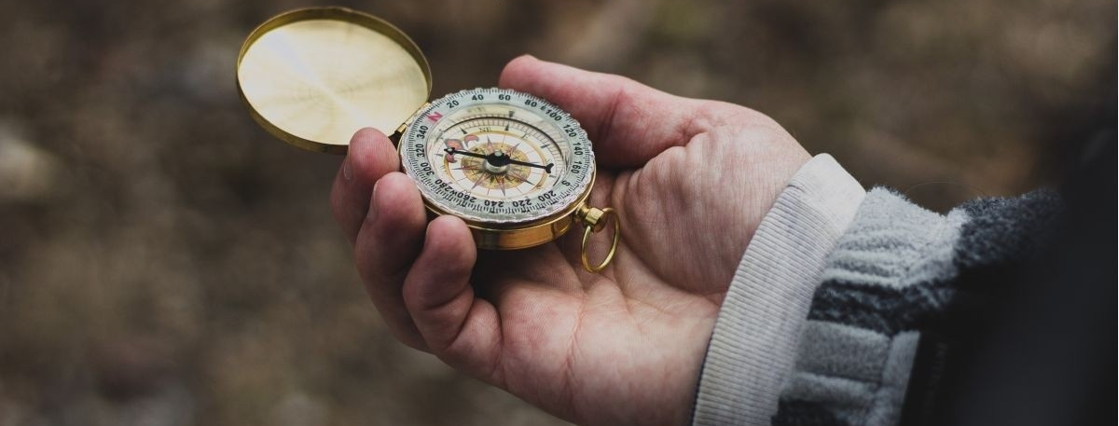
If the Lord wills…
Whatever your plans for 2022…?

Slide 18
If the Lord wills…
Whatever your plans for 2022…?
They are your choice,

Slide 19
If the Lord wills…
Whatever your plans for 2022…?
They are your choice,
but God’s property

Slide 20
If the Lord wills…
Whatever your plans for 2022…?
They are your choice,
but God’s property
—Choose wisely!

Slide 21
If the Lord wills…
James 4:15—
¹⁵Instead, you ought to say, “If the Lord wills, we will live and also do this or that.”

Slide 22
If the Lord wills…
Proverbs 16:9
⁹The mind of man plans his way,
But the Lord directs his steps.

Slide 23
If the Lord wills…
Proverbs 16:3—
³Commit your works to the Lord
And your plans will be established.

Slide 24
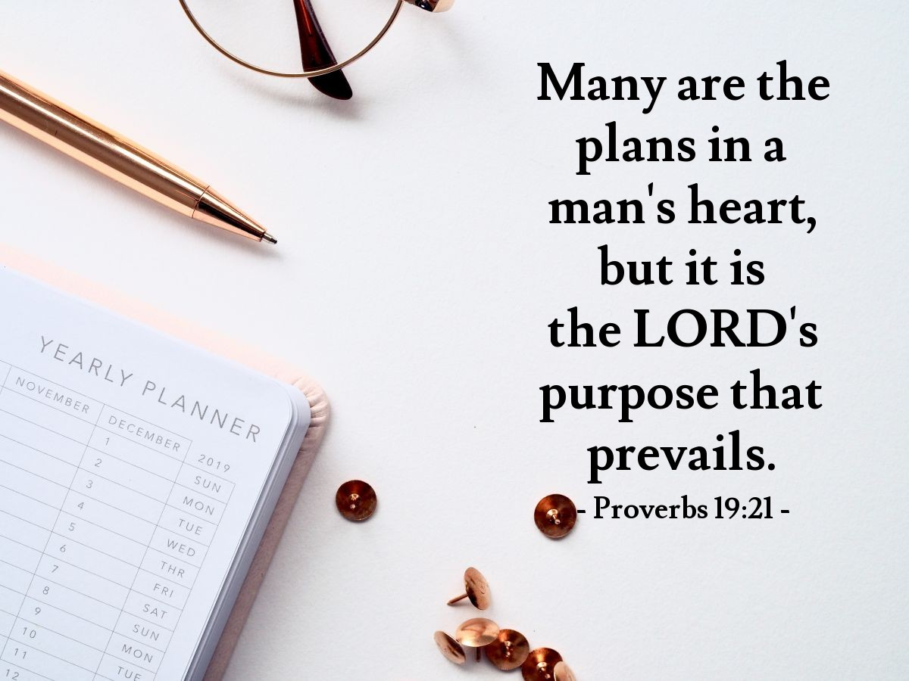
If the Lord wills…

Slide 25
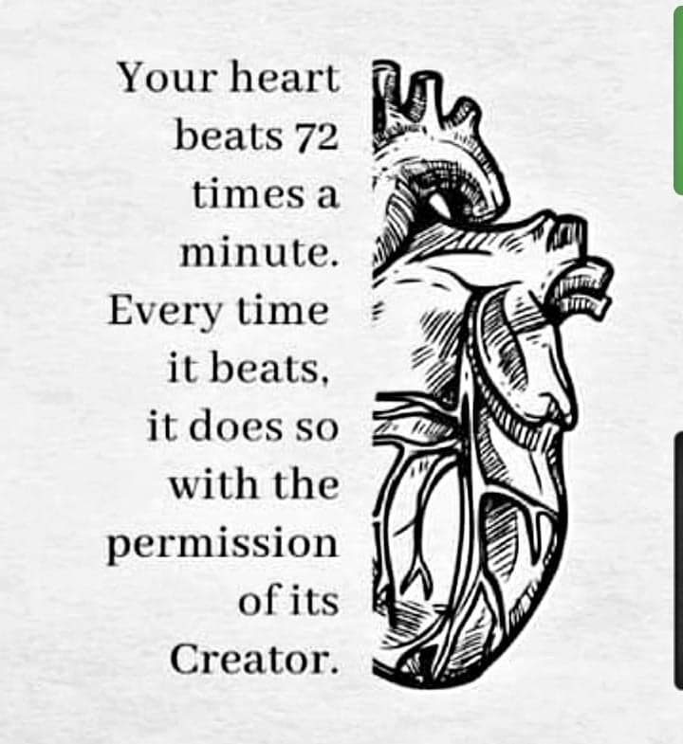
If the Lord wills…
Acts 17:28—
²⁸for in Him
we live
and move
and exist,
as even some of your own poets have said,
‘For we also are His children.’

Slide 26

If the Lord wills…
Philippians 4:19—
¹⁹And my God will supply all your needs according to His riches in glory in Christ Jesus. (NASB95)

Slide 27
If the Lord wills…
Needs provided for:

Slide 28
If the Lord wills…
Needs provided for:
Quantity potential—ALL!

Slide 29
If the Lord wills…
Needs provided for:
Quantity potential—ALL!
Quantity available—“According to His riches in glory.”

Slide 30
If the Lord wills…
Needs provided for:
Quantity potential—ALL!
Quantity available—“According to His riches in glory.”
A fact best accepted than worried about.

Slide 31
If the Lord wills…
Needs provided for:
Quantity potential—ALL!
Quantity available—“According to His riches in glory.”
A fact best accepted than worried about.
To worry is to deny God’s power.

Slide 32

If the Lord wills…
2 Corinthians 8:7—
⁷But just as you
abound in everything,
in faith
and utterance
and knowledge
and in all earnestness
and in
the love
we inspired in you,
see that you
abound in this gracious work also. (NASB95)

Slide 33
If the Lord wills…
2 Corinthians 9:8—
⁸And God is able
to make
all grace abound to you,
so that
always
having all sufficiency
in everything,
you may have an
abundance
for every good deed;
(NASB95)

Slide 34
If the Lord wills…
Malachi 3:10—
“Bring the
whole tithe
into the storehouse,
so that there may
be food in My house,
and test Me now in this,”
says the Lord of hosts,
“if I will not open for you
the windows of heaven
and pour out for you a
blessing until it
overflows. (NASB95)

Slide 35

If the Lord wills…
Isaiah 58:11—
¹¹“And the Lord will continually guide you,
And satisfy your desire in scorched places,
And give strength to your bones;
And you will be like a watered garden,
And like a spring of water whose waters do not fail. (NASB95)

Slide 36
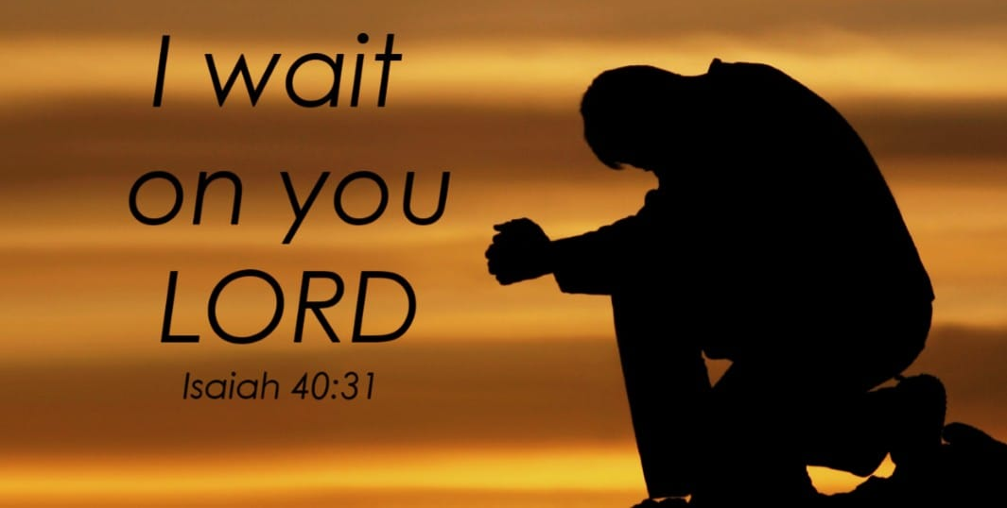
If the Lord wills…
Isaiah 40:31
³¹Yet those who wait for the Lord
Will gain new strength;
They will mount up with wings like eagles,
They will run and not get tired,
They will walk and not become weary. (NASB95)

Slide 37
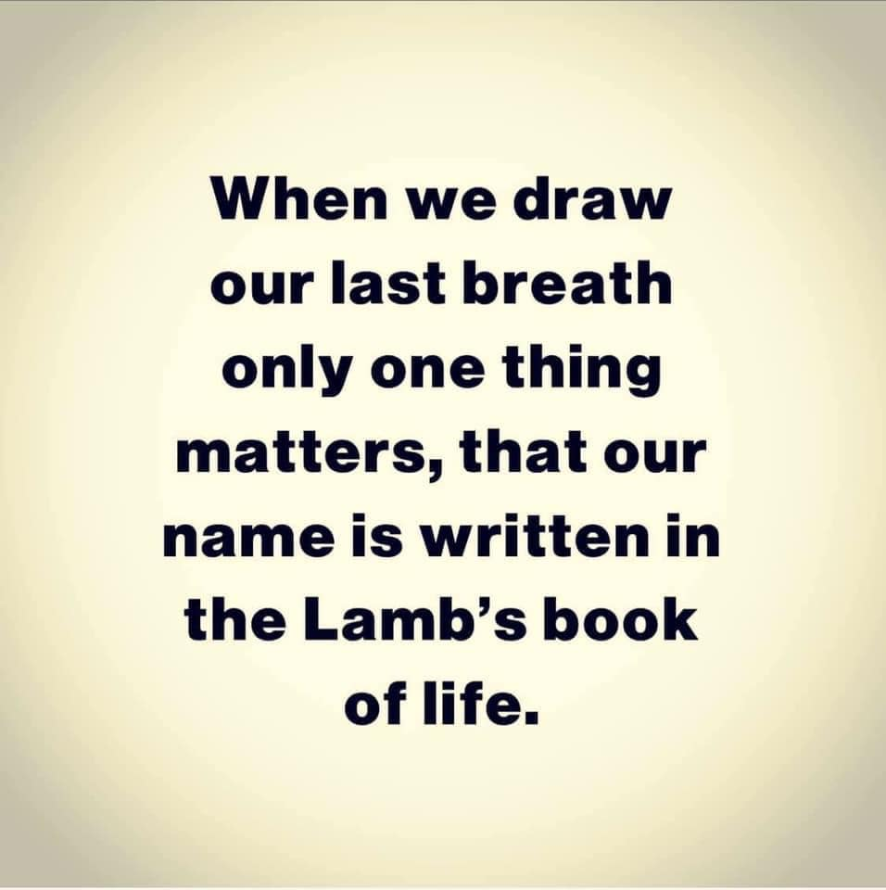
If the Lord wills…

Slide 38

Acts 2:41—
⁴¹So then, those who had received his word were baptized; and that day there were added about three thousand souls. (NASB95)

