Slide 1
Series: Unique (Part 1.).
“No one like Him!”
John Staiger
Morningside Church of Christ
Sunday 28 November 2021
PM Sermon
Broadcast on Facebook Live from Massey, Auckland, Aotearoa/NZ.
www.morningsidechurchofchrist.org.nz

Slide 2

Unique
(Part 1.)
“No one like Him!”

Slide 3

Quality unequalled…!
What qualities set Jesus of Nazareth apart from the rest of humanity?
His Divinity!
(Isaiah 7:14 – Matthew 1:23)

Slide 4
Quality unequalled…!
What qualities set Jesus of Nazareth apart from the rest of humanity?
His Divinity!
(Isaiah 7:14 – Matthew 1:23)

Slide 5

Quality unequalled…!
What qualities set Jesus of Nazareth apart from the rest of humanity?
Again…His Divinity!
Claimed to be the God of the Burning Bush!
Willing to die for it.

Slide 6
Quality unequalled…!
What qualities set Jesus of Nazareth apart from the rest of humanity?
Again…His Divinity!
Claimed to be the God of the Burning Bush!
Willing to die for it.

Slide 7
Quality unequalled…!
What qualities set Jesus of Nazareth apart from the rest of humanity?
Again…His Divinity!
Claimed to be the God of the Burning Bush!
Willing to die for it.

Slide 8
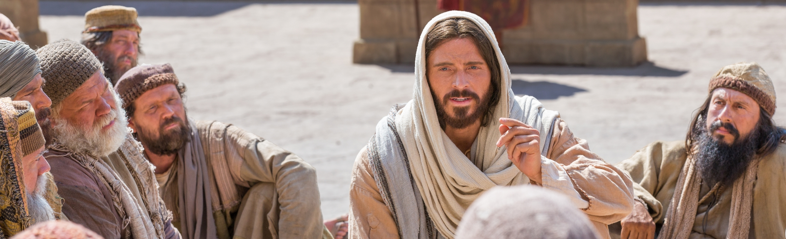
Quality unequalled…!
What qualities set Jesus of Nazareth apart from the rest of humanity?
His Teachings!
“No one ever spoke like this man!” (Jn.7:46).
Spoke as having Authority (MT.7:29).

Slide 9
Quality unequalled…!
What qualities set Jesus of Nazareth apart from the rest of humanity?
His Teachings!
“No one ever spoke like this man!” (Jn.7:46).
Spoke as having Authority (MT.7:29).

Slide 10
Quality unequalled…!
What qualities set Jesus of Nazareth apart from the rest of humanity?
His Teachings!
“No one ever spoke like this man!” (Jn.7:46).
Spoke as one having Authority (Mt.7:29).

Slide 11

Quality unequalled…!
What qualities set Jesus of Nazareth apart from the rest of humanity?
His Compassion!
Healed the sick, cast out demons, opened the eyes of the blind, raised the dead…

Slide 12
Quality unequalled…!
What qualities set Jesus of Nazareth apart from the rest of humanity?
His Compassion!
Healed the sick, cast out demons, opened the eyes of the blind, raised the dead…

Slide 13
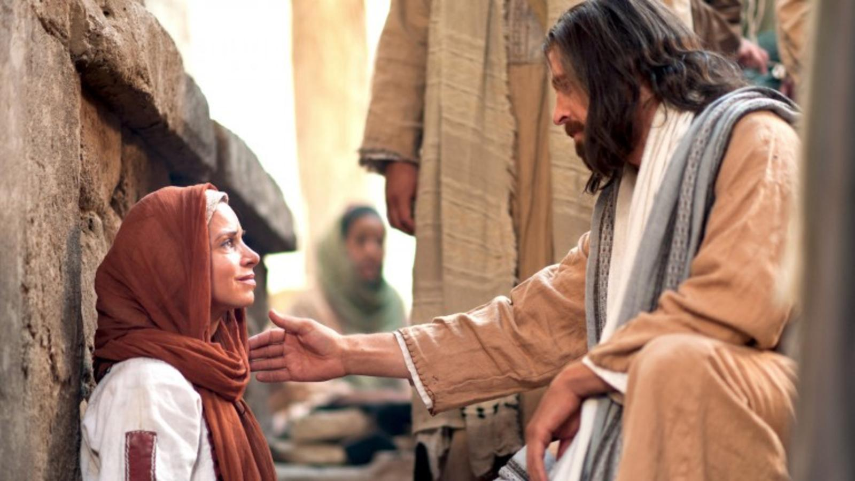
Quality unequalled…!
What qualities set Jesus of Nazareth apart from the rest of humanity?
His Good Works!
Acts 10:38—You know of Jesus…and how He went about doing good and healing…

Slide 14
Quality unequalled…!
What qualities set Jesus of Nazareth apart from the rest of humanity?
His Good Works!
Acts 10:38—You know of Jesus…and how He went about doing good and healing…

Slide 15
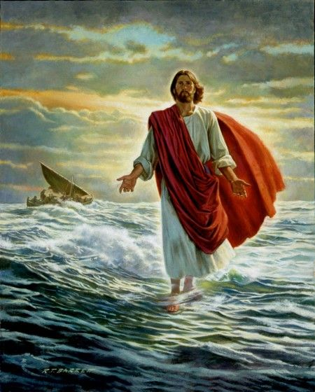
Quality unequalled…!
What qualities set Jesus of Nazareth apart from the rest of humanity?
                His Miracles!

Slide 16
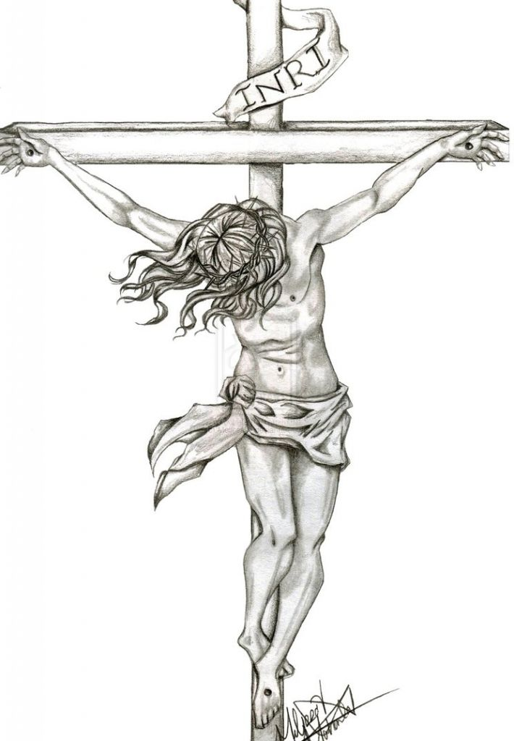
Quality unequalled…!
What qualities set Jesus of Nazareth apart from the rest of humanity?
                His Crucifixion!

Slide 17
Quality unequalled…!
What qualities set Jesus of Nazareth apart from the rest of humanity?
                His Crucifixion!
Mark 15:15—Wishing to satisfy the crowd, Pilate released Barabbas for them, and after having Jesus scourged, he handed Him over to be crucified. (NASB)

Slide 18
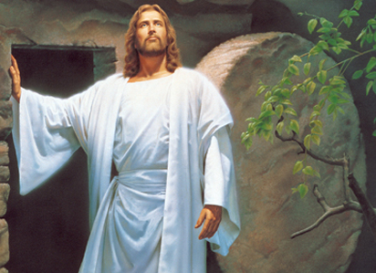
Quality unequalled…!
What qualities set Jesus of Nazareth apart from the rest of humanity?
                His Resurrection!

Slide 19
Quality unequalled…!
What qualities set Jesus of Nazareth apart from the rest of humanity?
                His Resurrection!
Matthew 28:7—⁷Go quickly and tell His disciples that He has risen from the dead; and behold, He is going ahead of you into Galilee, there you will see Him; behold, I have told you.” (NASB)

Slide 20
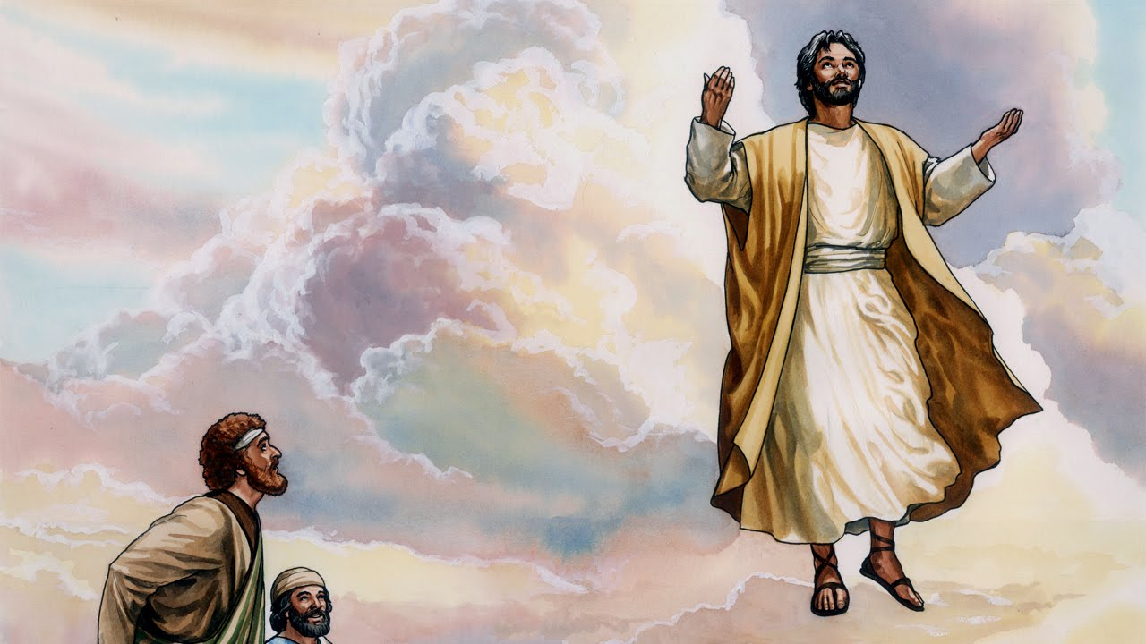
Quality unequalled…!
What qualities set Jesus of Nazareth apart from the rest of humanity?
                His
                Ascension!

Slide 21
Quality unequalled…!
What qualities set Jesus of Nazareth apart from the rest of humanity?
                His
                Ascension!
Acts 1:11—¹¹They also said, “Men of Galilee, why do you stand looking into the sky? This Jesus, who has been taken up from you into heaven, will come in just the same way as you have watched Him go into heaven.” (NASB)

Slide 22
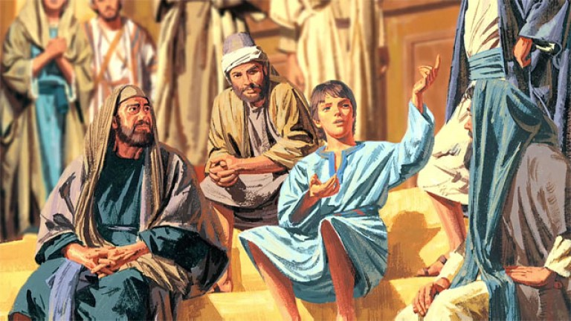
About His father’s Business…
Ever calm and confident.
Nothing surprised him.
Nothing daunted him.
His is the only life that met all that was expected of it—all it was designed for.

Slide 23
About His father’s Business…
Luke 2:49—And He said to them, “Why is it that you were looking for Me? Did you not know that I had to be in My Father’s house?” (NASB)
Ever calm and confident.
Nothing surprised him.
Nothing daunted him.
His is the only life that met all that was expected of it—all it was designed for.

Slide 24
About His father’s Business…
Luke 2:49—And He said to them, “Why is it that you were looking for Me? Did you not know that I had to be in My Father’s house?” (NASB)
Ever calm and confident.
Nothing surprised him.
Nothing daunted him.
His is the only life that met all that was expected of it—all it was designed for.

Slide 25
About His father’s Business…
Luke 2:49—And He said to them, “Why is it that you were looking for Me? Did you not know that I had to be in My Father’s house?” (NASB)
Ever calm and confident.
Nothing surprised him.
Nothing daunted him.
His is the only life that met all that was expected of it—all it was designed for.

Slide 26
About His father’s Business…
Luke 2:49—And He said to them, “Why is it that you were looking for Me? Did you not know that I had to be in My Father’s house?” (NASB)
Ever calm and confident.
Nothing surprised him.
Nothing daunted him.
His is the only life that met all that was expected of it—all it was designed for.

Slide 27
About His father’s Business…
Luke 2:49—And He said to them, “Why is it that you were looking for Me? Did you not know that I had to be in My Father’s house?” (NASB)
Ever calm and confident.
Nothing surprised him.
Nothing daunted him.
His is the only life that met all that was expected of it—all it was designed for.

Slide 28
About His father’s Business…
Luke 2:49—And He said to them, “Why is it that you were looking for Me? Did you not know that I had to be in My Father’s house?” (NASB)
Ever calm and confident.
Nothing surprised him.
Nothing daunted him.
His is the only life that met all that was expected of it—all it was designed for.

Slide 29

His face was ever toward Jerusalem…

Slide 30
His face was ever toward Jerusalem…
Luke 9:30-31—³⁰ And behold, two men were talking with Him; and they were Moses and Elijah, ³¹ who, appearing in ^{[a]}glory, were speaking of His departure which He was about to accomplish at Jerusalem. (NASB) [a]Or splendor

Slide 31

His face was ever toward Jerusalem…
Luke 9:51—When the days were approaching for His ascension, He was determined to go to Jerusalem; (NASB)

Slide 32
His was unique as to his life’s plan…

Slide 33
His was unique as to his life’s plan…
He had a work to accomplish which no else could do. (Lk.19:10; 1Tim.1:15)
He carried out God’s purpose by working according to a definite goal.
Few people plan the work of their lives.
Fewer still are able to carry out their plans.
Incidental and accidental things spoil plans.
Events compel us to change or abandon plans.
It is foolish for us to say, “Today or tomorrow we will go into the city, and buy and sell and get gain.” (James 4:13)

Slide 34
His was unique as to his life’s plan…
He had a work to accomplish which no else could do. (Lk.19:10; 1Tim.1:15)
He carried out God’s purpose by working according to that definite goal.
Few people plan the work of their lives.
Fewer still are able to carry out their plans.
Incidental and accidental things spoil plans.
Events compel us to change or abandon plans.
It is foolish for us to say, “Today or tomorrow we will go into the city, and buy and sell and get gain.” (James 4:13)

Slide 35
His was unique as to his life’s plan…
He had a work to accomplish which no else could do. (Lk.19:10; 1Tim.1:15)
He carried out God’s purpose by working according to that definite goal.
Few people plan the work of their lives.
Fewer still are able to carry out their plans.
Incidental and accidental things spoil plans.
Events compel us to change or abandon plans.
It is foolish for us to say, “Today or tomorrow we will go into the city, and buy and sell and get gain.” (James 4:13)

Slide 36
His was unique as to his life’s plan…
He had a work to accomplish which no else could do. (Lk.19:10; 1Tim.1:15)
He carried out God’s purpose by working according to that definite goal.
Few people plan the work of their lives.
Fewer still are able to carry out their plans.
Incidental and accidental things spoil plans.
Events compel us to change or abandon plans.
It is foolish for us to say, “Today or tomorrow we will go into the city, and buy and sell and get gain.” (James 4:13)

Slide 37
His was unique as to his life’s plan…
He had a work to accomplish which no else could do. (Lk.19:10; 1Tim.1:15)
He carried out God’s purpose by working according to that definite goal.
Few people plan the work of their lives.
Fewer still are able to carry out their plans.
Incidental and accidental things spoil plans.
Events compel us to change or abandon plans.
It is foolish for us to say, “Today or tomorrow we will go into the city, and buy and sell and get gain.” (James 4:13)

Slide 38
His was unique as to his life’s plan…
He had a work to accomplish which no else could do. (Lk.19:10; 1Tim.1:15)
He carried out God’s purpose by working according to that definite goal.
Few people plan the work of their lives.
Fewer still are able to carry out their plans.
Incidental and accidental things spoil plans.
Events compel us to change or abandon plans.
It is foolish for us to say, “Today or tomorrow we will go into the city, and buy and sell and get gain.” (James 4:13)

Slide 39
His was unique as to his life’s plan…
He had a work to accomplish which no else could do. (Lk.19:10; 1Tim.1:15)
He carried out God’s purpose by working according to that definite goal.
Few people plan the work of their lives.
Fewer still are able to carry out their plans.
Incidental and accidental things spoil plans.
Events compel us to change or abandon plans.
It is foolish for us to say, “Today or tomorrow we will go into the city, and buy and sell and get gain.” (James 4:13)

Slide 40
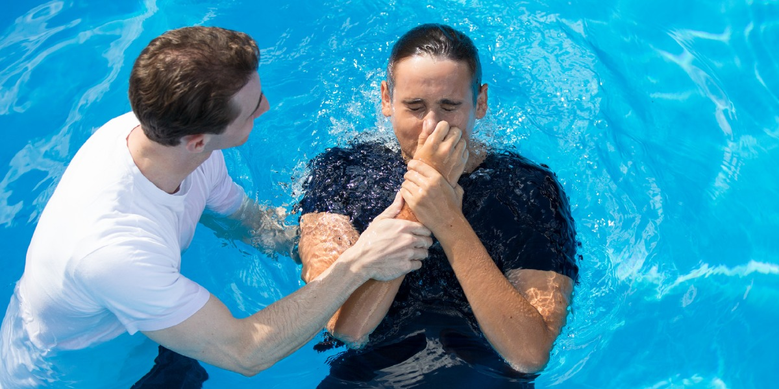
Acts 2:38—³⁸ Peter said to them, “Repent, and each of you be baptized in the name of Jesus Christ for the forgiveness of your sins; and you will receive the gift of the Holy Spirit.

