Slide 1
Series: Unique (Part 2.).
“No one like you!”
John Staiger
Morningside Church of Christ
Sunday 5 December 2021
PM Sermon
Broadcast on Facebook Live from Massey, Auckland, Aotearoa/NZ.
www.morningsidechurchofchrist.org.nz

Slide 2

Unique
(Part 2.)
“No one like you!”

Slide 3
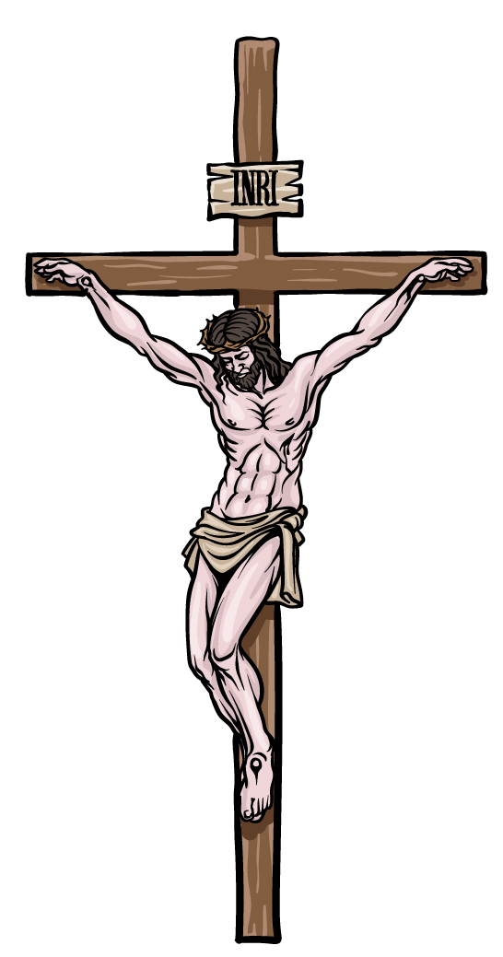
Unique—No one Like You…!
Unique Owner—Jesus

Slide 4
Unique—No one Like You…!
Unique Owner—Jesus
Titus 2:14—
¹⁴who gave Himself for us to redeem us from every lawless deed, and to purify for Himself a people for His own possession, zealous for good deeds. (NASB95)

Slide 5
Unique—No one Like You…!
Unique Owner—Jesus
Titus 2:14—
Redeemed us.

Slide 6
Unique—No one Like You…!
Unique Owner—Jesus
Titus 2:14—
Redeemed us.
From every lawless deed.

Slide 7
Unique—No one Like You…!
Unique Owner—Jesus
Titus 2:14—
Redeemed us.
From every lawless deed.
Purify for Himself.

Slide 8
Unique—No one Like You…!
Unique Owner—Jesus
Titus 2:14—
Redeemed us.
From every lawless deed.
Purify for Himself.
A people for His own possession—Peculiar (KJV).

Slide 9
Unique—No one Like You…!
Unique Owner—Jesus
Titus 2:14—
Redeemed us.
From every lawless deed.
Purify for Himself.
A people for His own possession—Peculiar (KJV).
Zealous for good deeds.

Slide 10
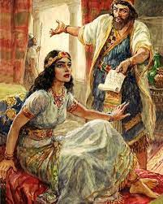
Unique—No one Like You…!
Unique placement—Esther

Slide 11
Unique—No one Like You…!
Unique placement—Esther
Esther 4:14—
¹⁴For if you remain silent at this time, relief and deliverance will arise for the Jews from another place and you and your father’s house will perish. And who knows whether you have not attained royalty for such a time as this?” (NASB95)

Slide 12
Unique—No one Like You…!
Unique placement—Esther
If you remain silent…

Slide 13
Unique—No one Like You…!
Unique placement—Esther
If you remain silent…
Relief and deliverance… from another place

Slide 14
Unique—No one Like You…!
Unique placement—Esther
If you remain silent…
Relief and deliverance… from another place
You and your father’s house will perish.

Slide 15
Unique—No one Like You…!
Unique placement—Esther
Esther 4:14—
“…And who knows whether you have not attained royalty for such a time as this?” (NASB95)

Slide 16
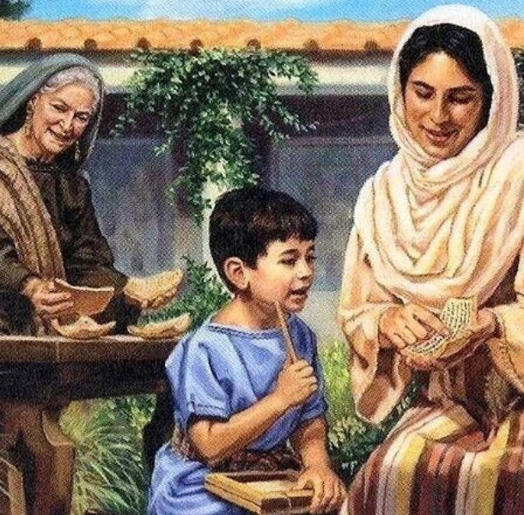
Unique—No one Like You…!
Unique Equipping—Timothy

Slide 17
Unique—No one Like You…!
Unique Equipping—Timothy
2 Timothy 1:5
⁵For I am mindful of the sincere faith within you, which first dwelt in your grandmother Lois and your mother Eunice, and I am sure that it is in you as well. (NASB95)

Slide 18
Unique—No one Like You…!
Unique Equipping—Timothy
2 Timothy 1:5
Sincere faith within you—Character!

Slide 19
Unique—No one Like You…!
Unique Equipping—Timothy
2 Timothy 1:5
Sincere faith within you—Character!
Lois and Eunice—Godly legacy.

Slide 20
Unique—No one Like You…!
Unique Equipping—Timothy
2 Timothy 1:5
Sincere faith within you—Character!
Lois and Eunice—Godly legacy.
I am sure that it is in you as well—obvious to all.

Slide 21

Unique—No one Like You…!
Unique Commission—Church
Titus 2:14—
…Zealous for good deeds. (NASB95)

Slide 22
Unique—No one Like You…!
Unique Commission—Church
1 Peter 3:13—
¹³ Who is there to harm you if you prove zealous for what is good? (NASB95)

Slide 23
Unique—No one Like You…!
Unique Commission—Church
2 Corinthians 5:20
²⁰Therefore, we are ambassadors for Christ, as though God were making an appeal through us; we beg you on behalf of Christ, be reconciled to God. (NASB95)

Slide 24
Unique—No one Like You…!
Unique Commission—Church
Jude 3
³Beloved, while I was making every effort to write you about our common salvation, I felt the necessity to write to you appealing that you contend earnestly for the faith which was once for all handed down to the saints. (NASB95)

Slide 25
Unique—No one Like You…!
Unique Commission—Church
1 Timothy 2:3-4
³This is good and acceptable in the sight of God our Saviour, ⁴who desires all men to be saved and to come to the knowledge of the truth.(NASB95)

Slide 26
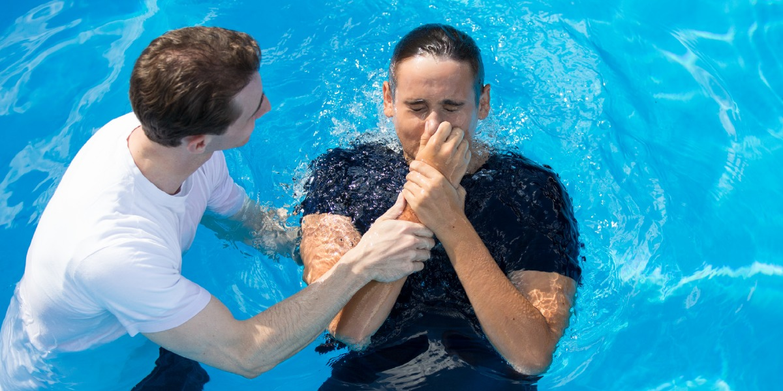
Galatians 3:27—
²⁷For all of you who were baptized into Christ have clothed yourselves with Christ. (NASB95)

