Slide 1
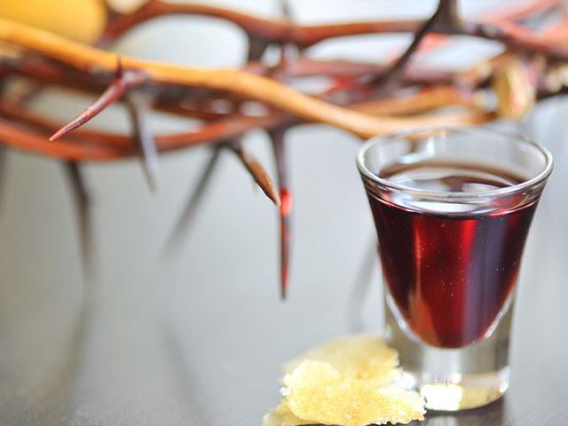
“Do this in remembrance of Me…”

Slide 2
Series: What on Earth…
Part 3. “Is Being Filled with the Holy Spirit?”
John Staiger
Morningside Church of Christ
Sunday 28 November 2021
AM Sermon
Broadcast live from Massey, Auckland, Aotearoa/NZ.

Slide 3

Series: What on Earth……
Part 3.
Is being Filled with the Holy Spirit?

Slide 4
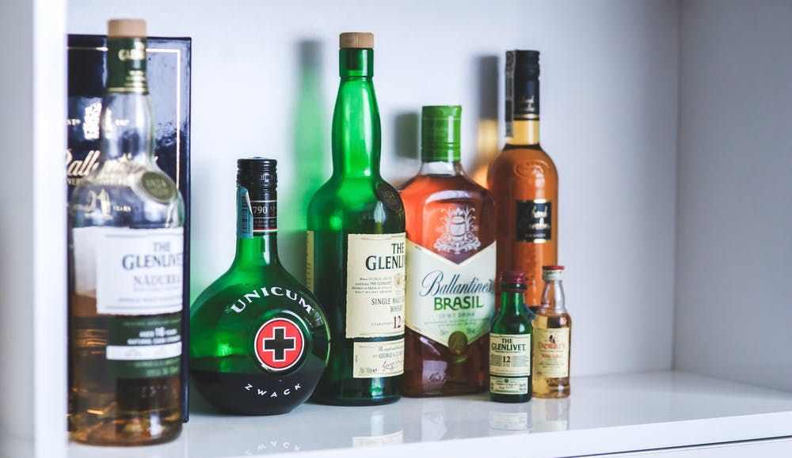
Being Filled with the Holy Spirit
Other kinds of spirits…

Slide 5

Being Filled with the Holy Spirit
Science shows drunk people have no idea how wasted they are.

Slide 6
Being Filled with the Holy Spirit
Just ask those who live with drunks.

Slide 7
Being Filled with the Holy Spirit
Ephesians 5:18—¹⁸And do not get drunk with wine, for that is dissipation, but be filled with the Spirit, (NASB95)

Slide 8
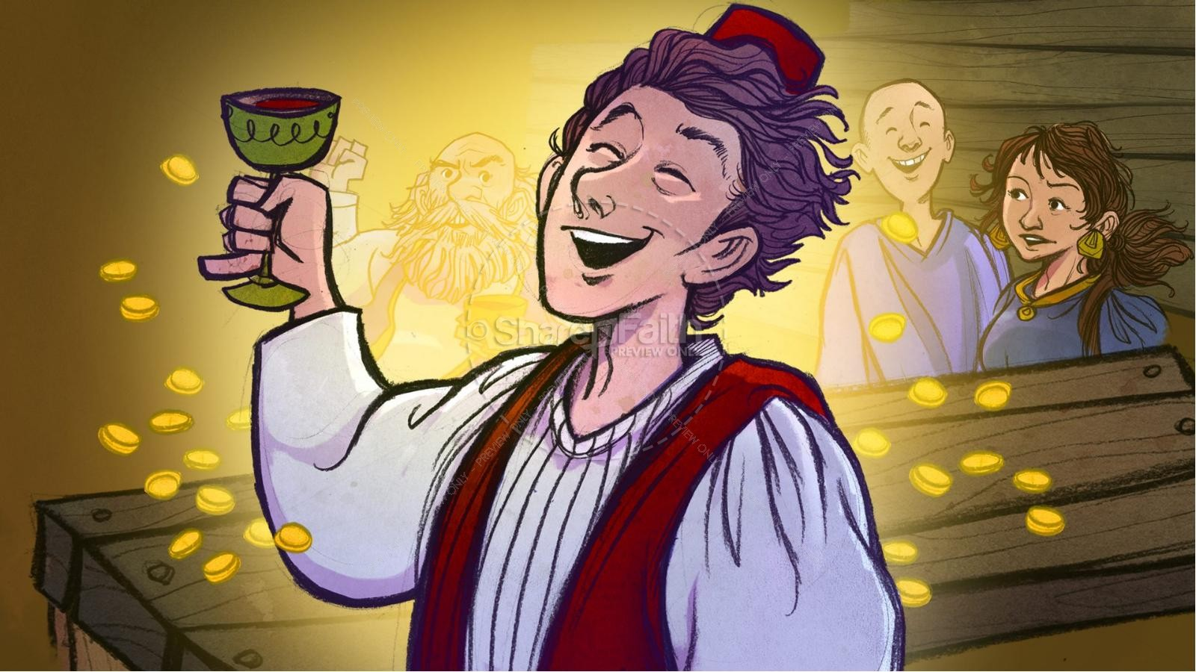
Being Filled with the Holy Spirit
The Prodigal Son
(Luke 15:11-32).

Slide 9
Being Filled with the Holy Spirit
The “spirit” of:
Freedom.
Good times.
Lifted spirits.
Joy.
Companionship.
Fun.
Forgotten sorrows.
The Prodigal Son
(Luke 15:11-32).

Slide 10
Being Filled with the Holy Spirit
The “spirit” of:
Freedom.
Good times.
Lifted spirits.
Joy.
Companionship.
Fun.
Forgotten sorrows.
The Prodigal Son
(Luke 15:11-32).

Slide 11
Being Filled with the Holy Spirit
The “spirit” of:
Freedom.
Good times.
Lifted spirits.
Joy.
Companionship.
Fun.
Forgotten sorrows.
The Prodigal Son
(Luke 15:11-32).

Slide 12
Being Filled with the Holy Spirit
The “spirit” of:
Freedom.
Good times.
Lifted spirits.
Joy.
Companionship.
Fun.
Forgotten sorrows.
The Prodigal Son
(Luke 15:11-32).

Slide 13
Being Filled with the Holy Spirit
The “spirit” of:
Freedom.
Good times.
Lifted spirits.
Joy.
Companionship.
Fun.
Forgotten sorrows.
The Prodigal Son
(Luke 15:11-32).

Slide 14
Being Filled with the Holy Spirit
The “spirit” of:
Freedom.
Good times.
Lifted spirits.
Joy.
Companionship.
Fun.
Forgotten sorrows.
The Prodigal Son
(Luke 15:11-32).

Slide 15
Being Filled with the Holy Spirit
The “spirit” of:
Freedom.
Good times.
Lifted spirits.
Joy.
Companionship.
Fun.
Forgotten sorrows.
The Prodigal Son
(Luke 15:11-32).

Slide 16
Being Filled with the Holy Spirit
The “spirit” of:
Freedom.
Good times.
Lifted spirits.
Joy.
Companionship.
Fun.
Forgotten sorrows.
The Prodigal Son
(Luke 15:11-32).

Slide 17
Being Filled with the Holy Spirit
The “spirit” of:
Freedom.
Good times.
Lifted spirits.
Joy.
Companionship.
Fun.
Forgotten sorrows.
Finally uninhibited.
The Prodigal Son
(Luke 15:11-32).

Slide 18
Being Filled with the Holy Spirit
UNTIL…
The Prodigal Son
(Luke 15:11-32).

Slide 19
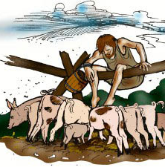
Being Filled with the Holy Spirit
Reality of a “Wasted” Soul:
No freedom.
Bad times.
Depressed.
Joyless.
Dishonoured.
Hungry.
Lonely.
Broken relationships.
The Prodigal Son
(Luke 15:11-32).

Slide 20
Being Filled with the Holy Spirit
Reality of a “Wasted” Soul:
No freedom.
Bad times.
Depressed.
Joyless.
Dishonoured.
Hungry.
Lonely.
Broken relationships.
The Prodigal Son
(Luke 15:11-32).

Slide 21
Being Filled with the Holy Spirit
Reality of a “Wasted” Soul:
No freedom.
Bad times.
Depressed.
Joyless.
Dishonoured.
Hungry.
Lonely.
Broken relationships.
The Prodigal Son
(Luke 15:11-32).

Slide 22
Being Filled with the Holy Spirit
Reality of a “Wasted” Soul:
No freedom.
Bad times.
Depressed.
Joyless.
Dishonoured.
Hungry.
Lonely.
Broken relationships.
The Prodigal Son
(Luke 15:11-32).

Slide 23
Being Filled with the Holy Spirit
Reality of a “Wasted” Soul:
No freedom.
Bad times.
Depressed.
Joyless.
Dishonoured.
Hungry.
Lonely.
Broken relationships.
The Prodigal Son
(Luke 15:11-32).

Slide 24
Being Filled with the Holy Spirit
Reality of a “Wasted” Soul:
No freedom.
Bad times.
Depressed.
Joyless.
Dishonoured.
Hungry.
Lonely.
Broken relationships.
The Prodigal Son
(Luke 15:11-32).

Slide 25
Being Filled with the Holy Spirit
Reality of a “Wasted” Soul:
No freedom.
Bad times.
Depressed.
Joyless.
Dishonoured.
Hungry.
Lonely.
Broken relationships.
The Prodigal Son
(Luke 15:11-32).

Slide 26
Being Filled with the Holy Spirit
Reality of a “Wasted” Soul:
No freedom.
Bad times.
Depressed.
Joyless.
Dishonoured.
Hungry.
Lonely.
Broken relationships.
The Prodigal Son
(Luke 15:11-32).

Slide 27
Being Filled with the Holy Spirit
Reality of a “Wasted” Soul:
No freedom.
Bad times.
Depressed.
Joyless.
Dishonoured.
Hungry.
Lonely.
Broken relationships.
The Prodigal Son
(Luke 15:11-32).

Slide 28
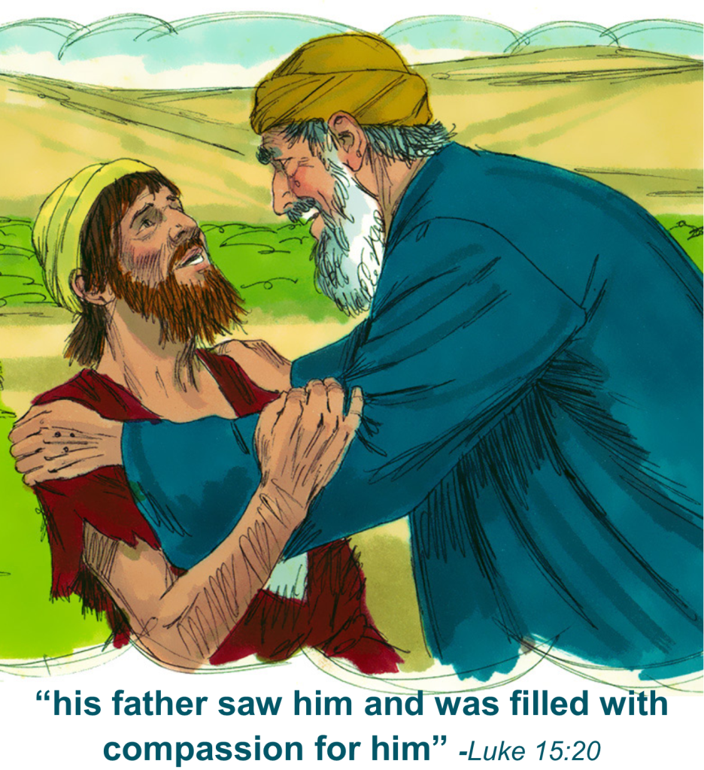
Being Filled with the Holy Spirit
Home with God:
“…filled with the Holy Spirit.”
Enriched.
Honoured.
Feed.
Family.
Reconciliation…
The Prodigal Son
(Luke 15:11-32).

Slide 29
Being Filled with the Holy Spirit
Home with God:
“…filled with the Holy Spirit.”
Enriched.
Honoured.
Feed.
Family.
Reconciliation…
The Prodigal Son
(Luke 15:11-32).

Slide 30
Being Filled with the Holy Spirit
Home with God:
“…filled with the Holy Spirit.”
Enriched.
Honoured.
Feed.
Family.
Reconciliation…
The Prodigal Son
(Luke 15:11-32).

Slide 31
Being Filled with the Holy Spirit
Home with God:
“…filled with the Holy Spirit.”
Enriched.
Honoured.
Feed.
Family.
Reconciliation…
The Prodigal Son
(Luke 15:11-32).

Slide 32
Being Filled with the Holy Spirit
Home with God:
“…filled with the Holy Spirit.”
Enriched.
Honoured.
Feed.
Family.
Reconciliation…
The Prodigal Son
(Luke 15:11-32).

Slide 33
Being Filled with the Holy Spirit
Home with God:
“…filled with the Holy Spirit.”
Enriched.
Honoured.
Feed.
Family.
Reconciliation…
The Prodigal Son
(Luke 15:11-32).

Slide 34
Being Filled with the Holy Spirit
Home with God:
“…filled with the Holy Spirit.”
Enriched.
Honoured.
Feed.
Family.
Reconciliation…
The Prodigal Son
(Luke 15:11-32).

Slide 35
Being Filled with the Holy Spirit
Home with God:
“…filled with the Holy Spirit.”
Lifted spirits.
Joy.
Companionship.
Fun.
No more sorrows.
Freedom.
Security.
The Prodigal Son
(Luke 15:11-32).

Slide 36
Being Filled with the Holy Spirit
Home with God:
“…filled with the Holy Spirit.”
Lifted spirits.
Joy.
Companionship.
Fun.
No more sorrows.
Freedom.
Security.
The Prodigal Son
(Luke 15:11-32).

Slide 37
Being Filled with the Holy Spirit
Home with God:
“…filled with the Holy Spirit.”
Lifted spirits.
Joy.
Companionship.
Fun.
No more sorrows.
Freedom.
Security.
The Prodigal Son
(Luke 15:11-32).

Slide 38
Being Filled with the Holy Spirit
Home with God:
“…filled with the Holy Spirit.”
Lifted spirits.
Joy.
Companionship.
Fun.
No more sorrows.
Freedom.
Security.
The Prodigal Son
(Luke 15:11-32).

Slide 39
Being Filled with the Holy Spirit
Home with God:
“…filled with the Holy Spirit.”
Lifted spirits.
Joy.
Companionship.
Fun.
Freedom.
Security.
The Prodigal Son
(Luke 15:11-32).

Slide 40
Being Filled with the Holy Spirit
Home with God:
“…filled with the Holy Spirit.”
Lifted spirits.
Joy.
Companionship.
Fun.
Freedom.
Security.
The Prodigal Son
(Luke 15:11-32).

Slide 41

Being Filled with the Holy Spirit
Ephesians 5:18-20—
¹⁸And do not get drunk with wine, for that is dissipation, but be filled with the Spirit, (NASB95)
Dissipation
leads to
disintegration.

Slide 42
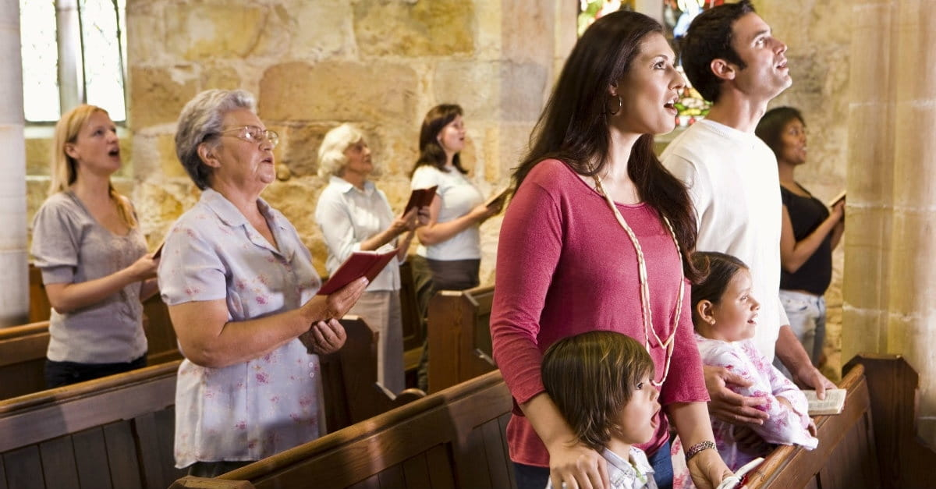
Being Filled with the Holy Spirit
Ephesians 5:18-20—
¹⁹speaking to one another in psalms and hymns and spiritual songs, singing and making melody with your heart to the Lord; (NASB95)
The Holy Spirit
leads to
Integration,
education,
And…

Slide 43

Being Filled with the Holy Spirit
Ephesians 5:18-20—
²⁰always giving thanks for all things in the name of our Lord Jesus Christ to God, even the Father; (NASB95)
The Holy Spirit
leads to
Celebration.

Slide 44
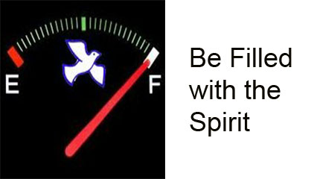
Being Filled with the Holy Spirit
Ephesians 5:18

Slide 45
Being Filled with the Holy Spirit
Not
WAIT
Ephesians 5:18

Slide 46
Being Filled with the Holy Spirit
Not
WAIT
But
WORK
Ephesians 5:18

Slide 47
Being Filled with the Holy Spirit
Not
WAIT
But
WORK
at being
Filled with the
Holy Spirit
Ephesians 5:18

Slide 48
Being Filled with the Holy Spirit
Not
WAIT
But
WORK
at being
Filled with the
Holy Spirit
"We are
commanded to be
filled with the Holy
Spirit.

Slide 49
Being Filled with the Holy Spirit
Not
WAIT
But
WORK
at being
Filled with the
Holy Spirit
"We are
commanded to be
filled with the Holy
Spirit.
There is no passivity
in being filled with
the Spirit.

Slide 50
Being Filled with the Holy Spirit
Not
WAIT
But
WORK
at being
Filled with the
Holy Spirit
"We are
commanded to be
filled with the Holy
Spirit.
There is no passivity
in being filled with
the Spirit.
The Spirit's control is
not automatic

Slide 51
Being Filled with the Holy Spirit
Not
WAIT
But
WORK
at being
Filled with the
Holy Spirit
"We are
commanded to be
filled with the Holy
Spirit.
There is no passivity
in being filled with
the Spirit.
The Spirit's control is
not automatic
but voluntary,
conceded
and invited."
(J. Oswald Sanders)

Slide 52

Being Filled with the Holy Spirit
Hebrews 5:12-14—
¹² For though by this time you ought to be teachers, you have need again for someone to teach you the elementary principles of the oracles of God, and you have come to need milk and not solid food. (NASB95)

Slide 53
Being Filled with the Holy Spirit
Hebrews 5:12-14—
¹³For everyone who partakes only of milk is not accustomed to the word of righteousness, for he is an infant. (NASB95)

Slide 54
Being Filled with the Holy Spirit
Hebrews 5:12-14—
¹⁴But solid food is for the mature, who because of practice have their senses trained to discern good and evil. (NASB95)

Slide 55

Acts 22:16—
Now why do you delay? Get up and be baptized, and wash away your sins, calling on His name.’

