Slide 1
Series: What on Earth…
Part 5. “Is the Church?”
John Staiger
Morningside Church of Christ
Sunday 12 December 2021
AM Sermon
Broadcast live from 42 Leslie Ave, Auckland, Aotearoa/NZ.

Slide 2
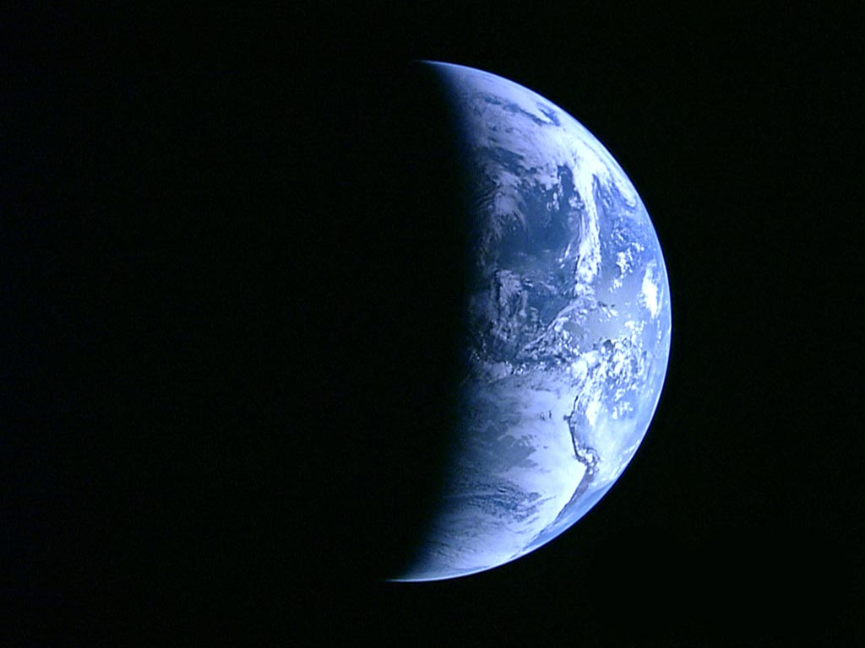
Series: What on Earth……
Part 5.
Is the Church?

Slide 3
What on Earth is the Church?”
Churches—There are a lot of them around…

Slide 4
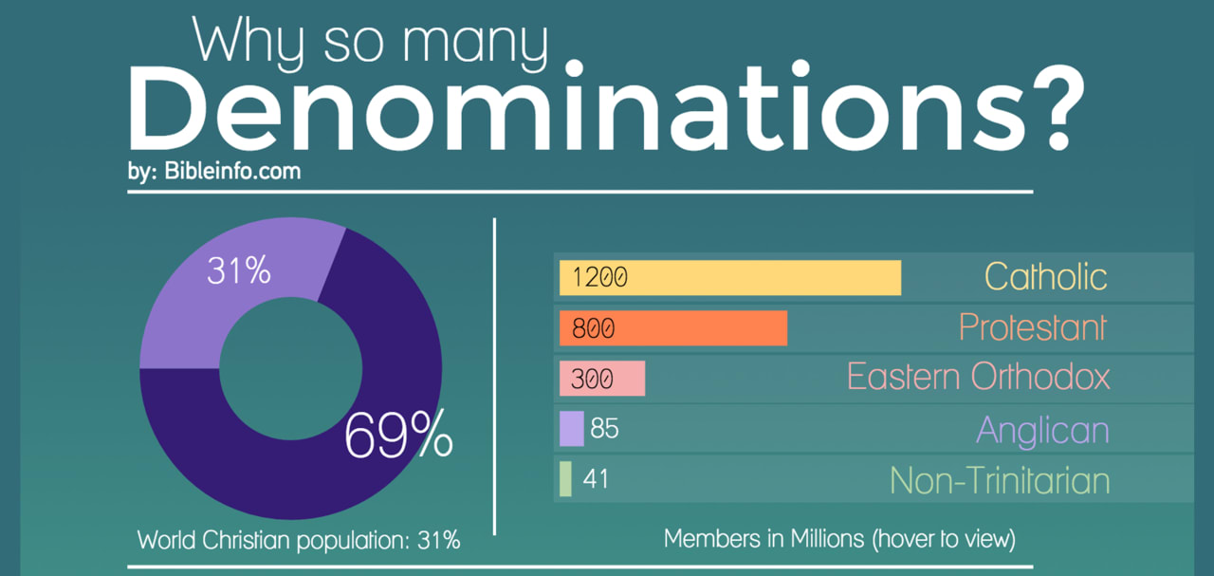
What on Earth is the Church?”
Churches—There are a lot of them around…

Slide 5
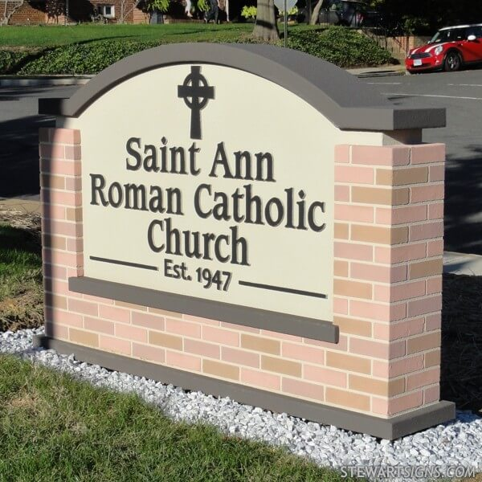
What on Earth is the Church?”
Churches—There are a lot of them around…

Slide 6
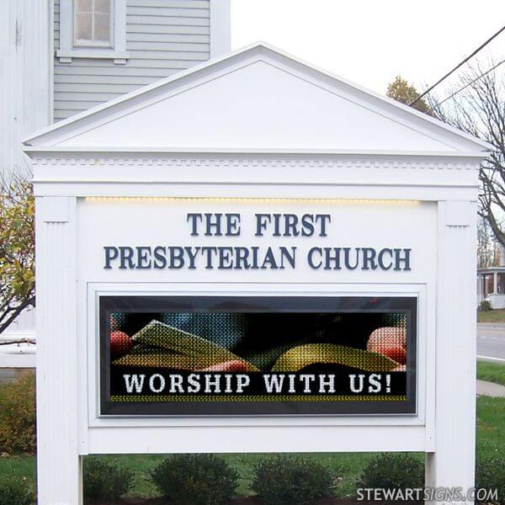
What on Earth is the Church?”
Churches—There are a lot of them around…

Slide 7
What on Earth is the Church?”
Churches—There are a lot of them around…

Slide 8

What on Earth is the Church?”
Churches—There are a lot of them around…

Slide 9
What on Earth is the Church?”
Churches—There are a lot of them around…

Slide 10
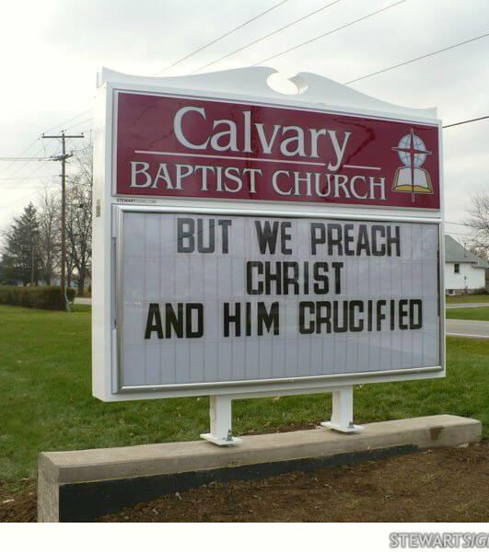
What on Earth is the Church?”
Churches—There are a lot of them around…

Slide 11
What on Earth is the Church?”
Churches—There are a lot of them around…

Slide 12
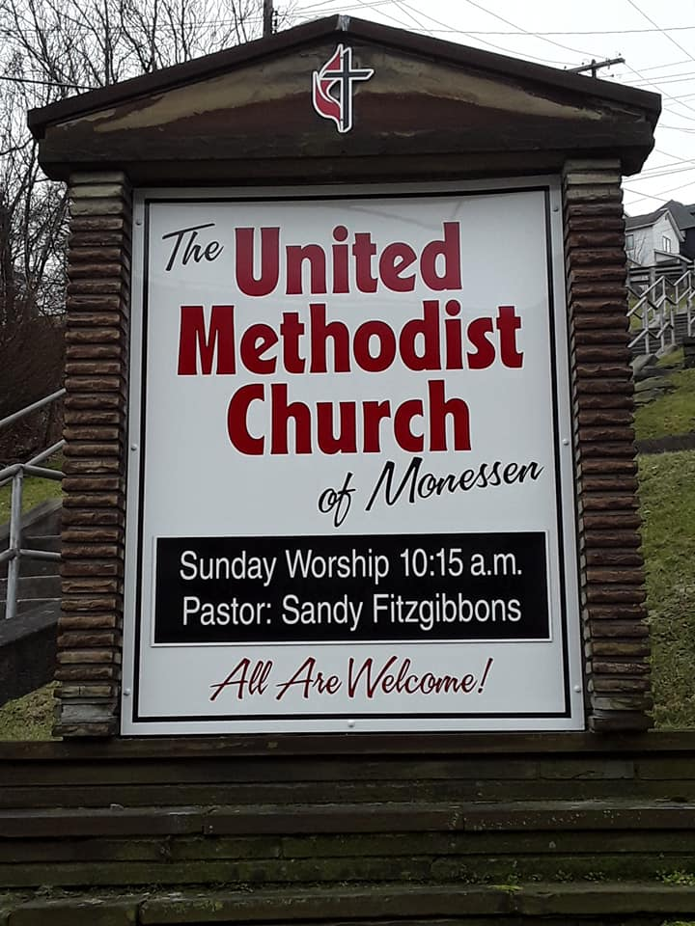
What on Earth is the Church?”
Churches—There are a lot of them around…

Slide 13
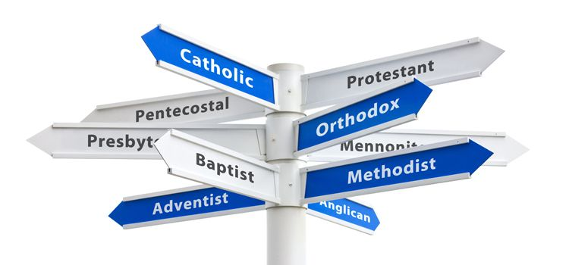
What on Earth is the Church?”
Churches—There are a lot of them around.
And hundreds more…

Slide 14

What on Earth is the Church?”

Slide 15
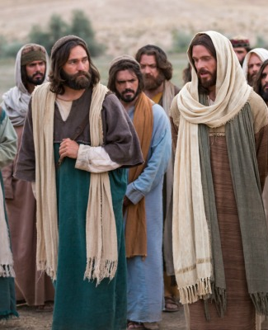
What on Earth is the Church?”
Jesus Built:
Matthew 16:18—
¹⁸I also say to you that you are ^{[a]}Peter, and upon this ^{[b]}rock I will build My church; and the gates of Hades will not overpower it. (NASB95)
[a]Gr Petros, a stone
[b] Gr petra, large rock; bed-rock

Slide 16

What on Earth is the Church?”
Jesus Built:
Matthew 16:18—
¹⁸ …you are:
Peter: “Petros—A stone”
and upon this
Rock: “Petra—A Bedrock.”
I will build My church; and the gates of Hades will not overpower it. (NASB95)

Slide 17
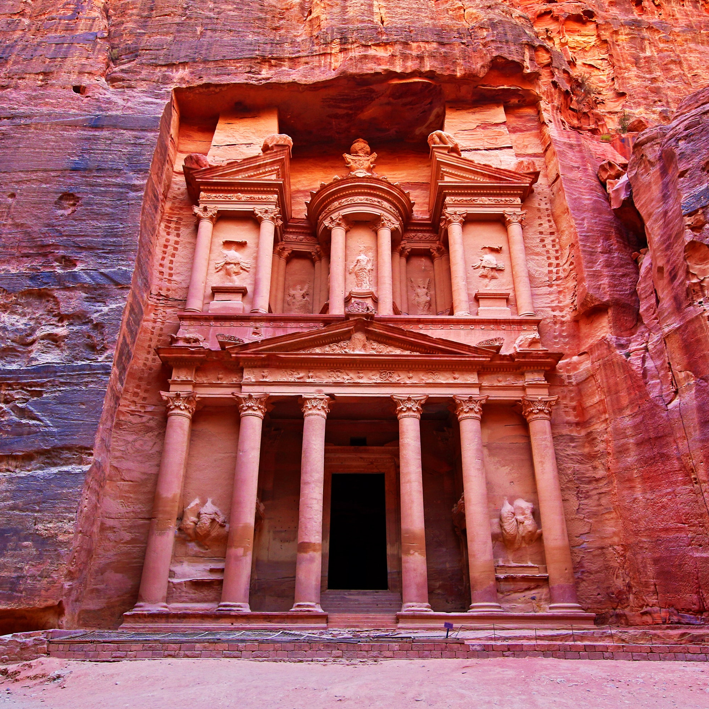
What on Earth is the Church?”
Jesus Built:
Matthew 16:18—
¹⁸ …you are:
Peter: “Petros—A stone”
and upon this
Rock: “Petra—A Bedrock.”
I will build My church; and the gates of Hades will not overpower it. (NASB95)

Slide 18
What on Earth is the Church?”
Jesus Built:
Matthew 16:18—
¹⁸ …you are:
Peter: “Petros—A stone”
and upon this
Rock: “Petra—A Bedrock.”
I will build My church; and the gates of Hades will not overpower it. (NASB95)

Slide 19
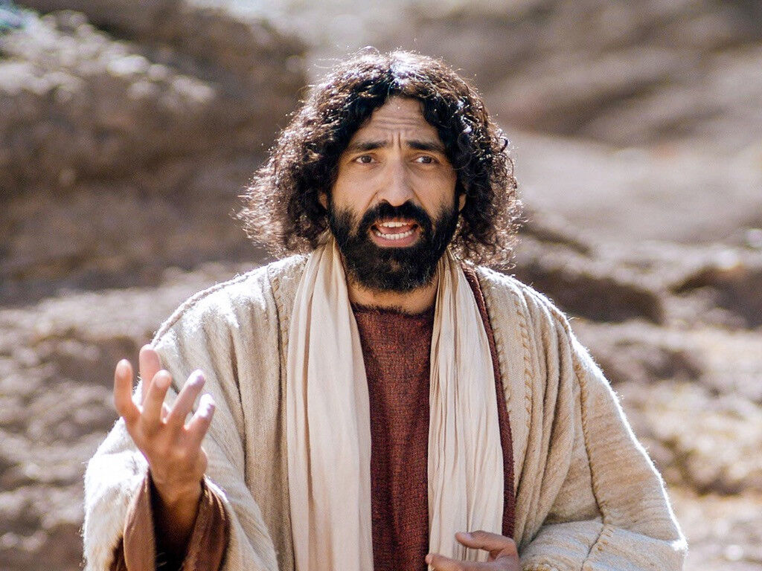
What on Earth is the Church?”
Jesus Built:
The “Petra” being Peter’s confession:

Slide 20
What on Earth is the Church?”
Jesus Built:
The “Petra” being Peter’s confession:
Matthew 16:16—
¹⁶Simon Peter answered, “You are the Christ, the Son of the living God.” (NASB95)

Slide 21
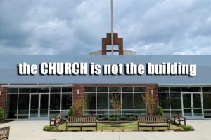
What on Earth is the Church?”
Jesus Built:
Ekklesia
(or ecclesia)
is the Greek word
translated in the
New Testament as
"church."

Slide 22

What on Earth is the Church?”
Jesus Built:
It comes from
ek,
meaning
"out from and to"
and
kaleo,
meaning
"to call."

Slide 23
What on Earth is the Church?”
Jesus Built:
It has to do with a
group of people
called out
from one place
to another.
It is an assembly
or a
congregation.

Slide 24
What on Earth is the Church?”
Jesus Built:
The ekklesia
in the
New Testament
is a group of people
who have been
called out
of the world
and to God;
it is the church.

Slide 25
What on Earth is the Church?”
Jesus Built:
1 Timothy 3:15—
¹⁵but in case I am delayed, I write so that you will know how one ought to conduct himself in the household of God, which is the church of the living God, the pillar and support of the truth. (NASB95)

Slide 26


What on Earth is the Church?”
Jesus Built:
1 Timothy 3:15—
¹⁵but in case I am delayed, I write so that you will know how one ought to conduct himself in the household of God, which is the church of the living God, the pillar and support of the truth. (NASB95)

Slide 27
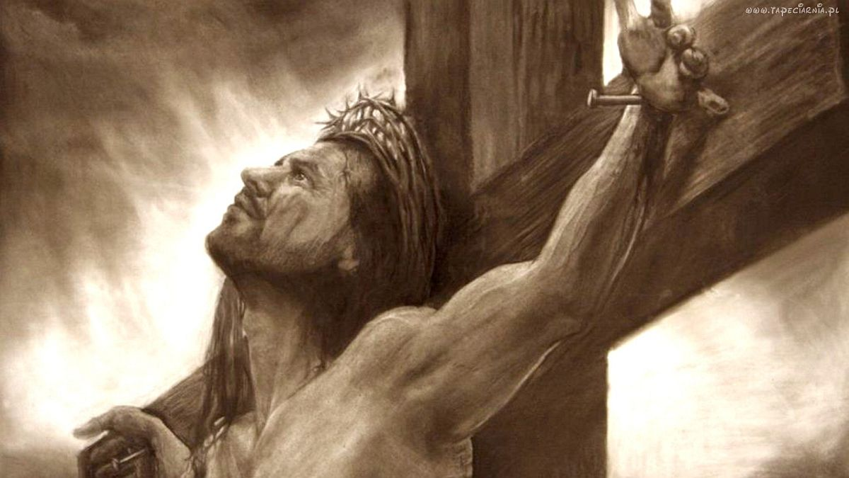
What on Earth is the Church?”
Jesus Built:
1 Timothy 3:15—
¹⁵but in case I am delayed, I write so that you will know how one ought to conduct himself in the household of God, which is the church of the living God, the pillar and support of the truth. (NASB95)

Slide 28

What on Earth is the Church?”
The Function of the Church:
Acts 2:42—
⁴²They were continually devoting themselves to the…

Slide 29

What on Earth is the Church?”
The Function of the Church:
Acts 2:42—
⁴²They were continually devoting themselves to the apostles’ teaching…

Slide 30
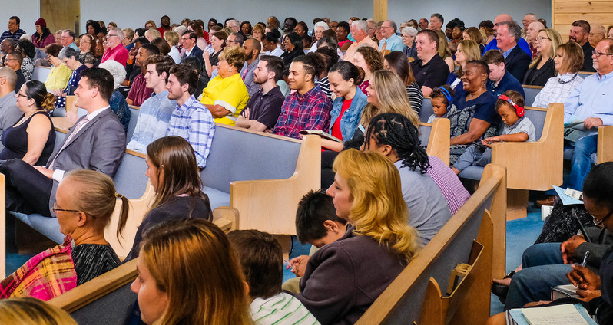
What on Earth is the Church?”
The Function of the Church:
Acts 2:42—
⁴²They were continually devoting themselves to the apostles’ teaching and to fellowship,… to the breaking of bread and to prayer. (NASB95)

Slide 31

What on Earth is the Church?”
The Function of the Church:
Acts 2:42—
⁴²They were continually devoting themselves to the apostles’ teaching and to fellowship, to the breaking of bread…

Slide 32

What on Earth is the Church?”
The Function of the Church:
Acts 2:42—
⁴²They were continually devoting themselves to the apostles’ teaching and to fellowship, to the breaking of bread and to prayer. (NASB95)

Slide 33
What on Earth is the Church?”
A great place to be:
A home for the wanderer.
A harbour of peace for the burdened.
She lifts our thoughts beyond the stars.
Leads us away from the troubles of time into the consciousness of eternity.
She is heaven on earth—a foretaste of glory divine.
Her mission is not to buy or sell but to deliver a message of salvation to the lost and assurance of an eternal home to the saved.

Slide 34
What on Earth is the Church?”
A great place to be:
The church is a place of rest for the weary.
A home for the wanderer.
A harbour of peace for the burdened.
She lifts our thoughts beyond the stars.
Leads us away from the troubles of time into the consciousness of eternity.
She is heaven on earth—a foretaste of glory divine.
Her mission is not to buy or sell but to deliver a message of salvation to the lost and assurance of an eternal home to the saved.

Slide 35
What on Earth is the Church?”
A great place to be:
The church is a place of rest for the weary.
A home for the wanderer.
A harbour of peace for the burdened.
She lifts our thoughts beyond the stars.
Leads us away from the troubles of time into the consciousness of eternity.
She is heaven on earth—a foretaste of glory divine.
Her mission is not to buy or sell but to deliver a message of salvation to the lost and assurance of an eternal home to the saved.

Slide 36
What on Earth is the Church?”
A great place to be:
The church is a place of rest for the weary.
A home for the wanderer.
A harbour of peace for the burdened.
She lifts our thoughts beyond the stars.
Leads us away from the troubles of time into the consciousness of eternity.
She is heaven on earth—a foretaste of glory divine.
Her mission is not to buy or sell but to deliver a message of salvation to the lost and assurance of an eternal home to the saved.

Slide 37
What on Earth is the Church?”
A great place to be:
The church is a place of rest for the weary.
A home for the wanderer.
A harbour of peace for the burdened.
She lifts our thoughts beyond the stars.
Leads us away from the troubles of time into the consciousness of eternity.
She is heaven on earth—a foretaste of glory divine.
Her mission is not to buy or sell but to deliver a message of salvation to the lost and assurance of an eternal home to the saved.

Slide 38
What on Earth is the Church?”
A great place to be:
The church is a place of rest for the weary.
A home for the wanderer.
A harbour of peace for the burdened.
She lifts our thoughts beyond the stars.
Leads us away from the troubles of time into the consciousness of eternity.
She is heaven on earth—a foretaste of glory divine.
Her mission is not to buy or sell but to deliver a message of salvation to the lost and assurance of an eternal home to the saved.

Slide 39
What on Earth is the Church?”
A great place to be:
The church is a place of rest for the weary.
A home for the wanderer.
A harbour of peace for the burdened.
She lifts our thoughts beyond the stars.
Leads us away from the troubles of time into the consciousness of eternity.
She is heaven on earth—a foretaste of glory divine.
Her mission is not to buy or sell but to deliver a message of salvation to the lost and assurance of an eternal home to the saved.

Slide 40
What on Earth is the Church?”
A great place to be:
The church is a place of rest for the weary.
A home for the wanderer.
A harbour of peace for the burdened.
She lifts our thoughts beyond the stars.
Leads us away from the troubles of time into the consciousness of eternity.
She is heaven on earth—a foretaste of glory divine.
Her mission is not to buy or sell but to deliver a message of salvation to the lost and assurance of an eternal home to the saved.

Slide 41

What on Earth is the Church?”
The True Church:
2 Timothy 2:19—
¹⁹Nevertheless, the firm foundation of God stands, having this seal, “The Lord knows those who are His,” and, “Everyone who names the name of the Lord is to abstain from wickedness.” (NASB95)

Slide 42

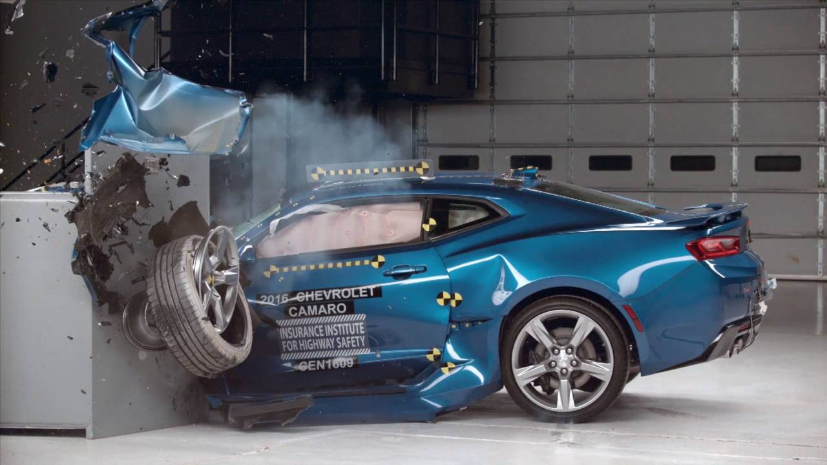
What on Earth is the Church?”
Is Christ in you?
2 Corinthians 13:5—
⁵Test yourselves to see if you are in the faith; examine yourselves! Or do you not recognize this about yourselves, that Jesus Christ is in you—unless indeed you fail the test? (NASB95)

Slide 43

Acts 2:41—
⁴¹So then, those who had received his word were baptized; and that day there were added about three thousand souls. (NASB95)

