Slide 1
Series: What on Earth…
Part 6. “Is Sanctification?”
John Staiger
Morningside Church of Christ
Sunday 19 December 2021
AM Sermon
Broadcast live from 42 Leslie Ave, Auckland, Aotearoa/NZ.

Slide 2
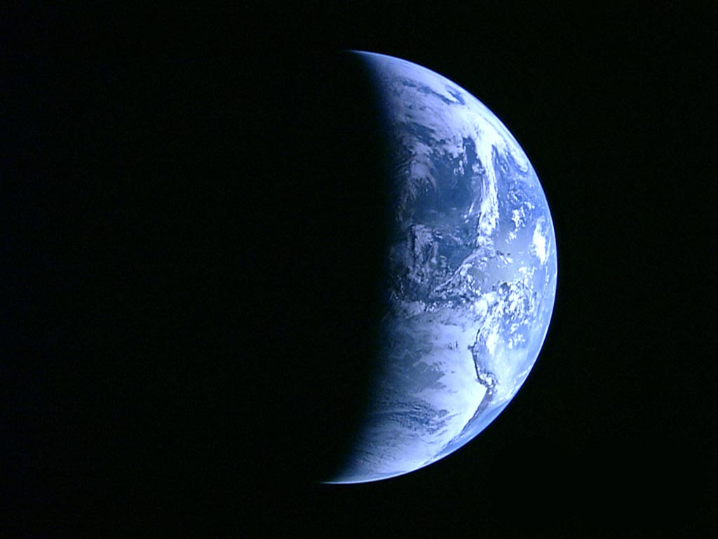
Series: What on Earth……
Part 6.
is Sanctification?

Slide 3
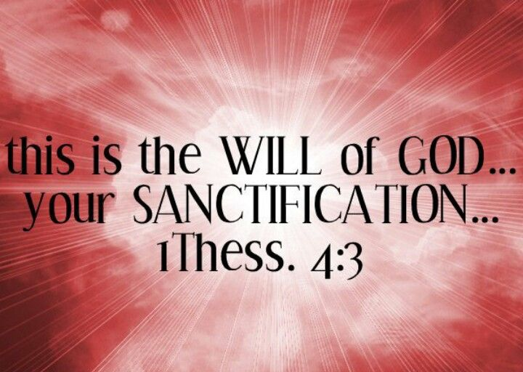
What on Earth is Sanctification?”

Slide 4

What on Earth is Sanctification?”

Slide 5
What on Earth is Sanctification?”
It is like the old fellow who was a drinker, a carouser, a liar and a user, but was soundly converted and he characterized his progress by saying,…

Slide 6
What on Earth is Sanctification?”
It is sort of like the old fellow who was a drinker, a carouser, a liar and a user, but was soundly converted and he characterized his progress by saying,
“I ain’t what I oughter be –

Slide 7
What on Earth is Sanctification?”
It is sort of like the old fellow who was a drinker, a carouser, a liar and a user, but was soundly converted and he characterized his progress by saying,
“I ain’t what I oughter be –
and I ain’t what I’m gonner be –

Slide 8
What on Earth is Sanctification?”
It is sort of like the old fellow who was a drinker, a carouser, a liar and a user, but was soundly converted and he characterized his progress by saying,
“I ain’t what I oughter be –
and I ain’t what I’m gonner be –
but thank the Lord I ain’t what I useter be neither!”

Slide 9
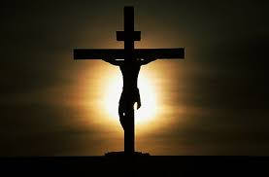
The ultimate sanctification of every believer in Christ is a covenant of mercy purchased on the cross.
Jesus saved us from the penalty of sin...
What on Earth is Sanctification?”

Slide 10
What on Earth is Sanctification?”
Sanctification is a once-for-ever separation of believers unto God.
It is a work God performs.
Hebrews 10:10…

Slide 11
What on Earth is Sanctification?”
Hebrews 10:10—
¹⁰By this will we have been sanctified through the offering of the body of Jesus Christ once for all. (NASB95)

Slide 12
What on Earth is Sanctification?”
1 Corinthians 1:30—
³⁰But by His doing you are in Christ Jesus, who became to us wisdom from God, and righteousness and sanctification, and redemption, (NASB95)

Slide 13
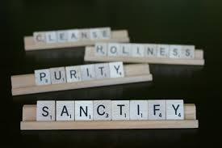
What on Earth is Sanctification?”
The word sanctification is related to the word saint.
Both words have to do with holiness.
To “sanctify” something is to set it apart for special use;
To “sanctify” a person is to make him holy.

Slide 14
What on Earth is Sanctification?”
The Greek word for sanctification is:
"hagiasmos"
meaning
"separation
or
setting apart."
Separation from the
secular and sinful
and
setting apart
for a sacred purpose.

Slide 15
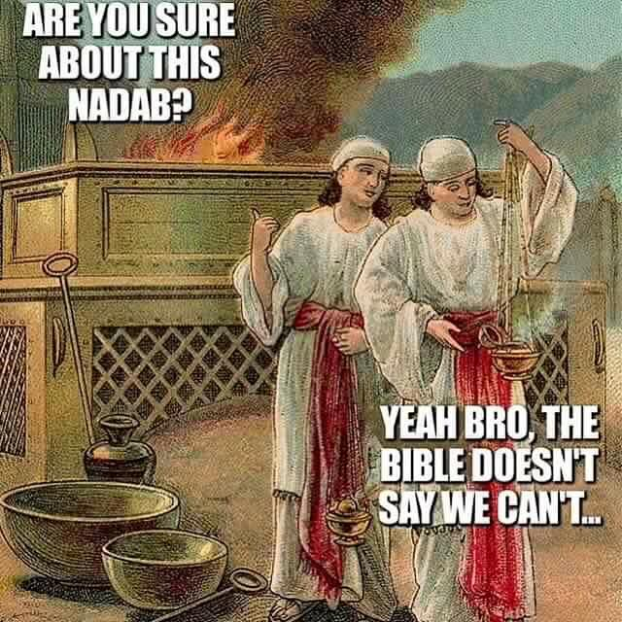
What on Earth is Sanctification?”
Nadab and Abihu (Leviticus 10:1-11).
Everything was Sanctified
Tribe—Levites
Priesthood—Aaronic
Tabernacle
Sacrifices
Clothes
Food
Fire

Slide 16

What on Earth is Sanctification?”
2 Corinthians 4:16—
"Therefore we do not lose heart. Though outwardly we are wasting away, yet inwardly we are being renewed day by day."

Slide 17
What on Earth is Sanctification?”
Colossians 3:9-10—
“…since you laid aside the old self with its evil practices, ¹⁰and have put on the new self who is being renewed to a true knowledge according to the image of the One who created him—

Slide 18
What on Earth is Sanctification?”
1 John 2:5-6—
⁵but whoever keeps His word, in him the love of God has truly been perfected. By this we know that we are in Him: ⁶the one who says he abides in Him ought himself to walk in the same manner as He walked. (NASB95)

Slide 19
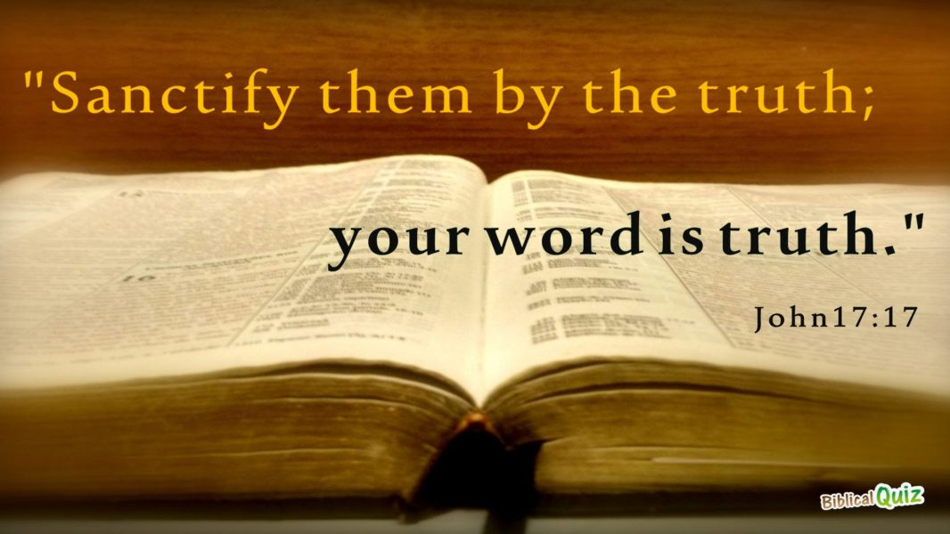
What on Earth is Sanctification?”

Slide 20
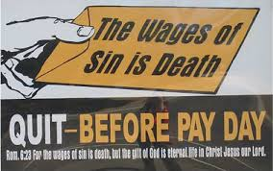
What on Earth is Sanctification?”

Slide 21

Acts 2:41—
⁴¹So then, those who had received his word were baptized; and that day there were added about three thousand souls. (NASB95)

Slide 22
1 Peter 1:2
²according to the foreknowledge of God the Father, by the sanctifying work of the Spirit… (NASB95)

