Slide 1
Series: The Word of God (Part 1.).
“Living and Active!”
John Staiger
Morningside Church of Christ
Sunday 12 December 2021
PM Sermon
Broadcast from 42 Leslie Avenue, Auckland, Aotearoa/NZ.
www.morningsidechurchofchrist.org.nz

Slide 2
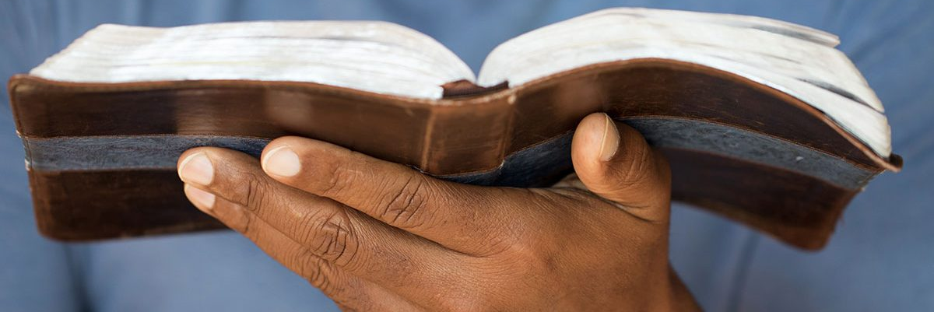
Word of God—Living and Active!
Hebrews 4:12—
¹²For the word of God is living and active and sharper than any two-edged sword, and piercing as far as the division of soul and spirit, of both joints and marrow, and able to judge the thoughts and intentions of the heart. (NASB95)

Slide 3
Word of God—Living and Active!
The Word of God
God’s specific revelation.
Our primary exposure is through His written Word, the Bible.
It is alive and active—it not only lives but works.

Slide 4
Word of God—Living and Active!
The Word of God
God’s specific revelation.
Our primary exposure is through His written Word, the Bible.
It is alive and active—it not only lives but works.

Slide 5
Word of God—Living and Active!
The Word of God
God’s specific revelation.
Our primary exposure is through His written Word, the Bible.
It is alive and active—it not only lives but works.

Slide 6
Word of God—Living and Active!
The Word of God
God’s specific revelation.
Our primary exposure is through His written Word, the Bible.
It is alive and active—it not only lives but works.

Slide 7
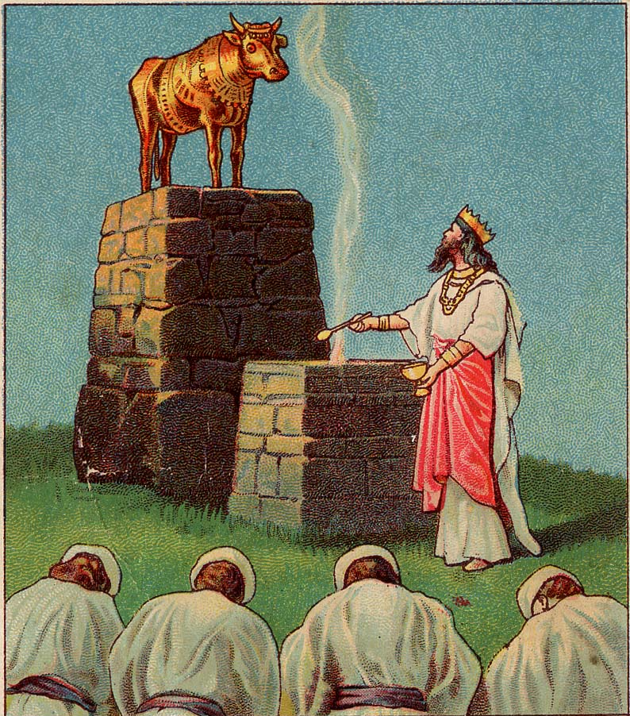
Word of God—Living and Active!
The Word of God is alive because God is a living God.

Slide 8
Word of God—Living and Active!
Hebrews 3:12—
¹²Take care, brethren, that there not be in any one of you an evil, unbelieving heart that falls away from the living God. (NASB95)
The Word of God is alive because God is a living God.

Slide 9
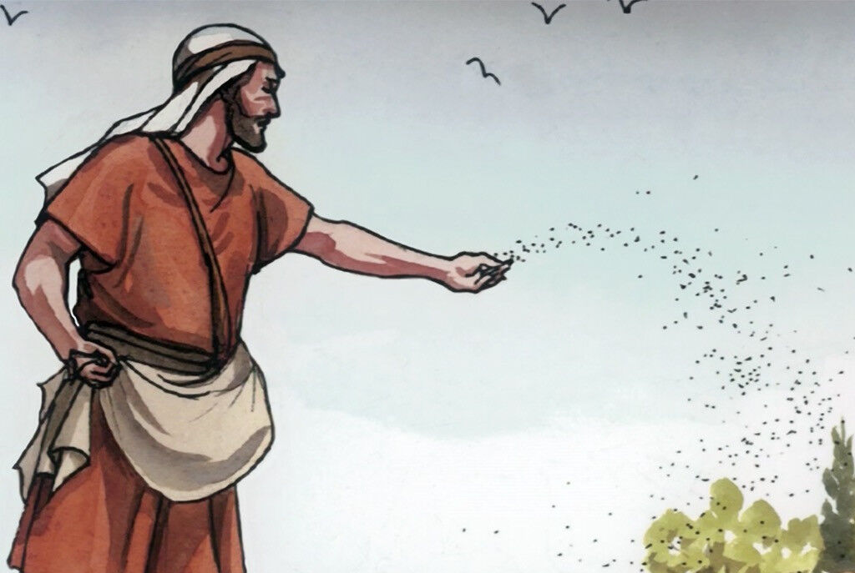
Word of God—Living and Active!
“Parable of the Sower.”

Slide 10
Word of God—Living and Active!
“Parable of the Sower.”
Jesus compared God’s Word to seed (Mt.13:1–23).

Slide 11
Word of God—Living and Active!
“Parable of the Sower.”
Jesus compared God’s Word to seed (Mt.13:1–23).
Seed, like the Word, is a living organism.

Slide 12
Word of God—Living and Active!
“Parable of the Sower.”
Jesus compared God’s Word to seed (Mt.13:1–23).
Seed, like the Word, is a living organism.
When spread and planted in fertile soil, produces abundant life.

Slide 13
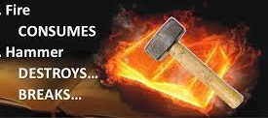
Word of God—Living and Active!
Delivers warnings:

Slide 14
Word of God—Living and Active!
Delivers warnings:
Brings judgment and punishment to the disobedient:

Slide 15
Word of God—Living and Active!
Delivers warnings:
Brings judgment and punishment to the disobedient:
Jeremiah 23:29—²⁹“Is not My word like fire?” declares the Lord, “and like a hammer which shatters a rock? (NASB95)

Slide 16
Word of God—Living and Active!
It is not static or idle in the lives of believers:
1 Thessalonians 2:13—
¹³For this reason we also constantly thank
God that when you received
the word of God
which you heard from us,
you accepted it not as the word of men,
but for what it really is,
the word of God,
which also performs its work in you who believe. (NASB95)
Active:
It is…
Effective
Powerful
Producing an intended result
It makes you…
Vibrant
Dynamic
Energized
Productive

Slide 17
Word of God—Living and Active!
It is not static or idle in the lives of believers:
1 Thessalonians 2:13—
¹³For this reason we also constantly thank
God that when you received
the word of God
which you heard from us,
you accepted it not as the word of men,
but for what it really is,
the word of God,
which also performs its work in you who believe. (NASB95)
Active:
It is…
Effective
Powerful
Producing an intended result
It makes you…
Vibrant
Dynamic
Energized
Productive

Slide 18
Word of God—Living and Active!
It is not static or idle in the lives of believers:
1 Thessalonians 2:13—
¹³For this reason we also constantly thank
God that when you received
the word of God
which you heard from us,
you accepted it not as the word of men,
but for what it really is,
the word of God,
which also performs its work in you who believe. (NASB95)
Active:
It is…
Effective
Powerful
Producing an intended result
It makes you…
Vibrant
Dynamic
Energized
Productive

Slide 19
Word of God—Living and Active!
It is not static or idle in the lives of believers:
1 Thessalonians 2:13—
¹³For this reason we also constantly thank
God that when you received
the word of God
which you heard from us,
you accepted it not as the word of men,
but for what it really is,
the word of God,
which also performs its work in you who believe. (NASB95)
Active:
It is…
Effective
Powerful
Producing an intended result
It makes you…
Vibrant
Dynamic
Energized
Productive

Slide 20
Word of God—Living and Active!
It is not static or idle in the lives of believers:
1 Thessalonians 2:13—
¹³For this reason we also constantly thank
God that when you received
the word of God
which you heard from us,
you accepted it not as the word of men,
but for what it really is,
the word of God,
which also performs its work in you who believe. (NASB95)
Active:
It is…
Effective
Powerful
Producing an intended result
It makes you…
Vibrant
Dynamic
Energized
Productive

Slide 21
Word of God—Living and Active!
It is not static or idle in the lives of believers:
1 Thessalonians 2:13—
¹³For this reason we also constantly thank
God that when you received
the word of God
which you heard from us,
you accepted it not as the word of men,
but for what it really is,
the word of God,
which also performs its work in you who believe. (NASB95)
Active:
It is…
Effective
Powerful
Producing an intended result
It makes you…
Vibrant
Dynamic
Energized
Productive

Slide 22
Word of God—Living and Active!
It is not static or idle in the lives of believers:
1 Thessalonians 2:13—
¹³For this reason we also constantly thank
God that when you received
the word of God
which you heard from us,
you accepted it not as the word of men,
but for what it really is,
the word of God,
which also performs its work in you who believe. (NASB95)
Active:
It is…
Effective
Powerful
Producing an intended result
It makes you…
Vibrant
Dynamic
Energized
Productive

Slide 23
Word of God—Living and Active!
It is not static or idle in the lives of believers:
1 Thessalonians 2:13—
¹³For this reason we also constantly thank
God that when you received
the word of God
which you heard from us,
you accepted it not as the word of men,
but for what it really is,
the word of God,
which also performs its work in you who believe. (NASB95)
Active:
It is…
Effective
Powerful
Producing an intended result
It makes you…
Vibrant
Dynamic
Energized
Productive

Slide 24
Word of God—Living and Active!
It is not static or idle in the lives of believers:
1 Thessalonians 2:13—
¹³For this reason we also constantly thank
God that when you received
the word of God
which you heard from us,
you accepted it not as the word of men,
but for what it really is,
the word of God,
which also performs its work in you who believe. (NASB95)
Active:
It is…
Effective
Powerful
Producing an intended result
It makes you…
Vibrant
Dynamic
Energized
Productive

Slide 25
Word of God—Living and Active!
It is not static or idle in the lives of believers:
1 Thessalonians 2:13—
¹³For this reason we also constantly thank
God that when you received
the word of God
which you heard from us,
you accepted it not as the word of men,
but for what it really is,
the word of God,
which also performs its work in you who believe. (NASB95)
Active:
It is…
Effective
Powerful
Producing an intended result
It makes you…
Vibrant
Dynamic
Energized
Productive

Slide 26
Word of God—Living and Active!
It is not static or idle in the lives of believers:
1 Thessalonians 2:13—
¹³For this reason we also constantly thank
God that when you received
the word of God
which you heard from us,
you accepted it not as the word of men,
but for what it really is,
the word of God,
which also performs its work in you who believe. (NASB95)
Active:
It is…
Effective
Powerful
Producing an intended result
It makes you…
Vibrant
Dynamic
Energized
Productive

Slide 27
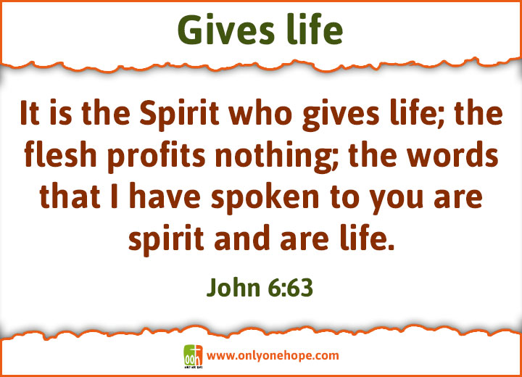
Word of God—Living and Active!

Slide 28
Word of God—Living and Active!
Ephesians 2:4-5—⁴But God, being rich in mercy, because of His great love with which He loved us, ⁵ even when we were dead in our transgressions, made us alive together with Christ (by grace you have been saved),

Slide 29
Word of God—Living and Active!

Slide 30

Word of God—Living and Active!
1 Peter 1:23—
²³for you have been born again not of seed which is perishable but imperishable, that is, through the living and enduring word of God. (NASB95)

Slide 31
Word of God—Living and Active!
1 Peter 1:23—
²³for you have been born again not of seed which is perishable but imperishable, that is, through the living and enduring word of God. (NASB95)
John 3:5—⁵Jesus answered, “Truly, truly, I say to you, unless one is born of water and the Spirit he cannot enter into the kingdom of God.

