Slide 1
Series: The Word of God (Part 2).
“Expect Changes!”
John Staiger
Morningside Church of Christ
Sunday 19 December 2021
PM Sermon
Broadcast from 42 Leslie Avenue, Auckland, Aotearoa/NZ.
www.morningsidechurchofchrist.org.nz

Slide 2
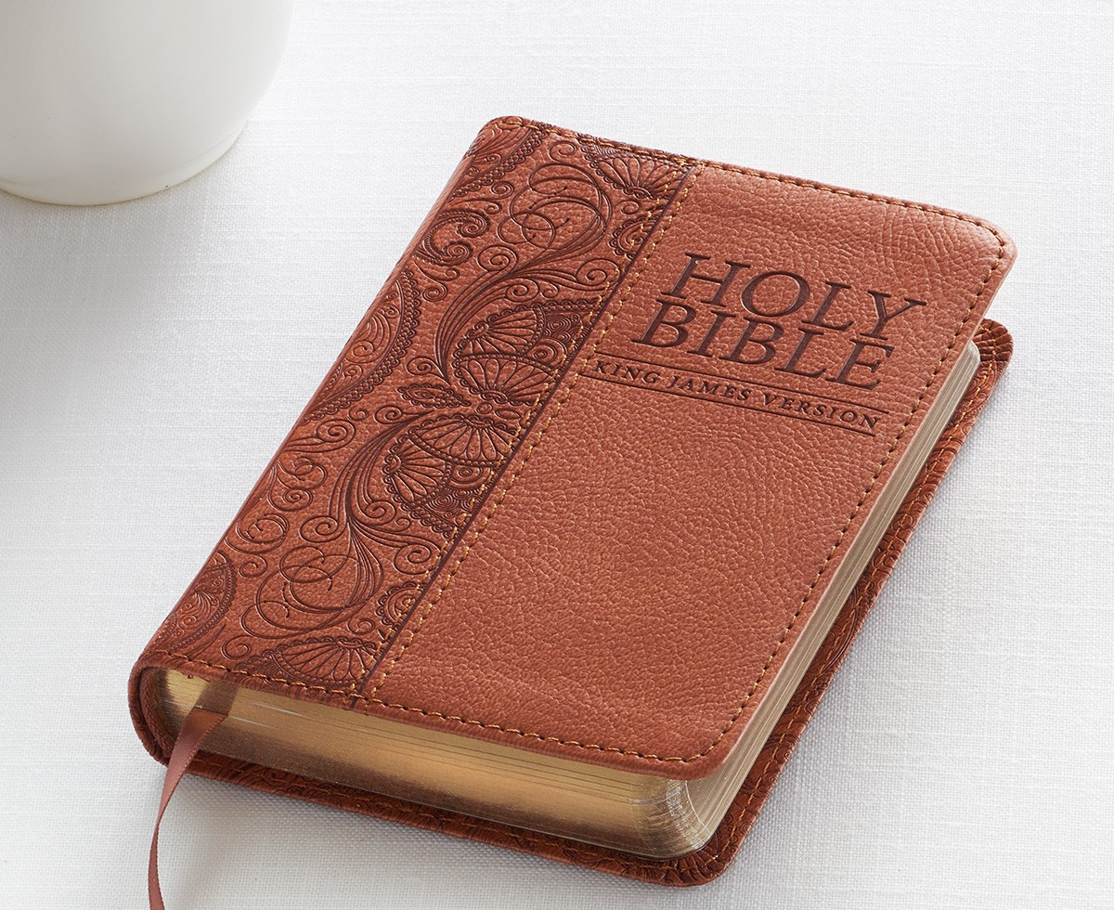

Word of God—Expect Changes!
What if we began to treat our BIBLES the way we treat our CELL PHONES?

Slide 3

Word of God—Expect Changes!
What if we began to treat our BIBLES the way we treat our CELL PHONES?
Took it everywhere.

Slide 4

Word of God—Expect Changes!
What if we began to treat our BIBLES the way we treat our CELL PHONES?
Took it everywhere.
Went back if we forgot it.

Slide 5

Word of God—Expect Changes!
What if we began to treat our BIBLES the way we treat our CELL PHONES?
Took it everywhere.
Went back if we forgot it.
Checked it for messages all the time.

Slide 6

Word of God—Expect Changes!
What if we began to treat our BIBLES the way we treat our CELL PHONES?
Took it everywhere.
Went back if we forgot it.
Checked it for messages all the time.
Used it in case of an emergency.

Slide 7

Word of God—Expect Changes!
What if we began to treat our BIBLES the way we treat our CELL PHONES?
Took it everywhere.
Went back if we forgot it.
Checked it for messages all the time.
Used it in case of an emergency.
Spent hours in it everyday.

Slide 8
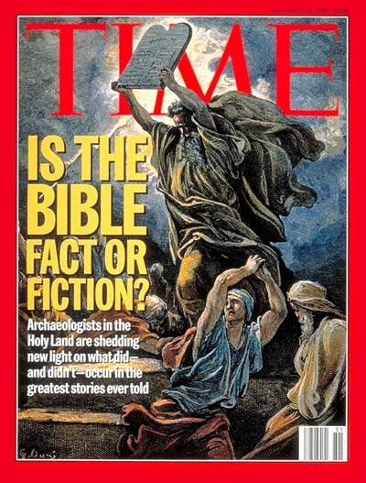
Word of God—Expect Changes!
“Is the Bible Fact or Fiction?”
(Time Magazine. 18-12-1995).

Slide 9
Word of God—Expect Changes!
“Is the Bible Fact or Fiction?”
(Time Magazine. 18-12-1995).
Critics say, “The Bible is a book of myths, so we can safely ignore it.”

Slide 10
Word of God—Expect Changes!
“Is the Bible Fact or Fiction?”
(Time Magazine. 18-12-1995).
Critics say, “The Bible is a book of myths, so we can safely ignore it.”
But it makes some incredible claims. These claims are either mythology, or they are facts that can be substantiated.

Slide 11
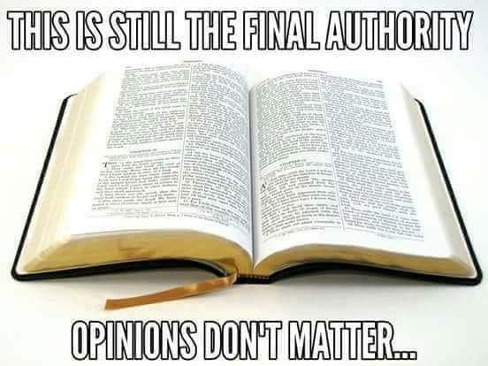
Word of God—Expect Changes!

Slide 12
Word of God—Expect Changes!
The words and concept of:
“Thus says the Lord” occurs over 400 times in the Bible.
That should tell us something!

Slide 13
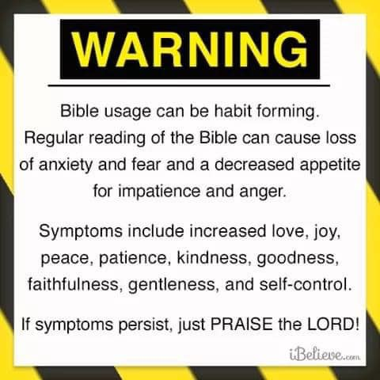
Word of God—Expect Changes!
The Word of God will transform your life.
Faith brings security

Slide 14
Word of God—Expect Changes!
The Word of God will transform your life.

Slide 15
Word of God—Expect Changes!
The Word of God will transform your life.

Slide 16
Word of God—Expect Changes!

Slide 17
Word of God—Expect Changes!
The Word of God will transform your life.

Slide 18
Word of God—Expect Changes!
The Word of God will transform your life.
Faith brings security.

Slide 19
Word of God—Expect Changes!
The Word of God will transform your life.
Faith brings security.
Hope brings direction.

Slide 20
Word of God—Expect Changes!
The Word of God will transform your life.
Faith brings security.
Hope brings direction.
Love brings community.

Slide 21
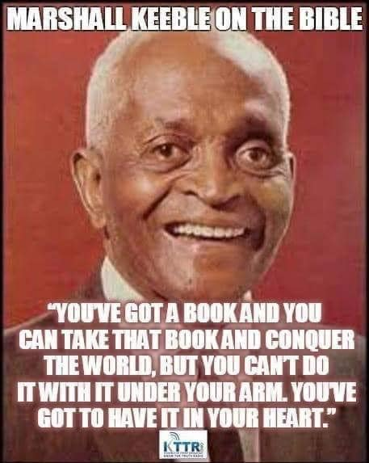
Word of God—Expect Changes!
Deuteronomy 6:6-7—
⁶These words, which I am commanding you today, shall be on your heart. ⁷You shall teach them diligently to your sons and shall talk of them when you sit in your house and when you walk by the way and when you lie down and when you rise up. (NASB95)

Slide 22
Word of God—Expect Changes!
Deuteronomy 6:6-7—
⁶These words, which I am commanding you today, shall be on your heart. ⁷You shall teach them diligently to your sons and shall talk of them when you sit in your house and when you walk by the way and when you lie down and when you rise up. (NASB95)

Slide 23
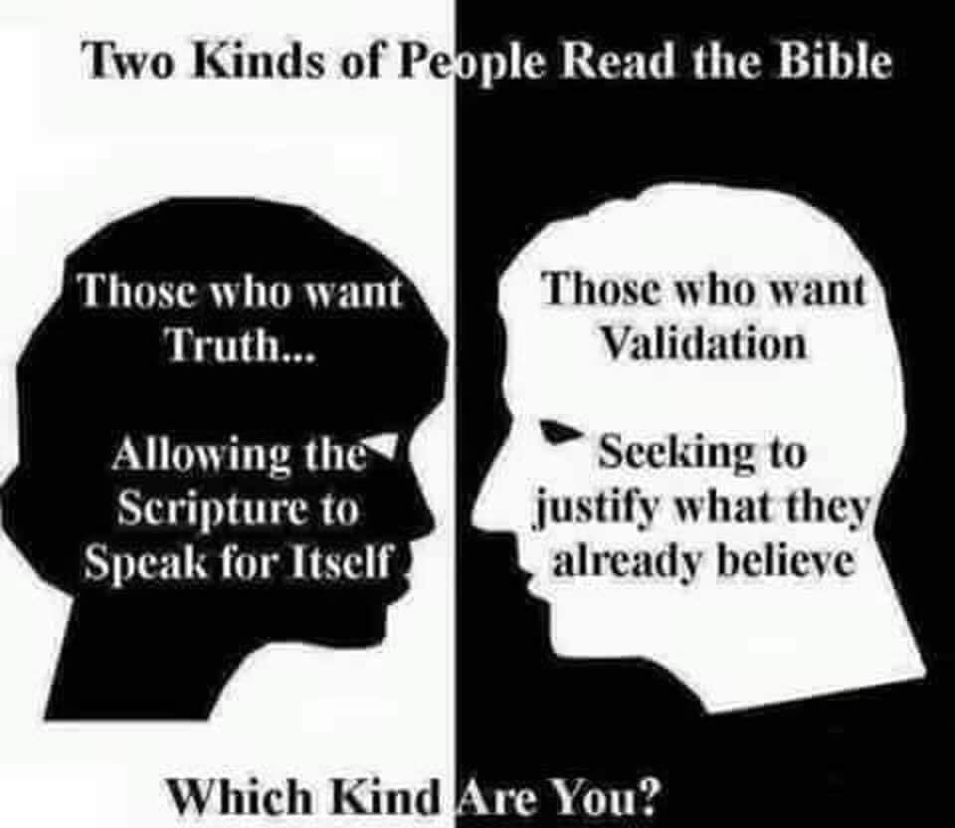
Word of God—Expect Changes!

Slide 24
Word of God—Expect Changes!

Slide 25
Word of God—Expect Changes!

Slide 26
Word of God—Expect Changes!

Slide 27
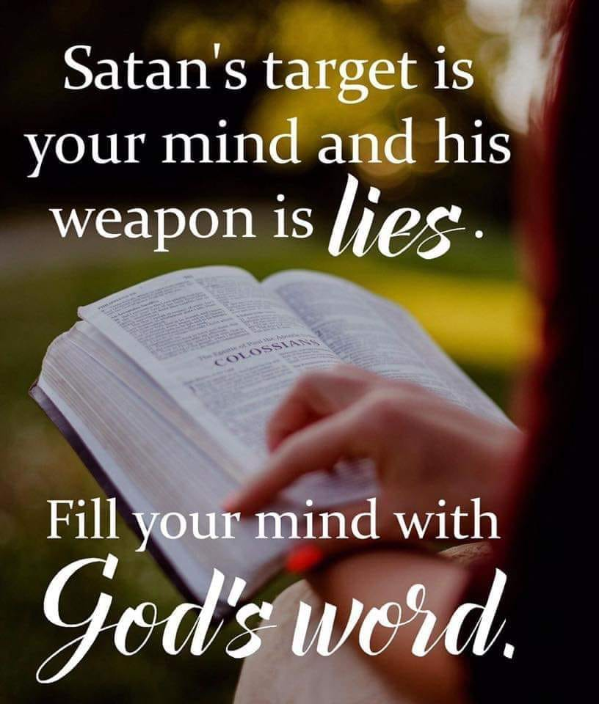
Word of God—Expect Changes!
Romans 8:5-6—
⁵For those who are according to the flesh set their minds on the things of the flesh, but those who are according to the Spirit, the things of the Spirit. ⁶For the mind set on the flesh is death, but the mind set on the Spirit is life and peace, (NASB95)

Slide 28
Word of God—Expect Changes!
Romans 8:5-6—
⁵For those who are according to the flesh set their minds on the things of the flesh, but those who are according to the Spirit, the things of the Spirit. ⁶For the mind set on the flesh is death, but the mind set on the Spirit is life and peace, (NASB95)

Slide 29

Word of God—Expect Changes!
2 Peter 3:4-5—
⁴They will say, “Where is this ‘coming’ he promised? Ever since our ancestors died, everything goes on as it has since the beginning of creation.” ⁵But they deliberately forget that long ago by God’s word the heavens came into being and the earth was formed out of water and by water. (NIV)

Slide 30
Word of God—Expect Changes!
2 Peter 3:4-5—
⁴They will say, “Where is this ‘coming’ he promised? Ever since our ancestors died, everything goes on as it has since the beginning of creation.” ⁵But they deliberately forget that long ago by God’s word the heavens came into being and the earth was formed out of water and by water. (NIV)

Slide 31

Word of God—Expect Changes!

Slide 32
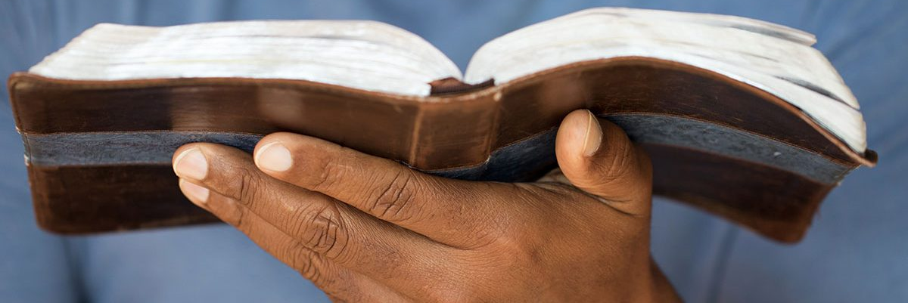
Word of God—Expect Changes!
Hebrews 4:12—
¹²For the word of God is living and active and sharper than any two-edged sword, and piercing as far as the division of soul and spirit, of both joints and marrow, and able to judge the thoughts and intentions of the heart. (NASB95)

Slide 33

Word of God—Expect Changes!
John 3:5—⁵Jesus answered, “Truly, truly, I say to you, unless one is born of water and the Spirit he cannot enter into the kingdom of God. (NASB95)

