Slide 1
Series: The Word of God (Part 3).
“Book of Solutions!”
John Staiger
Morningside Church of Christ
Sunday 19 December 2021
PM Sermon
Broadcast from 42 Leslie Avenue, Auckland, Aotearoa/NZ.
www.morningsidechurchofchrist.org.nz

Slide 2
Word of God—Book of Solutions!
The world is full of concerns—

Slide 3
Word of God—Book of Solutions!
The world is full of concerns—
Those that matter:

Slide 4
Word of God—Book of Solutions!
The world is full of concerns—
Those that matter:
State of your soul?

Slide 5
Word of God—Book of Solutions!
The world is full of concerns—
Those that matter:
State of your soul?
What’s in the Bible?

Slide 6
Word of God—Book of Solutions!
The world is full of concerns—
Those that matter:
State of your soul?
What’s in the Bible?
What is true love?—God!

Slide 7
Word of God—Book of Solutions!
The world is full of concerns—
Those that matter:
State of your soul?
What’s in the Bible?
What is true love?—God!
Souls of others.

Slide 8
Word of God—Book of Solutions!
The world is full of concerns—
Those that matter:
State of your soul?
What’s in the Bible?
What is true love?—God!
Souls of others.
Food and shelter.

Slide 9
Word of God—Book of Solutions!
The world is full of concerns—
Those that matter:
State of your soul?
What’s in the Bible?
What is true love?—God!
Souls of others.
Food and shelter.
Peace.

Slide 10
Word of God—Book of Solutions!
The world is full of concerns—
Those that matter:
State of your soul?
What’s in the Bible?
What is true love?—God!
Souls of others.
Food and shelter.
Peace.
Contentment.

Slide 11
Word of God—Book of Solutions!
The world is full of concerns—
Those that matter:
State of your soul?
What’s in the Bible?
What is true love?—God!
Souls of others.
Food and shelter.
Peace.
Contentment.
Those that don’t matter:

Slide 12
Word of God—Book of Solutions!
The world is full of concerns—
Those that matter:
State of your soul?
What’s in the Bible?
What is true love?—God!
Souls of others.
Food and shelter.
Peace.
Contentment.
Those that don’t matter:
Getting my way.

Slide 13
Word of God—Book of Solutions!
The world is full of concerns—
Those that matter:
State of your soul?
What’s in the Bible?
What is true love?—God!
Souls of others.
Food and shelter.
Peace.
Contentment.
Those that don’t matter:
Getting my way.
Always being right.

Slide 14
Word of God—Book of Solutions!
The world is full of concerns—
Those that matter:
State of your soul?
What’s in the Bible?
What is true love?—God!
Souls of others.
Food and shelter.
Peace.
Contentment.
Those that don’t matter:
Getting my way.
Always being right.
Having more.

Slide 15
Word of God—Book of Solutions!
The world is full of concerns—
Those that matter:
State of your soul?
What’s in the Bible?
What is true love?—God!
Souls of others.
Food and shelter.
Peace.
Contentment.
Those that don’t matter:
Getting my way.
Always being right.
Having more.
Being offended.

Slide 16
Word of God—Book of Solutions!
The world is full of concerns—
Those that matter:
State of your soul?
What’s in the Bible?
What is true love?—God!
Souls of others.
Food and shelter.
Peace.
Contentment.
Those that don’t matter:
Getting my way.
Always being right.
Having more.
Being offended.
Being rejected.

Slide 17
Word of God—Book of Solutions!
The world is full of concerns—
Those that matter:
State of your soul?
What’s in the Bible?
What is true love?—God!
Souls of others.
Food and shelter.
Peace.
Contentment.
Those that don’t matter:
Getting my way.
Always being right.
Having more.
Being offended.
Being rejected.
Keeping up with…?

Slide 18

Word of God—Book of Solutions!

Slide 19
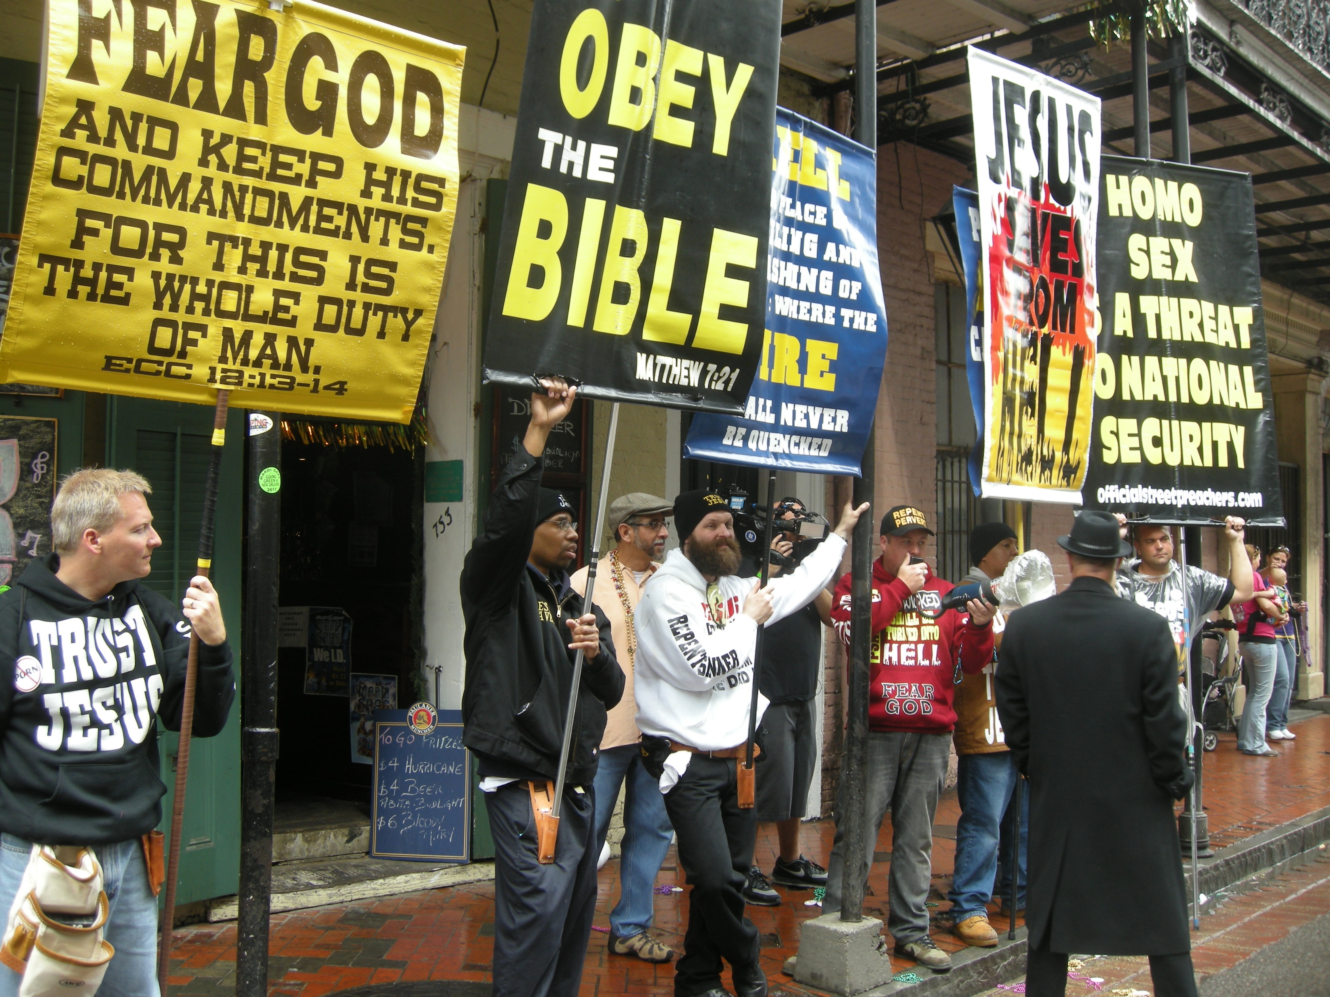
Word of God—Book of Solutions!

Slide 20
Word of God—Book of Solutions!

Slide 21
Word of God—Book of Solutions!

Slide 22

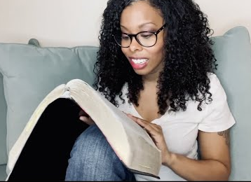
Word of God—Book of Solutions!

Slide 23
Word of God—Book of Solutions!

Slide 24
Word of God—Book of Solutions!
John 5:39—³⁹You search the Scriptures because you think that in them you have eternal life; it is these that testify about Me; (NASB95)

Slide 25

Word of God—Book of Solutions!

Slide 26
Word of God—Book of Solutions!

Slide 27
Word of God—Book of Solutions!

Slide 28
Word of God—Book of Solutions!
This is the answer

Slide 29

Word of God—Book of Solutions!
Plenty of options:
Denominationalism.
Atheism.
Islam.
Hinduism.
Buddhism.
New Age.
Cults.

Slide 30

Word of God—Book of Solutions!

Slide 31
Word of God—Book of Solutions!

Slide 32
Word of God—Book of Solutions!
Matthew 15:3—
³And He answered and said to them, “Why do you yourselves transgress the commandment of God for the sake of your tradition? (NASB95)

Slide 33
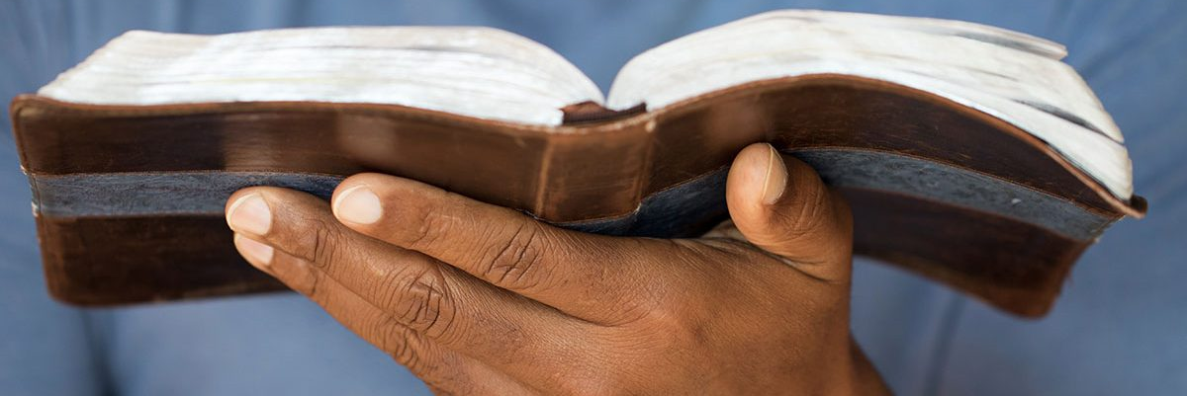
Word of God—Book of Solutions!
Hebrews 4:12—
¹²For the word of God is living and active and sharper than any two-edged sword, and piercing as far as the division of soul and spirit, of both joints and marrow, and able to judge the thoughts and intentions of the heart. (NASB95)

Slide 34

Word of God—Book of Solutions!
Acts 2:37-38—
³⁷Now when they heard this, they were pierced to the heart, and said to Peter and the rest of the apostles,
“Brethren,
what shall we do?”
³⁸Peter said to them, “Repent, and each of you be baptized in the name of Jesus Christ for the forgiveness of your sins; and you will receive the gift of the Holy Spirit. (NASB95)

