Slide 1
Series: If the Lord wills…
Part 2. “Called According to His Purpose.”
John Staiger
Morningside Church of Christ
Sunday 2 January 2022
AM Sermon
Broadcast live from 42 Leslie Ave, Auckland, Aotearoa/NZ.

Slide 2

If the Lord wills…Called according to His Purpose

Slide 3
If the Lord wills…Called according to His Purpose
A New Year.

Slide 4
If the Lord wills…Called according to His Purpose
A New Year.
What will it bring?

Slide 5
If the Lord wills…Called according to His Purpose
A New Year.
What will it bring?
Much goodness I pray.

Slide 6
If the Lord wills…Called according to His Purpose
A New Year.
What will it bring?
Much goodness I pray.
A time of testing?

Slide 7
If the Lord wills…Called according to His Purpose
A New Year.
What will it bring?
Much goodness I pray.
A time of testing?
Opportunities for growth?

Slide 8
If the Lord wills…Called according to His Purpose
A New Year.
What will it bring?
Much goodness I pray.
A time of testing?
Opportunities for growth?
Refocus…

Slide 9

If the Lord wills…Called according to His Purpose
In the 1990s things got tough for some farmers.

Slide 10
If the Lord wills…Called according to His Purpose
In the 1990s things got tough for some farmers.
They had to diversify to make a living.

Slide 11
If the Lord wills…Called according to His Purpose
In the 1990s things got tough for some farmers.
They had to diversify to make a living.
They opened up their farms for tourism.

Slide 12
If the Lord wills…Called according to His Purpose
In the 1990s things got tough for some farmers.
They had to diversify to make a living.
They opened up their farms for tourism.

Slide 13
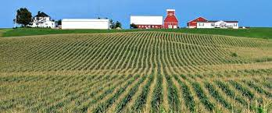
If the Lord wills…Called according to His Purpose
This is a farm used according to its purpose

Slide 14
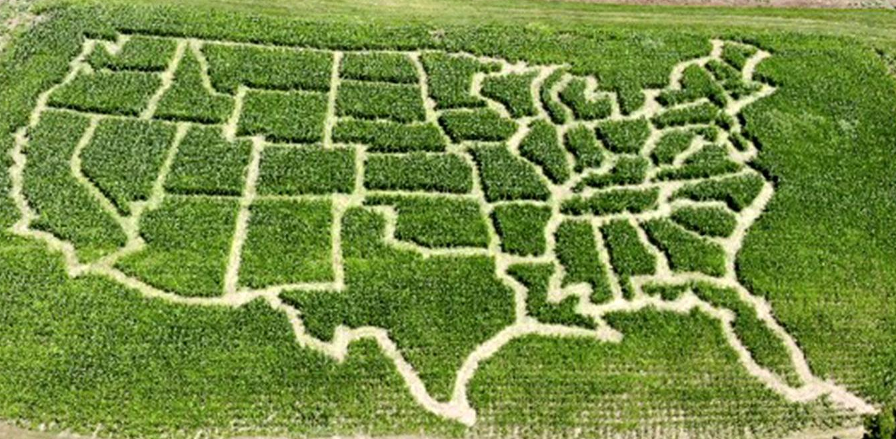
If the Lord wills…Called according to His Purpose
This is a farm used for “agritourism,”

Slide 15

If the Lord wills…Called according to His Purpose
This is NOT what farms are made for.

Slide 16
If the Lord wills…Called according to His Purpose
This is NOT what farms are made for.
—Not according to it’s purpose.

Slide 17

If the Lord wills…Called according to His Purpose
Christian—You are designed for purpose…

Slide 18

If the Lord wills…Called according to His Purpose
Christian—You are designed for purpose…
Are we puppets in God’s hands?
NO! We are always people of choice.
When we chose to follow Jesus we walk on his path.
His will becomes our will.
His purpose becomes our purpose.

Slide 19
If the Lord wills…Called according to His Purpose
Christian—You are designed for purpose…
Are we puppets in God’s hands?
NO! We are always people of choice.
When we chose to follow Jesus we walk on his path.
His will becomes our will.
His purpose becomes our purpose.

Slide 20
If the Lord wills…Called according to His Purpose
Christian—You are designed for purpose…
Are we puppets in God’s hands?
NO! We are always people of choice.
When we chose to follow Jesus we walk on his path.
His will becomes our will.
His purpose becomes our purpose.

Slide 21
If the Lord wills…Called according to His Purpose
Christian—You are designed for purpose…
Are we puppets in God’s hands?
NO! We are always people of choice.
When we chose to follow Jesus we walk on his path.
His will becomes our will.
His purpose becomes our purpose.

Slide 22
If the Lord wills…Called according to His Purpose
Christian—You are designed for purpose…
Are we puppets in God’s hands?
NO! We are always people of choice.
When we chose to follow Jesus we walk on his path.
His will becomes our will.
His purpose becomes our purpose.

Slide 23

If the Lord wills…Called according to His Purpose
Christian—You are now caught up in God’s plan and purpose…

Slide 24

If the Lord wills…Called according to His Purpose
Christian—You are now caught up in God’s plan and purpose…
Romans 8:28—

Slide 25
If the Lord wills…Called according to His Purpose
Christian—You are now caught up in God’s plan and purpose…
Romans 8:28—
²⁸And we know that God causes all things to work together for good to those who love God, to those who are called according to His purpose. (NASB95)

Slide 26
If the Lord wills…Called according to His Purpose
Christian—You are now caught up in God’s plan and purpose…
Romans 8:28—
²⁸And we know that God causes all things to work together for good to those who love God, to those who are called according to His purpose. (NASB95)
This is where all things work together for good.

Slide 27
If the Lord wills…Called according to His Purpose
Christian—You are now caught up in God’s plan and purpose…
Romans 8:28—
²⁸And we know that God causes all things to work together for good to those who love God, to those who are called according to His purpose. (NASB95)
For those who Love Him.

Slide 28
If the Lord wills…Called according to His Purpose
Christian—You are now caught up in God’s plan and purpose…
Romans 8:28—
²⁸And we know that God causes all things to work together for good to those who love God, to those who are called according to His purpose. (NASB95)
For those who have loved His appearing…
2 Timothy 4:8—in the future there is laid up for me the crown…to all who have loved His appearing.

Slide 29
If the Lord wills…Called according to His Purpose
Christian—You are now caught up in God’s plan and purpose…
Romans 8:28—
²⁸And we know that God causes all things to work together for good to those who love God, to those who are called according to His purpose. (NASB95)
For those who have loved His appearing…
2 Timothy 4:8—in the future there is laid up for me the crown…to all who have loved His appearing.

Slide 30
If the Lord wills…Called according to His Purpose
God’s plan and purpose has always been “Reconciliation.”

Slide 31
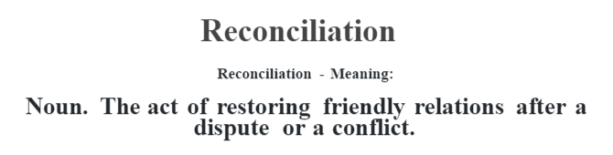
If the Lord wills…Called according to His Purpose
God’s plan and purpose has always been “Reconciliation.”

Slide 32

If the Lord wills…Called according to His Purpose
God’s plan and purpose has always been “Reconciliation.”

Slide 33
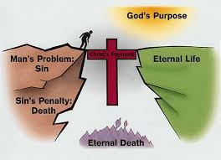
If the Lord wills…Called according to His Purpose
God’s plan and purpose has always been “Reconciliation.”

Slide 34
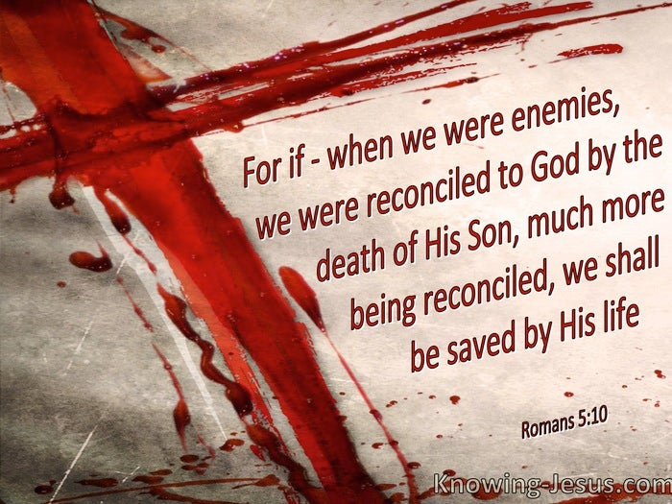
If the Lord wills…Called according to His Purpose
God’s plan and purpose has always been “Reconciliation.”

Slide 35
If the Lord wills…Called according to His Purpose
God’s plan and purpose has always been “Reconciliation.”
2 Corinthians 5:18-20—
¹⁸Now all these things are from God, who reconciled us to Himself through Christ and gave us the ministry of reconciliation,…

Slide 36
If the Lord wills…Called according to His Purpose
God’s plan and purpose has always been “Reconciliation.”
2 Corinthians 5:18-20—¹⁹namely, that God was in Christ reconciling the world to Himself, not counting their trespasses against them, and He has committed to us the word of reconciliation…

Slide 37
If the Lord wills…Called according to His Purpose
God’s plan and purpose has always been “Reconciliation.”
2 Corinthians 5:18-20—²⁰Therefore, we are ambassadors for Christ, as though God were making an appeal through us; we beg you on behalf of Christ, be reconciled to God. (NASB95)

Slide 38
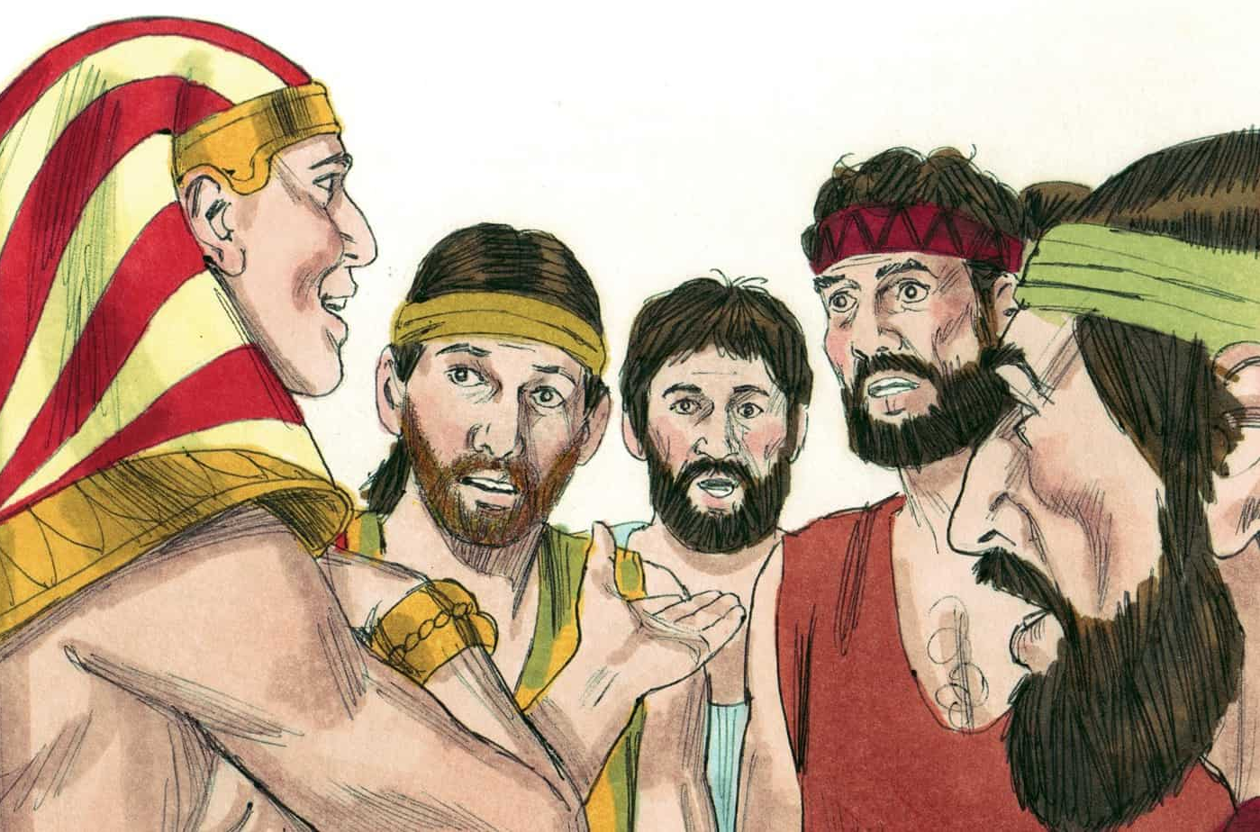
If the Lord wills…Called according to His Purpose
Joseph was caught up in God’s plan and purpose…

Slide 39
If the Lord wills…Called according to His Purpose
Joseph was caught up in God’s plan and purpose…
Genesis 50:20—²⁰As for you, you meant evil against me, but God meant it for good in order to bring about this present result, to preserve many people alive. (NASB95)

Slide 40

If the Lord wills…According to His Purpose
The church is caught up in God’s plan and purpose…

Slide 41
If the Lord wills…According to His Purpose
The church is caught up in God’s plan and purpose…
Ephesians 3:10-11—
¹⁰so that the manifold wisdom of God might now be made known through the church to the rulers and the authorities in the heavenly places. ¹¹ This was in accordance with the eternal purpose which He carried out in Christ Jesus our Lord, (NASB95)

Slide 42
If the Lord wills…According to His Purpose
The church is caught up in God’s plan and purpose…
Colossians 3:15—
¹⁵Let the peace of Christ rule in your hearts, to which indeed you were called in one body; and be thankful. (NASB95

Slide 43
If the Lord wills…According to His Purpose
The church is caught up in God’s plan and purpose…
2 Timothy 1:9—
⁹who has saved us and called us with a holy calling, not according to our works, but according to His own purpose and grace which was granted us in Christ Jesus from all eternity, (NASB95)

Slide 44
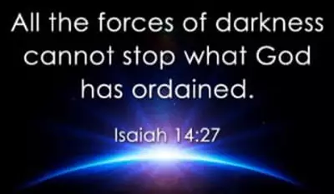
If the Lord wills…According to His Purpose
Be careful how you get caught up in God’s plan and purpose…
Isaiah 14:27—
When the Lord All-Powerful makes a plan, no one can stop it.
When the Lord raises his hand to punish people, no one can stop it.
(NCV)

Slide 45
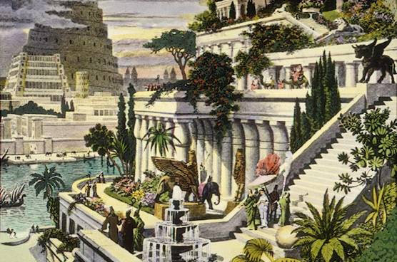
If the Lord wills…According to His Purpose
Be careful how you get caught up in God’s plan and purpose…
Jeremiah 51:29—
²⁹So the land quakes and writhes,
For the purposes of the Lord against Babylon stand,
To make the land of Babylon
A desolation without inhabitants. (NASB95)

Slide 46

If the Lord wills…According to His Purpose
Being caught up in God’s plan and purpose…

Slide 47

Acts 2:41—
⁴¹So then, those who had received his word were baptized; and that day there were added about three thousand souls. (NASB95)

