Slide 1
Series: The Company You Keep…
Part 2. “Good Company.”
John Staiger
Morningside Church of Christ
Sunday 16 January 2022
AM Sermon
Broadcast live from 42 Leslie Ave, Auckland, Aotearoa/NZ.

Slide 2
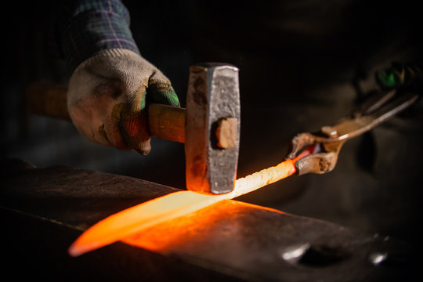
The Company You Keep—Part 2. “Good Company.”
You’re in good company when…
They sharpen you for the fight—
Cause you to:
Reflect,
Think deeply,
Consider the implications of your actions.

Slide 3
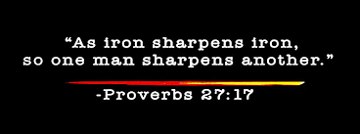
The Company You Keep—Part 2. “Good Company.”
You’re in good company when…
They sharpen you for the fight—
Cause you to:
Reflect,
Think deeply,
Consider the implications of your actions.

Slide 4
The Company You Keep—Part 2. “Good Company.”
You’re in good company when…
They sharpen you for the fight—
Cause you to:

Slide 5
The Company You Keep—Part 2. “Good Company.”
You’re in good company when…
They sharpen you for the fight—
Cause you to:
Reflect…
On the
PAST

Slide 6
The Company You Keep—Part 2. “Good Company.”
You’re in good company when…
They sharpen you for the fight—
Cause you to:
Think deeply…
About your present
MOTIVES

Slide 7
The Company You Keep—Part 2. “Good Company.”
You’re in good company when…
They sharpen you for the fight—
Cause you to:
Consider…
The implications of your actions upon the FUTURE.

Slide 8
The Company You Keep—Part 2. “Good Company.”
You’re in good company when…
They watch over you—

Slide 9
The Company You Keep—Part 2. “Good Company.”
You’re in good company when…
They watch over you—
Jude 20-23—
²⁰But you, behold, building yourselves up on your most holy faith,…

Slide 10
The Company You Keep—Part 2. “Good Company.”
You’re in good company when…
They watch over you—
Jude 20-23—
²⁰But you, behold, building yourselves up on your most holy faith, praying in the Holy Spirit,…

Slide 11
The Company You Keep—Part 2. “Good Company.”
You’re in good company when…
They watch over you—
Jude 20-23
²¹keep yourselves in the love of God,…

Slide 12
The Company You Keep—Part 2. “Good Company.”
You’re in good company when…
They watch over you—
Jude 20-23
²¹keep yourselves in the love of God, waiting anxiously for the mercy of our Lord Jesus Christ to eternal life.

Slide 13
The Company You Keep—Part 2. “Good Company.”
You’re in good company when…
They watch over you—
Jude 20-23
²²And have mercy on some, who are doubting;

Slide 14
The Company You Keep—Part 2. “Good Company.”
You’re in good company when…
They watch over you—
Jude 20-23
²³save others, snatching them out of the fire; and on some have mercy with fear, hating even the garment polluted by the flesh.

Slide 15
The Company You Keep—Part 2. “Good Company.”
You’re in good company when…
They are Cross Centred—

Slide 16
The Company You Keep—Part 2. “Good Company.”
You’re in good company when…
They are Cross Centred—
They keep the Cross at the centre of all relationships.

Slide 17
The Company You Keep—Part 2. “Good Company.”
You’re in good company when…
They are Cross Centred—
They keep the Cross at the centre of all relationships.
Not just…
At church,
Or around you,
EVERYWHERE!

Slide 18
The Company You Keep—Part 2. “Good Company.”
You’re in good company when…
They are Cross Centred—
Philippians 3:17-19—
¹⁷ Brethren, join in following my example, and observe those who walk according to the pattern you have in us…

Slide 19
The Company You Keep—Part 2. “Good Company.”
You’re in good company when…
They are Cross Centred—
Philippians 3:17-19—
¹⁸ For many walk, of whom I often told you, and now tell you even weeping, that they are enemies of the cross of Christ,…

Slide 20
The Company You Keep—Part 2. “Good Company.”
You’re in good company when…
They are Cross Centred—
Philippians 3:17-19—
¹⁹ whose end is destruction, whose god is their appetite, and whose glory is in their shame, who set their minds on earthly things.

Slide 21
The Company You Keep—Part 2. “Good Company.”
You’re in good company when…
They care about the destiny of your soul—
Remember prying,
¹³ ‘And do not lead us into temptation, but deliver us from evil” (Mt.6:13)?
These are the guides and deliverers God sent.

Slide 22
The Company You Keep—Part 2. “Good Company.”
You’re in good company when…
They care about the destiny of your soul—
Remember praying,
¹³ ‘And do not lead us into temptation, but deliver us from evil” (Mt.6:13)?
These are the guides and deliverers God sent.

Slide 23
The Company You Keep—Part 2. “Good Company.”
You’re in good company when…
They care about the destiny of your soul—
Remember praying,
¹³ ‘And do not lead us into temptation, but deliver us from evil” (Mt.6:13)?
These are the guides and deliverers God sent.

Slide 24
The Company You Keep—Part 2. “Good Company.”
You’re in good company when…
They care about the destiny of your soul—
Remember praying,
¹³ ‘And do not lead us into temptation, but deliver us from evil” (Mt.6:13)?
These are the guides and deliverers God sent.

Slide 25
The Company You Keep—Part 2. “Good Company.”
You’re in good company when…
There is respect—

Slide 26
The Company You Keep—Part 2. “Good Company.”
You’re in good company when…
There is respect—
Leviticus 19:32—
³²Stand up in the presence of the aged, show respect for the elderly and revere your God. I am the Lord.

Slide 27
The Company You Keep—Part 2. “Good Company.”
You’re in good company when…
There is respect—
Romans 12:17—
¹⁷Never pay back evil for evil to anyone. Respect what is right in the sight of all men.

Slide 28
The Company You Keep—Part 2. “Good Company.”
You’re in good company when…
There is respect—
Hebrews 12:9—
⁹Furthermore, we had earthly fathers to discipline us, and we respected them; shall we not much rather be subject to the Father of spirits, and live?

Slide 29
The Company You Keep—Part 2. “Good Company.”
Finally…

Slide 30
Acts 2:41—
⁴¹So then, those who had received his word were baptized; and that day there were added about three thousand souls. (NASB95)

