Slide 1
Series: The Word of God (Part 3).
“Book of Discovery!”
John Staiger
Morningside Church of Christ
Sunday 2 January 2022
PM Sermon
Broadcast from 42 Leslie Avenue, Auckland, Aotearoa/NZ.
www.morningsidechurchofchrist.org.nz

Slide 2

Word of God—Book of Discovery!
You will discover that there’s no such thing as an Atheist…
…Just believers in denial.
No one believes that we happened by accident.
A person may feel, speak, and act like it, but they don’t believe it.

Slide 3



Word of God—Book of Discovery!
THE IKEA BIBLE
Some view the Bible as an impossible mission.
Hard to read.
Hard to learn.
Too many facts.
Strange people.
Old customs.
Beyond them.

Slide 4

Word of God—Book of Discovery!
“He who has ears to hear, let him hear” (Mt.11:15).
1 Peter 1:10-11—

Slide 5
Word of God—Book of Discovery!
“He who has ears to hear, let him hear” (Mt.11:15).
1 Peter 1:10-11—¹⁰As to this salvation, the prophets who prophesied of the grace that would come to you made careful searches and inquiries, ¹¹seeking to know what person or time the Spirit of Christ within them was indicating as He predicted the sufferings of Christ and the glories to follow.

Slide 6

Word of God—Book of Discovery!

Slide 7
Word of God—Book of Discovery!

Slide 8

Word of God—Book of Discovery!
You will discover that this is our goal

Slide 9
Word of God—Book of Discovery!
You will discover that this is our goal
Proverbs 11:30—
The fruit of the righteous is a tree of life,
And he who is wise wins souls.

Slide 10
Word of God—Book of Discovery!
You will discover that this is our goal
Words of:
Salvation.
Life.
Peace.
Purpose.
Family.
Friendship.
Proverbs 11:30—
The fruit of the righteous is a tree of life,
And he who is wise wins souls.

Slide 11
Word of God—Book of Discovery!
You will discover that this is our goal
Words of:
Salvation.
Life.
Peace.
Purpose.
Family.
Friendship.
Proverbs 22:6—
Train up a child in the way he should go, Even when he is old he will not depart from it.

Slide 12

Word of God—Book of Discovery!
Ephesians 6:17—…and the sword of the Spirit, which is the word of God.
2 Timothy 3:16-17—
¹⁶All Scripture is inspired by God and profitable for teaching, for reproof, for correction, for training in righteousness; ¹⁷so that the man of God may be adequate, equipped for every good work. (NASB95)

Slide 13
Word of God—Book of Discovery!
Ephesians 6:17—…and the sword of the Spirit, which is the word of God.
2 Timothy 3:16-17—
¹⁶All Scripture is inspired by God and profitable for teaching, for reproof, for correction, for training in righteousness; ¹⁷so that the man of God may be adequate, equipped for every good work. (NASB95)

Slide 14

Word of God—Book of Discovery!

Slide 15
Word of God—Book of Discovery!

Slide 16
Word of God—Book of Discovery!

Slide 17
Word of God—Book of Discovery!

Slide 18
Word of God—Book of Discovery!

Slide 19
Word of God—Book of Discovery!

Slide 20
Word of God—Book of Discovery!

Slide 21
Word of God—Book of Discovery!

Slide 22
Word of God—Book of Discovery!

Slide 23

Word of God—Book of Discovery!
You’ll discover that without faith in the Scriptures we are powerless
Romans 1:16-17—
¹⁶For I am not ashamed of the gospel, for it is the power of God for salvation to everyone who believes, to the Jew first and also to the Greek. ¹⁷For in it the righteousness of God is revealed from faith to faith; as it is written, “But the righteous man shall live by faith.” (NASB95)

Slide 24
Word of God—Book of Discovery!
You’ll discover that without faith in the Scriptures we are powerless
Romans 1:16-17—
¹⁶For I am not ashamed of the gospel, for it is the power of God for salvation to everyone who believes, to the Jew first and also to the Greek. ¹⁷For in it the righteousness of God is revealed from faith to faith; as it is written, “But the righteous man shall live by faith.” (NASB95)

Slide 25

Word of God—Book of Discovery!
In the Bible you will discover Eternal life

Slide 26
Word of God—Book of Discovery!
In the Bible you will discover Eternal life
John 17:3—

Slide 27
Word of God—Book of Discovery!
In the Bible you will discover Eternal life
John 17:3—
³This is eternal life, that they may know You, the only true God, and Jesus Christ whom You have sent. (NASB95)

Slide 28

Word of God—Book of Discovery!
You will discover Abundant Living.
John 10:10—

Slide 29
Word of God—Book of Discovery!
You will discover Abundant Living.
John 10:10—
¹⁰The thief comes only to steal and kill and destroy; I came that they may have life, and have it abundantly.

Slide 30

Word of God—Book of Discovery!
You will discover how much you don’t know.

Slide 31
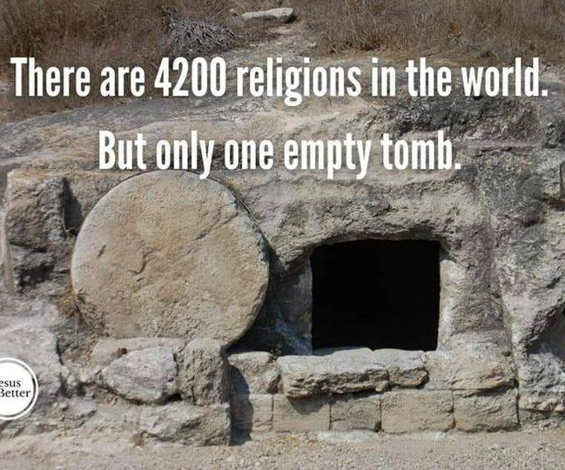
Word of God—Book of Discovery!
You will discover how Jesus was proven to be Christ.

Slide 32
Word of God—Book of Discovery!
You will discover how Jesus was proven to be Christ.
1 Timothy 3:16—
By common confession, great is the mystery of godliness:
He who was revealed in the flesh,
Was vindicated in the Spirit,
Seen by angels,
Proclaimed among the nations,
Believed on in the world,
Taken up in glory.

Slide 33
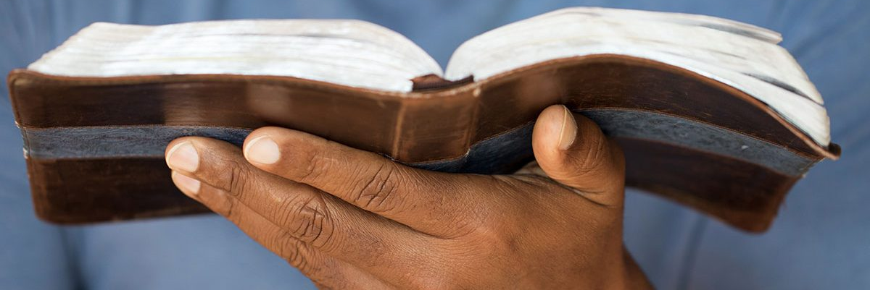
Word of God—
Hebrews 4:12—
¹²For the word of God is living and active and sharper than any two-edged sword, and piercing as far as the division of soul and spirit, of both joints and marrow, and able to judge the thoughts and intentions of the heart. (NASB95)

Slide 34

Word of God—Book of Solutions!
Acts 2:37-38—
³⁷Now when they heard this, they were pierced to the heart, and said to Peter and the rest of the apostles,
“Brethren,
what shall we do?”
³⁸Peter said to them, “Repent, and each of you be baptized in the name of Jesus Christ for the forgiveness of your sins; and you will receive the gift of the Holy Spirit. (NASB95)

