Slide 1
Series: The Word of God (Part 6).
“The Legacy you leave.”
John Staiger
Morningside Church of Christ
Sunday 16 January 2022
PM Sermon
Broadcast from 42 Leslie Avenue, Auckland, Aotearoa/NZ.
www.morningsidechurchofchrist.org.nz

Slide 2
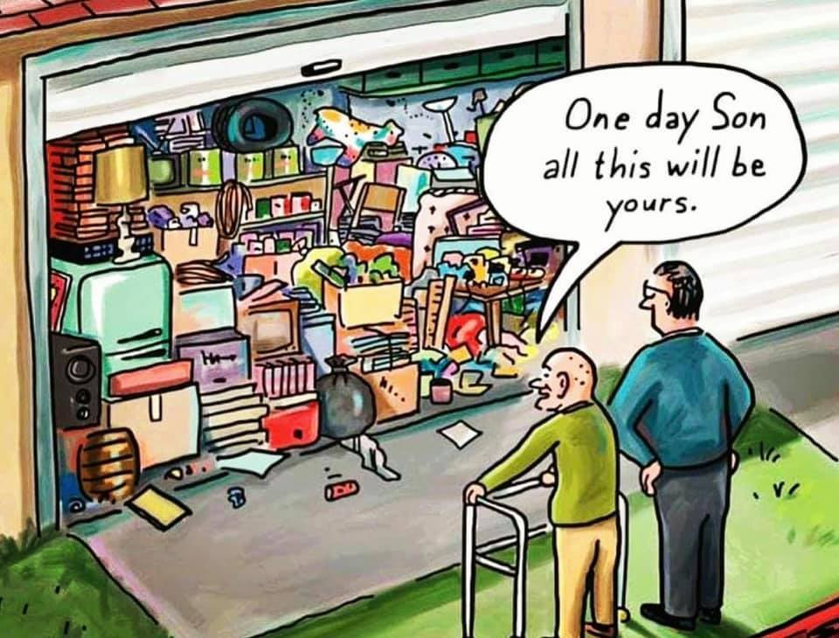
Word of God—The Legacy you leave!
The legacy of worldly riches…

Slide 3
Word of God—The Legacy you leave!
The legacy of things…
Is there anything wrong with leaving a legacy of money and property?

Slide 4
Word of God—The Legacy you leave!
The legacy of things…
Is it a good idea to ask what will happen to your stewardship of money and property?

Slide 5
Word of God—The Legacy you leave!
The legacy of things…
Proverbs 13:22—
²²A good man leaves an inheritance to his children’s children, And the wealth of the sinner is stored up for the righteous. (NASB95)

Slide 6
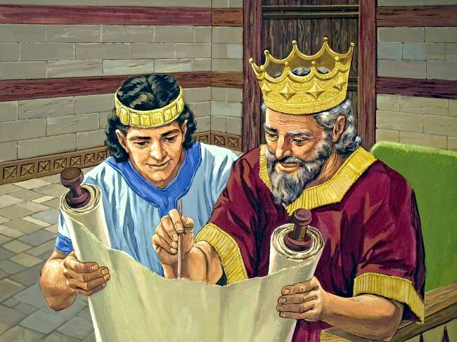
Word of God—The Legacy you leave!
The legacy of worldly riches…
King David planned for the temple that Solomon built.

Slide 7
Word of God—The Legacy you leave!
The legacy of worldly riches…
King David planned for the temple that Solomon built.
King Solomon would have longed for is son to carry on the Kingdom.

Slide 8
Word of God—The Legacy you leave!
The legacy of worldly riches…
King David planned for the temple that Solomon built.
King Solomon would have longed for is son to carry on the Kingdom.
Solomon knew the shortcomings of having “Everything!”

Slide 9
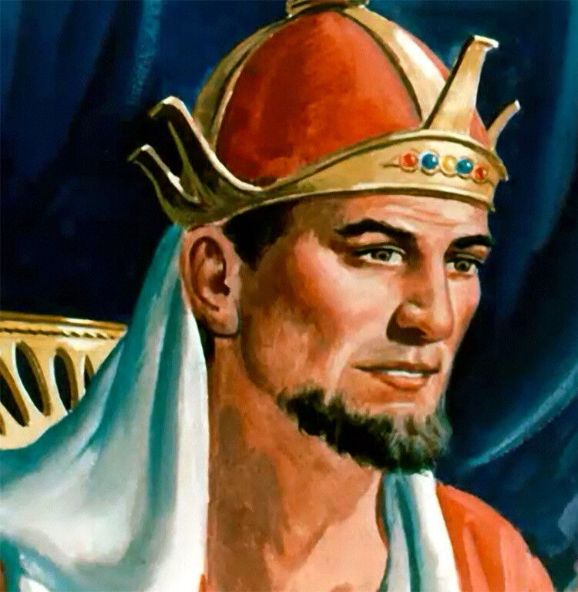
Word of God—The Legacy you leave!
The legacy of worldly riches…
Ecclesiastes 2:18
¹⁸Thus I hated all the fruit of my labour for which I had laboured under the sun, for I must leave it to the man who will come after me.

Slide 10
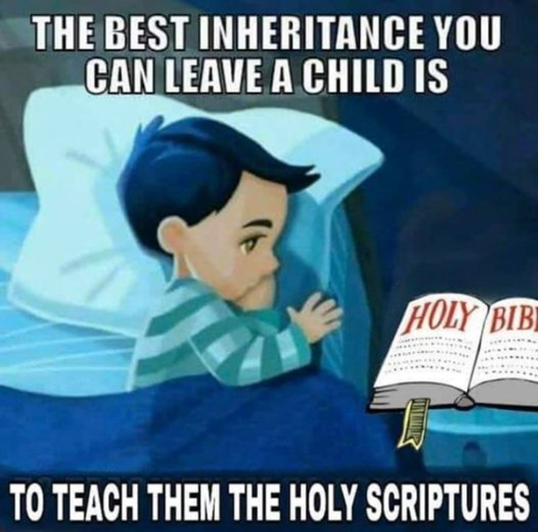
Word of God—The Legacy you leave!
The legacy of Faith…
Proverbs 22:6—

Slide 11
Word of God—The Legacy you leave!
The legacy of Faith…
Proverbs 22:6—
⁶Train up a child in the way he should go, Even when he is old he will not depart from it. (NASB95)

Slide 12
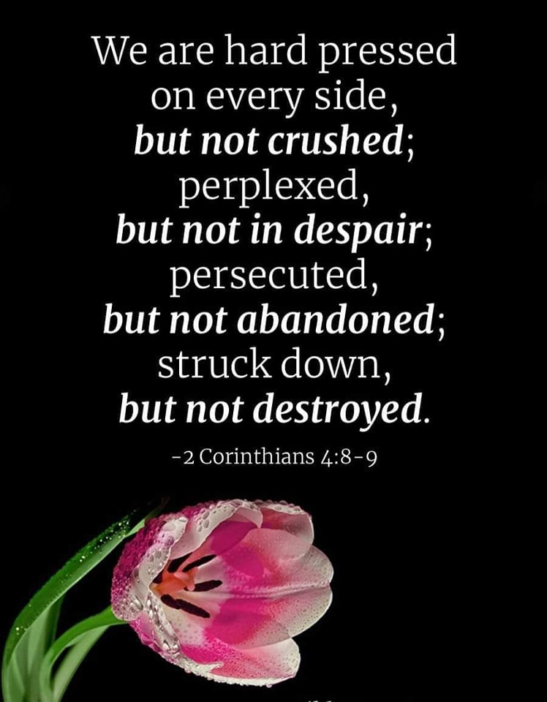
Word of God—The Legacy you leave!
The legacy of strength…
The Bible is a Book of struggles.

Slide 13
Word of God—The Legacy you leave!
The legacy of strength…
The Bible is a Book of struggles.
We don’t hide this.

Slide 14
Word of God—The Legacy you leave!
The legacy of strength…
The Bible is a Book of struggles.
We don’t hide this.
Sin brings struggle.

Slide 15
Word of God—The Legacy you leave!
The legacy of strength…
The Bible is a Book of struggles.
We don’t hide this.
Sin brings struggle.
Faith overcomes,…

Slide 16
Word of God—The Legacy you leave!
The legacy of strength…
The Bible is a Book of struggles.
We don’t hide this.
Sin brings struggle.
Faith overcomes,
But it marks you out for Satan’s special attention.

Slide 17
Word of God—The Legacy you leave!
The legacy of strength…
The Bible is a Book of struggles.
We don’t hide this.
Sin brings struggle.
Faith overcomes,
But it marks you out for Satan’s special attention.
He wants you back!

Slide 18
Word of God—The Legacy you leave!
The legacy of strength…
The Bible is a Book of struggles.
We don’t hide this.
Sin brings struggle.
Faith overcomes
Hope anchors the soul:…

Slide 19
Word of God—The Legacy you leave!
The legacy of strength…
The Bible is a Book of struggles.
We don’t hide this.
Sin brings struggle.
Faith overcomes
Hope anchors the soul:…
But, invites Satan’s distractions of doubt.

Slide 20
Word of God—The Legacy you leave!
The legacy of strength…
The Bible is a Book of struggles.
We don’t hide this.
Sin brings struggle.
Faith overcomes
Hope anchors the soul.
Love binds us in holy unity…

Slide 21
Word of God—The Legacy you leave!
The legacy of strength…
The Bible is a Book of struggles.
We don’t hide this.
Sin brings struggle.
Faith overcomes
Hope anchors the soul.
Love binds us in holy unity.
But, Satan wrecks everything we allow him to.

Slide 22
Word of God—The Legacy you leave!
The legacy of little…

Slide 23
Word of God—The Legacy you leave!
The legacy of little…
A little here, and a little there…

Slide 24
Word of God—The Legacy you leave!
The legacy of little…
A little here, and a little there.
Just as a little leaven leavens the whole lump—for evil (1Cor.5:6)…

Slide 25
Word of God—The Legacy you leave!
The legacy of little…
A little here, and a little there.
Just as a little leaven leavens the whole lump—for evil (1Cor.5:6).
But, …A mustard-seed sized faith can move mountains (Mt.17:20).

Slide 26
Word of God—The Legacy you leave!
The legacy of little…
Make the Bible fun:
Devotionals.
Books.
Movies.
Quizzes.
Word Games.
Stories.
Pictures.
Puzzles.

Slide 27
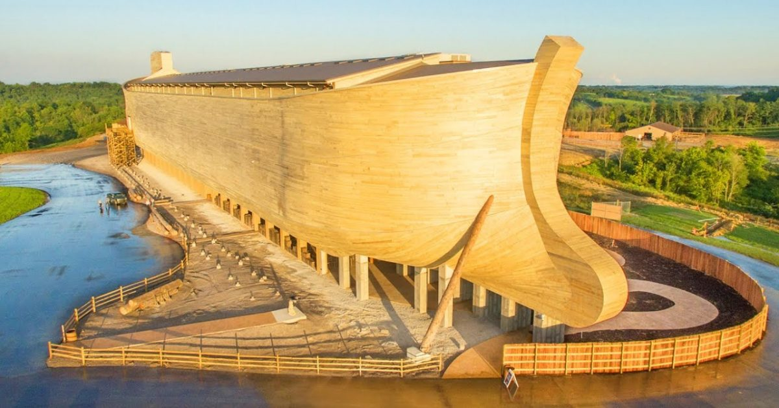
Word of God—The Legacy you leave!
The legacy of experience…

Slide 28
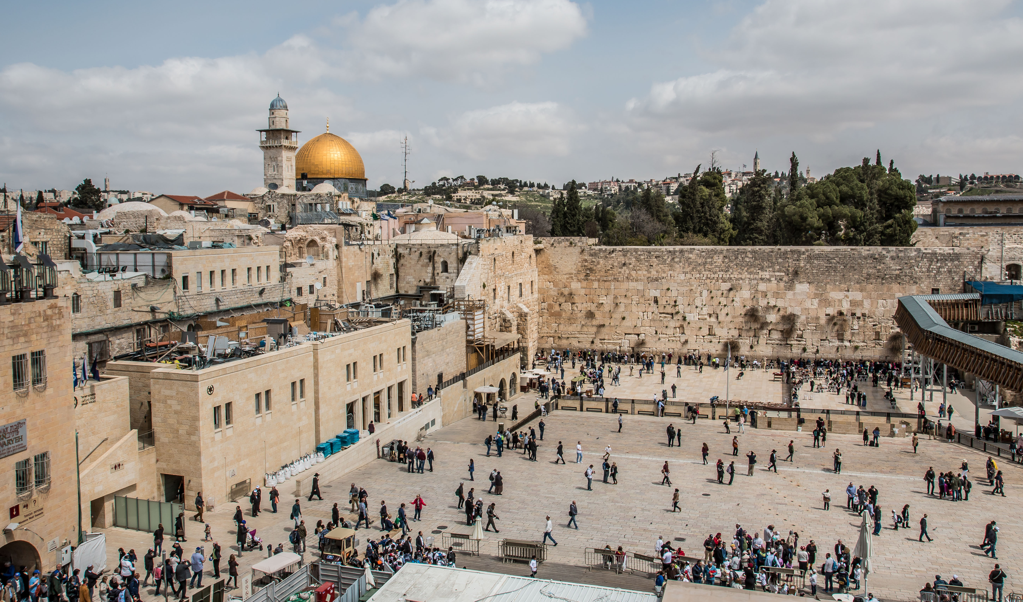
Word of God—The Legacy you leave!
The legacy of experience…

Slide 29
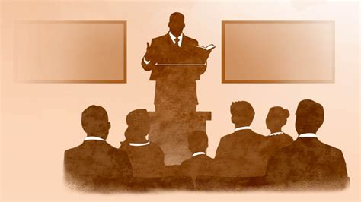
Word of God—The Legacy you leave!
The legacy of experience…

Slide 30
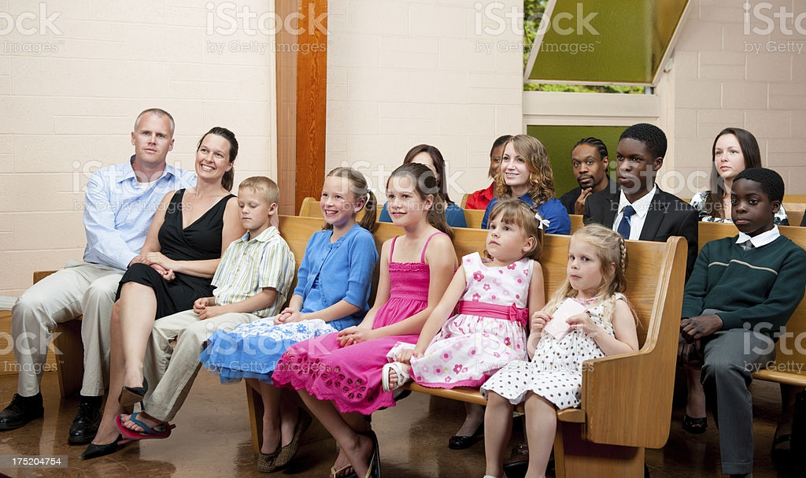
Word of God—The Legacy you leave!
The legacy of experience…

Slide 31
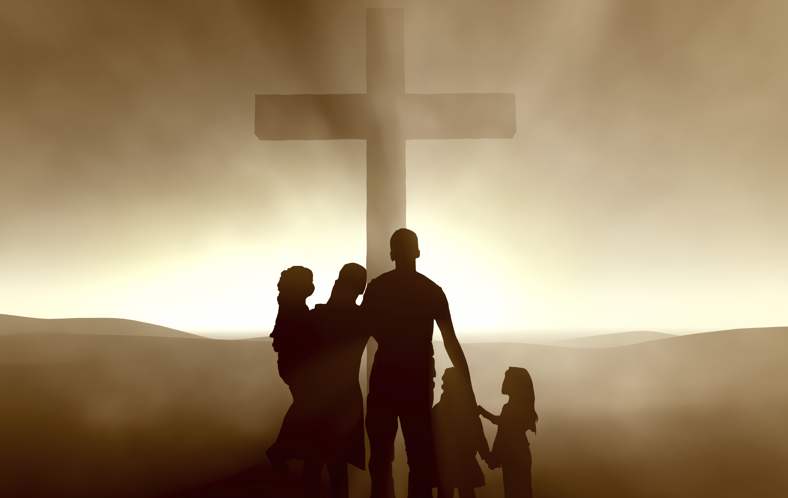
Word of God—The Legacy you leave!
The legacy of experience…

Slide 32
Word of God—The Legacy you leave!
Hebrews 4:12—
¹²For the word of God is living and active and sharper than any two-edged sword, and piercing as far as the division of soul and spirit, of both joints and marrow, and able to judge the thoughts and intentions of the heart. (NASB95)

Slide 33
Word of God—Book of Solutions!
Acts 2:37-38—
³⁷Now when they heard this, they were pierced to the heart, and said to Peter and the rest of the apostles,
“Brethren,
what shall we do?”
³⁸Peter said to them, “Repent, and each of you be baptized in the name of Jesus Christ for the forgiveness of your sins; and you will receive the gift of the Holy Spirit. (NASB95)

