Slide 1
“Being Like Him Too.”
John Staiger
Morningside Church of Christ
Sunday 6 February 2022
PM Sermon
Broadcast live from 42 Leslie Ave, Auckland, Aotearoa/NZ.

Slide 2
Being like Him too

Slide 3
Being Like Him Too...
Guilty by association…

Slide 4
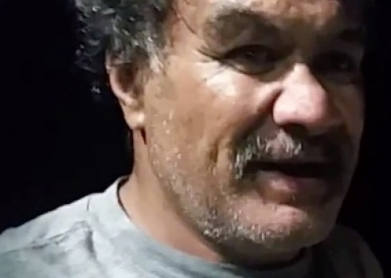
Being Like Him Too...
Guilty by association…
Ngapari Nui was a volunteer prison worker who was removed from his position…

Slide 5
Being Like Him Too...
Guilty by association…
Because of a life membership to Black Power gang.

Slide 6
Being Like Him Too...
Everyone wants to be the King…

Slide 7
Being Like Him Too...
Everyone wants to be the King…

Slide 8
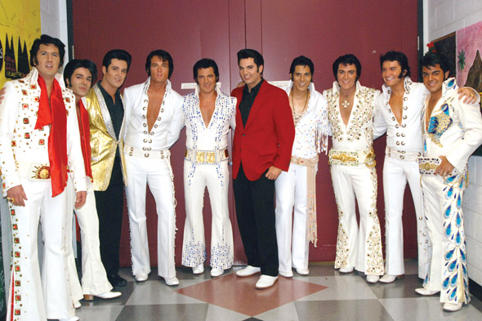
Being Like Him Too...
Everyone wants to be the King…

Slide 9
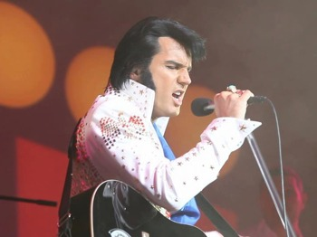
Being Like Him Too...
Everyone wants to be the King…
And…Sooner or later:

Slide 10
Being Like Him Too...
Everyone wants to be the King…
And…Sooner or later:
You can’t tell the original…

Slide 11
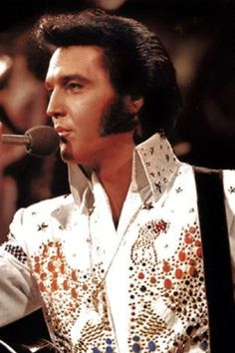
Being Like Him Too...
Everyone wants to be the King…
Sooner or later:
You can’t tell the original from the disciple.

Slide 12
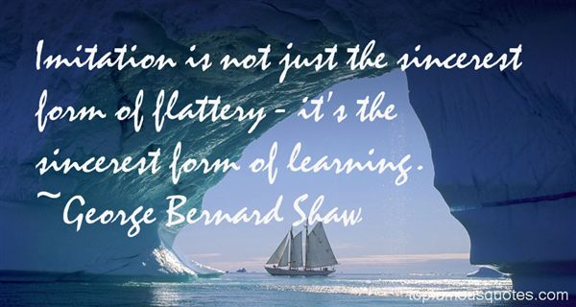
Being Like Him Too...

Slide 13
Being Like Him Too...
Not just…Guilty by association!

Slide 14
Being Like Him Too...
Not just…Guilty by association!

Slide 15
Being Like Him Too...
Not just…Guilty by association!
Acts 4:13—¹³ Now as they observed the confidence of Peter and John and understood that they were uneducated and untrained men, they were amazed, and began to recognize them as having been with Jesus. (NASB)

Slide 16
Being Like Him Too...
Not just…Guilty by association!
The
Attitudes
Words and Works
of
Peter and John
said
EVERYTHING
about them.

Slide 17
Being Like Him Too...
Not just…Guilty by association!
“Confident”
Though considered
Uneducated
and
Untrained

Slide 18
Being Like Him Too...
Not just…Guilty by association!
They produced
“Amazement”
In the hearts
of
Jesus’
enemies

Slide 19
Being Like Him Too...
Not just…Guilty by association!
It was too obvious:
“They began to
recognize them
as having
been with
Jesus.”

Slide 20
Being Like Him Too...
Being FOR Jesus is being WITH Jesus!

Slide 21
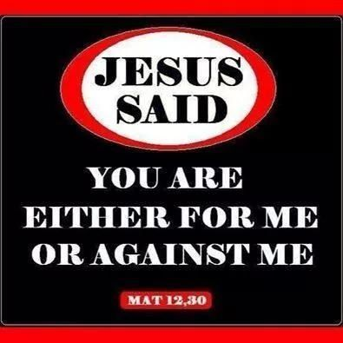
Being Like Him Too...
Being FOR Jesus is being WITH Jesus!
Matthew 12:30—
He who is not with Me is against Me; and he who does not gather with Me scatters. (NASB)

Slide 22
Being Like Him Too...
Being FOR Jesus is WITH Jesus!
Such is the
Closeness
Intensity
and
Mission
of the
Relationship.

Slide 23
Being Like Him Too...
Being FOR Jesus is WITH Jesus!
Everyone
is
Affected
_________
Everyone
is
Included

Slide 24
Being Like Him Too...
Being FOR Jesus is WITH Jesus!
Everyone
is
Affected
_________
Everyone
is
Included

Slide 25
Being Like Him Too...
Influence gathered in the presence of the Master

Slide 26
Being Like Him Too...
Influence gathered in the presence of the Master
1 John 1:1-4—What was from the beginning, what we have heard, what we have seen with our eyes, what we have looked at and touched with our hands, concerning the Word of Life. (NASB)

Slide 27
Being Like Him Too...
Influence gathered in the presence of the Master
HEARD—SEEN—LOOKED AT—TOUCHED
1 John 1:1-4—What was from the beginning, what we have heard, what we have seen with our eyes, what we have looked at and touched with our hands, concerning the Word of Life. (NASB)

Slide 28
Being Like Him Too...
Always with us…

Slide 29
Being Like Him Too...
Always with us…
Matthew 28:20—²⁰ Teach them to obey everything that I have taught you, and I will be with you always, even until the end of this age.” (NCV)

Slide 30
Being Like Him Too...
Always with us…
His witness is all around us, everywhere, all the time
Matthew 28:20—²⁰ Teach them to obey everything that I have taught you, and I will be with you always, even until the end of this age.” (NCV)

Slide 31
Being Like Him Too...
Always with us…
His witness is all around us, everywhere, all the time
He is with us:
Matthew 28:20—²⁰ Teach them to obey everything that I have taught you, and I will be with you always, even until the end of this age.” (NCV)

Slide 32
Being Like Him Too...
Always with us…
His witness is all around us, everywhere, all the time
He is with us:
The Holy Spirit dwells in us
Matthew 28:20—²⁰ Teach them to obey everything that I have taught you, and I will be with you always, even until the end of this age.” (NCV)

Slide 33
Being Like Him Too...
Always with us…
His witness is all around us, everywhere, all the time
He is with us:
The Bible is his living word
Matthew 28:20—²⁰ Teach them to obey everything that I have taught you, and I will be with you always, even until the end of this age.” (NCV)

Slide 34
Being Like Him Too...
Always with us…
His witness is all around us, everywhere, all the time
He is with us:
Providentially he causes all things to work together for good.
Matthew 28:20—²⁰ Teach them to obey everything that I have taught you, and I will be with you always, even until the end of this age.” (NCV)

Slide 35
Being Like Him Too...
Always with us…
His witness is all around us, everywhere, all the time
He is with us:
Providentially he answers every prayer asked according to his will .
Matthew 28:20—²⁰ Teach them to obey everything that I have taught you, and I will be with you always, even until the end of this age.” (NCV)

Slide 36
Being Like Him Too...
Always with us…
His witness is all around us, everywhere, all the time
He is with us:
We have the church—his body.
Matthew 28:20—²⁰ Teach them to obey everything that I have taught you, and I will be with you always, even until the end of this age.” (NCV)

Slide 37
Being Like Him Too...
Always with us…
His witness is all around us, everywhere, all the time
He is with us:
His saints—Christians offer us wisdom, comfort, direction.
Matthew 28:20—²⁰ Teach them to obey everything that I have taught you, and I will be with you always, even until the end of this age.” (NCV)

Slide 38
Being Like Him Too...
Always with us…
His witness is all around us, everywhere, all the time
He is with us:
His creation bears witness to his glory and splendour.
Matthew 28:20—²⁰ Teach them to obey everything that I have taught you, and I will be with you always, even until the end of this age.” (NCV)

Slide 39
Being Like Him Too...
Always with us…
Galatians 3:26-27
²⁶ For you are all sons of God through faith in Christ Jesus. ²⁷ For all of you who were baptized into Christ have clothed yourselves with Christ. (NASB)

