Slide 1
Series: Burdens are lifted…
Part 1. “Come unto Me.”
John Staiger
Morningside Church of Christ
Sunday 30 January 2022
AM Sermon
Broadcast live from 42 Leslie Ave, Auckland, Aotearoa/NZ.

Slide 2
Burdens are lifted…
Part 1.
“Come unto Me.”

Slide 3
Series: Burdens are lifted…Part 1. “Come unto Me.”
Burdens abound…
All of us are burdened

Slide 4
Series: Burdens are lifted…Part 1. “Come unto Me.”
Burdens abound…
All of us are burdened
Some burdens are common to all of us:

Slide 5
Series: Burdens are lifted…Part 1. “Come unto Me.”
Burdens abound…
All of us are burdened
Some burdens are common to all of us:
Death

Slide 6
Series: Burdens are lifted…Part 1. “Come unto Me.”
Burdens abound…
All of us are burdened
Some burdens are common to all of us:
Death
Separation

Slide 7
Series: Burdens are lifted…Part 1. “Come unto Me.”
Burdens abound…
All of us are burdened
Some burdens are common to all of us:
Death
Separation
Loneliness

Slide 8
Series: Burdens are lifted…Part 1. “Come unto Me.”
Burdens abound…
All of us are burdened
Some burdens are common to all of us:
Death
Separation
Loneliness
Unfulfilled promises

Slide 9
Series: Burdens are lifted…Part 1. “Come unto Me.”
Burdens abound…
All of us are burdened
Some burdens are common to all of us:
Death
Separation
Loneliness
Unfulfilled promises
Meanness

Slide 10
Series: Burdens are lifted…Part 1. “Come unto Me.”
Burdens abound…
All of us are burdened
Some burdens are common to all of us:
Death
Separation
Loneliness
Unfulfilled promises
Meanness
Discouragement

Slide 11
Series: Burdens are lifted…Part 1. “Come unto Me.”
Burdens abound…
All of us are burdened
Some burdens are common to all of us:
Physical pain

Slide 12
Series: Burdens are lifted…Part 1. “Come unto Me.”
Burdens abound…
All of us are burdened
Some burdens are common to all of us:
Physical pain
Illness

Slide 13
Series: Burdens are lifted…Part 1. “Come unto Me.”
Burdens abound…
All of us are burdened
Some burdens are common to all of us:
Physical pain
Illness
Infirmity

Slide 14
Series: Burdens are lifted…Part 1. “Come unto Me.”
Burdens abound…
All of us are burdened
Some burdens are common to all of us:
Unemployment

Slide 15
Series: Burdens are lifted…Part 1. “Come unto Me.”
Burdens abound…
All of us are burdened
Some burdens are common to all of us:
Unemployment
Insufficient means

Slide 16
Series: Burdens are lifted…Part 1. “Come unto Me.”
Burdens abound…
All of us are burdened
Some burdens are common to all of us:
Unemployment
Insufficient means
Theft…

Slide 17
Series: Burdens are lifted…Part 1. “Come unto Me.”
Burdens abound…
All of us are burdened
Some burdens are common to all of us:
Lost in sin

Slide 18
Series: Burdens are lifted…Part 1. “Come unto Me.”
Burdens abound…
All of us are burdened
Some burdens are common to all of us:
Lost in sin
Temptation

Slide 19
Series: Burdens are lifted…Part 1. “Come unto Me.”
Burdens abound…
All of us are burdened
Some burdens are common to all of us:
Lost in sin
Temptation
Trials

Slide 20
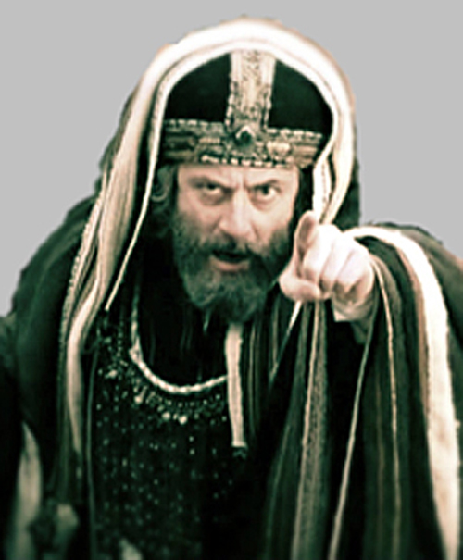
Series: Burdens are lifted…Part 1. “Come unto Me.”
Where comfort is offered…
The comfort of man—presented as if the comfort of God:
Matthew 23:15 "Woe to you, scribes and Pharisees, hypocrites! For you travel land and sea to win one proselyte, [convert] and when he is won, you make him twice as much a son of hell as yourselves.

Slide 21
Series: Burdens are lifted…Part 1. “Come unto Me.”
Where comfort is offered…
The comfort of man—presented as if the comfort of God:
Matthew 23:15 "Woe to you, scribes and Pharisees, hypocrites! For you travel land and sea to win one proselyte, [convert] and when he is won, you make him twice as much a son of hell as yourselves.

Slide 22
Series: Burdens are lifted…Part 1. “Come unto Me.”
Where comfort is offered…
The comfort of man—presented as if the comfort of God:
Fear

Slide 23
Series: Burdens are lifted…Part 1. “Come unto Me.”
Where comfort is offered…
The comfort of man—presented as if the comfort of God:
Fear
Guilt

Slide 24
Series: Burdens are lifted…Part 1. “Come unto Me.”
Where comfort is offered…
The comfort of man—presented as if the comfort of God:
Fear
Guilt
Bullying

Slide 25
Series: Burdens are lifted…Part 1. “Come unto Me.”
Where comfort is offered…
The comfort of man—presented as if the comfort of God:
Fear
Guilt
Bullying
Emotional binds

Slide 26
Series: Burdens are lifted…Part 1. “Come unto Me.”
Where comfort is offered…
The comfort of man—presented as if the comfort of God:
Fear
Guilt
Bullying
Emotional binds
Material incentives

Slide 27
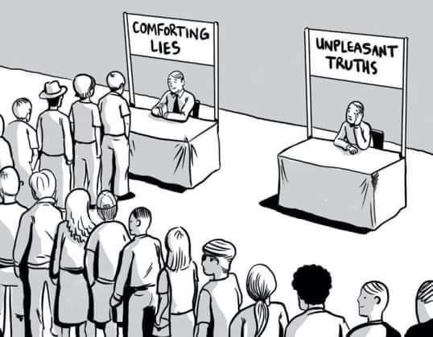
Series: Burdens are lifted…Part 1. “Come unto Me.”
Where comfort is offered…
The wisdom of man

Slide 28
Series: Burdens are lifted…Part 1. “Come unto Me.”
Where comfort is offered…
The wisdom of man
Discern all:

Slide 29
Series: Burdens are lifted…Part 1. “Come unto Me.”
Where comfort is offered…
The wisdom of man
Discern all:
Social media

Slide 30
Series: Burdens are lifted…Part 1. “Come unto Me.”
Where comfort is offered…
The wisdom of man
Discern all:
Social media
Newspapers

Slide 31
Series: Burdens are lifted…Part 1. “Come unto Me.”
Where comfort is offered…
The wisdom of man
Discern all:
Social media
Newspapers
TV

Slide 32
Series: Burdens are lifted…Part 1. “Come unto Me.”
Where comfort is offered…
The wisdom of man
Discern all:
Social media
Newspapers
TV
Favourite podcasts

Slide 33
Series: Burdens are lifted…Part 1. “Come unto Me.”
Where comfort is offered…
The wisdom of man
Discern all:
Social media
Newspapers
TV
Favourite podcasts
Friends

Slide 34
Series: Burdens are lifted…Part 1. “Come unto Me.”
Where comfort is offered…
The wisdom of man
Discern all:
Social media
Newspapers
TV
Favourite podcasts
Friends
OK… “IF” you accept that…

Slide 35
Series: Burdens are lifted…Part 1. “Come unto Me.”
Where to look for comfort…

Slide 36
Series: Burdens are lifted…Part 1. “Come unto Me.”
Where to look for comfort…
The wisdom of God

Slide 37
Series: Burdens are lifted…Part 1. “Come unto Me.”
Where to look for comfort…
The wisdom of God
“The Book about Jesus’ Rescue Mission.”

Slide 38
Series: Burdens are lifted…Part 1. “Come unto Me.”
Where to look for comfort…
The wisdom of God
“The Book about Jesus’ Rescue Mission.”
Without it we remain:

Slide 39
Series: Burdens are lifted…Part 1. “Come unto Me.”
Where to look for comfort…
The wisdom of God
“The Book about Jesus’ Rescue Mission.”
Without it we remain:
Lost

Slide 40
Series: Burdens are lifted…Part 1. “Come unto Me.”
Where to look for comfort…
The wisdom of God
“The Book about Jesus’ Recue Mission.”
Without it we remain:
Lost
Condemned

Slide 41
Series: Burdens are lifted…Part 1. “Come unto Me.”
Where to look for comfort…
The wisdom of God
“The Book about Jesus’ Rescue Mission.”
Without it we remain:
Lost
Condemned
Confused

Slide 42
Series: Burdens are lifted…Part 1. “Come unto Me.”
Where to look for comfort…
The wisdom of God
“The Book about Jesus’ Rescue Mission.”
Without it we remain:
Lost
Condemned
Confused
Disconnected

Slide 43
Series: Burdens are lifted…Part 1. “Come unto Me.”
Where to look for comfort…
The wisdom of God
“The Book about Jesus’ Rescue Mission.”
Without it we remain:
Lost
Condemned
Confused
Disconnected
Burdened!

Slide 44
Series: Burdens are lifted…Part 1. “Come unto Me.”
Where to look for comfort…
The wisdom of God
“The Book about Jesus’ Rescue Mission.”
Mark 9:7—
“This is My beloved Son, listen to Him!” (NASB95)

Slide 45
Series: Burdens are lifted…Part 1. “Come unto Me.”
Where to look for comfort…
The wisdom of God
“The Book about Jesus’ Rescue Mission.”
2 Timothy 3:16-17—
¹⁶All Scripture is inspired by God and profitable for teaching, for reproof, for correction, for training in righteousness; ¹⁷so that the man of God may be adequate, equipped for every good work. (NASB95)

Slide 46
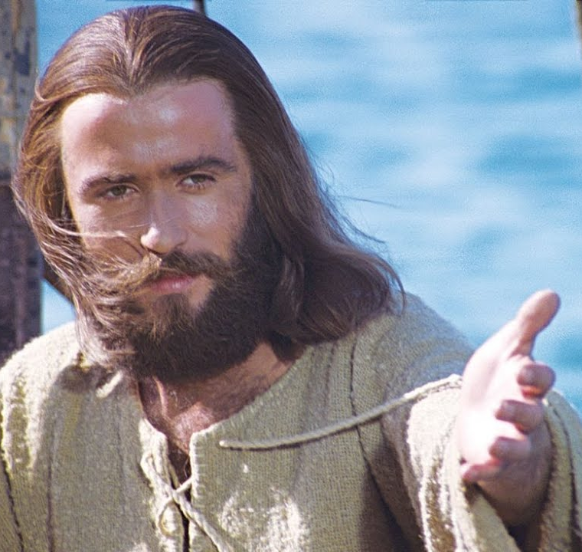
Series: Burdens are lifted…Part 1. “Come unto Me.”
The Burden-Lifter…
Matthew 11:28-29
²⁸ “Come to me, all of you who are weary and burdened, and I will give you rest…

Slide 47
Series: Burdens are lifted…Part 1. “Come unto Me.”
The Burden-Lifter…
Matthew 11:28-29
²⁹ Take up my yoke and learn from me, because I am lowly and humble in heart, and you will find rest for your souls. (CSB)

Slide 48
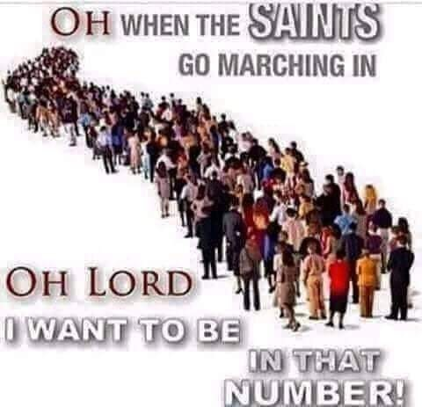
Series: Burdens are lifted…Part 1. “Come unto Me.”

Slide 49
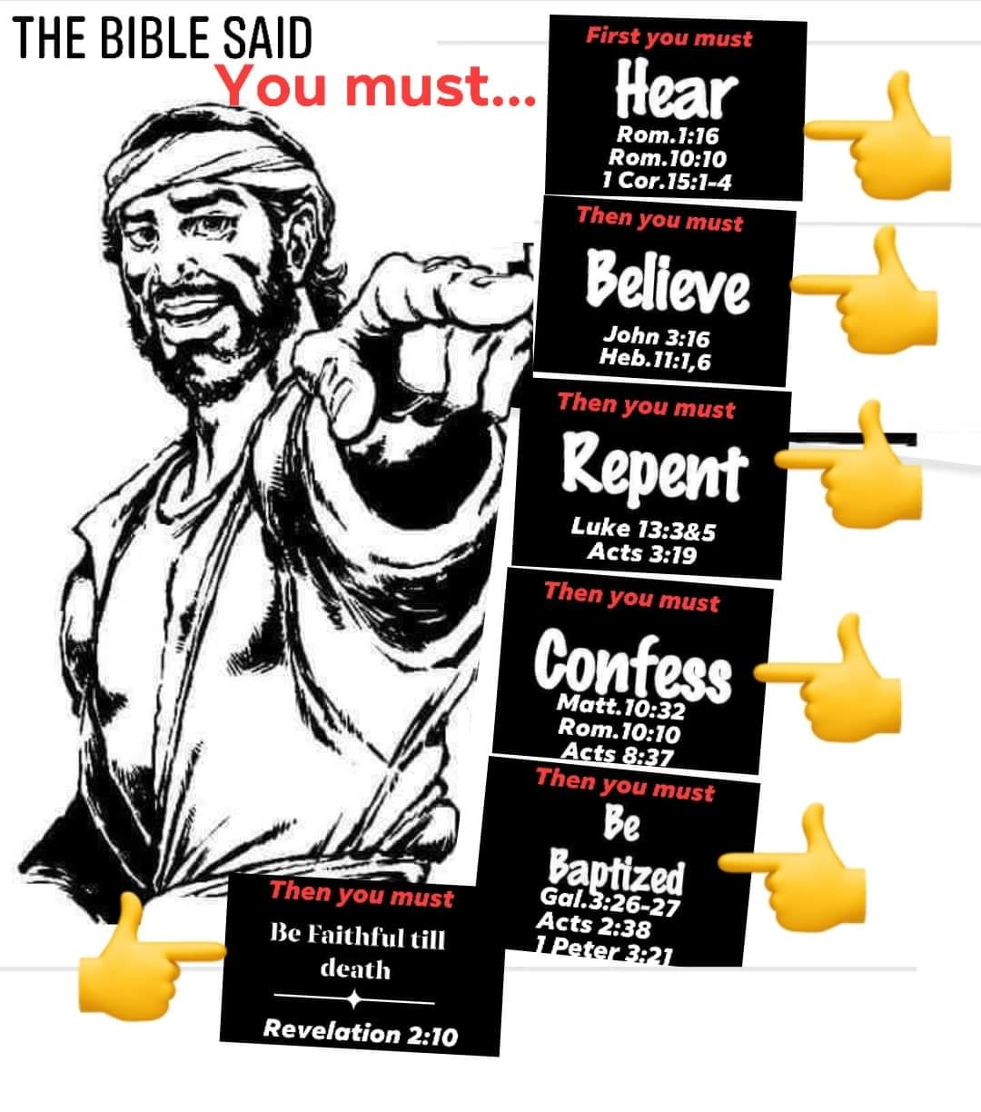
Series: Burdens are lifted…Part 1. “Come unto Me.”

