Slide 1
Series: Burdens are lifted…
Part 2. “Taking the Strain.”
John Staiger
Morningside Church of Christ
Sunday 6 February 2022
AM Sermon
Broadcast live from 42 Leslie Ave, Auckland, Aotearoa/NZ.

Slide 2
Burdens are lifted…
Part 2.
“Taking the Strain.”

Slide 3
Series: Burdens are lifted…Part 2. “Taking the Strain.”
Life gets tough—Any advice..?
Plenty…and to spare!

Slide 4
Series: Burdens are lifted…Part 2. “Taking the Strain.”
Life gets tough—Any advice..?

Slide 5
Series: Burdens are lifted…Part 2. “Taking the Strain.”
Life gets tough—Any advice..?
I have no idea what this means…

Slide 6
Series: Burdens are lifted…Part 2. “Taking the Strain.”
Life gets tough—Any advice..?
But if it means “The Helmet of Salvation,” I’ll take it.

Slide 7
Series: Burdens are lifted…Part 2. “Taking the Strain.”
Life gets tough—Any advice..?

Slide 8
Series: Burdens are lifted…Part 2. “Taking the Strain.”
Life gets tough—Any advice..?
It most certainly pays to look to your potential.

Slide 9
Series: Burdens are lifted…Part 2. “Taking the Strain.”
Life gets tough—Any advice..?

Slide 10
Series: Burdens are lifted…Part 2. “Taking the Strain.”
Life gets tough—Any advice..?
OK…?
or Clint Eastwood?

Slide 11
Series: Burdens are lifted…Part 2. “Taking the Strain.”
Life gets tough—Any advice..?
OK…?
I’m I John Wayne…? or Clint Eastwood?

Slide 12
Series: Burdens are lifted…Part 2. “Taking the Strain.”
Life gets tough—Any advice..?
OK…?
I’m I John Wayne or Clint Eastwood?

Slide 13
Series: Burdens are lifted…Part 2. “Taking the Strain.”
Life gets tough—Any advice..?
OK…?
I’m I John Wayne or Clint Eastwood?
Sorry guys, but the
TOUGH,
RUGGED INDIVIDUAL
makes better movies than
REALITY

Slide 14
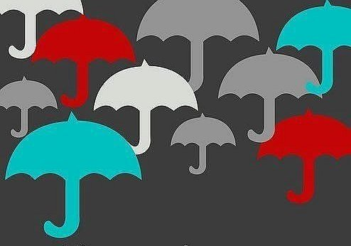
Series: Burdens are lifted…Part 2. “Taking the Strain.”
Not here to rain on your parade…

Slide 15
Series: Burdens are lifted…Part 2. “Taking the Strain.”
Not here to rain on your parade…
Life is to be enjoyed.

Slide 16
Series: Burdens are lifted…Part 2. “Taking the Strain.”
Not here to rain on your parade…
Life is to be enjoyed.
To be full of—
Abundance.
Victories.
Fun.

Slide 17
Series: Burdens are lifted…Part 2. “Taking the Strain.”
Life gets Difficult…
Life delivers heavy, crushing blows.
We get weighed down.
They seem more than a soul can carry.
We need help.

Slide 18
Series: Burdens are lifted…Part 2. “Taking the Strain.”
Life gets Difficult…
Life delivers heavy, crushing blows.
We get weighed down.
They seem more than a soul can carry.
We need help.

Slide 19
Series: Burdens are lifted…Part 2. “Taking the Strain.”
Life gets Difficult…
Life delivers heavy, crushing blows.
We get weighed down.
They seem more than a soul can carry.
We need help.

Slide 20
Series: Burdens are lifted…Part 2. “Taking the Strain.”
Life gets Difficult…
Life delivers heavy, crushing blows.
We get weighed down.
They seem more than a soul can carry.
We need help.

Slide 21
Series: Burdens are lifted…Part 2. “Taking the Strain.”
Life gets Difficult…
Life delivers heavy, crushing blows.
We get weighed down.
They seem more than a soul can carry.
We need help.

Slide 22
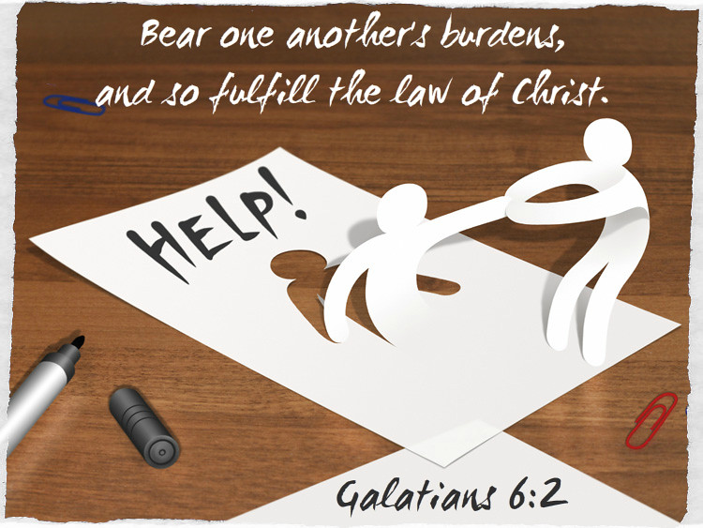
Series: Burdens are lifted…Part 2. “Taking the Strain.”
How do we know someone is struggling…?

Slide 23
Series: Burdens are lifted…Part 2. “Taking the Strain.”
How do we know someone is struggling…?
Like Jeremiah—Their countenance has fallen.
They are unsettled.
We don’t see them as much anymore.
Some are open about their burdens.
Others are concerned for good reason.
Disappear into our own worlds.

Slide 24
Series: Burdens are lifted…Part 2. “Taking the Strain.”
How do we know someone is struggling…?
Like Jeremiah—Their countenance has fallen.
They are unsettled.
We don’t see them as much anymore.
Some are open about their burdens.
Others are concerned for good reason.
Disappear into our own worlds.

Slide 25
Series: Burdens are lifted…Part 2. “Taking the Strain.”
How do we know someone is struggling…?
Like Jeremiah—Their countenance has fallen.
They are unsettled.
We don’t see them as much anymore.
Some are open about their burdens.
Others are concerned for good reason.
Disappear into our own worlds.

Slide 26
Series: Burdens are lifted…Part 2. “Taking the Strain.”
How do we know someone is struggling…?
Like Jeremiah—Their countenance has fallen.
They are unsettled.
We don’t see them as much anymore.
Some are open about their burdens.
Others are concerned for good reason.
Disappear into our own worlds.

Slide 27
Series: Burdens are lifted…Part 2. “Taking the Strain.”
How do we know someone is struggling…?
Like Jeremiah—Their countenance has fallen.
They are unsettled.
We don’t see them as much anymore.
Some are open about their burdens.
Others are concerned for them for good reason.
Disappear into our own worlds.

Slide 28
Series: Burdens are lifted…Part 2. “Taking the Strain.”
How do we know someone is struggling…?
Like Jeremiah—Their countenance has fallen.
They are unsettled.
We don’t see them as much anymore.
Some are open about their burdens.
Others are concerned for them for good reason.
Disappear into our own worlds.

Slide 29
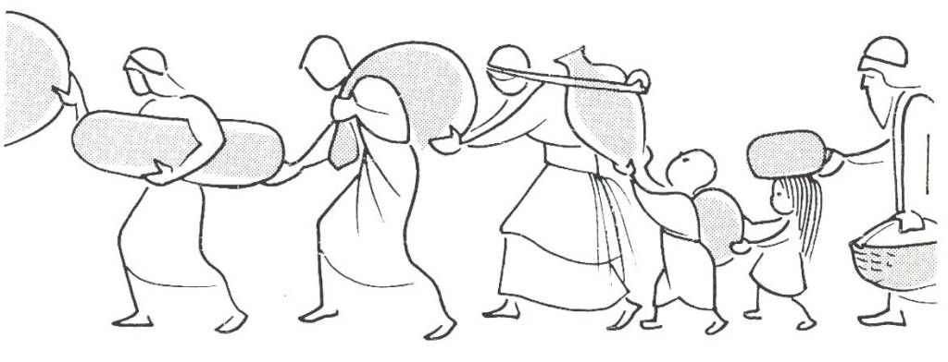
Series: Burdens are lifted…Part 2. “Taking the Strain.”
How to take the Strain—Fulfilling the Law of Christ…

Slide 30
Series: Burdens are lifted…Part 2. “Taking the Strain.”
How to take the Strain—Fulfilling the Law of Christ…
Galatians 6:2—
²Bear one another’s burdens, and thereby fulfill the law of Christ. (NASB95)

Slide 31
Series: Burdens are lifted…Part 2. “Taking the Strain.”
How to take the Strain—Fulfilling the Law of Christ…
Bearer “…You who are spiritual”

Slide 32
Series: Burdens are lifted…Part 2. “Taking the Strain.”
How to take the Strain—Fulfilling the Law of Christ…
Bearer “…You who are spiritual”
Spiritual people for spiritual work.

Slide 33
Series: Burdens are lifted…Part 2. “Taking the Strain.”
How to take the Strain—Fulfilling the Law of Christ…
Bearer “…You who are spiritual”
Always caring—ready to help

Slide 34
Series: Burdens are lifted…Part 2. “Taking the Strain.”
How to take the Strain—Fulfilling the Law of Christ…
Bearer “…You who are spiritual”
Strong to strengthen

Slide 35
Series: Burdens are lifted…Part 2. “Taking the Strain.”
How to take the Strain—Fulfilling the Law of Christ…
Bearer “…You who are spiritual”
Confidential

Slide 36
Series: Burdens are lifted…Part 2. “Taking the Strain.”
How to take the Strain—Fulfilling the Law of Christ…
Bearer “…You who are spiritual”
If you are in a bad place, seek help yourself.

Slide 37
Series: Burdens are lifted…Part 2. “Taking the Strain.”
The Goal—

Slide 38
Series: Burdens are lifted…Part 2. “Taking the Strain.”
The Goal—
“Restore such a one”
Back on the ‘Narrow Road!’
Not your personal counselling client
God’s struggling child
Repentance
Fellowship
Healing
Growth
Maturity
Strong to take the strain

Slide 39
Series: Burdens are lifted…Part 2. “Taking the Strain.”
The Goal—
“Restore such a one”
Back on the ‘Narrow Road!’
Not your personal counselling client
God’s struggling child
Repentance
Fellowship
Healing
Growth
Maturity
Strong to take the strain

Slide 40
Series: Burdens are lifted…Part 2. “Taking the Strain.”
The Goal—
“Restore such a one”
Back on the ‘Narrow Road!’
Not your personal counselling client
God’s struggling child
Repentance
Fellowship
Healing
Growth
Maturity
Strong to take the strain

Slide 41
Series: Burdens are lifted…Part 2. “Taking the Strain.”
The Goal—
“Restore such a one”
Back on the ‘Narrow Road!’
Not your personal counselling client
God’s struggling child
Repentance
Fellowship
Healing
Growth
Maturity
Strong to take the strain

Slide 42
Series: Burdens are lifted…Part 2. “Taking the Strain.”
The Goal—
“Restore such a one”
Back on the ‘Narrow Road!’
Not your personal counselling client
God’s struggling child
Repentance
Fellowship
Healing
Growth
Maturity
Strong to take the strain

Slide 43
Series: Burdens are lifted…Part 2. “Taking the Strain.”
The Goal—
“Restore such a one”
Back on the ‘Narrow Road!’
Not your personal counselling client
God’s struggling child
Repentance
Fellowship
Healing
Growth
Maturity
Strong to take the strain

Slide 44
Series: Burdens are lifted…Part 2. “Taking the Strain.”
The Goal—
“Restore such a one”
Back on the ‘Narrow Road!’
Not your personal counselling client
God’s struggling child
Repentance
Fellowship
Healing
Growth
Maturity
Strong to take the strain

Slide 45
Series: Burdens are lifted…Part 2. “Taking the Strain.”
The Goal—
“Restore such a one”
Back on the ‘Narrow Road!’
Not your personal counselling client
God’s struggling child
Repentance
Fellowship
Healing
Growth
Maturity
Strong to take the strain

Slide 46
Series: Burdens are lifted…Part 2. “Taking the Strain.”
The Goal—
“Restore such a one”
Back on the ‘Narrow Road!’
Not your personal counselling client
God’s struggling child
Repentance
Fellowship
Healing
Growth
Maturity
Strong to take the strain

Slide 47
Series: Burdens are lifted…Part 2. “Taking the Strain.”
The Goal—
“Restore such a one”
Back on the ‘Narrow Road!’
Not your personal counselling client
God’s struggling child
Repentance
Fellowship
Healing
Growth
Maturity
Strong to take the strain

Slide 48
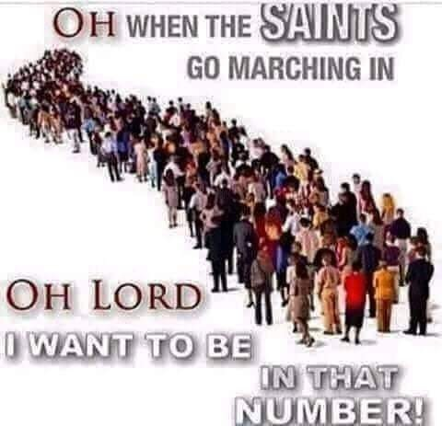
Series: Burdens are lifted… Part 2. “Taking the Strain.”

Slide 49
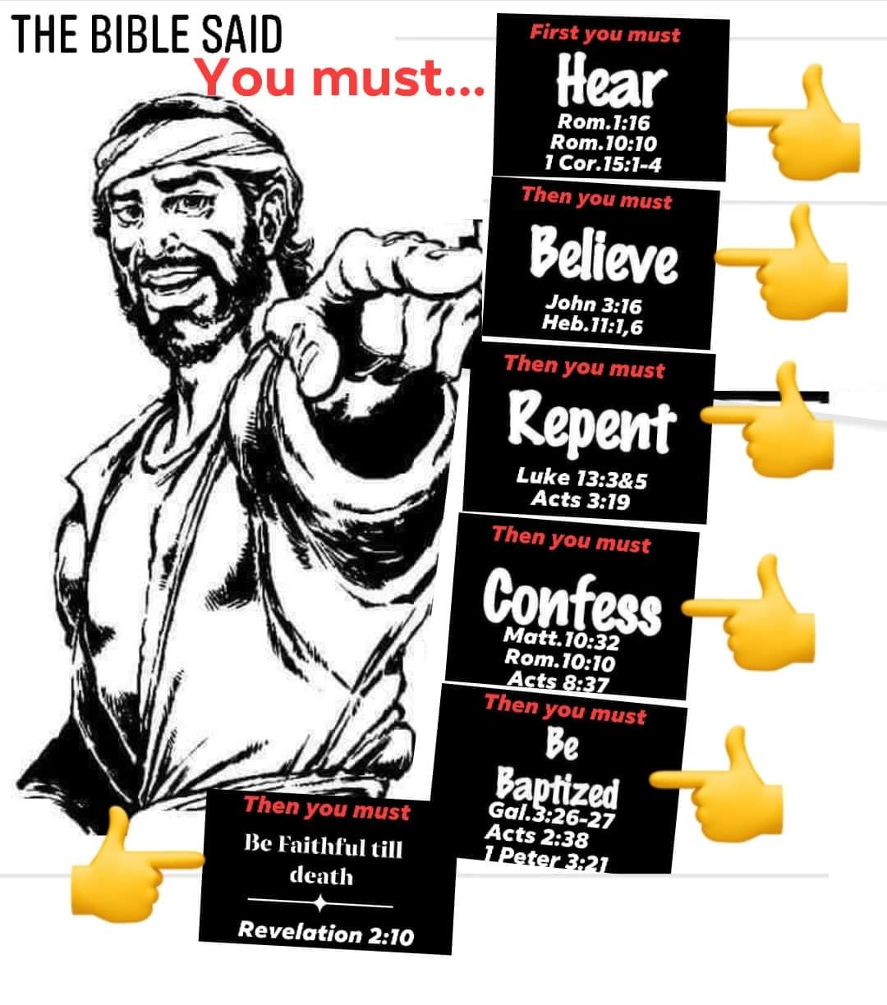
Series: Burdens are lifted… Part 2. “Taking the Strain.”

