Slide 1
“Human Solutions
Part 2. We’re not that good at this…
John Staiger
Morningside Church of Christ
Sunday 20 February 2022
PM Sermon
Broadcast live from 42 Leslie Ave, Auckland, Aotearoa/NZ.

Slide 2
Human Solutions
Part 2.
We’re not that good at this…

Slide 3
Human Solutions…Part 2. We’re not that good at this…
Because when we make decisions for ourselves…
We choose selfishly:

Slide 4
Human Solutions…Part 2. We’re not that good at this…
Because
We choose selfishly:

Slide 5
Human Solutions…Part 2. We’re not that good at this…
.. make decisions for ourselves…………..
We choose selfishly:
Chaos results when citizens do what is right to them (Judges 21:25).

Slide 6
Human Solutions…Part 2. We’re not that good at this…
Because when we makes for ourselves……………..
We choose selfishly:

Slide 7
Human Solutions…Part 2. We’re not that good at this…
Because when we makes for ourselves……………..
We choose selfishly:
This is why laws are necessary in a country.

Slide 8
Human Solutions…Part 2. We’re not that good at this…
Because when we makes for ourselves……………..
We choose selfishly:
This is why laws are necessary in a country.
Rulers become selfish and crush the human spirit in order to keep their own position.

Slide 9
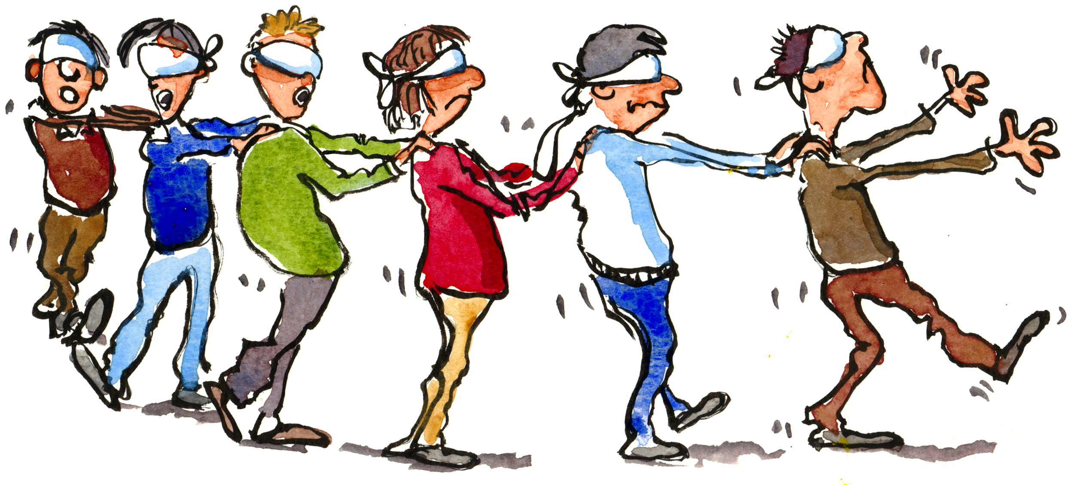
Human Solutions…Part 2. We’re not that good at this…
Because we are susceptible to spiritual blindness:

Slide 10
Human Solutions…Part 2. We’re not that good at this…
Because we are susceptible to spiritual blindness:
Luke 6:39—³⁹And He also spoke a parable to them: “A blind man cannot guide a blind man, can he? Will they not both fall into a pit? (NASB95)

Slide 11
Human Solutions…Part 2. We’re not that good at this…
Because we are susceptible to spiritual blindness:
Jesus suggested that those who claim to see are in fact the ones who are blind (John 9:41).

Slide 12
Human Solutions…Part 2. We’re not that good at this…
Because we are susceptible to spiritual blindness:
John 9:41—⁴¹Jesus said to them, “If you were blind, you would have no sin; but since you say, ‘We see,’ your sin remains.(NASB)

Slide 13
Human Solutions…Part 2.
Because we are susceptible to spiritual blindness:
The irony—We continually delude ourselves. We think ourselves, “Oh so wise.”

Slide 14
Human Solutions…Part 2. We’re not that good at this…
Because we are susceptible to spiritual blindness:
Its our arrogance that blinds us to our failures!

Slide 15
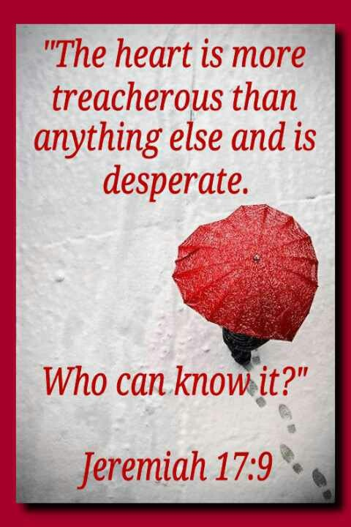
Human Solutions…Part 2. We’re not that good at this…
Because more than conscience must be our guide:

Slide 16
Human Solutions…Part 2. We’re not that good at this…
Because more than conscience must be our guide:
And who does the heart deceive?

Slide 17
Human Solutions…Part 2. We’re not that good at this…
Because more than conscience must be our guide:
Usually, it deceives its owner!

Slide 18
Human Solutions…Part 2. We’re not that good at this…
Because more than conscience must be our guide:
We are expert at:

Slide 19
Human Solutions…Part 2. We’re not that good at this…
Because more than conscience must be our guide:
We are expert at:
Finding “excellent” reasons for our own actions.

Slide 20
Human Solutions…Part 2. We’re not that good at this…
Because more than conscience must be our guide:
We are expert at:
Finding “excellent” reasons for our own actions.
Excusing our sinful actions.

Slide 21
Human Solutions…Part 2. We’re not that good at this…
Because more than conscience must be our guide:
We are expert at:
Finding “excellent” reasons for our own actions.
Excusing our sinful actions.
Pleading extenuating circumstances in our own case.

Slide 22
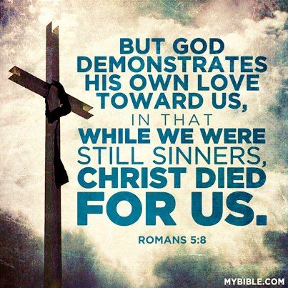
Human Solutions…Part 2. We’re not that good at this…
Because We’re only human.

Slide 23
Human Solutions…Part 2. We’re not that good at this…
Because We’re only human.
We’re not gods.

Slide 24
Human Solutions…Part 2. We’re not that good at this…
Because We’re only human.
We’re not:

Slide 25
Human Solutions…Part 2. We’re not that good at this…
Because We’re only human.
We’re not:
Noble

Slide 26
Human Solutions…Part 2. We’re not that good at this…
Because We’re only human.
We’re not:
Noble
Wise

Slide 27
Human Solutions…Part 2. We’re not that good at this…
Because We’re only human.
We’re not:
Noble
Wise
Ever advancing

Slide 28
Human Solutions…Part 2. We’re not that good at this…
Because We’re only human.
We sin:

Slide 29
Human Solutions…Part 2. We’re not that good at this…
Because We’re only human.
We sin:
Always desperately in need of God’s guidance!

Slide 30
Human Solutions…Part 2. We’re not that good at this…
Because We’re only human.
Unresolved problems:

Slide 31
Human Solutions…Part 2. We’re not that good at this…
Because We’re only human.
Unresolved problems:
Murder
Violence
Racism
Hatred
Greed
Theft
Immorality

Slide 32
Human Solutions…Part 2. We’re not that good at this…
Because We’re only human.
Biggest problem:

Slide 33
Human Solutions…Part 2. We’re not that good at this…
Because We’re only human.
Biggest problem:
Separation from God.

Slide 34
Human Solutions…Part 2. We’re not that good at this…
Because We’re only human.
Biggest problem:
Separation from God.
For this we must seek our Saviour—Jesus Christ.

Slide 35
Human Solutions…Part 2. We’re not that good at this…
Because We’re only human.
Biggest problem:
Separation from God.
For this we must seek our Saviour—Jesus Christ.
1 Timothy 2:5— For there is one God, and one mediator also between God and men, the man Christ Jesus,

