Slide 1
Series: On Track (Part 1).
“Just Fix It! (Again, if you have to).”
John Staiger
Morningside Church of Christ
Sunday 23 January 2022
PM Sermon
Broadcast from 42 Leslie Avenue, Auckland, Aotearoa/NZ.
www.morningsidechurchofchrist.org.nz

Slide 2
Just Fix It!
(Again, if you have to.)

Slide 3
Just Fix It!
Jesus and Judas—He betrayed Jesus.

Slide 4
Just Fix It!
Jesus and Judas—Jesus did warn him…

Slide 5
Just Fix It!
Jesus and Judas—Jesus did warn him…
General warnings to the 12—“Did I Myself not choose you, the twelve, and yet one of you is a devil?” (Jn.6:70)

Slide 6
Just Fix It!
Jesus and Judas—Jesus did warn him…
A Public “specific” warning at Last Supper—“Did I Myself not choose you, the twelve, and yet one of you is a devil?” And Judas, who was betraying Him, said, “Surely it is not I, Rabbi?” Jesus said to him, “You have said it yourself.” (Mt.26:23-24)

Slide 7
Just Fix It!
Jesus and Judas—Jesus did warn him…
Warned him privately—“What thou doest, do quickly.” (Jn.13:27)

Slide 8
Just Fix It!
Jesus and Judas—What could have been done?
Jesus
Never chosen Judas as a disciple?
Spoken to him everyday?
Named and shamed Judas earlier?
Kicked him our of the 12?
Told everyone Judas was a thief?

Slide 9
Just Fix It!
Jesus and Judas—What could have been done?
Jesus
Never chosen Judas as a disciple?
Spoken to him everyday?
Named and shamed Judas earlier?
Kicked him our of the 12?
Told everyone Judas was a thief?

Slide 10
Just Fix It!
Jesus and Judas—What could have been done?
Jesus
Never chosen Judas as a disciple?
Spoken to him everyday?
Named and shamed Judas earlier?
Kicked him our of the 12?
Told everyone Judas was a thief?

Slide 11
Just Fix It!
Jesus and Judas—What could have been done?
Jesus
Never chosen Judas as a disciple?
Spoken to him everyday?
Named and shamed Judas earlier?
Kicked him our of the 12?
Told everyone Judas was a thief?

Slide 12
Just Fix It!
Jesus and Judas—What could have been done?
Jesus
Never chosen Judas as a disciple?
Spoken to him everyday?
Named and shamed Judas earlier?
Kicked him our of the 12?
Told everyone Judas was a thief?

Slide 13
Just Fix It!
Jesus and Judas—What could have been done?
Jesus
Never chosen Judas as a disciple?
Spoken to him everyday?
Named and shamed Judas earlier?
Kicked him out of the 12?
Told everyone Judas was a thief?

Slide 14
Just Fix It!
Jesus and Judas—What could have been done?
Jesus
Never chosen Judas as a disciple?
Spoken to him everyday?
Named and shamed Judas earlier?
Kicked him out of the 12?
Told everyone Judas was a thief?

Slide 15
Just Fix It!
Jesus and Judas—What could have been done?
Judas
Was chosen for God’s reasons
His evil was used as a part of God’s plan to save man
He had complete freewill
Knew the consequences
The disciples saw Jesus let freewill happen
We all learn from it—Grow from it

Slide 16
Just Fix It!
Jesus and Judas—What could have been done?
Judas
Was chosen for God’s reasons
His evil was used as a part of God’s plan to save man
He had complete freewill
Knew the consequences
The disciples saw Jesus let freewill happen
We all learn from it—Grow from it

Slide 17
Just Fix It!
Jesus and Judas—What could have been done?
Judas
Was chosen for God’s reasons
His evil was used as a part of God’s plan to save man
He had complete freewill
Knew the consequences
The disciples saw Jesus let freewill happen
We all learn from it—Grow from it

Slide 18
Just Fix It!
Jesus and Judas—What could have been done?
Judas
Was chosen for God’s reasons
His evil was used as a part of God’s plan to save man
He had complete freewill
Knew the consequences
The disciples saw Jesus let freewill happen
We all learn from it—Grow from it

Slide 19
Just Fix It!
Jesus and Judas—What could have been done?
Judas
Was chosen for God’s reasons
His evil was used as a part of God’s plan to save man
He had complete free will
Knew the consequences
The disciples saw Jesus let freewill happen
We all learn from it—Grow from it

Slide 20
Just Fix It!
Jesus and Judas—What could have been done?
Judas
Was chosen for God’s reasons
His evil was used as a part of God’s plan to save man
He had complete free will
Knew the consequences
The disciples saw Jesus let free will happen
We all learn from it—Grow from it

Slide 21
Just Fix It!
Jesus and Judas—What could have been done?
Judas
Was chosen for God’s reasons
His evil was used as a part of God’s plan to save man
He had complete free will
Knew the consequences
The disciples saw Jesus let free will happen
We all learn from it—Grow from it

Slide 22
Just Fix It!
King David and Absalom
Killed his brother, Amnon.
Banished
David didn’t see him
Back to Jerusalem, but wouldn’t see him
Absalom attempted to take the kingdom
Defeated and killed by Joab

Slide 23
Just Fix It!
King David and Absalom
Killed his brother, Amnon.
Banished
David didn’t see him
Back to Jerusalem, but wouldn’t see him
Absalom attempted to take the kingdom
Defeated and killed by Joab

Slide 24
Just Fix It!
King David and Absalom—What could David have done?
David
Watched his children
Punished Amnon
Kept Absalom close

Slide 25
Just Fix It!
King David and Absalom—What could David have done?
David
Watched his children
Punished Amnon
Kept Absalom close

Slide 26
Just Fix It!
King David and Absalom—What could David have done?
David
Watched his children
Punished Amnon
Kept Absalom close

Slide 27
Just Fix It!
King David and Absalom—What could David have done?
David
Watched his children
Punished Amnon
Kept Absalom close

Slide 28
Just Fix It!
King David and Absalom—What could David have done?
Absalom
God used his evil to punish David’s sin
Needed the firm hand of his father

Slide 29
Just Fix It!
King David and Absalom—What could David have done?
Absalom
God used his evil to punish David’s sin
Needed the firm hand of his father

Slide 30
Just Fix It!
King David and Absalom—What could David have done?
Absalom
God used his evil to punish David’s sin
Needed the firm hand of his father

Slide 31
Just Fix It!
Your Opponent at Law wants to sue you!

Slide 32
Just Fix It!
Your Opponent at Law wants to sue you!

Slide 33
Just Fix It!
Your Opponent at Law wants to sue you! What to do?
Matthew 5:25—
Make friends quickly with your opponent at law while you are with him on the way, so that your opponent may not hand you over to the judge, and the judge to the officer, and you be thrown into prison. ²⁶ Truly I say to you, you will not come out of there until you have paid up the last cent. (NASB)

Slide 34
Just Fix It!
If anyone wants to sue you and take your shirt…?
Matthew 5:40

Slide 35
Just Fix It!
If anyone wants to sue you and take your shirt…?
Matthew 5:40

Slide 36
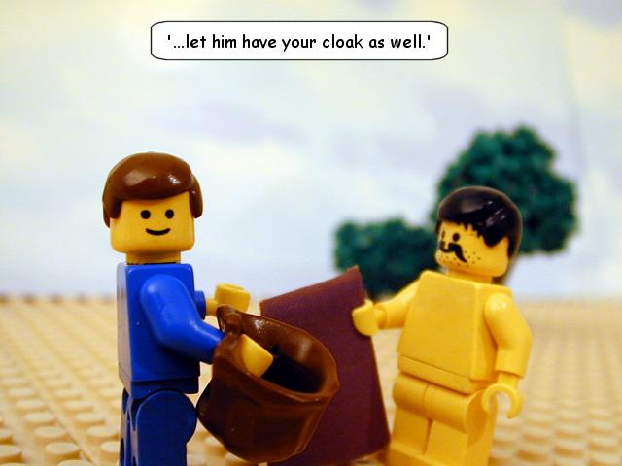
Just Fix It!
If anyone wants to sue you and take your shirt…?
—What to do?
Matthew 5:40

Slide 37
Just Fix It!
Problem with Self-righteousness?

Slide 38
Just Fix It!
Problem with Self-righteousness?

Slide 39
Just Fix It!
Problem with Self-righteousness?—What to do?

Slide 40
Just Fix It!
Problem with Self-righteousness?—What to do?

Slide 41
Just Fix It!
Problem with Anger?

Slide 42
Just Fix It!
Problem with Anger?
Angry words
Oh, let them never
From the tongue
Unbridled slip…

Slide 43
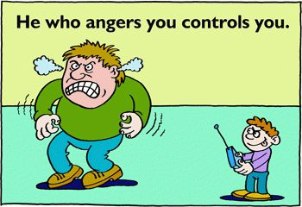
Just Fix It!
Problem with Anger?—What to do?
Proverbs 16:32—
³²He who is slow to anger is better than the mighty, And he who rules his spirit, than he who captures a city.

Slide 44
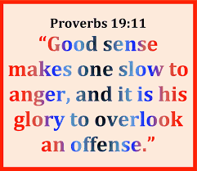
Just Fix It!
Problem with Anger?—What to do?

Slide 45
Just Fix It!
Problem with Anger?—What to do?

Slide 46
Just Fix It!
Problem with Money?

Slide 47
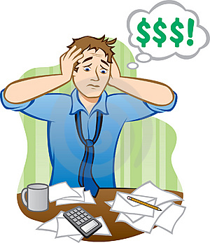
Just Fix It!
Problem with Money?

Slide 48
Just Fix It!
Problem with Money?

Slide 49
Just Fix It!
Problem with Money?—What to do?

Slide 50
Just Fix It!
Problem with Money?—What to do?

Slide 51
Just Fix It!
Problem with Temptation?—

Slide 52
Just Fix It!
Problem with Temptation?—No, not this one!

Slide 53
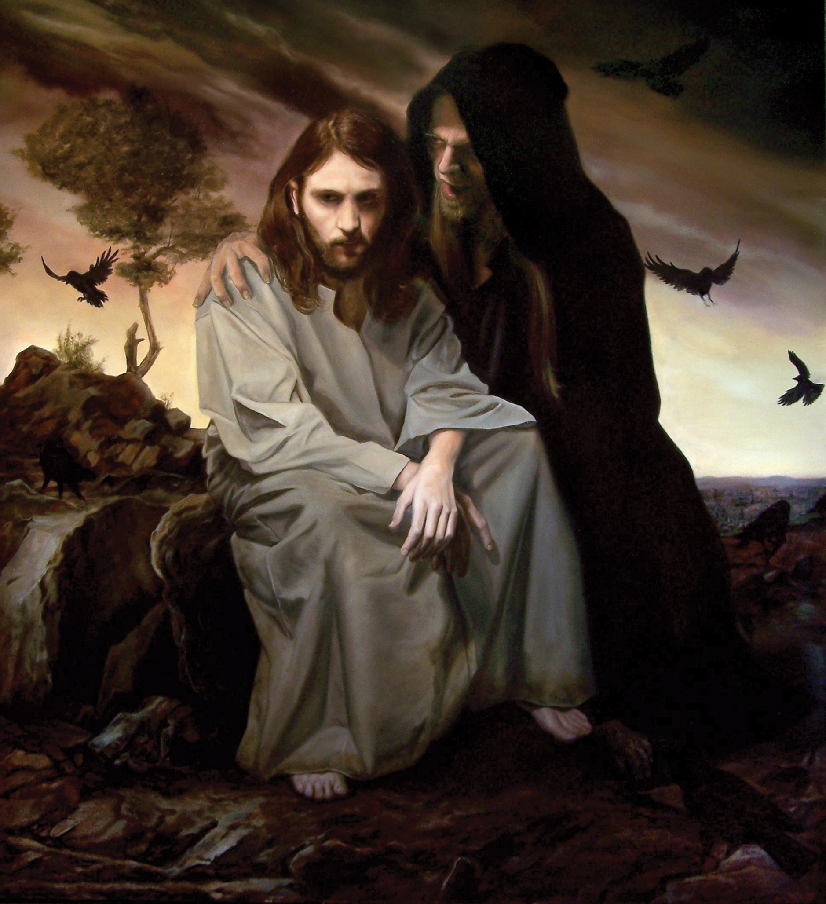
Just Fix It!
Problem with Temptation?—This one!

Slide 54
Just Fix It!
Problem with Temptation?—What to do?

Slide 55
Just Fix It!
Problem with Temptation?—What to do?

Slide 56
Just Fix It!
Problem with Temptation?—What to do?

