Slide 1
There is Still Only One
John Staiger
Morningside Church of Christ
Sunday 30 January 2022
PM Sermon
Broadcast live from 42 Leslie Ave, Auckland, Aotearoa/NZ.

Slide 2
There is Still Only One!

Slide 3
There is Still Only One…
Gospel
1 Corinthians 15:1-4
Now I make known to you, brethren,
the gospel which I preached to you, which also you received,
in which also you stand,
²by which also you are saved,
if you hold fast the word which I preached to you,
unless you believed in vain.
³For I delivered to you as of first importance what I also received,
that Christ died for our sins according to the Scriptures,
⁴and that He was buried,
and that He was raised on the third day
according to the Scriptures, (NASB)

Slide 4
There is Still Only One…
Gospel
1 Corinthians 15:1-4
Now I make known to you, brethren,
the gospel which I preached to you, which also you received,
in which also you stand,
²by which also you are saved,
if you hold fast the word which I preached to you,
unless you believed in vain.
³For I delivered to you as of first importance what I also received,
that Christ died for our sins according to the Scriptures,
⁴and that He was buried,
and that He was raised on the third day
according to the Scriptures, (NASB)

Slide 5
There is Still Only One…
Gospel
1 Corinthians 15:1-4
Now I make known to you, brethren,
the gospel which I preached to you, which also you received,
in which also you stand,
²by which also you are saved,
if you hold fast the word which I preached to you,
unless you believed in vain.
³For I delivered to you as of first importance what I also received,
that Christ died for our sins according to the Scriptures,
⁴and that He was buried,
and that He was raised on the third day
according to the Scriptures, (NASB)

Slide 6
There is Still Only One…
Gospel
1 Corinthians 15:1-4
Now I make known to you, brethren,
the gospel which I preached to you, which also you received,
in which also you stand,
²by which also you are saved,
if you hold fast the word which I preached to you,
unless you believed in vain.
³For I delivered to you as of first importance what I also received,
that Christ died for our sins according to the Scriptures,
⁴and that He was buried,
and that He was raised on the third day
according to the Scriptures, (NASB)

Slide 7
There is Still Only One…
Gospel
1 Corinthians 15:1-4
Now I make known to you, brethren,
the gospel which I preached to you, which also you received,
in which also you stand,
²by which also you are saved,
if you hold fast the word which I preached to you,
unless you believed in vain.
³For I delivered to you as of first importance what I also received,
that Christ died for our sins according to the Scriptures,
⁴and that He was buried,
and that He was raised on the third day
according to the Scriptures, (NASB)

Slide 8
There is Still Only One…
Gospel
1 Corinthians 15:1-4
Now I make known to you, brethren,
the gospel which I preached to you, which also you received,
in which also you stand,
²by which also you are saved,
if you hold fast the word which I preached to you,
unless you believed in vain.
³For I delivered to you as of first importance what I also received,
that Christ died for our sins according to the Scriptures,
⁴and that He was buried,
and that He was raised on the third day
according to the Scriptures, (NASB)

Slide 9
There is Still Only One…
Gospel
1 Corinthians 15:1-4
Now I make known to you, brethren,
the gospel which I preached to you, which also you received,
in which also you stand,
²by which also you are saved,
if you hold fast the word which I preached to you,
unless you believed in vain.
³For I delivered to you as of first importance what I also received,
that Christ died for our sins according to the Scriptures,
⁴and that He was buried,
and that He was raised on the third day
according to the Scriptures, (NASB)

Slide 10
There is Still Only One…
Gospel
1 Corinthians 15:1-4
Now I make known to you, brethren,
the gospel which I preached to you, which also you received,
in which also you stand,
²by which also you are saved,
if you hold fast the word which I preached to you,
unless you believed in vain.
³For I delivered to you as of first importance what I also received,
that Christ died for our sins according to the Scriptures,
⁴and that He was buried,
and that He was raised on the third day
according to the Scriptures, (NASB)

Slide 11
There is Still Only One…
Gospel
1 Corinthians 15:1-4
Now I make known to you, brethren,
the gospel which I preached to you, which also you received,
in which also you stand,
²by which also you are saved,
if you hold fast the word which I preached to you,
unless you believed in vain.
³For I delivered to you as of first importance what I also received,
that Christ died for our sins according to the Scriptures,
⁴and that He was buried,
and that He was raised on the third day
according to the Scriptures, (NASB)

Slide 12
There is Still Only One…
Gospel
1 Corinthians 15:1-4
Now I make known to you, brethren,
the gospel which I preached to you, which also you received,
in which also you stand,
²by which also you are saved,
if you hold fast the word which I preached to you,
unless you believed in vain.
³For I delivered to you as of first importance what I also received,
that Christ died for our sins according to the Scriptures,
⁴and that He was buried,
and that He was raised on the third day
according to the Scriptures, (NASB)

Slide 13
There is Still Only One…
Gospel
1 Corinthians 15:1-4
Now I make known to you, brethren,
the gospel which I preached to you, which also you received,
in which also you stand,
²by which also you are saved,
if you hold fast the word which I preached to you,
unless you believed in vain.
³For I delivered to you as of first importance what I also received,
that Christ died for our sins according to the Scriptures,
⁴and that He was buried,
and that He was raised on the third day
according to the Scriptures, (NASB)

Slide 14
There is Still Only One…
One
Gospel
1 Corinthians 15:1-4
Now I make known to you, brethren,
the gospel which I preached to you, which also you received,
in which also you stand,
²by which also you are saved,
if you hold fast the word which I preached to you,
unless you believed in vain.
³For I delivered to you as of first importance what I also received,
that Christ died for our sins according to the Scriptures,
⁴and that He was buried,
and that He was raised on the third day
according to the Scriptures, (NASB)

Slide 15
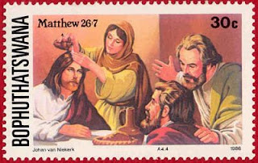
.m
Gospel
John 14:6
⁶ Jesus *said to him, “I am the way, and the truth, and the life; no one comes to the Father but through Me. (NASB)
Mt. 26:13
Truly I say to you, wherever this gospel is preached in the whole world, what this woman has done will also be spoken of in memory of her.” (NASB)

Slide 16
.m
This One Historic Event
There God dealt once and for all
With the universal problem of human sin and divine wrath
The slaughter of the Lamb of God 2,000 years ago
To purchase eternal life for everyone
All who seek to have their names in the Book of Life.
Gospel
John 14:6
⁶ Jesus *said to him, “I am the way, and the truth, and the life; no one comes to the Father but through Me. (NASB)
Mt. 26:13
Truly I say to you, wherever this gospel is preached in the whole world, what this woman has done will also be spoken of in memory of her.” (NASB)

Slide 17
.m
This One Historic Event
There God dealt once and for all
With the universal problem of human sin and divine wrath
The slaughter of the Lamb of God 2,000 years ago
To purchase eternal life for everyone
All who seek to have their names in the Book of Life.
Gospel
John 14:6
⁶ Jesus *said to him, “I am the way, and the truth, and the life; no one comes to the Father but through Me. (NASB)
Mt. 26:13
Truly I say to you, wherever this gospel is preached in the whole world, what this woman has done will also be spoken of in memory of her.” (NASB)

Slide 18
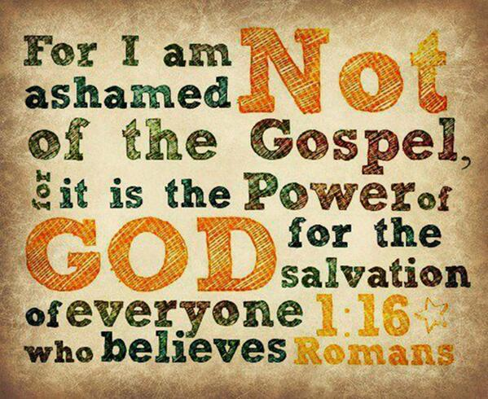
There is Still Only One…
One
Man
1 Timothy 2:5
⁵ For there is one God, and one mediator also between God and men, the man Christ Jesus, (NASB)

Slide 19
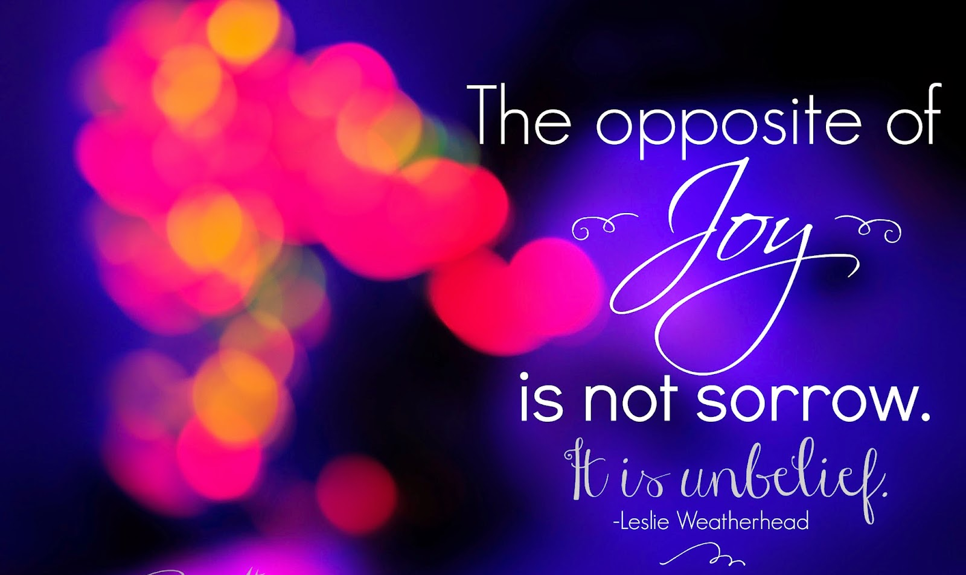
There is Still Only One…
One
Event
Romans 3:23-26—
²³for all have sinned and fall short of the glory of God, ²⁴and all are justified freely by his grace through the redemption that came by Christ Jesus. ²⁵God presented Christ as a sacrifice of atonement, through the shedding of his blood—to be received by faith. He did this to demonstrate his righteousness, because in his forbearance he had left the sins committed beforehand unpunished— ²⁶he did it to demonstrate his righteousness at the present time, so as to be just and the one who justifies those who have faith in Jesus.

Slide 20
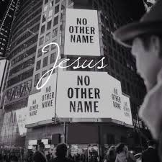
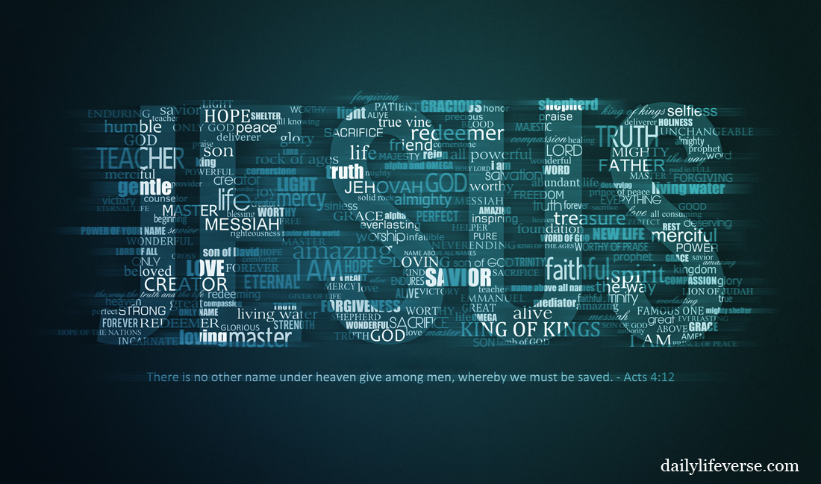
There is Still Only One…
One
Name
Acts 4:12—
¹²Salvation is found in no one else, for there is no other name under heaven given to mankind by which we must be saved.”

Slide 21
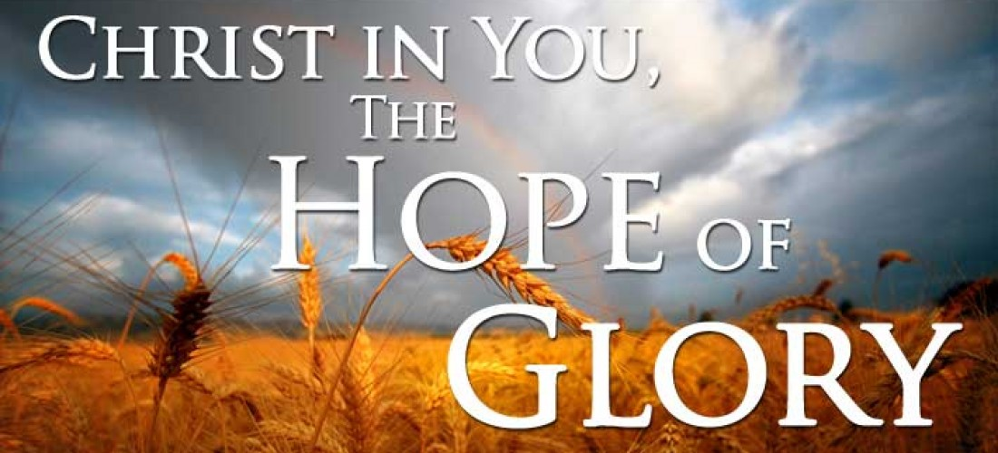
There is Still Only One…
The one supreme
all-pervading
all-unifying
passion of a Christian
—in a not-yet saved world—
is the glory of God
shining through that one gospel
Creating an indestructible joy in the face of fiery trials
So that the Christian life is described as
“sorrowful, yet always rejoicing.” (2Cor.6:10)
One
Passion

Slide 22
There is Still Only One…
The one supreme
all-pervading
all-unifying
passion of a Christian
—in a not-yet saved world—
is the glory of God
shining through that one gospel
Creating an indestructible joy in the face of fiery trials
So that the Christian life is described as
“sorrowful, yet always rejoicing.” (2Cor.6:10)
One
Passion

Slide 23
There is Still Only One…
The one supreme
all-pervading
all-unifying
passion of a Christian
—in a not-yet saved world—
is the glory of God
shining through that one gospel
Creating an indestructible joy in the face of fiery trials
So that the Christian life is described as
“sorrowful, yet always rejoicing.” (2Cor.6:10)
One
Passion

Slide 24
There is Still Only One…
The one supreme
all-pervading
all-unifying
passion of a Christian
—in a not-yet saved world—
is the glory of God
shining through that one gospel
Creating an indestructible joy in the face of fiery trials
So that the Christian life is described as
“sorrowful, yet always rejoicing.” (2Cor.6:10)
One
Passion

Slide 25
There is Still Only One…
The one supreme
all-pervading
all-unifying
passion of a Christian
—in a not-yet saved world—
is the glory of God
shining through that one gospel
Creating an indestructible joy in the face of fiery trials
So that the Christian life is described as
“sorrowful, yet always rejoicing.” (2Cor.6:10)
One
Passion

Slide 26
There is Still Only One…
The one supreme
all-pervading
all-unifying
passion of a Christian
—in a not-yet saved world—
is the glory of God
shining through that one gospel
Creating an indestructible joy in the face of fiery trials
So that the Christian life is described as
“sorrowful, yet always rejoicing.” (2Cor.6:10)
One
Passion

Slide 27
There is Still Only One…
The one supreme
all-pervading
all-unifying
passion of a Christian
—in a not-yet saved world—
is the glory of God
shining through that one gospel
Creating an indestructible joy in the face of fiery trials
So that the Christian life is described as
“sorrowful, yet always rejoicing.” (2Cor.6:10)
One
Passion

Slide 28
There is Still Only One…
The one supreme
all-pervading
all-unifying
passion of a Christian
—in a not-yet saved world—
is the glory of God
shining through that one gospel
Creating an indestructible joy in the face of fiery trials
So that the Christian life is described as
“sorrowful, yet always rejoicing.” (2Cor.6:10)
One
Passion

Slide 29
There is Still Only One…
The one supreme
all-pervading
all-unifying
passion of a Christian
—in a not-yet saved world—
is the glory of God
shining through that one gospel
Creating an indestructible joy in the face of fiery trials
So that the Christian life is described as
“sorrowful, yet always rejoicing.” (2Cor.6:10)
One
Passion

Slide 30
There is Still Only One…
The one supreme
all-pervading
all-unifying
passion of a Christian
—in a not-yet saved world—
is the glory of God
shining through that one gospel
Creating an indestructible joy in the face of fiery trials
So that the Christian life is described as
“sorrowful, yet always rejoicing.” (2Cor.6:10)
One
Passion

Slide 31
There is Still Only One…
The one supreme
all-pervading
all-unifying
passion of a Christian
—in a not-yet saved world—
is the glory of God
shining through that one gospel
Creating an indestructible joy in the face of fiery trials
So that the Christian life is described as
“sorrowful, yet always rejoicing.” (2Cor.6:10)
One
Passion

Slide 32
There is Still Only One…
The one supreme
all-pervading
all-unifying
passion of a Christian
—in a not-yet saved world—
is the glory of God
shining through that one gospel
Creating an indestructible joy in the face of fiery trials
So that the Christian life is described as
“sorrowful, yet always rejoicing.” (2Cor.6:10)
One
Passion

Slide 33
There is Still Only One…
One
Passion

Slide 34
There is Still Only One…
One
Passion
The joy of the Christian is joy in the glory of God.

Slide 35
There is Still Only One…
One
Passion
When you enjoy something, it shows that it is supremely valuable and glorious to you.

Slide 36
There is Still Only One…

Slide 37
Matthew 28:19-20 ¹⁹ Therefore go and make disciples of all nations, baptizing them in the name of the Father and of the Son and of the Holy Spirit, ²⁰ and teaching them to obey everything I have commanded you. And surely I am with you always, to the very end of the age.” (NIV)
There is Still Only One…

