Slide 1
Series: Where Do I Fit?
Part 1. “A Place for Everyone.”
John Staiger
Morningside Church of Christ
Sunday 13 February 2022
AM Sermon
Broadcast live from 42 Leslie Ave, Auckland, Aotearoa/NZ.

Slide 2
Series: Where Do I Fit? Part 1. A Place for Everyone

Slide 3
Series: Where Do I Fit? Part 1. A Place for Everyone
Lessons from Covid…
Isolated isn’t disconnection.

Slide 4
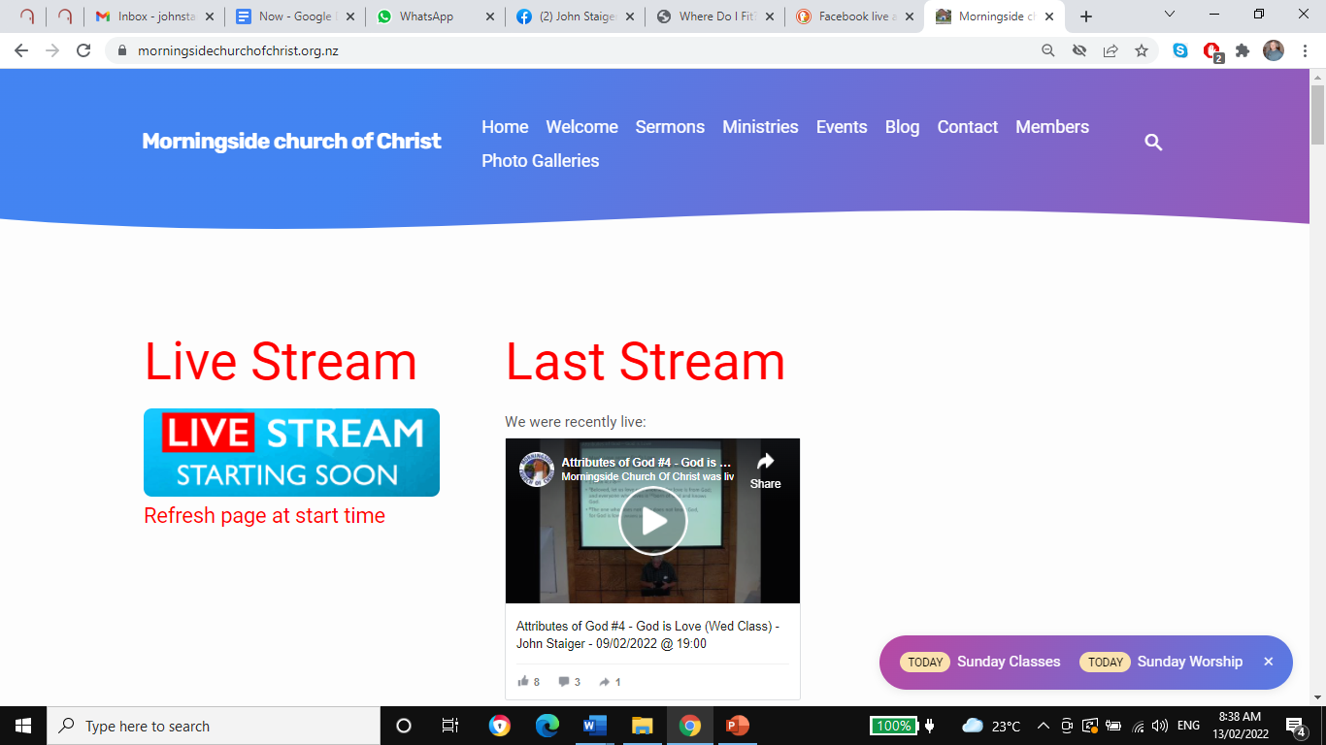
Series: Where Do I Fit? Part 1. A Place for Everyone
Lessons from Covid…
Isolated isn’t disconnected.

Slide 5
Series: Where Do I Fit? Part 1. A Place for Everyone
Lessons from Covid…
2. Lest we have gotten used to being apart—
A trail we have worked around.
Keep calling
Get together

Slide 6
Series: Where Do I Fit? Part 1. A Place for Everyone
Lessons from Covid…
3. We had more time to grow in faith—
Don’t slow down
Mediating on the Word of God.
Strengthening each other’s faith in close proximity.
Praying for a common cause
Finding opportunities to reach out.

Slide 7
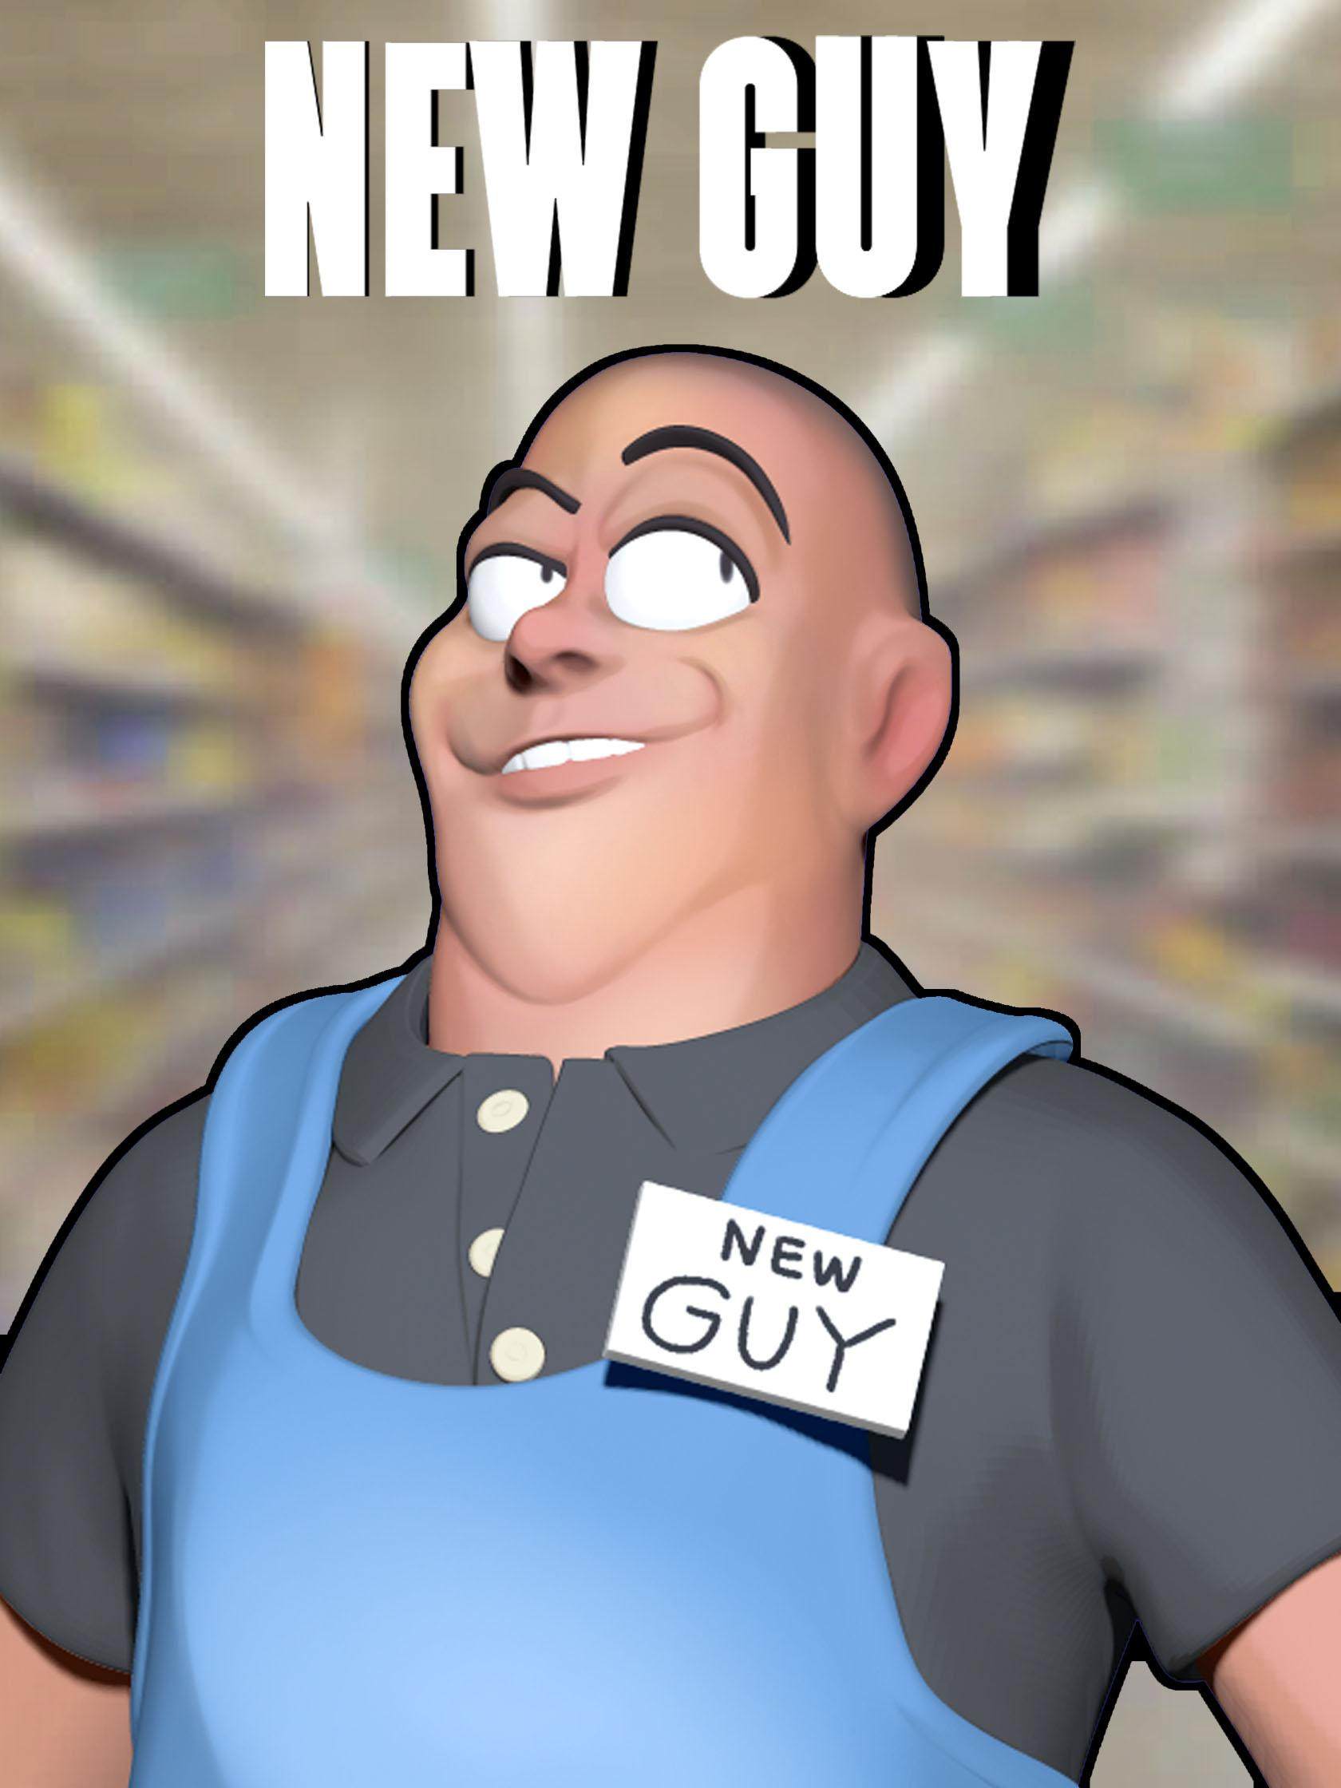
Series: Where Do I Fit? Part 1. A Place for Everyone
I’m new around here…

Slide 8
Series: Where Do I Fit? Part 1. A Place for Everyone
I’m new around here…
1. The Ministry of the Brush—
Two days after my baptism I was at my very first church Working “Bee.”
Fred Martin handed me a paintbrush and said, “Just put an undercoat on that; that will keep you busy.”
Three hours later…
That was the day

Slide 9
Series: Where Do I Fit? Part 1. A Place for Everyone
I’m new around here…
1. The Ministry of the Brush—
Two days after my baptism I was at my very first church Working “Bee.”
Fred Martin handed me a paintbrush and said, “Just put an undercoat on that; that will keep you busy.”
Three hours later…
That was the day

Slide 10
Series: Where Do I Fit? Part 1. A Place for Everyone
I’m new around here…
1. The Ministry of the Brush—
Two days after my baptism I was at my very first church Working “Bee.”
Fred Martin handed me a paintbrush and said, “Just put an undercoat on that; that will keep you busy.”
Three hours later…
That was the day

Slide 11
Series: Where Do I Fit? Part 1. A Place for Everyone
I’m new around here…
1. The Ministry of the Brush—
Two days after my baptism I was at my very first church Working “Bee.”
Fred Martin handed me a paintbrush and said, “Just put an undercoat on that; that will keep you busy.”
Three hours later…
That was the day

Slide 12
Series: Where Do I Fit? Part 1. A Place for Everyone
I’m new around here…
1. The Ministry of the Brush—
Two days after my baptism I was at my very first church Working “Bee.”
Fred Martin handed me a paintbrush and said, “Just put an undercoat on that; that will keep you busy.”
Three hours later…
That was the day I got to know my new brothers

Slide 13
Series: Where Do I Fit? Part 1. A Place for Everyone
I’m new around here…
2. Everyone was perfect—
They still are,…
But everyone has their struggles.
But we helped each other along.
Growing strong Christians takes the generous investment of love.

Slide 14
Series: Where Do I Fit? Part 1. A Place for Everyone
I’m new around here…
2. Everyone was perfect—
They still are…
But everyone has their struggles.
But we helped each other along.
Growing strong Christians takes the generous investment of love.

Slide 15
Series: Where Do I Fit? Part 1. A Place for Everyone
I’m new around here…
2. Everyone was perfect—
They still are…
But everyone has their struggles.
But we helped each other along.
Growing strong Christians takes the generous investment of love.

Slide 16
Series: Where Do I Fit? Part 1. A Place for Everyone
I’m new around here…
2. Everyone was perfect—
They still are…
But everyone has their struggles.
But we help each other along.
Growing strong Christians takes the generous investment of love.

Slide 17
Series: Where Do I Fit? Part 1. A Place for Everyone
I’m new around here…
2. Everyone was perfect—
They still are…
But everyone has their struggles.
But we help each other along.
Nehemiah 4:6—So we built the wall and the whole wall was joined together to half its height, for the people had a mind to work.

Slide 18
Series: Where Do I Fit? Part 1. A Place for Everyone
I’m new around here…
2. Everyone was perfect—
They still are…
But everyone has their struggles.
But we helped each other along.
Growing strong Christians takes the generous investment of love.

Slide 19
Series: Where Do I Fit? Part 1. A Place for Everyone
This is going to take some getting used to…
1. Everything is new—
New faith
New worship
New place to meet
New faces
New friends
New language
New habits
New challenges

Slide 20
Series: Where Do I Fit? Part 1. A Place for Everyone
This is going to take some getting used to…
1. Everything is new—
New faith
New worship
New place to meet
New faces
New friends
New language
New habits
New challenges

Slide 21
Series: Where Do I Fit? Part 1. A Place for Everyone
This is going to take some getting used to…
1. Everything is new—
New faith
New worship
New place to meet
New faces
New friends
New language
New habits
New challenges

Slide 22
Series: Where Do I Fit? Part 1. A Place for Everyone
This is going to take some getting used to…
1. Everything is new—
New faith
New worship
Ephesians 5:19—
speaking to one another in psalms and hymns and spiritual songs, singing and making melody with your heart to the Lord;

Slide 23
Series: Where Do I Fit? Part 1. A Place for Everyone
This is going to take some getting used to…
1. Everything is new—
New faith
New worship
New place to meet

Slide 24
Series: Where Do I Fit? Part 1. A Place for Everyone
This is going to take some getting used to…
1. Everything is new—
New faith
New worship
New place to meet
No stain glass windows
Crosses…?
Very functional
Everyone a “priest”?

Slide 25
Series: Where Do I Fit? Part 1. A Place for Everyone
This is going to take some getting used to…
1. Everything is new—
New faith
New worship
New place to meet
New faces
New friends
New language
New habits
New challenges

Slide 26
Series: Where Do I Fit? Part 1. A Place for Everyone
This is going to take some getting used to…
1. Everything is new—
New faith
New worship
New place to meet
New faces
New friends
New language
New habits
New challenges

Slide 27
Series: Where Do I Fit? Part 1. A Place for Everyone
This is going to take some getting used to…
1. Everything is new—
New faith
New worship
New place to meet
New faces
New friends
New language
New habits
New challenges

Slide 28
Series: Where Do I Fit? Part 1. A Place for Everyone
This is going to take some getting used to…
1. Everything is new—
New faith
New worship
New place to meet
New faces
New friends
New language
New habits
New challenges

Slide 29
Series: Where Do I Fit? Part 1. A Place for Everyone
This is going to take some getting used to…
1. Everything is new—
New faith
New worship
New place to meet
New faces
New friends
New language
New habits
New challenges

Slide 30
Series: Where Do I Fit? Part 1. A Place for Everyone
This is going to take some getting used to…
2. Change changes things—

Slide 31
Series: Where Do I Fit? Part 1. A Place for Everyone
This is going to take some getting used to…
2. Change changes things—
I see everything differently
I see everyone differently
I have been accepted here
I have been rejected there

Slide 32
Series: Where Do I Fit? Part 1. A Place for Everyone
This is going to take some getting used to…
3. I need strength—
One thing never changes
You need grace to help in time of need:
Hebrews 4:16—
Therefore let us draw near with confidence to the throne of grace, so that we may receive mercy and find grace to help in time of need. (NASB95)

Slide 33
Series: Where Do I Fit? Part 1. A Place for Everyone
This is going to take some getting used to…
3. I need strength—
One thing never changes
You need grace to help in time of need:
Hebrews 4:16—
Therefore let us draw near with confidence to the throne of grace, so that we may receive mercy and find grace to help in time of need. (NASB95)

Slide 34
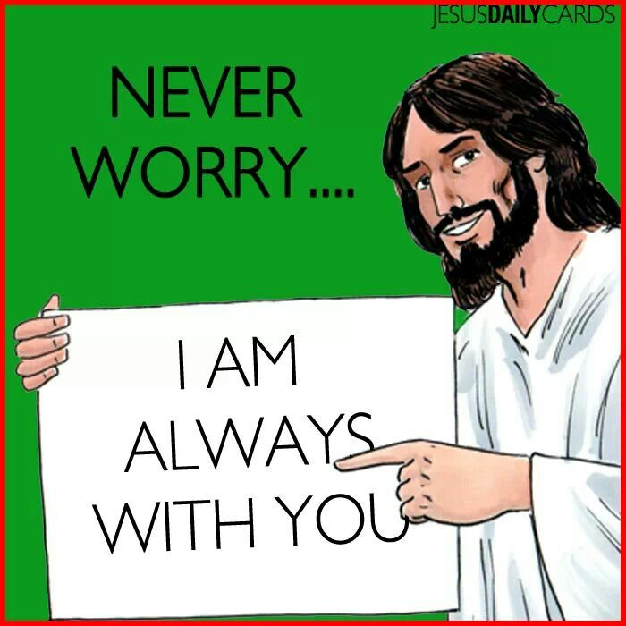
Series: Where Do I Fit? Part 1. A Place for Everyone
This is going to take some getting used to…
3. I need strength—
One thing never changes
You need grace to help in time of need:
Hebrews 4:16—
Therefore let us draw near with confidence to the throne of grace, so that we may receive mercy and find grace to help in time of need. (NASB95)

Slide 35
Series: Where Do I Fit? Part 1. A Place for Everyone
This is going to take some getting used to…
3. I need strength—
One thing never changes
You need grace to help in time of need:
Hebrews 4:16—
Therefore let us draw near with confidence to the throne of grace, so that we may receive mercy and find grace to help in time of need. (NASB95)

Slide 36
Series: Where Do I Fit? Part 1. A Place for Everyone
This is going to take some getting used to…
3. I need strength—
One thing never changes
We are here for each other

Slide 37
Series: Where Do I Fit? Part 1. A Place for Everyone
This is going to take some getting used to…
3. I need strength—
One thing never changes
We are here for each other
Hebrews 3:13—
But encourage one another day after day, as long as it is still called “Today,” so that none of you will be hardened by the deceitfulness of sin.

Slide 38
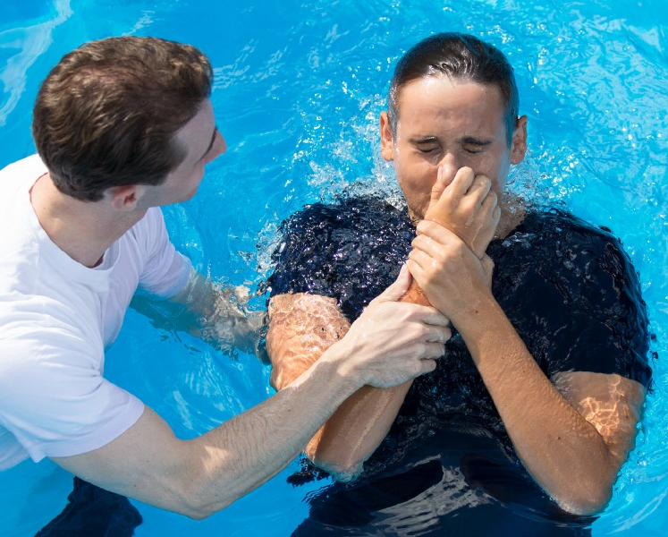
Series: Where Do I Fit? Part 1. A Place for Everyone
Where to Start—Be added to the church…
Acts 2:41—
So then, those who had received his word were baptized; and that day there were added about three thousand souls.

