Slide 1
Series: Where Do I Fit?
Part 2. “My Talents are…”
John Staiger
Morningside Church of Christ
Sunday 20 February 2022
AM Sermon
Broadcast live from 42 Leslie Ave, Auckland, Aotearoa/NZ.

Slide 2
Series: Where Do I Fit? Part 2. My Talents are…

Slide 3
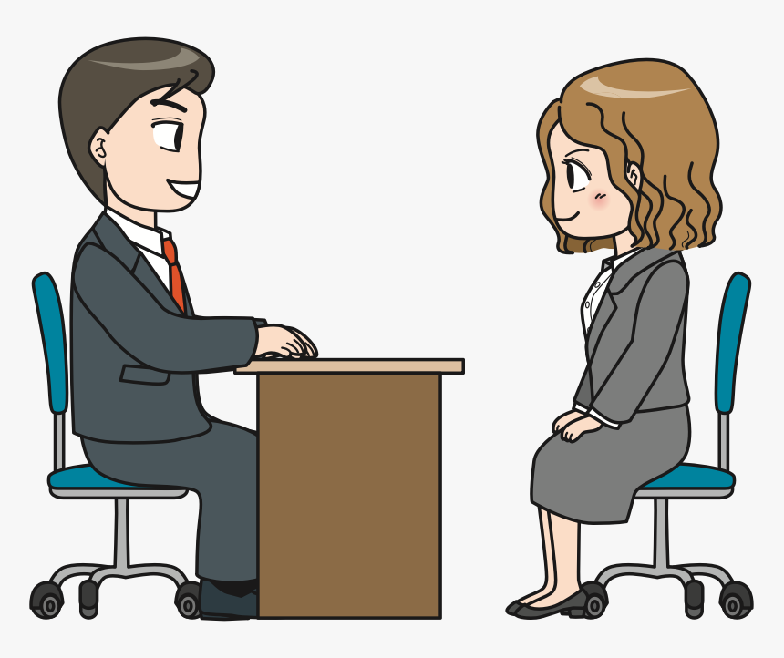
Series: Where Do I Fit? Part 2. My Talents are…
Be holy, because I am holy—1 Peter 1:16
Now Hiring
Jennifer Smith needed a job.

Slide 4
Series: Where Do I Fit? Part 2. My Talents are…
Be holy, because I am holy—1 Peter 1:16
Now Hiring
Sadly, she didn’t have high hopes about her job interview with the technology-consulting firm.

Slide 5
Series: Where Do I Fit? Part 2. My Talents are…
Be holy, because I am holy—1 Peter 1:16
Now Hiring
She couldn’t write a line of computer code and knew next to nothing about the business.
“We’ll get back to you,” they said.
So…

Slide 6
Series: Where Do I Fit? Part 2. My Talents are…
Be holy, because I am holy—1 Peter 1:16
Now Hiring
“We’ll get back to you,” they said.
So…

Slide 7
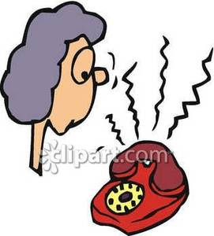
Series: Where Do I Fit? Part 2. My Talents are…
Be holy, because I am holy—1 Peter 1:16
Now Hiring
She was surprised when she received a call asking her to come back in.

Slide 8
Series: Where Do I Fit? Part 2. My Talents are…
Be holy, because I am holy—1 Peter 1:16
Now Hiring
When told her she had the job, Jennifer’s surprise showed.

Slide 9
Series: Where Do I Fit? Part 2. My Talents are…
Be holy, because I am holy—1 Peter 1:16
Now Hiring
The administrator smiled and said…

Slide 10
Series: Where Do I Fit? Part 2. My Talents are…
Be holy, because I am holy—1 Peter 1:16
Now Hiring
“We look for people with:

Slide 11
Series: Where Do I Fit? Part 2. My Talents are…
Be holy, because I am holy—1 Peter 1:16
Now Hiring
“We look for people with:
Good character

Slide 12
Series: Where Do I Fit? Part 2. My Talents are…
Be holy, because I am holy—1 Peter 1:16
Now Hiring
“We look for people with:
Good character
Good judgement

Slide 13
Series: Where Do I Fit? Part 2. My Talents are…
Be holy, because I am holy—1 Peter 1:16
Now Hiring
“We look for people with:
Good character
Good judgement
And the ability to work well with others.

Slide 14
Series: Where Do I Fit? Part 2. My Talents are…
Be holy, because I am holy—1 Peter 1:16
Now Hiring
We can teach skills…

Slide 15
Series: Where Do I Fit? Part 2. My Talents are…
Be holy, because I am holy—1 Peter 1:16
Now Hiring
We can teach skills…
We can’t teach character.”

Slide 16
Series: Where Do I Fit? Part 2. My Talents are…
Be holy, because I am holy—1 Peter 1:16
Now Hiring
To qualify for kingdom work, cultivate the fruit of the Spirit (Gal 5:22–23).

Slide 17
Series: Where Do I Fit? Part 2. My Talents are…
Be holy, because I am holy—1 Peter 1:16
Now Hiring

Slide 18
Series: Where Do I Fit? Part 2. My Talents are…
Be holy, because I am holy—1 Peter 1:16
Now Hiring
If you do that, you needn’t be concerned about your skill set.

Slide 19
Series: Where Do I Fit? Part 2. My Talents are…
Be holy, because I am holy—1 Peter 1:16
Now Hiring
God will slot you in the right position.

Slide 20
Series: Where Do I Fit? Part 2. My Talents are…
Be holy, because I am holy—1 Peter 1:16
Now Hiring
There are plenty of kingdom openings for people of character.

Slide 21
Series: Where Do I Fit? Part 2. My Talents are…
Let God worry about the Opportunities

Slide 22
Series: Where Do I Fit? Part 2. My Talents are…
Let God worry about the Opportunities
1 Corinthians 3:5—
⁵What then is Apollos? And what is Paul? Servants through whom you believed, even as the Lord gave opportunity to each one. (NASB95)

Slide 23
Series: Where Do I Fit? Part 2. My Talents are…
Let God worry about the Opportunities
Galatians 6:10—
¹⁰So then, while we have opportunity, let us do good to all people, and especially to those who are of the household of the faith. (NASB95)

Slide 24
Series: Where Do I Fit? Part 2. My Talents are…
Let God worry about the Opportunities
Colossians 4:5—
⁵Conduct yourselves with wisdom toward outsiders, making the most of the opportunity. (NASB95)

Slide 25
Series: Where Do I Fit? Part 2. My Talents are…
Let God worry about the Opportunities
Philippians 4:10
¹⁰But I rejoiced in the Lord greatly, that now at last you have revived your concern for me; indeed, you were concerned before, but you lacked opportunity. (NASB95)

Slide 26
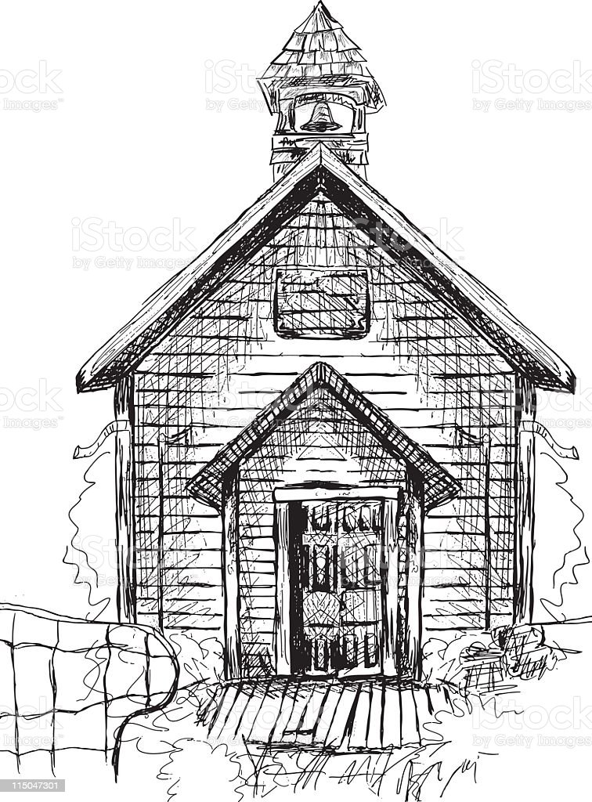
Series: Where Do I Fit? Part 2. My Talents are…
Loyalty doesn’t complain about inconvenience.

Slide 27
Series: Where Do I Fit? Part 2. My Talents are…
Loyalty doesn’t complain about inconvenience.
I heard a story about an old man who was always present when the church met…

Slide 28
Series: Where Do I Fit? Part 2. My Talents are…
Loyalty doesn’t complain about inconvenience.
Even though he was stone deaf.

Slide 29
Series: Where Do I Fit? Part 2. My Talents are…
Loyalty doesn’t complain about inconvenience.
Asked why he continued to attend when he couldn’t hear a word being said, he replied…

Slide 30
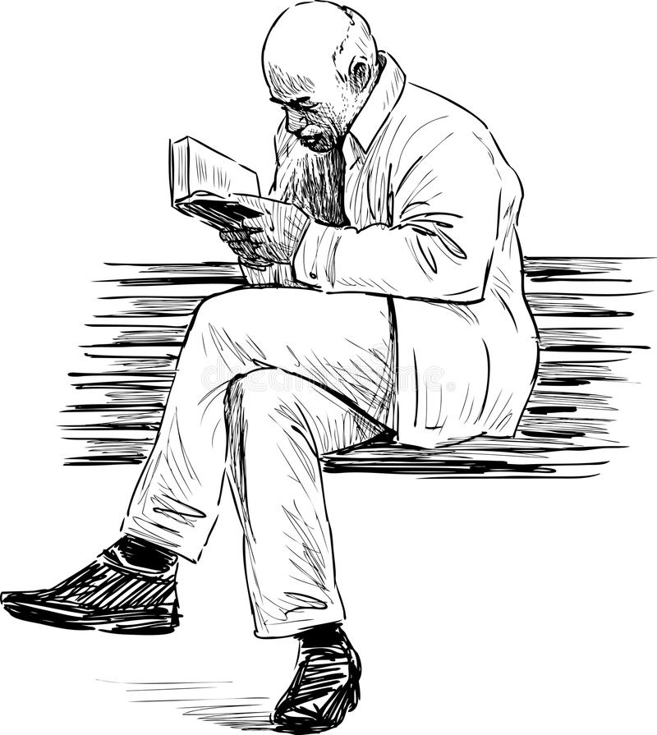
Series: Where Do I Fit? Part 2. My Talents are…
Loyalty doesn’t complain about inconvenience.
“I want everyone to know whose side I’m on.”

Slide 31
Series: Where Do I Fit? Part 2. My Talents are…
Gifts—Some miraculous…some not…

Slide 32
Series: Where Do I Fit? Part 2. My Talents are…
Gifts—Some miraculous…some not…
Romans 12:6-8—
⁶ Since we have gifts that differ according to the grace given to us, each of us is to exercise them accordingly:

Slide 33
Series: Where Do I Fit? Part 2. My Talents are…
Gifts—Some miraculous…some not…
Romans 12:6-8—
⁶ …if prophecy, according to the proportion of his faith;

Slide 34
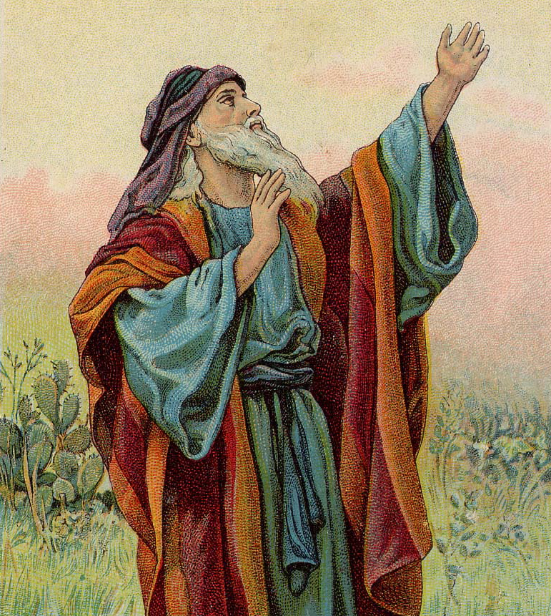
Series: Where Do I Fit? Part 2. My Talents are…
Gifts—Some miraculous…some not…
Romans 12:6-8—
⁶ …if prophecy, according to the proportion of his faith;
We do not have direct prophecy today…

Slide 35
Series: Where Do I Fit? Part 2. My Talents are…
Gifts—Some miraculous…some not…
Romans 12:6-8—
⁶ …if prophecy, according to the proportion of his faith;
But this is all we need!

Slide 36
Series: Where Do I Fit? Part 2. My Talents are…
Gifts—Some miraculous…some not…
Romans 12:6-8—
⁷if service, in his serving;

Slide 37
Series: Where Do I Fit? Part 2. My Talents are…
Gifts—Some miraculous…some not…
Romans 12:6-8—
⁷…or he who teaches, in his teaching;

Slide 38
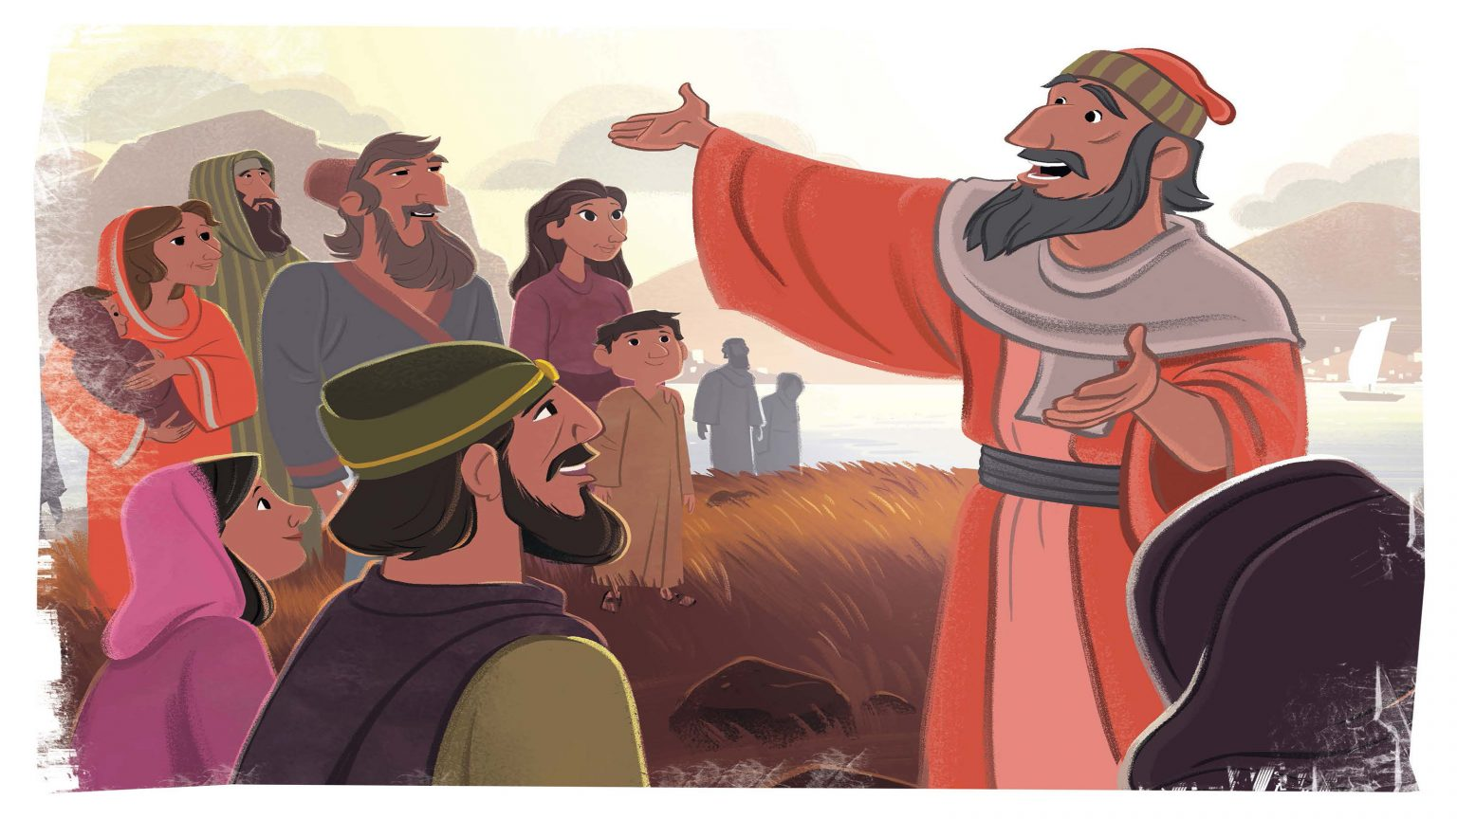
Series: Where Do I Fit? Part 2. My Talents are…
Gifts—Some miraculous…some not…
Romans 12:6-8—
⁸or he who exhorts, in his exhortation;

Slide 39
Series: Where Do I Fit? Part 2. My Talents are…
Gifts—Some miraculous…some not…
Romans 12:6-8—
⁸or he who exhorts, in his exhortation;
Encouragement becomes a way of life.

Slide 40
Series: Where Do I Fit? Part 2. My Talents are…
Gifts—Some miraculous…some not…
Romans 12:6-8—
⁸or he who exhorts, in his exhortation;
Encouragement becomes a way of life.
Barnabas means: “Son of Exhortation.” (Acts 4:36)

Slide 41
Series: Where Do I Fit? Part 2. My Talents are…
Gifts—Some miraculous…some not…
Romans 12:6-8—
⁸…he who gives, with liberality;

Slide 42
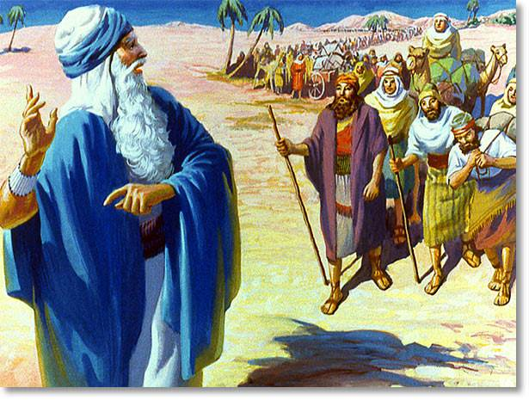
Series: Where Do I Fit? Part 2. My Talents are…
Gifts—Some miraculous…some not…
Romans 12:6-8—
⁸…he who leads, with diligence

Slide 43
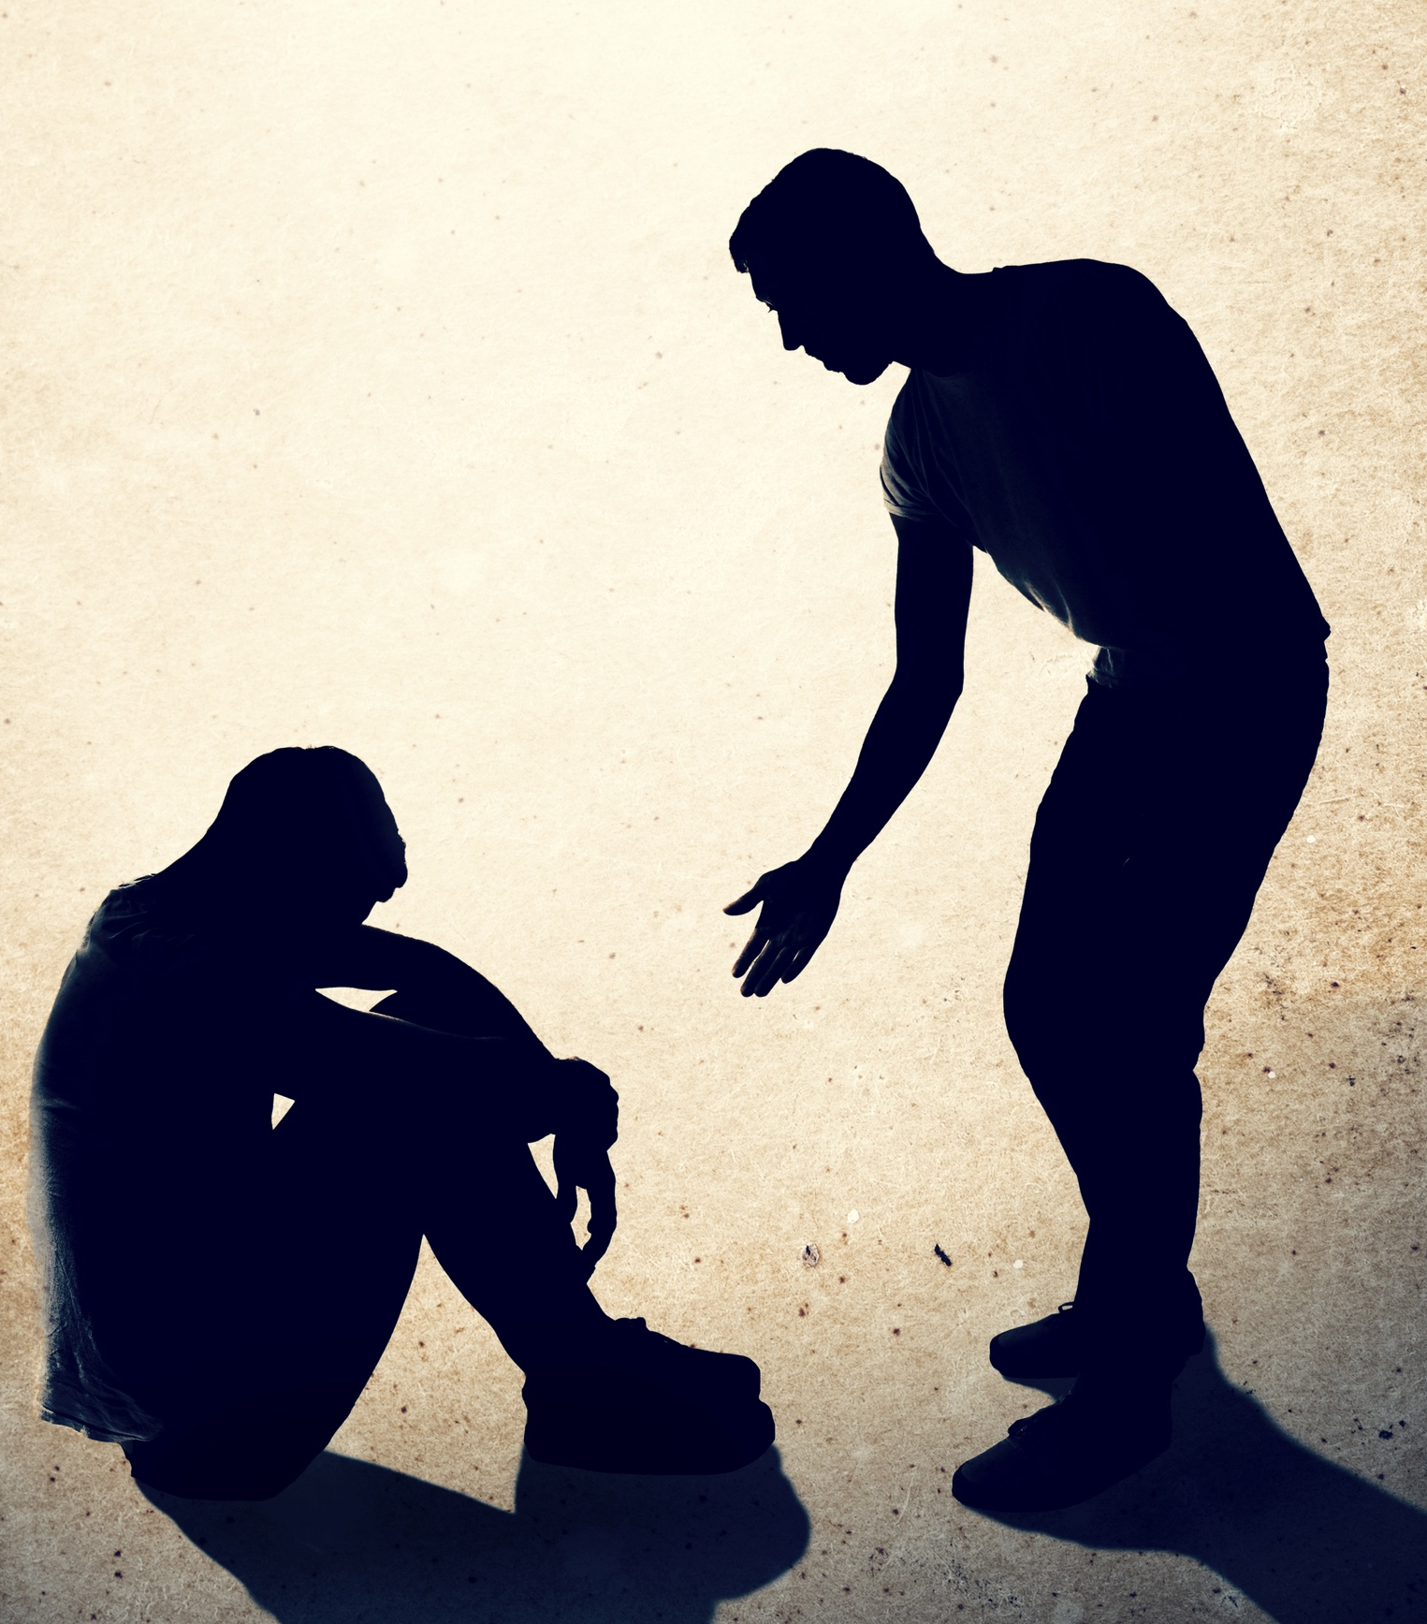
Series: Where Do I Fit? Part 2. My Talents are…
Gifts—Some miraculous…some not…
Romans 12:6-8—
⁸…he who shows mercy, with cheerfulness.

Slide 44
Series: Where Do I Fit? Part 2. My Talents are…
Always Ready…

Slide 45
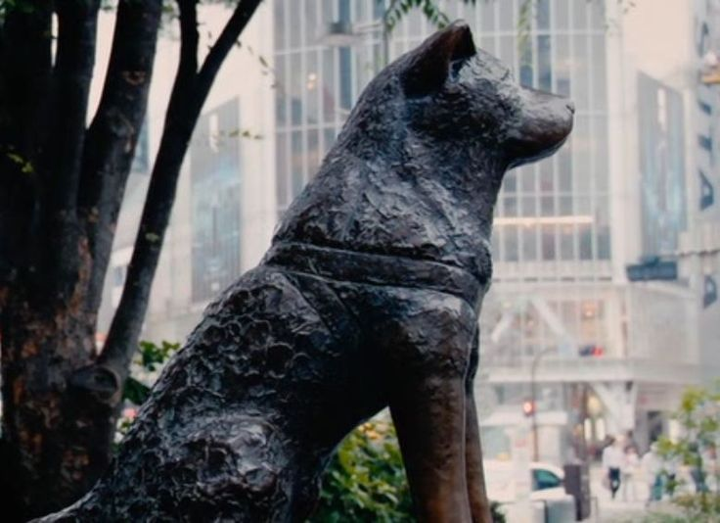
Series: Where Do I Fit? Part 2. My Talents are…
Always Ready…
At the Shibuya train station in Tokyo, there is a statue of a dog: Hachikō.

Slide 46
Series: Where Do I Fit? Part 2. My Talents are…
Always Ready…
Hachikō’s master, Hidesabuō Ueno, was a professor at the Tokyo Imperial University.

Slide 47
Series: Where Do I Fit? Part 2. My Talents are…
Always Ready…
Every afternoon, Hachikō came to meet Euno’s commuter train.

Slide 48
Series: Where Do I Fit? Part 2. My Talents are…
Always Ready…
But one day, Ueno wasn’t on the train—

Slide 49
Series: Where Do I Fit? Part 2. My Talents are…
Always Ready…
But one day, Ueno wasn’t on the train—he had died of a cerebral haemorrhage in his office.

Slide 50
Series: Where Do I Fit? Part 2. My Talents are…
Always Ready…
Every day, until his death nine years later, Hachikō was at the station when the train arrived…

Slide 51
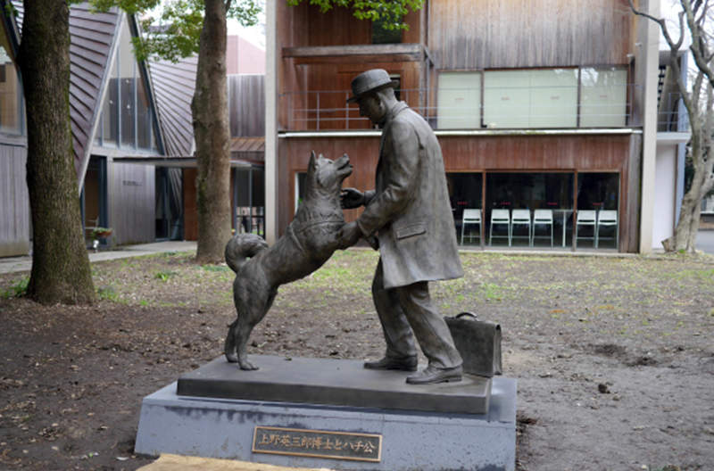
Series: Where Do I Fit? Part 2. My Talents are…
Always Ready…
…awaiting the return of his master.

Slide 52
Series: Where Do I Fit? Part 2. My Talents are…
Always Ready…
Jesus is coming soon, morning or night or noon Many will meet their doom, trumpets will sound.
All of the dead shall rise, righteous meet in the skies, Going where no one dies, heaven-ward bound.

Slide 53
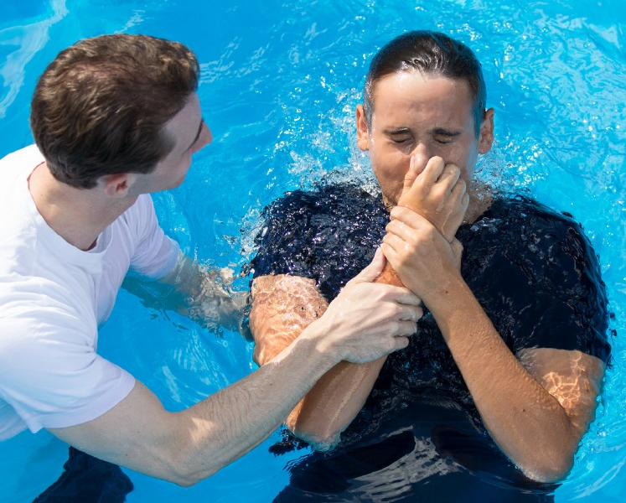
Series: Where Do I Fit? Part 2. My Talents are…
Where to Start—Be added to the church…
Acts 2:41—
So then, those who had received his word were baptized; and that day there were added about three thousand souls.

