Slide 1
“Leadership”
Part 1.
John Staiger
Morningside Church of Christ
Wednesday 2 March 2022
Broadcast on Facebook Live
Auckland, Aotearoa/NZ.
www.morningsidechurchofchrist.org.nz

Slide 2
Leadership
Part 1.

Slide 3
Leadership comes in many forms…
Leadership—Part 1.

Slide 4
Leadership—Part 1.

Slide 5
Leadership—Part 1.

Slide 6
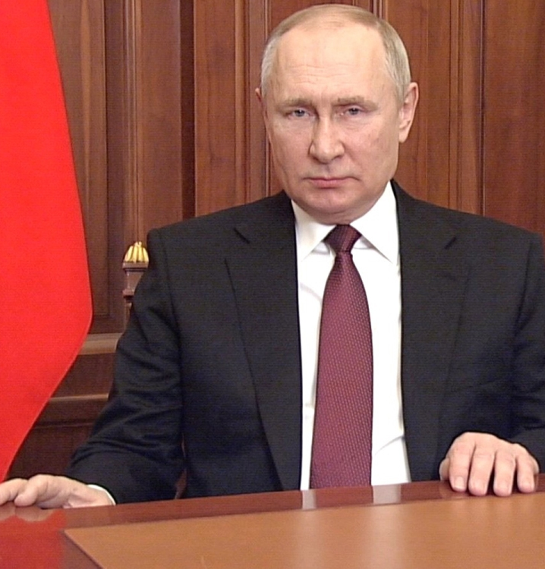
Leadership—Part 1.

Slide 7
Leadership—Part 1.

Slide 8
Leadership—Part 1.
Leadership—Everyone has a Part

Slide 9
Leadership—Part 1.
Leadership—Everyone has a Part

Slide 10
Leadership—Part 1.
Leadership—Everyone has a Part
Very broad definition of Christian leadership:

Slide 11
Leadership—Part 1.
Leadership—Everyone has a Part
Very broad definition of Christian leadership:
Every obedient Christian should include themselves.

Slide 12
Leadership—Part 1.
Leadership—Everyone has a Part
Very broad definition of Christian leadership:
Every obedient Christian should include themselves
We should all be influencing someone to be more like Christ.

Slide 13
Leadership—Part 1.
Leadership—More Specifically

Slide 14
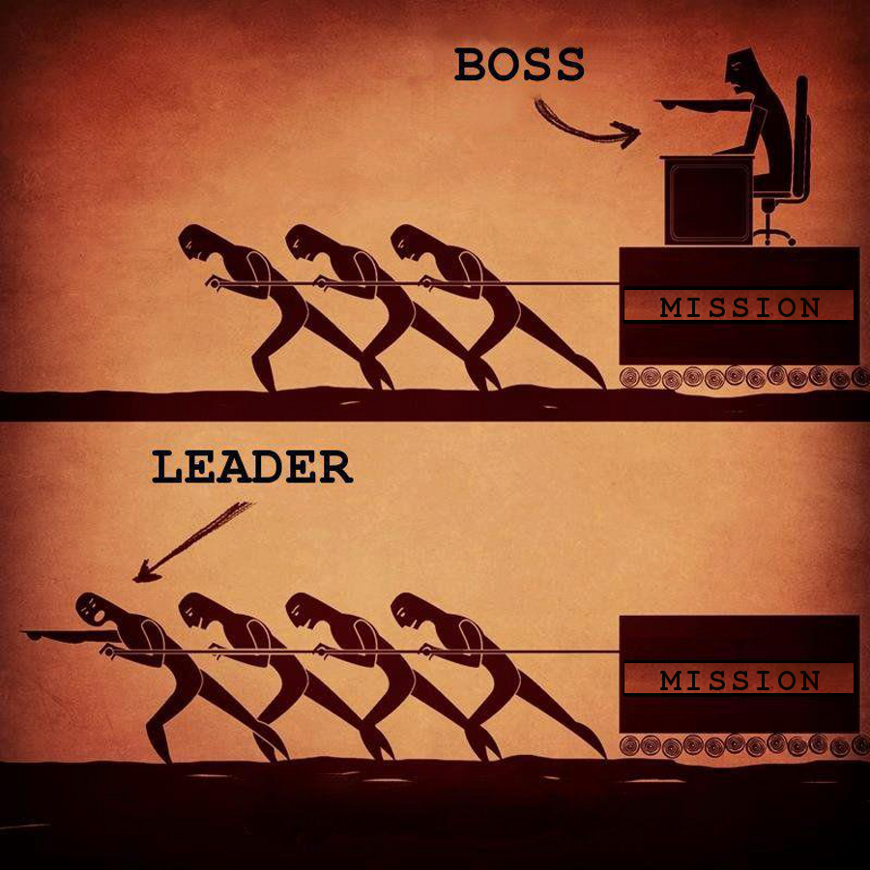
Leadership—Part 1.
Leadership—More Specifically

Slide 15
Leadership—Part 1.
Leadership—More Specifically
But if we get more specific:
What we usually mean by a good Christian leader—

Slide 16
Leadership—Part 1.
Leadership—More Specifically
But if we get more specific:
What we usually mean by a good Christian leader—

Slide 17
Leadership—Part 1.
Leadership—More Specifically
But if we get more specific:
What we usually mean by a good Christian leader—
Is someone who is really good at influencing others toward Christlikeness.
They have personal strengths that draw others into the sway of their influence
Leading them to the ways of Christ.

Slide 18
Leadership—Part 1.
Leadership—More Specifically
But if we get more specific:
What we usually mean by a good Christian leader—
Is someone who is really good at influencing others toward Christlikeness.
They have personal strengths that draw others into the sway of their influence.
Leading them to the ways of Christ.

Slide 19
Leadership—Part 1.
Leadership—More Specifically
But if we get more specific:
What we usually mean by a good Christian leader—
Is someone who is really good at influencing others toward Christlikeness.
They have personal strengths that draw others into the sway of their influence.
Leading them to the ways of Christ.

Slide 20
Leadership—Part 1.
Leadership—Not Enough

Slide 21
Leadership—Part 1.
Leadership—Not Enough

Slide 22
Leadership—Part 1.
Leadership—Not Enough
There is a worldwide lack—
Of men and women have truly heard the call of God to aspire to spiritual leadership

Slide 23
Leadership—Part 1.
Leadership—Not Enough
There is a worldwide lack—
Of men and women have truly heard the call of God to aspire to spiritual leadership.

Slide 24
Leadership—Part 1.
Leadership—Not Enough
Deeply taught in the Scriptures to lead the churches—

Slide 25
Leadership—Part 1.
Leadership—Not Enough
Deeply taught in the Scriptures to lead the churches—
people willing to suffer

Slide 26
Leadership—Part 1.
Leadership—Not Enough
Deeply taught in the Scriptures to lead the churches—
people willing to suffer
Scorn

Slide 27
Leadership—Part 1.
Leadership—Not Enough
Deeply taught in the Scriptures to lead the churches—
people willing to suffer
Scorn
Poverty

Slide 28
Leadership—Part 1.
Leadership—Not Enough
Deeply taught in the Scriptures to lead the churches—
people willing to suffer
Scorn
Poverty
The shame of the Cross for the sake of the Saviour who redeemed them.

Slide 29
Leadership—Part 1.
Leadership—Not Enough
Those who accurately and effectively expound the Scriptures are few.

Slide 30
Leadership—Part 1.
What are the marks of a Leader?
Worthy to be Copied—

Slide 31
Leadership—Part 1.
What are the marks of a Leader?
Worthy to be Copied—
a. Follow me as…
1Cor.11:1—Be imitators of me, just as I also am of Christ. (NASB)

Slide 32
Leadership—Part 1.
What are the marks of a Leader?
Worthy to be Copied—
a. Follow me as…
1Cor.11:1—Be imitators of me, just as I also am of Christ. (NASB)

Slide 33
Leadership—Part 1.
What are the marks of a Leader?
1. Worthy to be Copied—
a. Follow me as…
1 Corinthians 4:14-16—¹⁴I do not write these things to shame you, but to admonish you as my beloved children. ¹⁵ For if you were to have countless tutors in Christ, yet you would not have many fathers, for in Christ Jesus I became your father through the gospel. ¹⁶ Therefore I exhort you, be imitators of me. (NASB)

Slide 34
Leadership—Part 1.
What are the marks of a Leader?
1. Worthy to be Copied—
a. Follow me as…
1 Corinthians 4:14-16—¹⁴I do not write these things to shame you, but to admonish you as my beloved children. ¹⁵ For if you were to have countless tutors in Christ, yet you would not have many fathers, for in Christ Jesus I became your father through the gospel. ¹⁶ Therefore I exhort you, be imitators of me. (NASB)

Slide 35
Leadership—Part 1.
What are the marks of a Leader?
Worthy to be Listened to…

Slide 36
Leadership—Part 1.
What are the marks of a Leader?
Worthy to be Listened to…
a. Taught First…

Slide 37
Leadership—Part 1.
What are the marks of a Leader?
Worthy to be Listened to…
a. Taught First…

Slide 38
Leadership—Part 1.
What are the marks of a Leader?
Worthy to be Listened to…
a. Taught First…
For the hand that rocks the cradle
Is the hand that rules the world. (William Ross Wallace).

Slide 39
Leadership—Part 1.
What are the marks of a Leader?
Worthy to be Listened to…
a. Taught First…
Luke 16:8—⁸…for the sons of this age are more shrewd in relation to their own kind than the sons of light.

Slide 40
Leadership—Part 1.
What are the marks of a Leader?
Worthy to be Listened to…
a. Taught First…
2 Timothy 3:14-15—¹⁴ You, however, continue in the things you have learned and become convinced of, knowing from whom you have learned them, ¹⁵and that from childhood you have known the sacred writings which are able to give you the wisdom that leads to salvation through faith which is in Christ Jesus. (NASB)

Slide 41
Leadership—Part 1.
What are the marks of a Leader?
Worthy to be Listened to…
b. Then Teach…
2 Timothy 2:15—¹⁵ Be diligent to present yourself approved to God as a workman who does not need to be ashamed, accurately handling the word of truth. (NASB)

Slide 42
Leadership—Part 1.
What are the marks of a Leader?
Worthy to be Listened to…
b. Then Teach…
2 Timothy 2:15—¹⁵ Be diligent to present yourself approved to God as a workman who does not need to be ashamed, accurately handling the word of truth. (NASB)

Slide 43
Leadership—Part 1.
What are the marks of a Leader?
Worthy to be Listened to…
c. With Extreme Caution…
With extreme caution…
James 3:1—
Let not many of you become teachers, my brethren, knowing that as such we will incur a stricter judgment. (NASB)

Slide 44
Leadership—Part 1.
What are the marks of a Leader?
Worthy to be Listened to…
c. With Extreme Caution…
With extreme caution…
James 3:1—
Let not many of you become teachers, my brethren, knowing that as such we will incur a stricter judgment. (NASB)

Slide 45
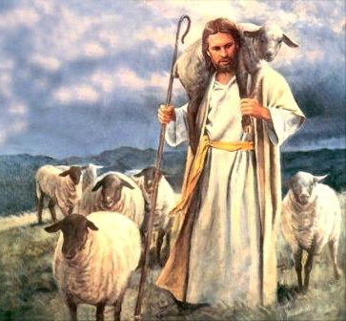
Leadership—Part 1.
What are the marks of a Leader?
3. Worthy to Serve Others…

Slide 46
Leadership—Part 1.
What are the marks of a Leader?
3. Worthy to Serve Others…
1 Peter 5:1-4—(NASB)
¹Therefore, I exhort the elders among you, as your fellow elder and witness of the sufferings of Christ, and a partaker also of the glory that is to be revealed,…

Slide 47
Leadership—Part 1.
What are the marks of a Leader?
3. Worthy to Serve Others…
1 Peter 5:1-4—(NASB)
…²shepherd the flock of God among you, exercising oversight not under compulsion, but voluntarily, according to the will of God; and not for sordid gain, but with eagerness;

Slide 48
Leadership—Part 1.
What are the marks of a Leader?
3. Worthy to Serve Others…
1 Peter 5:1-4—(NASB)
…³nor yet as lording it over those allotted to your charge, but proving to be examples to the flock.

Slide 49
Leadership—Part 1.
What are the marks of a Leader?
3. Worthy to Serve Others…
1 Peter 5:1-4—(NASB)
…⁴And when the Chief Shepherd appears, you will receive the unfading crown of glory.

Slide 50
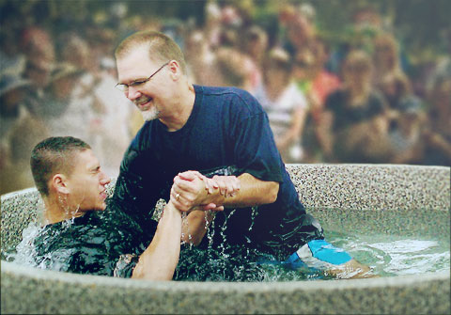
Follow Christ’s Leadership Matthew 28:19-20—¹⁹Go therefore and make disciples of all the nations, baptizing them in the name of the Father and the Son and the Holy Spirit, ²⁰ teaching them to observe all that I commanded you; and lo, I am with you always, even to the end of the age.” (NASB)

