Slide 1
“Leadership”
Part 2.
John Staiger
Morningside Church of Christ
Wednesday 9 March 2022
Broadcast on Facebook Live
Auckland, Aotearoa/NZ.
www.morningsidechurchofchrist.org.nz

Slide 2
Leadership
Part 2.

Slide 3
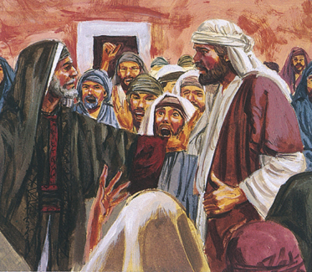
Leadership—Part 2.
Samuel warned Israel:
Their desire for a secular-type king would…

Slide 4
Leadership—Part 2.
Samuel warned Israel:
Their desire for a secular-type king would end in slavery.

Slide 5
Leadership—Part 2.
Samuel warned Israel:
Their desire for a secular-type king would end in slavery.
God told Samuel to…

Slide 6
Leadership—Part 2.
Samuel warned Israel:
Their desire for a secular-type king would end in slavery.
God told Samuel to… give them what they wanted.

Slide 7
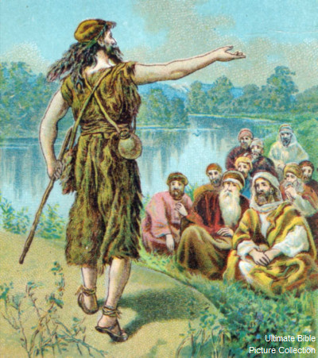
Leadership—Part 2.
John the Baptist

Slide 8
Leadership—Part 2.
John the Baptist
Didn’t hold back on leaders.

Slide 9
Leadership—Part 2.
John the Baptist
Didn’t hold back on leaders.
Even at baptisms.

Slide 10
Leadership—Part 2.
John the Baptist didn’t hold back on leaders.
Even at baptisms.

Slide 11
Leadership—Part 2.
John the Baptist didn’t hold back on leaders.
Even at baptisms. Matthew 3:7—But when he saw many of the Pharisees and Sadducees coming for baptism, he said to them…

Slide 12
Leadership—Part 2.
John the Baptist didn’t hold back on leaders.
Even at baptisms. Matthew 3:7—But when he saw many of the Pharisees and Sadducees coming for baptism, he said to them, “You brood of vipers, who warned you to flee from the wrath to come? (NASB)

Slide 13
Leadership—Part 2.
Jesus was not always pleasant.

Slide 14
Leadership—Part 2.
Jesus was not always pleasant.
Religious leaders were especially under his microscope.
Then Jesus spoke to the crowds and to His disciples, ² saying: “The scribes and the Pharisees have seated themselves in the chair of Moses; ³therefore all that they tell you, do and observe, but do not do according to their deeds; for they say things and do not do them. (NASB)

Slide 15
Leadership—Part 2.
Jesus was not always pleasant.
Religious leaders were especially under his microscope.
Then Jesus spoke to the crowds and to His disciples, ² saying: “The scribes and the Pharisees have seated themselves in the chair of Moses… ³therefore all that they tell you, do and observe, but do not do according to their deeds; for they say things and do not do them. (NASB)

Slide 16
Leadership—Part 2.
Jesus was not always pleasant.
Religious leaders were especially under his microscope.
Then Jesus spoke to the crowds and to His disciples, ² saying: “The scribes and the Pharisees have seated themselves in the chair of Moses; ³therefore all that they tell you, do and observe, but do not do according to their deeds; for they say things and do not do them. (NASB)

Slide 17
Leadership—Part 2.
Jesus was not always pleasant.
Religious leaders were especially under his microscope.
Then Jesus spoke to the crowds and to His disciples, ² saying: “The scribes and the Pharisees have seated themselves in the chair of Moses; ³therefore all that they tell you, do and observe, but do not do according to their deeds… for they say things and do not do them. (NASB)

Slide 18
Leadership—Part 2.
Jesus was not always pleasant.
Religious leaders were especially under his microscope.
Then Jesus spoke to the crowds and to His disciples, ² saying: “The scribes and the Pharisees have seated themselves in the chair of Moses; ³therefore all that they tell you, do and observe, but do not do according to their deeds; for they say things and do not do them. (NASB)

Slide 19
Leadership—Part 2.
What the church needs…
1. Spirit-filled
Acts 6:3 ³ Therefore, brethren, select from among you seven men of good reputation, full of the Spirit and of wisdom, whom we may put in charge of this task

Slide 20
Leadership—Part 2.
What the church needs…
Spirit-filled.
Leaders transformed by the Holy Spirit.
It is obvious to all.
They demonstrate the attitudes and actions of a Sprit-filled life.
Acts 6:3 ³ Therefore, brethren, select from among you seven men of good reputation, full of the Spirit and of wisdom, whom we may put in charge of this task

Slide 21
Leadership—Part 2.
What the church needs…
Spirit-filled.
Leaders transformed by the Holy Spirit.
It is obvious to all.
They demonstrate the attitudes and actions of a Sprit-filled life.
Acts 6:3 ³ Therefore, brethren, select from among you seven men of good reputation, full of the Spirit and of wisdom, whom we may put in charge of this task

Slide 22
Leadership—Part 2.
What the church needs…
Spirit-filled.
Leaders transformed by the Holy Spirit.
It is obvious to all.
They demonstrate the attitudes and actions of a Spirit-filled life.
Acts 6:3 ³ Therefore, brethren, select from among you seven men of good reputation, full of the Spirit and of wisdom, whom we may put in charge of this task

Slide 23
Leadership—Part 2.
What the church needs…
2. Bible-saturated.
These are our teachers.
You hear the Bible in their conversations.
Everything is analyzed and filtered through the Bible.
2 Timothy 2:15—¹⁵ Be diligent to present yourself approved to God as a workman who does not need to be ashamed, accurately handling the word of truth. (NASB)

Slide 24
Leadership—Part 2.
What the church needs…
3. Christ-exalting.
Christ is raised up as sovereign.
All laws, judgements and opinions of man are subordinate.
“Jesus, name above all names!”
Revelation 5:12—saying with a loud voice, “Worthy is the Lamb that was slain to receive power and riches and wisdom and might and honour and glory and blessing.” (NASB)

Slide 25
Leadership—Part 2.
What the church needs…
4. Self-abasing…
Seeking humility before God.
Christ and the church are continually pushed to the front.
Always willing to be last.
1 Timothy 1:15—It is a trustworthy statement, deserving full acceptance, that Christ Jesus came into the world to save sinners, among whom I am foremost of all. (NASB)

Slide 26
Leadership—Part 2.
What the church needs…
5. Untiring.
Energy for God.
Remove that which drags down.
Seeking the strength od the Lord.
1 Corinthians 15:10—But by the grace of God I am what I am, and His grace toward me did not prove vain; but I laboured even more than all of them, yet not I, but the grace of God with me. (NASB)

Slide 27
Leadership—Part 2.
What the church needs…
6. Persevering Leaders.
Not a place of fits-and-starts.
Only done together.
You will be tested.
1 Timothy 4:16—Pay close attention to yourself and to your teaching; persevere in these things, for as you do this you will ensure salvation both for yourself and for those who hear you. (NASB)

Slide 28
Leadership—Part 2.
Leader’s Impact:
We need leaders who exert a…
Deep
Broad
Life-changing
influence for Jesus Christ

Slide 29
Leadership—Part 2.
God’s Time:
The most important thing you may ever do for the cause of Christ may go unnoticed by man for 30 years.

Slide 30
Leadership—Part 2.
God’s Time:
The most important thing you may ever do for the cause of Christ may go unnoticed by man for 30 years.
Don't quench the Spirit of God by being impatient.

Slide 31
Leadership—Part 2.
Man’s Commendation:
2 Corinthians 10:12
For we are not bold to class
or compare ourselves with
some of those who
commend themselves;
but when they
measure themselves
by themselves
and compare themselves
with themselves,
they are without
understanding.

Slide 32
Leadership—Part 2.
God’s Commendation:
2 Corinthians 10:18—For it is not he who commends himself that is approved, but he whom the Lord commends. (NASB)

Slide 33
Leadership—Part 2.
God’s Commendation:
2 Corinthians 10:18—For it is not he who commends himself that is approved, but he whom the Lord commends. (NASB)
1 Thessalonians 2:4—but just as we have been approved by God to be entrusted with the gospel, so we speak, not as pleasing men, but God who examines our hearts. (NASB)

Slide 34
Leadership—Part 2.
Me at Any Cost:
What some men lack in the qualities that make up a Godly leader…

Slide 35
Leadership—Part 2.
Me at Any Cost:
What some men lack in the qualities that make up a Godly leader…
They make up for in the desire to hold the position anyway.

Slide 36
Leadership—Part 2.
Anti-Leadership Mentality:
There are people who oppose leadership wherever it begins to emerge.
Opposition to Christian leadership is not born out of great vision
But is born out of a list of petty resentments.
A church without strong leaders is not a democracy of giants.

Slide 37
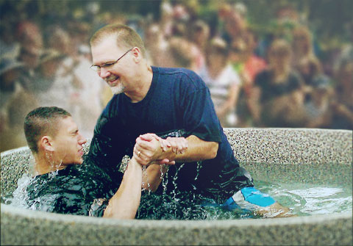
Follow Christ’s Leadership Matthew 28:19-20—¹⁹Go therefore and make disciples of all the nations, baptizing them in the name of the Father and the Son and the Holy Spirit, ²⁰ teaching them to observe all that I commanded you; and lo, I am with you always, even to the end of the age.” (NASB)

