Slide 1
“Human Solutions
Part 3. Where from Here?
John Staiger
Morningside Church of Christ
Sunday 6 March 2022
PM Sermon
Broadcast live from 42 Leslie Ave, Auckland, Aotearoa/NZ.

Slide 2
Human Solutions
Part 3.
Where from Here?

Slide 3
Human Solutions…Part 3. Where from Here?
What are planes for…?

Slide 4
Human Solutions…Part 3. Where from Here?
What are planes for…?

Slide 5
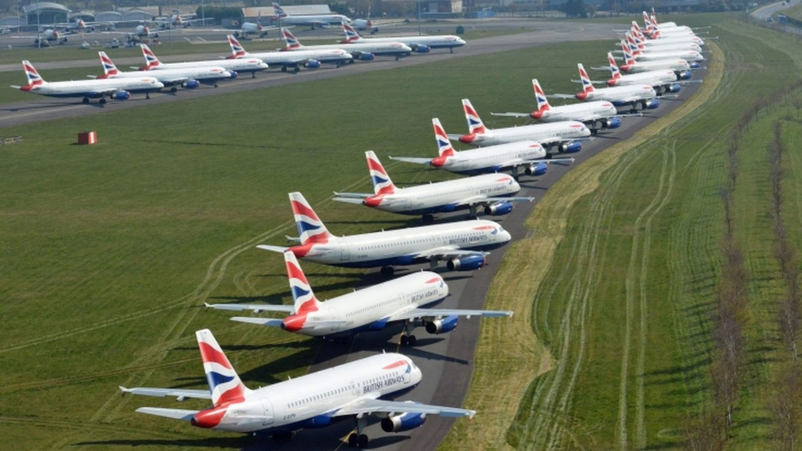
Human Solutions…Part 3. Where from Here?
Stranded…?

Slide 6
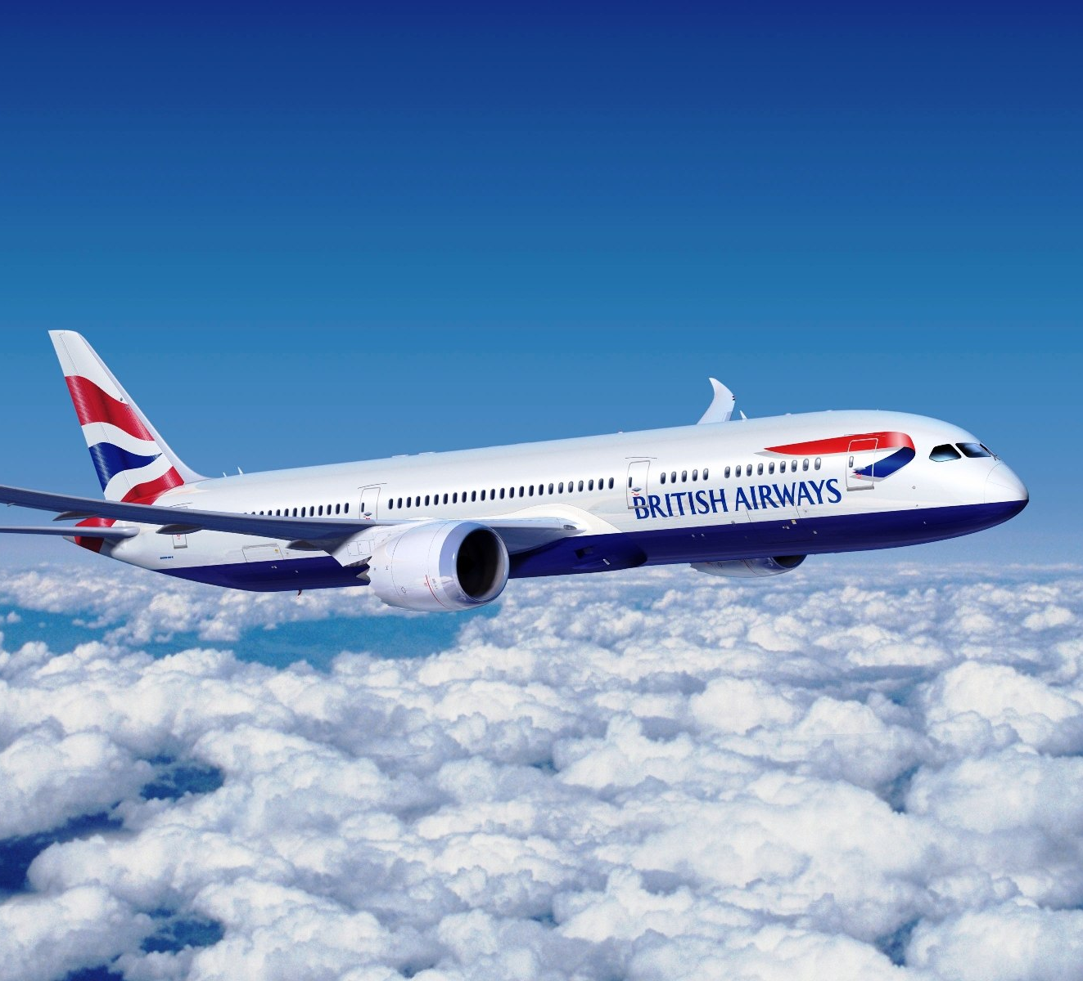
Human Solutions…Part 3. Where from Here?
When in operation…
Designed to fly:

Slide 7
Human Solutions…Part 3. Where from Here?
When in operation…
Designed to fly:
Constant monitoring.
Regular maintenance.
Expected to work for its owner.
Otherwise, corrosion will see in.

Slide 8
Human Solutions…Part 3. Where from Here?
When in operation…
Designed to fly:
Constant monitoring.
Regular maintenance.

Slide 9
Human Solutions…Part 3. Where from Here?
When in operation…
Designed to fly:
Constant monitoring.
Regular maintenance.
Expected to work for its owner.

Slide 10
Human Solutions…Part 3. Where from Here?
When in operation…
Designed to fly:
Constant monitoring.
Regular maintenance.
Expected to work for its owner.
Otherwise, corrosion will see in.

Slide 11
Human Solutions…Part 3. Where from Here?
What are Christians for…?
Mark 16:15

Slide 12
Human Solutions…Part 3. Where from Here?
What are Christians for…?
Mark 16:15

Slide 13
Human Solutions…Part 3. Where from Here?
Spiritually Stranded…

Slide 14
Human Solutions…Part 3. Where from Here?
When in operation…
Designed to go:
Constant monitoring.
Matthew 26:41
⁴¹ Keep watching and praying that you may not enter into temptation; the spirit is willing, but the flesh is weak.” (NASB95)
Mark 16:15

Slide 15
Human Solutions…Part 3. Where from Here?
When in operation…
Designed to go:
Constant monitoring.
Matthew 26:41
⁴¹ Keep watching and praying that you may not enter into temptation; the spirit is willing, but the flesh is weak.” (NASB95)
Mark 16:15

Slide 16
Human Solutions…Part 3. Where from Here?
When in operation…
Designed to go:
Regular maintenance.
2 Peter 1:10
¹⁰ Therefore, brethren, be all the more diligent to make certain about His calling and choosing you; for as long as you practice these things, you will never stumble;
Mark 16:15

Slide 17
Human Solutions…Part 3. Where from Here?
When in operation…
Designed to go:
Regular maintenance.
2 Peter 1:10
¹⁰ Therefore, brethren, be all the more diligent to make certain about His calling and choosing you; for as long as you practice these things, you will never stumble;
Mark 16:15

Slide 18
Human Solutions…Part 3. Where from Here?
When in operation…
Designed to go:
Expected to work for its owner.
Ephesians 2:10—
¹⁰For we are His workmanship, created in Christ Jesus for good works, which God prepared beforehand so that we would walk in them.
Mark 16:15

Slide 19
Human Solutions…Part 3. Where from Here?
When in operation…
Designed to go:
Expected to work for its owner.
Ephesians 2:10—
¹⁰For we are His workmanship, created in Christ Jesus for good works, which God prepared beforehand so that we would walk in them.
Mark 16:15

Slide 20
Human Solutions…Part 3. Where from Here?
When in operation…
Designed to go:
Otherwise, corrosion will see in.
2 Peter 1:8—
⁸For if these qualities are yours and are increasing, they render you neither useless nor unfruitful in the true knowledge of our Lord Jesus Christ.

Slide 21
Human Solutions…Part 3. Where from Here?
Spiritually Stranded…
Designed to go:
Otherwise, corrosion will see in.
2 Peter 1:8—
⁸For if these qualities are yours and are increasing, they render you neither useless nor unfruitful in the true knowledge of our Lord Jesus Christ.

Slide 22
Human Solutions…Part 3. Where from Here?
Stranded no more…
2 Peter 1:5-7—
⁵Now for this very reason also, applying a
in your faith
supply moral excellence,
and in your moral excellence, knowledge,
⁶ and in your knowledge, self-control,
and in your self-control, perseverance,
and in your perseverance, godliness,
⁷and in your godliness, brotherly kindness,
and in your brotherly kindness, love.

Slide 23
Human Solutions…Part 3. Where from Here?
Stranded no more…
2 Peter 1:5-7—
⁵Now for this very reason also, applying all diligence,
in your faith
supply moral excellence,
and in your moral excellence, knowledge,
⁶ and in your knowledge, self-control,
and in your self-control, perseverance,
and in your perseverance, godliness,
⁷and in your godliness, brotherly kindness,
and in your brotherly kindness, love.

Slide 24
Human Solutions…Part 3. Where from Here?
Stranded no more…
2 Peter 1:5-7—
⁵Now for this very reason also, applying all diligence,
in your faith
supply moral excellence,
and in your moral excellence, knowledge,
⁶ and in your knowledge, self-control,
and in your self-control, perseverance,
and in your perseverance, godliness,
⁷and in your godliness, brotherly kindness,
and in your brotherly kindness, love.

Slide 25
Human Solutions…Part 3. Where from Here?
Stranded no more…
2 Peter 1:5-7—
⁵Now for this very reason also, applying all diligence,
in your faith
supply moral excellence,
and in your moral excellence, knowledge,
⁶ and in your knowledge, self-control,
and in your self-control, perseverance,
and in your perseverance, godliness,
⁷and in your godliness, brotherly kindness,
and in your brotherly kindness, love.

Slide 26
Human Solutions…Part 3. Where from Here?
Stranded no more…
2 Peter 1:5-7—
⁵Now for this very reason also, applying all diligence,
in your faith
supply moral excellence,
and in your moral excellence, knowledge,
⁶ and in your knowledge, self-control,
and in your self-control, perseverance,
and in your perseverance, godliness,
⁷and in your godliness, brotherly kindness,
and in your brotherly kindness, love.

Slide 27
Human Solutions…Part 3. Where from Here?
Stranded no more…
2 Peter 1:5-7—
⁵Now for this very reason also, applying all diligence,
in your faith
supply moral excellence,
and in your moral excellence, knowledge,
⁶ and in your knowledge, self-control,
and in your self-control, perseverance,
and in your perseverance, godliness,
⁷and in your godliness, brotherly kindness,
and in your brotherly kindness, love.

Slide 28
Human Solutions…Part 3. Where from Here?
Stranded no more…
2 Peter 1:5-7—
⁵Now for this very reason also, applying all diligence,
in your faith
supply moral excellence,
and in your moral excellence, knowledge,
⁶ and in your knowledge, self-control,
and in your self-control, perseverance,
and in your perseverance, godliness,
⁷and in your godliness, brotherly kindness,
and in your brotherly kindness, love.

Slide 29
Human Solutions…Part 3. Where from Here?
Stranded no more…
2 Peter 1:5-7—
⁵Now for this very reason also, applying all diligence,
in your faith
supply moral excellence,
and in your moral excellence, knowledge,
⁶ and in your knowledge, self-control,
and in your self-control, perseverance,
and in your perseverance, godliness,
⁷and in your godliness, brotherly kindness,
and in your brotherly kindness, love.

Slide 30
Human Solutions…Part 3. Where from Here?
Stranded no more…
2 Peter 1:5-7—
⁵Now for this very reason also, applying all diligence,
in your faith
supply moral excellence,
and in your moral excellence, knowledge,
⁶ and in your knowledge, self-control,
and in your self-control, perseverance,
and in your perseverance, godliness,
⁷and in your godliness, brotherly kindness,
and in your brotherly kindness, love.

Slide 31
Human Solutions…Part 3. Where from Here?
Stranded no more…
2 Peter 1:5-7—
⁵Now for this very reason also, applying all diligence,
in your faith
supply moral excellence,
and in your moral excellence, knowledge,
⁶ and in your knowledge, self-control,
and in your self-control, perseverance,
and in your perseverance, godliness,
⁷and in your godliness, brotherly kindness,
and in your brotherly kindness, love.

Slide 32
Human Solutions…Part 3. Where from Here?
Into the Future…
2 Peter 3:17-18
¹⁷ Therefore, dear friends, since you have been forewarned, be on your guard so that you may not be carried away by the error of the lawless and fall from your secure position. ¹⁸ But grow in the grace and knowledge of our Lord and Saviour Jesus Christ. To him be glory both now and forever! Amen.

