Slide 1
Series: Making Progress
Part 2. Signs along the Way
John Staiger
Morningside Church of Christ
Sunday 17 April 2022
AM Sermon
Broadcast live from 42 Leslie Ave, Auckland, Aotearoa/NZ.

Slide 2
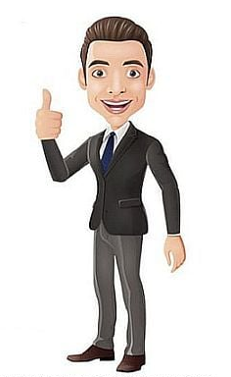
Series: Making Progress
Part 2.
Signs along the Way

Slide 3
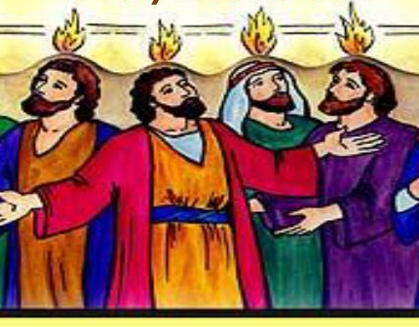
Series: Making Progress Part 2. Signs along the Way
Pentecost—Signs Enough!

Slide 4
Series: Making Progress Part 2. Signs along the Way
Pentecost—Signs Enough!
Acts 2:1-4—
When the day of Pentecost arrived, they were all together in one place.

Slide 5
Series: Making Progress Part 2. Signs along the Way
Pentecost—Signs Enough!
Acts 2:1-4—
²And suddenly there came from heaven a sound like a mighty rushing wind, and it filled the entire house where they were sitting.

Slide 6
Series: Making Progress Part 2. Signs along the Way
Pentecost—Signs Enough!
Acts 2:1-4—
³And divided tongues as of fire appeared to them and rested on each one of them.

Slide 7
Series: Making Progress Part 2. Signs along the Way
Pentecost—Signs Enough!
Acts 2:1-4—
⁴And they were all filled with the Holy Spirit and began to speak in other tongues as the Spirit gave them utterance. (ESV)

Slide 8
Series: Making Progress Part 2. Signs along the Way
Pentecost—The Reason!

Slide 9
Series: Making Progress Part 2. Signs along the Way
Pentecost—The Reason!
God’s Great Salvation
Hebrews 2:3-5—
³…It was declared at first by the Lord, and it was attested to us by those who heard, ⁴while God also bore witness by signs and wonders and various miracles and by gifts of the Holy Spirit distributed according to his will. (ESV)

Slide 10

Series: Making Progress Part 2. Signs along the Way
The Eternal replaces the Temporary

Slide 11
Series: Making Progress Part 2. Signs along the Way
The Eternal replaces the Temporary
1 Corinthians 13:8—
Love never ends. As for prophecies, they will pass away; as for tongues, they will cease; as for knowledge, it will pass away.

Slide 12

Series: Making Progress Part 2. Signs along the Way
Lord, Show me a Sign!
Not the Harvest I Expected…

Slide 13
Series: Making Progress Part 2. Signs along the Way
Lord, Show me a Sign!
Not the Harvest I Expected…
Sometimes—

Slide 14
Series: Making Progress Part 2. Signs along the Way
Lord, Show me a Sign!
Not the Harvest I Expected…
Sometimes—
We are all over the place.

Slide 15
Series: Making Progress Part 2. Signs along the Way
Lord, Show me a Sign!
Not the Harvest I Expected…
Sometimes—
We are all over the place.
We dig ourselves into a hole.

Slide 16
Series: Making Progress Part 2. Signs along the Way
Lord, Show me a Sign!
Not the Harvest I Expected…
Sometimes—
We are all over the place.
We dig ourselves into a hole.
Our sins find us out.

Slide 17
Series: Making Progress Part 2. Signs along the Way
Lord, Show me a Sign!
Not the Harvest I Expected…
Sometimes—
We are all over the place.
We dig ourselves into a hole.
Our sins find us out.
Our memories are short.

Slide 18

Series: Making Progress Part 2. Signs along the Way
Lord, Show me a Sign!
You are the Sign…

Slide 19
Series: Making Progress Part 2. Signs along the Way
Lord, Show me a Sign!
You are the Sign…
What God is telling you—

Slide 20
Series: Making Progress Part 2. Signs along the Way
Lord, Show me a Sign!
You are the Sign…
What God is telling you—
There is something missing.

Slide 21
Series: Making Progress Part 2. Signs along the Way
Lord, Show me a Sign!
You are the Sign…
What God is telling you—
There is something missing.
Things have to change.

Slide 22
Series: Making Progress Part 2. Signs along the Way
Lord, Show me a Sign!
You are the Sign…
What God is telling you—
There is something missing.
Things have to change.
Keep on sowing…keep on reaping!

Slide 23

Series: Making Progress Part 2. Signs along the Way
Signs are to be Seen…
2 Peter 1:5-7—
⁵Now for this very reason also, applying all diligence, in your faith supply
Moral excellence…
Knowledge…
Self-control…
Perseverance…
Godliness…
Brotherly kindness…
Love.

Slide 24
Series: Making Progress Part 2. Signs along the Way
Signs are to be Seen…
2 Peter 1:8—
⁸For if these qualities are yours and are increasing, they render you neither useless nor unfruitful in the true knowledge of our Lord Jesus Christ.

Slide 25
Series: Making Progress Part 2. Signs along the Way
Signs are to be Seen…
2 Peter 1:9—
⁹For he who lacks these qualities is blind or short-sighted, having forgotten his purification from his former sins.

Slide 26

Series: Making Progress Part 2. Signs along the Way
Choose your Direction…
Proverbs 4:25—
²⁵Let your eyes look directly ahead
And let your gaze be fixed straight in front of you.

Slide 27
Series: Making Progress Part 2. Signs along the Way
Choose your Direction…
Hebrews 12:1-2—
“…let us run with endurance the race that is set before us, ²fixing our eyes on Jesus…”

Slide 28
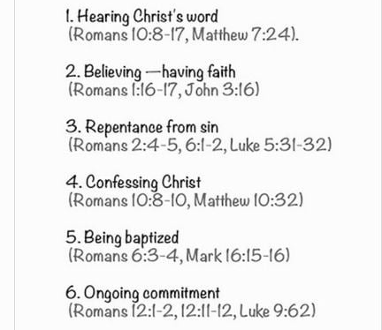
Series: Making Progress Part 2. Signs along the Way
Where to Start—Be added to the church…

Slide 29

Series: Making Progress Part 2. Signs along the Way
Where to Start—Be added to the church…
John 3:5—
⁵Jesus answered, “Truly, truly, I say to you, unless one is born of water and the Spirit he cannot enter into the kingdom of God. (NASB95)

