Slide 1
Series: Where Do I Fit?
Part 3. “How Are You Handling Your Strengths?”
John Staiger
Morningside Church of Christ
Sunday 6 March 2022
AM Sermon
Broadcast live from 42 Leslie Ave, Auckland, Aotearoa/NZ.

Slide 2
Series: Where Do I Fit? Part 3.
“How Are You Handling Your Strengths?”

Slide 3
Series: Where Do I Fit? Part 3. “How Are You Handling Your Strengths?”
1 Peter 4:10
As each one has received a special gift,
employ it in serving one another
as good stewards of the manifold grace of God.
(NASB95)
Your talent is God’s gift to you.

Slide 4
Series: Where Do I Fit? Part 3. “How Are You Handling Your Strengths?”
1 Peter 4:10
As each one has received a special gift,
employ it in serving one another
as good stewards of the manifold grace of God.
(NASB95)
Your talent is God’s gift to you.
Your unselfish use of it is His gift to others.

Slide 5
Series: Where Do I Fit? Part 3. “How Are You Handling Your Strengths?”
1 Peter 4:10
As each one has received a special gift,
employ it in serving one another
as good stewards of the manifold grace of God.
(NASB95)
God has given each of us a gift, a strong point.

Slide 6
Series: Where Do I Fit? Part 3. “How Are You Handling Your Strengths?”
1 Peter 4:10
As each one has received a special gift,
employ it in serving one another
as good stewards of the manifold grace of God.
(NASB95)
There is the temptation to use that gift selfishly.

Slide 7
Series: Where Do I Fit? Part 3. “How Are You Handling Your Strengths?”
We face two questions regarding our strengths:
“How can I use this gift to promote myself?”
“How can I use this gift to serve others in Christ?”

Slide 8
Series: Where Do I Fit? Part 3. “How Are You Handling Your Strengths?”
We face two questions regarding our strengths:
“How can I use this gift to promote myself?”
“How can I use this gift to serve others in Christ?”

Slide 9
Series: Where Do I Fit? Part 3. “How Are You Handling Your Strengths?”
We face two questions regarding our strengths:
“How can I use this gift to promote myself?”
“How can I use this gift to serve others in Christ?”

Slide 10
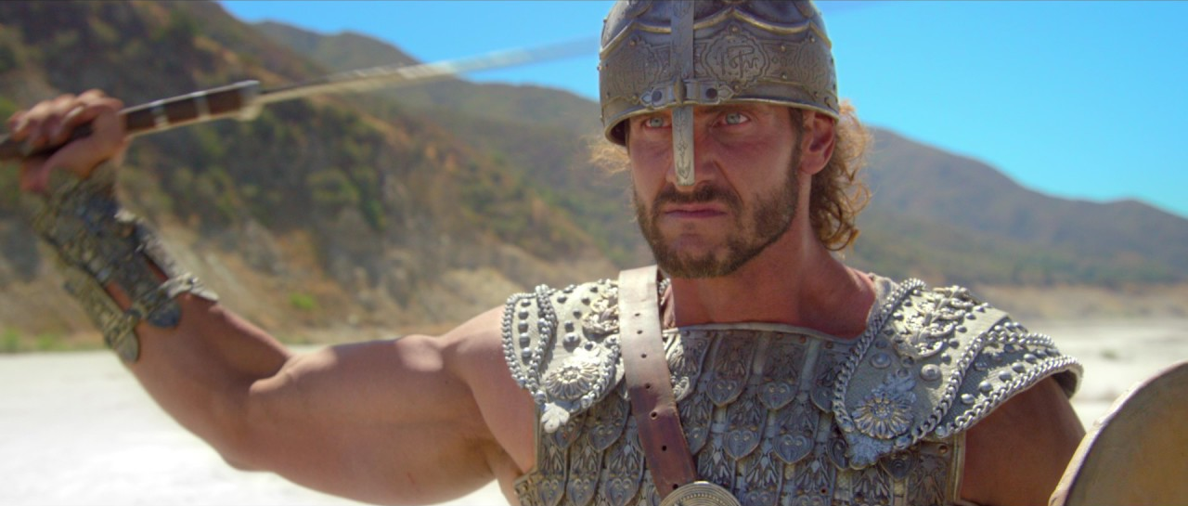
Series: Where Do I Fit? Part 3. “How Are You Handling Your Strengths?”
Advantages that can be hard to miss…
Goliath –

Slide 11
Series: Where Do I Fit? Part 3. “How Are You Handling Your Strengths?”
Advantages that can be hard to miss…
9 foot tall.
Philistia’s champion.
Instilled fear.
Goliath –

Slide 12
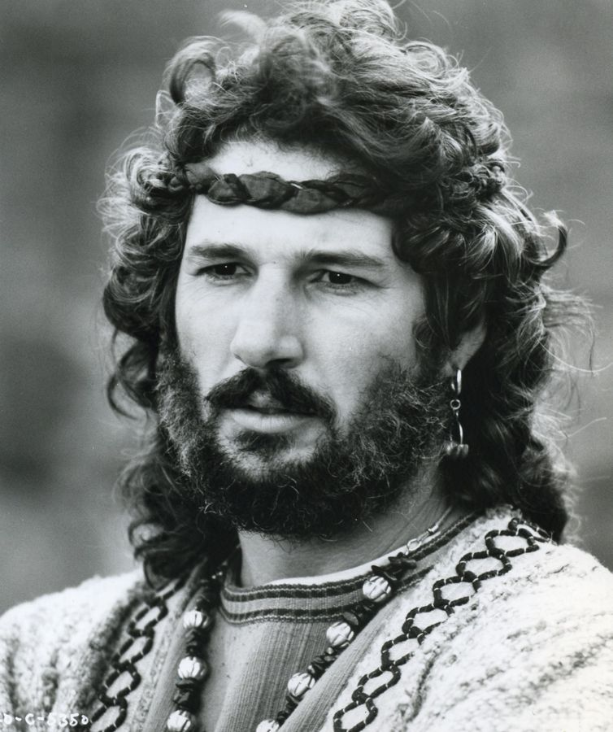
Series: Where Do I Fit? Part 3. “How Are You Handling Your Strengths?”
Advantages that can be hard to miss…
King David

Slide 13
Series: Where Do I Fit? Part 3. “How Are You Handling Your Strengths?”
Advantages that can be hard to miss…
King David
Handsome
An athletic man.
Confident.
Brave.
Israel’s General.
Singer.
Songwriter
Loved God.

Slide 14
Series: Where Do I Fit? Part 3. “How Are You Handling Your Strengths?”
Advantages that can be hard to miss…
King Solomon.

Slide 15
Series: Where Do I Fit? Part 3. “How Are You Handling Your Strengths?”
Advantages that can be hard to miss…
King Solomon.
Very Intelligent
Very Rich
Very good Statesman.
Wrote Proverbs
Wrote Ecclesiastes.

Slide 16
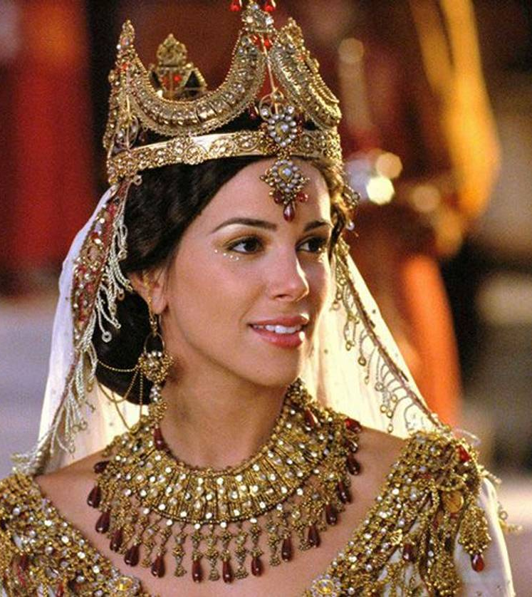
Series: Where Do I Fit? Part 3. “How Are You Handling Your Strengths?”
Advantages that can be hard to miss…
Esther

Slide 17
Series: Where Do I Fit? Part 3. “How Are You Handling Your Strengths?”
Advantages that can be hard to miss…
Esther
The single most beautiful woman in the Persian Empire.
Humble.
Godly.

Slide 18
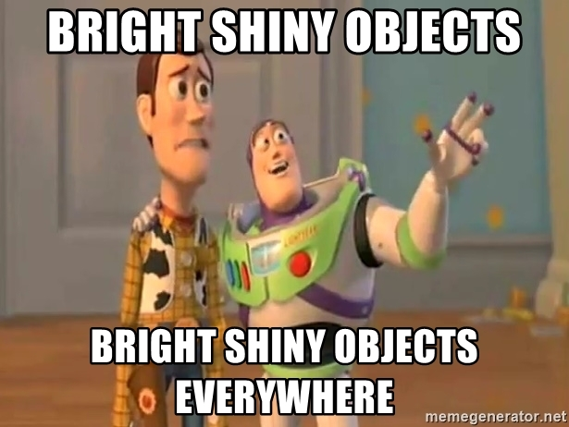
Series: Where Do I Fit? Part 3. “How Are You Handling Your Strengths?”
Tempted in our “Strengths…”

Slide 19
Series: Where Do I Fit? Part 3. “How Are You Handling Your Strengths?”
Tempted in our “Strengths…”
Good looks.
Pleasing personality.
Position.
Charisma.
Money.
Talent.
Intelligence.

Slide 20
Series: Where Do I Fit? Part 3. “How Are You Handling Your Strengths?”
Tempted in our “Strengths…”
We are too easily tempted to use it to our advantage.

Slide 21
Series: Where Do I Fit? Part 3. “How Are You Handling Your Strengths?”
Tempted in our “Strengths…”
So, our strength often becomes our weakness.
We are too easily tempted to use it to our advantage.

Slide 22
Series: Where Do I Fit? Part 3. “How Are You Handling Your Strengths?”
Caution is always best…
Turned out to be “Over-rated.”
Goliath –

Slide 23
Series: Where Do I Fit? Part 3. “How Are You Handling Your Strengths?”
Caution is always best…
Turned out to be “Over-rated.”
Goliath –

Slide 24
Series: Where Do I Fit? Part 3. “How Are You Handling Your Strengths?”
Caution is always best…
King David

Slide 25
Series: Where Do I Fit? Part 3. “How Are You Handling Your Strengths?”
Caution is always best…
King David
The incident with Bathsheba hurt him and Israel.

Slide 26
Series: Where Do I Fit? Part 3. “How Are You Handling Your Strengths?”
Caution is always best…
King David
God said, “I have found David son of Jesse a man after my own heart; he will do everything I want him to do” (Acts 13:22).

Slide 27
Series: Where Do I Fit? Part 3. “How Are You Handling Your Strengths?”
Caution is always best…
King David
David was far from flawless, but he stayed centred in God’s will.

Slide 28
Series: Where Do I Fit? Part 3. “How Are You Handling Your Strengths?”
Caution is always best…
King David
He had no other “god.”

Slide 29
Series: Where Do I Fit? Part 3. “How Are You Handling Your Strengths?”
Caution is always best…
King Solomon.
Turned to idols.

Slide 30
Series: Where Do I Fit? Part 3. “How Are You Handling Your Strengths?”
Caution is always best…
King Solomon.
Ecclesiastes 12:13-14
¹³ The conclusion, when all has been heard, is: fear God and keep His commandments, because this applies to every person. ¹⁴For God will bring every act to judgment, everything which is hidden, whether it is good or evil. (NASB95)

Slide 31
Series: Where Do I Fit? Part 3. “How Are You Handling Your Strengths?”
You are chosen for a reason…

Slide 32
Series: Where Do I Fit? Part 3. “How Are You Handling Your Strengths?”
You are chosen for a reason…

Slide 33
Series: Where Do I Fit? Part 3. “How Are You Handling Your Strengths?”
You are chosen for a reason…
Esther 4:13-14
¹³Then Mordecai told them to reply to Esther, “Do not imagine that you in the king’s palace can escape any more than all the Jews. ¹⁴For if you remain silent at this time, relief and deliverance will arise for the Jews from another place and you and your father’s house will perish. And who knows whether you have not attained royalty for such a time as this?”

Slide 34
Series: Where Do I Fit? Part 3. “How Are You Handling Your Strengths?”
You are chosen for a reason…
1 Peter 5:5-7
⁵You younger men, likewise, be subject to your elders; and all of you, clothe yourselves with humility toward one another, for God is opposed to the proud, but gives grace to the humble.
⁶ Therefore humble yourselves under the mighty hand of God, that He may exalt you at the proper time, ⁷ casting all your anxiety on Him, because He cares for you.

Slide 35
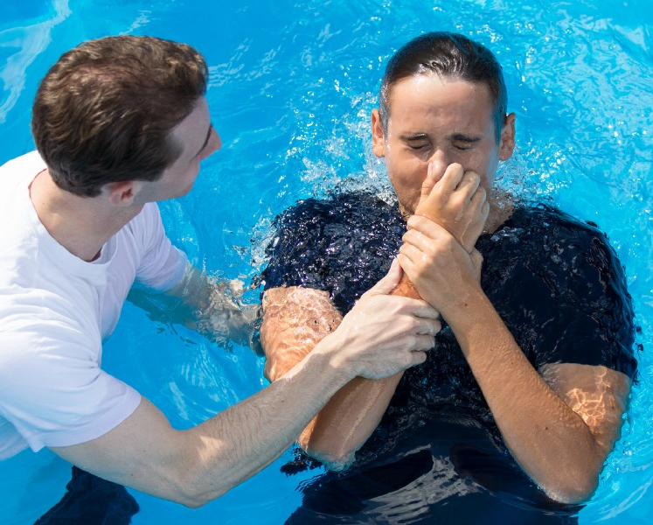
Series: Where Do I Fit? Part 3. “How Are You Handling Your Strengths?”
Where to Start—Be added to the church…
Acts 2:41—
So then, those who had received his word were baptized; and that day there were added about three thousand souls.

