Slide 1
“Beyond Our Four Walls”
Part 5. Dealing with Opposition
John Staiger
Morningside Church of Christ
Wednesday 4 May 2022
Broadcast on Facebook Live
Auckland, Aotearoa/NZ.
www.morningsidechurchofchrist.org.nz

Slide 2
“Beyond Our Four Walls”
Part 5.

Slide 3
Series: “Beyond Our Four Walls” Part 5. Dealing with Opposition.
Most common methods of dealing with Christian opposition:

Slide 4
Series: “Beyond Our Four Walls” Part 5. Dealing with Opposition.
Most common methods of dealing with Christian opposition:
1. Hide your faith.

Slide 5
Series: “Beyond Our Four Walls” Part 5. Dealing with Opposition.
Most common methods of dealing with Christian opposition:
1. Hide your faith.

Slide 6
Series: “Beyond Our Four Walls” Part 5. Dealing with Opposition.
Most common methods of dealing with Christian opposition:
1. Hide your faith.
Tell no one.

Slide 7
Series: “Beyond Our Four Walls” Part 5. Dealing with Opposition.
Most common methods of dealing with Christian opposition:
1. Hide your faith.
Tell no one.
This can be motivated by fear.

Slide 8
Series: “Beyond Our Four Walls” Part 5. Dealing with Opposition.
Most common methods of dealing with Christian opposition:
1. Hide your faith.
Tell no one.
This can be motivated by fear.
Or a sign of satisfaction with the status quo.

Slide 9
Series: “Beyond Our Four Walls” Part 5. Dealing with Opposition.
Most common methods of dealing with Christian opposition:
1. Hide your faith.
Tell no one.
This can be motivated by fear.
Or a sign of satisfaction with the status quo.
No desire to “Rock the boat.”

Slide 10
Series: “Beyond Our Four Walls” Part 5. Dealing with Opposition.
Most common methods of dealing with Christian opposition:
2. Say, “My faith is a personal matter.”

Slide 11
Series: “Beyond Our Four Walls” Part 5. Dealing with Opposition.
Most common methods of dealing with Christian opposition:
2. Say, “My faith is a personal matter.”

Slide 12
Series: “Beyond Our Four Walls” Part 5. Dealing with Opposition.
Most common methods of dealing with Christian opposition:
2. Say, “My faith is a personal matter.”
No desire to be challenged.

Slide 13
Series: “Beyond Our Four Walls” Part 5. Dealing with Opposition.
Most common methods of dealing with Christian opposition:
2. Say, “My faith is a personal matter.”
No desire to be challenged.
Fear that a discussion might be held against them later.

Slide 14
Series: “Beyond Our Four Walls” Part 5. Dealing with Opposition.
Most common methods of dealing with Christian opposition:
2. Say, “My faith is a personal matter.”
No desire to be challenged.
Fear that a discussion might be held against them later.
Cost a job or a relationship.

Slide 15
Series: “Beyond Our Four Walls” Part 5. Dealing with Opposition.
Most common methods of dealing with Christian opposition:
3. Say, “I respect your opinions, but can we agree to disagree?”

Slide 16
Series: “Beyond Our Four Walls” Part 5. Dealing with Opposition.
Most common methods of dealing with Christian opposition:
3. Say, “I respect your opinions, but can we agree to disagree?”

Slide 17
Series: “Beyond Our Four Walls” Part 5. Dealing with Opposition.
Most common methods of dealing with Christian opposition:
3. Say, “I respect your opinions, but can we agree to disagree?”
Generally said after a discussion.

Slide 18
Series: “Beyond Our Four Walls” Part 5. Dealing with Opposition.
Most common methods of dealing with Christian opposition:
3. Say, “I respect your opinions, but can we agree to disagree?”
Generally said after a discussion.
Maybe the best conclusion in some cases.

Slide 19
Series: “Beyond Our Four Walls” Part 5. Dealing with Opposition.
Most common methods of dealing with Christian opposition:
3. Say, “I respect your opinions, but can we agree to disagree?”
Generally said after a discussion.
Maybe the best conclusion in some cases.
Problem…

Slide 20
Series: “Beyond Our Four Walls” Part 5. Dealing with Opposition.
Most common methods of dealing with Christian opposition:
3. Say, “I respect your opinions, but can we agree to disagree?”
Generally said after a discussion.
Maybe the best conclusion in some cases.
Problem if it gives the impression that:

Slide 21
Series: “Beyond Our Four Walls” Part 5. Dealing with Opposition.
Most common methods of dealing with Christian opposition:
3. Say, “I respect your opinions, but can we agree to disagree?”
Generally said after a discussion.
Maybe the best conclusion in some cases.
Problem if it gives the impression that: “To disagree is fine with God.”

Slide 22
Series: “Beyond Our Four Walls” Part 5. Dealing with Opposition.
Meeting Opposition:

Slide 23
Series: “Beyond Our Four Walls” Part 5. Dealing with Opposition.
Meeting Opposition:
1. Expect it!

Slide 24
Series: “Beyond Our Four Walls” Part 5. Dealing with Opposition.
Meeting Opposition:
1. Expect it!

Slide 25
Series: “Beyond Our Four Walls” Part 5. Dealing with Opposition.
Meeting Opposition:
1. Expect it!
1 Peter 4:12—
¹²Beloved, do not be surprised at the fiery ordeal among you, which comes upon you for your testing, as though some strange thing were happening to you; (NASB95)

Slide 26
Series: “Beyond Our Four Walls” Part 5. Dealing with Opposition.
Meeting Opposition:
1. Expect it!
1 Peter 4:12—
¹²Beloved, do not be surprised at the fiery ordeal among you, which comes upon you for your testing, as though some strange thing were happening to you; (NASB95)

Slide 27
Series: “Beyond Our Four Walls” Part 5. Dealing with Opposition.
Meeting Opposition:
1. Expect it!
1 Peter 4:12—
¹²Beloved, do not be surprised at the fiery ordeal among you… which comes upon you for your testing, as though some strange thing were happening to you; (NASB95)

Slide 28
Series: “Beyond Our Four Walls” Part 5. Dealing with Opposition.
Meeting Opposition:
1. Expect it!
1 Peter 4:12—
¹²Beloved, do not be surprised at the fiery ordeal among you, which comes upon you for your testing, as though some strange thing were happening to you; (NASB95)

Slide 29
Series: “Beyond Our Four Walls” Part 5. Dealing with Opposition.
Meeting Opposition:
1. Expect it!
1 Peter 4:12—
¹²Beloved, do not be surprised at the fiery ordeal among you, which comes upon you for your testing, as though some strange thing were happening to you; (NASB95)

Slide 30
Series: “Beyond Our Four Walls” Part 5. Dealing with Opposition.
Meeting Opposition:
2. It is not Personal.

Slide 31
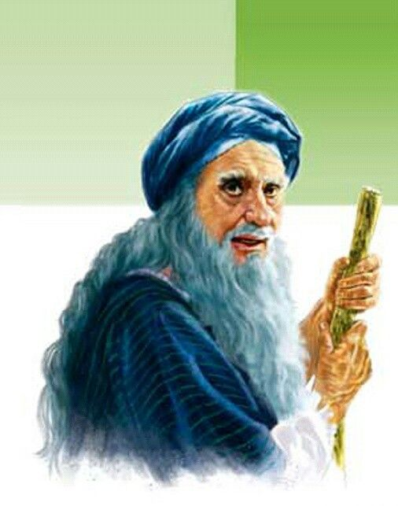
Series: “Beyond Our Four Walls” Part 5. Dealing with Opposition.
Meeting Opposition:
2. It is not Personal.
Samuel took Israel’s request for a king personally.

Slide 32
Series: “Beyond Our Four Walls” Part 5. Dealing with Opposition.
Meeting Opposition:
2. It is not Personal.
Samuel took Israel’s request for a king personally.

Slide 33
Series: “Beyond Our Four Walls” Part 5. Dealing with Opposition.
Meeting Opposition:
2. It is not Personal.
Samuel took Israel’s request for a king personally.
1 Samuel 8:7—
⁷ The Lord said to Samuel, “Listen to the voice of the people in regard to all that they say to you, for they have not rejected you, but they have rejected Me from being king over them. (NASB95)

Slide 34
Series: “Beyond Our Four Walls” Part 5. Dealing with Opposition.
Meeting Opposition:
2. It is not Personal.
Samuel took Israel’s request for a king personally.
1 Samuel 8:7—
⁷ The Lord said to Samuel, “Listen to the voice of the people in regard to all that they say to you, for they have not rejected you, but they have rejected Me from being king over them. (NASB95)

Slide 35
Series: “Beyond Our Four Walls” Part 5. Dealing with Opposition.
Meeting Opposition:
2. It is not Personal.
Samuel took Israel’s request for a king personally.
1 Samuel 8:7—
⁷ The Lord said to Samuel, “Listen to the voice of the people in regard to all that they say to you, for they have not rejected you, but they have rejected Me from being king over them. (NASB95)

Slide 36
Series: “Beyond Our Four Walls” Part 5. Dealing with Opposition.
Meeting Opposition:
2. It is not Personal.
Tragically, they are setting themselves up as “fools” before God.

Slide 37
Series: “Beyond Our Four Walls” Part 5. Dealing with Opposition.
Meeting Opposition:
2. It is not Personal.
Tragically, they are setting themselves up as “fools” before God.

Slide 38
Series: “Beyond Our Four Walls” Part 5. Dealing with Opposition.
Meeting Opposition:
3. Be Ready!

Slide 39
Series: “Beyond Our Four Walls” Part 5. Dealing with Opposition.
Meeting Opposition:
3. Be Ready!
1Peter 3:15

Slide 40
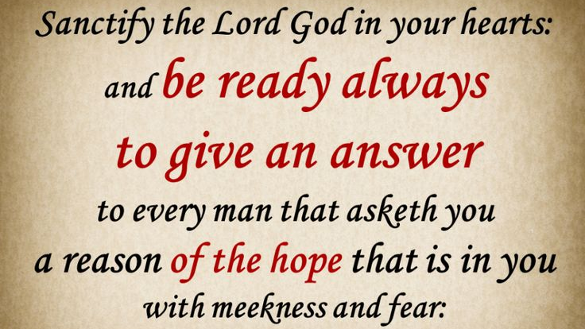
Series: “Beyond Our Four Walls” Part 5. Dealing with Opposition.
Meeting Opposition:
3. Be Ready!
1Peter 3:15

Slide 41
Series: “Beyond Our Four Walls” Part 5. Dealing with Opposition.
Meeting Opposition:
3. Be Ready!
1Peter 3:15
Attitude check:

Slide 42
Series: “Beyond Our Four Walls” Part 5. Dealing with Opposition.
Meeting Opposition:
3. Be Ready!
1Peter 3:15
Attitude check:
“Gentleness and Respect.”

Slide 43
Series: “Beyond Our Four Walls” Part 5. Dealing with Opposition.
Meeting Opposition:
3. Be Ready!
1Peter 3:15
Attitude check:
“Gentleness and Respect.”
We are trying to persuade a soul, not win an argument!

Slide 44
Series: “Beyond Our Four Walls” Part 5. Dealing with Opposition.
Meeting Opposition:
3. Be Ready!
1Peter 3:15
Attitude check:
“Gentleness and Respect.”
We are trying to persuade a soul, not win an argument!
Pride puts both on the wrong side.

Slide 45
Series: “Beyond Our Four Walls” Part 5. Dealing with Opposition.
Meeting Opposition:
3. Be Ready!
2 Timothy 4:2—
²preach the word; be ready in season and out of season; reprove, rebuke, exhort, with great patience and instruction. (NASB95)

Slide 46
Series: “Beyond Our Four Walls” Part 5. Dealing with Opposition.
Meeting Opposition:
3. Be Ready!
2 Timothy 4:2—
²preach the word; be ready in season and out of season; reprove, rebuke, exhort, with great patience and instruction. (NASB95)

Slide 47
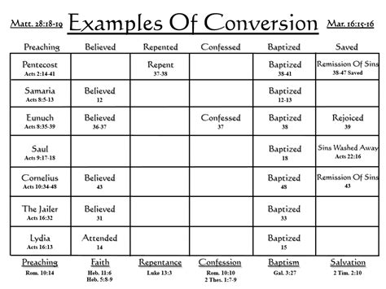
Series: “Beyond Our Four Walls” Part 5. Dealing with Opposition.
Meeting Opposition:
3. Be Ready!

Slide 48
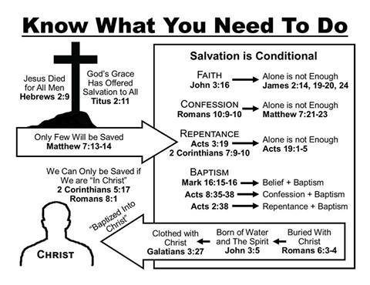
Series: “Beyond Our Four Walls” Part 5. Dealing with Opposition.
Meeting Opposition:
3. Be Ready!

Slide 49
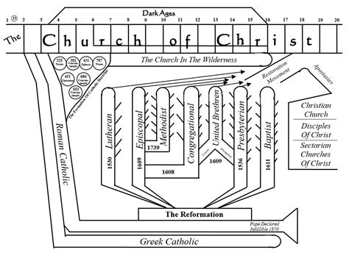
Series: “Beyond Our Four Walls” Part 5. Dealing with Opposition.
Meeting Opposition:
3. Be Ready!

Slide 50
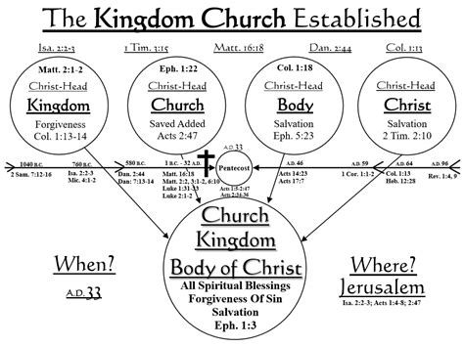
Series: “Beyond Our Four Walls” Part 5. Dealing with Opposition.
Meeting Opposition:
3. Be Ready!

Slide 51
Series: “Beyond Our Four Walls” Part 5. Dealing with Opposition.
Preparing our Hearts:

Slide 52
Series: “Beyond Our Four Walls” Part 5. Dealing with Opposition.
Preparing our Hearts:
1. How much do I care?

Slide 53
Series: “Beyond Our Four Walls” Part 5. Dealing with Opposition.
Preparing our Hearts:
1. How much do I care?
Am I willing to sacrifice?

Slide 54
Series: “Beyond Our Four Walls” Part 5. Dealing with Opposition.
Preparing our Hearts:
1. How much do I care?
Am I willing to sacrifice?
What will it take?

Slide 55
Series: “Beyond Our Four Walls” Part 5. Dealing with Opposition.
Preparing our Hearts:
1. How much do I care?
Am I willing to sacrifice?
What will it take?
Time

Slide 56
Series: “Beyond Our Four Walls” Part 5. Dealing with Opposition.
Preparing our Hearts:
1. How much do I care?
Am I willing to sacrifice?
What will it take?
Time
Humility

Slide 57
Series: “Beyond Our Four Walls” Part 5. Dealing with Opposition.
Preparing our Hearts:
1. How much do I care?
Am I willing to sacrifice?
What will it take?
Time
Humility
Hurt Feelings

Slide 58
Series: “Beyond Our Four Walls” Part 5. Dealing with Opposition.
Preparing our Hearts:
1. How much do I care?
Am I willing to sacrifice?
What will it take?
Time
Humility
Hurt Feelings
Being messed around

Slide 59
Series: “Beyond Our Four Walls” Part 5. Dealing with Opposition.
Preparing our Hearts:
1. How much do I care?
Am I willing to sacrifice?
What will it take?
Time
Humility
Hurt Feelings
Being messed around
Being Criticised

Slide 60
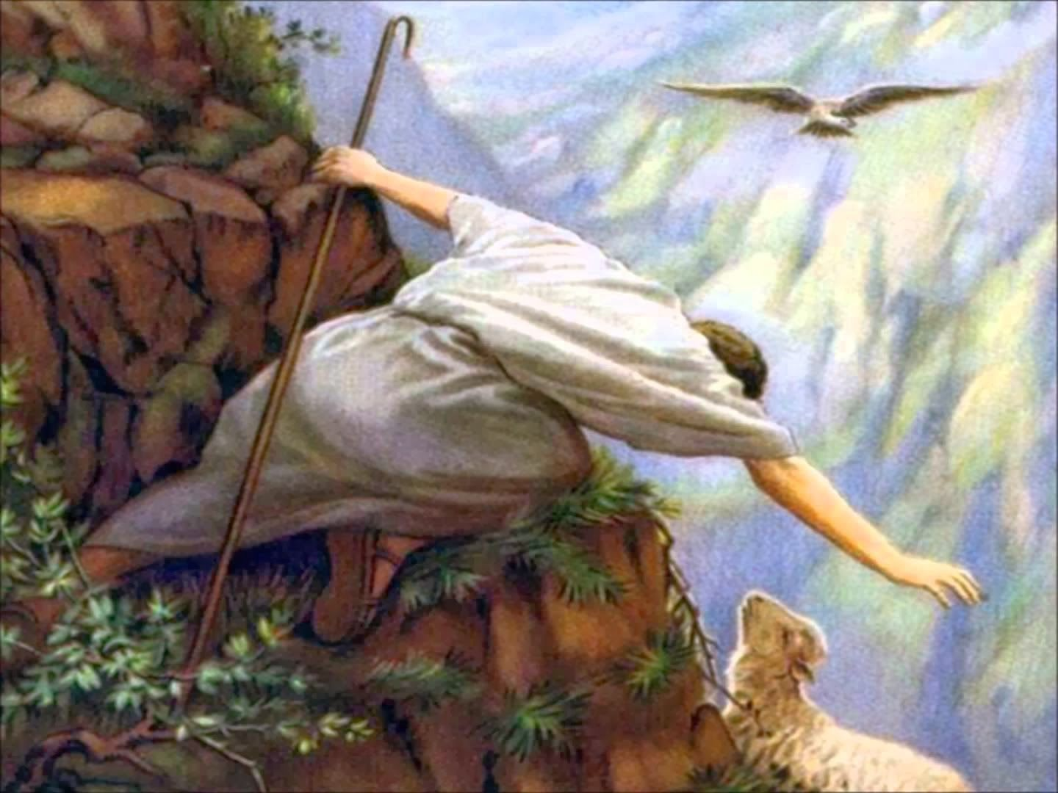
Series: “Beyond Our Four Walls” Part 5. Dealing with Opposition.
Preparing our Hearts:
1. How much do I care?
Am I willing to sacrifice?
Jesus left the 99.

Slide 61
Series: “Beyond Our Four Walls” Part 5. Dealing with Opposition.
Preparing our Hearts:
1. How much do I care?
Am I willing to sacrifice?
Jesus left the 99.
Luke 15:7—
⁷I tell you that in the same way, there will be more joy in heaven over one sinner who repents than over ninety-nine righteous persons who need no repentance.
(NASB95)

