Slide 1
“Beyond Our Four Walls”
Part 6. “Never Let a Chance Go By!”
John Staiger
Morningside Church of Christ
Wednesday 11 May 2022
Broadcast on Facebook Live
Auckland, Aotearoa/NZ.
www.morningsidechurchofchrist.org.nz

Slide 2
“Beyond Our Four Walls”
“Never
Let a Chance
Go By!”
Part 6.

Slide 3
Series: “Beyond Our Four Walls” Part 6. “Never Let a Chance Go By!”
In the Closet…
Matthew 6:6—
But thou, when thou prayest, enter into thy closet, and when thou hast shut thy door, pray to thy Father which is in secret; and thy Father which seeth in secret shall reward thee openly. (KJV)

Slide 4
Series: “Beyond Our Four Walls” Part 6. “Never Let a Chance Go By!”
In the Closet…
Matthew 6:6—
But thou, when thou prayest, enter into thy closet, and when thou hast shut thy door, pray to thy Father which is in secret; and thy Father which seeth in secret shall reward thee openly. (KJV)

Slide 5
Series: “Beyond Our Four Walls” Part 6. “Never Let a Chance Go By!”
In the Closet…
Matthew 6:6—
But thou, when thou prayest, enter into thy closet, and when thou hast shut thy door, pray to thy Father which is in secret; and thy Father which seeth in secret shall reward thee openly. (KJV)

Slide 6
Series: “Beyond Our Four Walls” Part 6. “Never Let a Chance Go By!”
In the Closet…
Make a prayer list.

Slide 7
Series: “Beyond Our Four Walls” Part 6. “Never Let a Chance Go By!”
In the Closet…
Make a prayer list.

Slide 8
Series: “Beyond Our Four Walls” Part 6. “Never Let a Chance Go By!”
In the Closet…
Make a prayer list.
1. Your nearest and dearest.
Repent of any issues.
Respect their view of you as someone they know.
Matthew 13:57—

Slide 9
Series: “Beyond Our Four Walls” Part 6. “Never Let a Chance Go By!”
In the Closet…
Make a prayer list.
1. Your nearest and dearest.
Repent of any issues.
Respect their view of you as someone they know.
Matthew 13:57—

Slide 10
Series: “Beyond Our Four Walls” Part 6. “Never Let a Chance Go By!”
In the Closet…
Make a prayer list.
1. Your nearest and dearest.
Repent of any issues.
Respect their view of you as someone they know.
Matthew 13:57—

Slide 11
Series: “Beyond Our Four Walls” Part 6. “Never Let a Chance Go By!”
In the Closet…
Make a prayer list.
1. Your nearest and dearest.
Repent of any issues.
Respect their view of you as someone they know.
Matthew 13:57—

Slide 12
Series: “Beyond Our Four Walls” Part 6. “Never Let a Chance Go By!”
In the Closet…
Matthew 13:57—
And they took offense at Him. But Jesus said to them, “A prophet is not without honour except in his hometown and in his own household.” (NASB95)

Slide 13
Series: “Beyond Our Four Walls” Part 6. “Never Let a Chance Go By!”
In the Closet…
Make a prayer list.
2. Strangers.

Slide 14
Series: “Beyond Our Four Walls” Part 6. “Never Let a Chance Go By!”
In the Closet…
Make a prayer list.
2. Strangers.
Memorise their names.

Slide 15
Series: “Beyond Our Four Walls” Part 6. “Never Let a Chance Go By!”
In the Closet…
Make a prayer list.
2. Strangers.
Memorise their names.
Pray as you go.

Slide 16
Series: “Beyond Our Four Walls” Part 6. “Never Let a Chance Go By!”
Take your prayers with you…
Mark 16:15-16—
¹⁵ And He said to them, “Go into all the world and preach the gospel to all creation. ¹⁶ He who has believed and has been baptized shall be saved; but he who has disbelieved shall be condemned. (NASB95)

Slide 17
Series: “Beyond Our Four Walls” Part 6. “Never Let a Chance Go By!”
Take your prayers with you…
Mark 16:15-16—
¹⁵ And He said to them, “Go into all the world and preach the gospel to all creation. ¹⁶ He who has believed and has been baptized shall be saved; but he who has disbelieved shall be condemned. (NASB95)

Slide 18
Series: “Beyond Our Four Walls” Part 6. “Never Let a Chance Go By!”
Take your prayers with you…
Mark 16:15-16—
¹⁵ And He said to them, “Go into all the world and preach the gospel to all creation. ¹⁶ He who has believed and has been baptized shall be saved; but he who has disbelieved shall be condemned. (NASB95)

Slide 19
Series: “Beyond Our Four Walls” Part 6. “Never Let a Chance Go By!”
Take your prayers with you…
Mark 16:15-16—
¹⁵ And He said to them, “Go into all the world and preach the gospel to all creation. ¹⁶ He who has believed and has been baptized shall be saved; but he who has disbelieved shall be condemned. (NASB95)

Slide 20
Series: “Beyond Our Four Walls” Part 6. “Never Let a Chance Go By!”
Take your prayers with you…
Mark 16:15-16—
¹⁵ And He said to them, “Go into all the world and preach the gospel to all creation. ¹⁶ He who has believed and has been baptized shall be saved; but he who has disbelieved shall be condemned. (NASB95)

Slide 21
Series: “Beyond Our Four Walls” Part 6. “Never Let a Chance Go By!”
Take your prayers with you…
Thank the Lord for the person(s) in front of you.
Pray for their souls.
Pray for a humble heart.

Slide 22
Series: “Beyond Our Four Walls” Part 6. “Never Let a Chance Go By!”
Take your prayers with you…
Thank the Lord for the person(s) in front of you.
Pray for their souls.
Pray for a humble heart.

Slide 23
Series: “Beyond Our Four Walls” Part 6. “Never Let a Chance Go By!”
Take your prayers with you…
Thank the Lord for the person(s) in front of you.
Pray for their souls.
Pray for a humble heart.

Slide 24
Series: “Beyond Our Four Walls” Part 6. “Never Let a Chance Go By!”
No time like the Present…

Slide 25
Series: “Beyond Our Four Walls” Part 6. “Never Let a Chance Go By!”
No time like the Present…

Slide 26
Series: “Beyond Our Four Walls” Part 6. “Never Let a Chance Go By!”
No time like the Present…
2 Corinthians 6:2—
for He says, “At the acceptable time I listened to you, And on the day of salvation I helped you.” Behold, now is “the acceptable time,” behold, now is “the day of salvation”— (NASB95)

Slide 27
Series: “Beyond Our Four Walls” Part 6. “Never Let a Chance Go By!”
No time like the Present…
2 Corinthians 6:2—
for He says, “At the acceptable time I listened to you, And on the day of salvation I helped you.” Behold, now is “the acceptable time,” behold, now is “the day of salvation”— (NASB95)

Slide 28
Series: “Beyond Our Four Walls” Part 6. “Never Let a Chance Go By!”
Always Learning…

Slide 29
Series: “Beyond Our Four Walls” Part 6. “Never Let a Chance Go By!”
Always Learning…
Go as a disciple—one always learning from the Master.

Slide 30
Series: “Beyond Our Four Walls” Part 6. “Never Let a Chance Go By!”
Always Learning…
Go as a disciple—one always learning from the Master.
Jesus showed us how:

Slide 31
Series: “Beyond Our Four Walls” Part 6. “Never Let a Chance Go By!”
Always Learning…
Go as a disciple—one always learning from the Master.
Jesus showed us how:
He loves us and demonstrated it.

Slide 32
Series: “Beyond Our Four Walls” Part 6. “Never Let a Chance Go By!”
Always Learning…
Go as a disciple—one always learning from the Master.
Jesus showed us how:
He loves us and demonstrated it.
Always ready to answer.

Slide 33
Series: “Beyond Our Four Walls” Part 6. “Never Let a Chance Go By!”
Always Learning…
Go as a disciple—one always learning from the Master.
Jesus showed us how:
He loves us and demonstrated it.
Always ready to answer.
Debated.

Slide 34
Series: “Beyond Our Four Walls” Part 6. “Never Let a Chance Go By!”
Always Learning…
Go as a disciple—one always learning from the Master.
Jesus showed us how:
He loves us and demonstrated it.
Always ready to answer.
Debated.
Asked questions.

Slide 35
Series: “Beyond Our Four Walls” Part 6. “Never Let a Chance Go By!”
Always Learning…
Go as a disciple—one always learning from the Master.
Jesus showed us how:
He loves us and demonstrated it.
Always ready to answer.
Debated.
Asked questions.
Challenged orthodoxy.

Slide 36
Series: “Beyond Our Four Walls” Part 6. “Never Let a Chance Go By!”
Always Learning…
Learn from your brethren who know what they are doing.

Slide 37
Series: “Beyond Our Four Walls” Part 6. “Never Let a Chance Go By!”
Always Learning…
Learn from your brethren who know what they are doing.
Listen to their stories.

Slide 38
Series: “Beyond Our Four Walls” Part 6. “Never Let a Chance Go By!”
Always Learning…
Learn from your brethren who know what they are doing.
Listen to their stories.
Ask them what they would change about their approach.

Slide 39
Series: “Beyond Our Four Walls” Part 6. “Never Let a Chance Go By!”
Pushing through Rejection…

Slide 40
Series: “Beyond Our Four Walls” Part 6. “Never Let a Chance Go By!”
Pushing through Rejection…
Successes are to be celebrated.

Slide 41
Series: “Beyond Our Four Walls” Part 6. “Never Let a Chance Go By!”
Pushing through Rejection…
Successes are to be celebrated.
You will be rejected for Christ’s sake.

Slide 42
Series: “Beyond Our Four Walls” Part 6. “Never Let a Chance Go By!”
Pushing through Rejection…
Successes are to be celebrated.
You will be rejected for Christ’s sake.
It is never nice.

Slide 43
Series: “Beyond Our Four Walls” Part 6. “Never Let a Chance Go By!”
Pushing through Rejection…
Successes are to be celebrated.
You will be rejected for Christ’s sake.
It is never nice.
If you don’t feel a sense of sadness there is something wrong.

Slide 44
Series: “Beyond Our Four Walls” Part 6. “Never Let a Chance Go By!”
Pushing through Rejection…
Successes are to be celebrated.
You will be rejected for Christ’s sake.
It is never nice.
If you don’t feel a sense of sadness there is something wrong.
Rejoice if persecuted for Christ’s name.

Slide 45
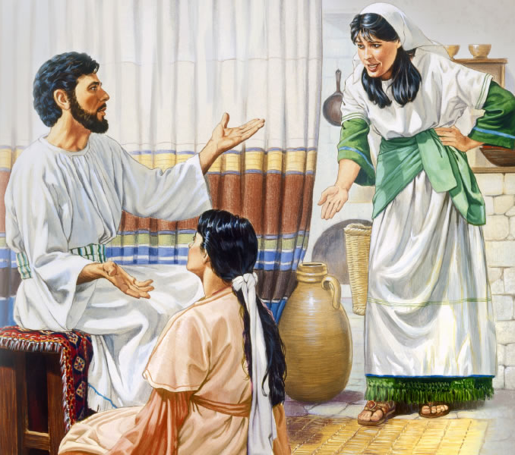
Series: “Beyond Our Four Walls” Part 6. “Never Let a Chance Go By!”
Hospitality

Slide 46
Series: “Beyond Our Four Walls” Part 6. “Never Let a Chance Go By!”
Hospitality
Don’t get carried away.
Keep it simple.
Hebrews 13:2—
Do not neglect to show hospitality to strangers, for by this some have entertained angels without knowing it. (NASB95)
Martha and Mary (Luke 10:38-42)

Slide 47
Series: “Beyond Our Four Walls” Part 6. “Never Let a Chance Go By!”
Hospitality
Don’t get carried away.
Keep it simple.
Hebrews 13:2—
Do not neglect to show hospitality to strangers, for by this some have entertained angels without knowing it. (NASB95)
Martha and Mary (Luke 10:38-42)

Slide 48
Series: “Beyond Our Four Walls” Part 6. “Never Let a Chance Go By!”
Hospitality
Don’t get carried away.
Keep it simple.
Hebrews 13:2—
Do not neglect to show hospitality to strangers, for by this some have entertained angels without knowing it. (NASB95)
Martha and Mary (Luke 10:38-42)

Slide 49
Series: “Beyond Our Four Walls” Part 6. “Never Let a Chance Go By!”
Hospitality
Don’t get carried away.
Keep it simple.
Hebrews 13:2—
Do not neglect to show hospitality to strangers, for by this some have entertained angels without knowing it. (NASB95)
Martha and Mary (Luke 10:38-42)

Slide 50
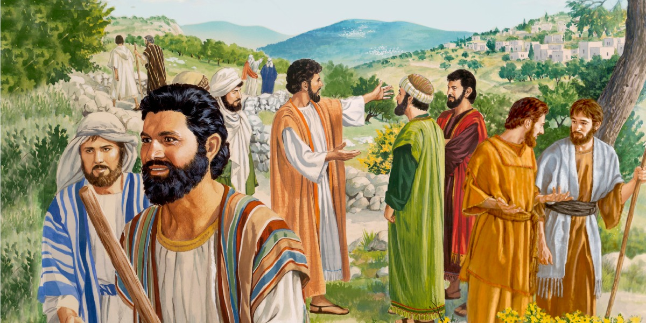
Series: “Beyond Our Four Walls” Part 6. “Never Let a Chance Go By!”
Strength in Numbers…
Luke 10:1—
After this the Lord appointed seventy-two others and sent them two by two ahead of him to every town and place where he was about to go. (NIV)

Slide 51
Series: “Beyond Our Four Walls” Part 6. “Never Let a Chance Go By!”
Strength in Numbers…
Luke 10:1—
After this the Lord appointed seventy-two others and sent them two by two ahead of him to every town and place where he was about to go. (NIV)

Slide 52
Series: “Beyond Our Four Walls” Part 6. “Never Let a Chance Go By!”
Strength in Numbers…
Keep Encouraged.

Slide 53
Series: “Beyond Our Four Walls” Part 6. “Never Let a Chance Go By!”
Strength in Numbers…
Keep Encouraged.
Keep safe.

Slide 54
Series: “Beyond Our Four Walls” Part 6. “Never Let a Chance Go By!”
Strength in Numbers…
Keep Encouraged.
Keep safe.
Keep focused.

