Slide 1
“Beyond Our Four Walls”
Part 7. “Just Ask Them!”
John Staiger
Morningside Church of Christ
Wednesday 18 May 2022
Broadcast on Facebook Live
Auckland, Aotearoa/NZ.
www.morningsidechurchofchrist.org.nz

Slide 2
“Beyond Our Four Walls”
“Just Ask Them!”
Part 7.

Slide 3
Series: “Beyond Our Four Walls” Part 7. “Just Ask Them!”
Guess who the Expert is…?

Slide 4
Series: “Beyond Our Four Walls” Part 7. “Just Ask Them!”
Guess who the Expert is…?

Slide 5
Series: “Beyond Our Four Walls” Part 7. “Just Ask Them!”
Guess who the Expert is…?

Slide 6
Series: “Beyond Our Four Walls” Part 7. “Just Ask Them!”
Guess who the Expert is…?
Gospel is put in the hands of mere mortals.
Expected to be ready.
Be ready.

Slide 7
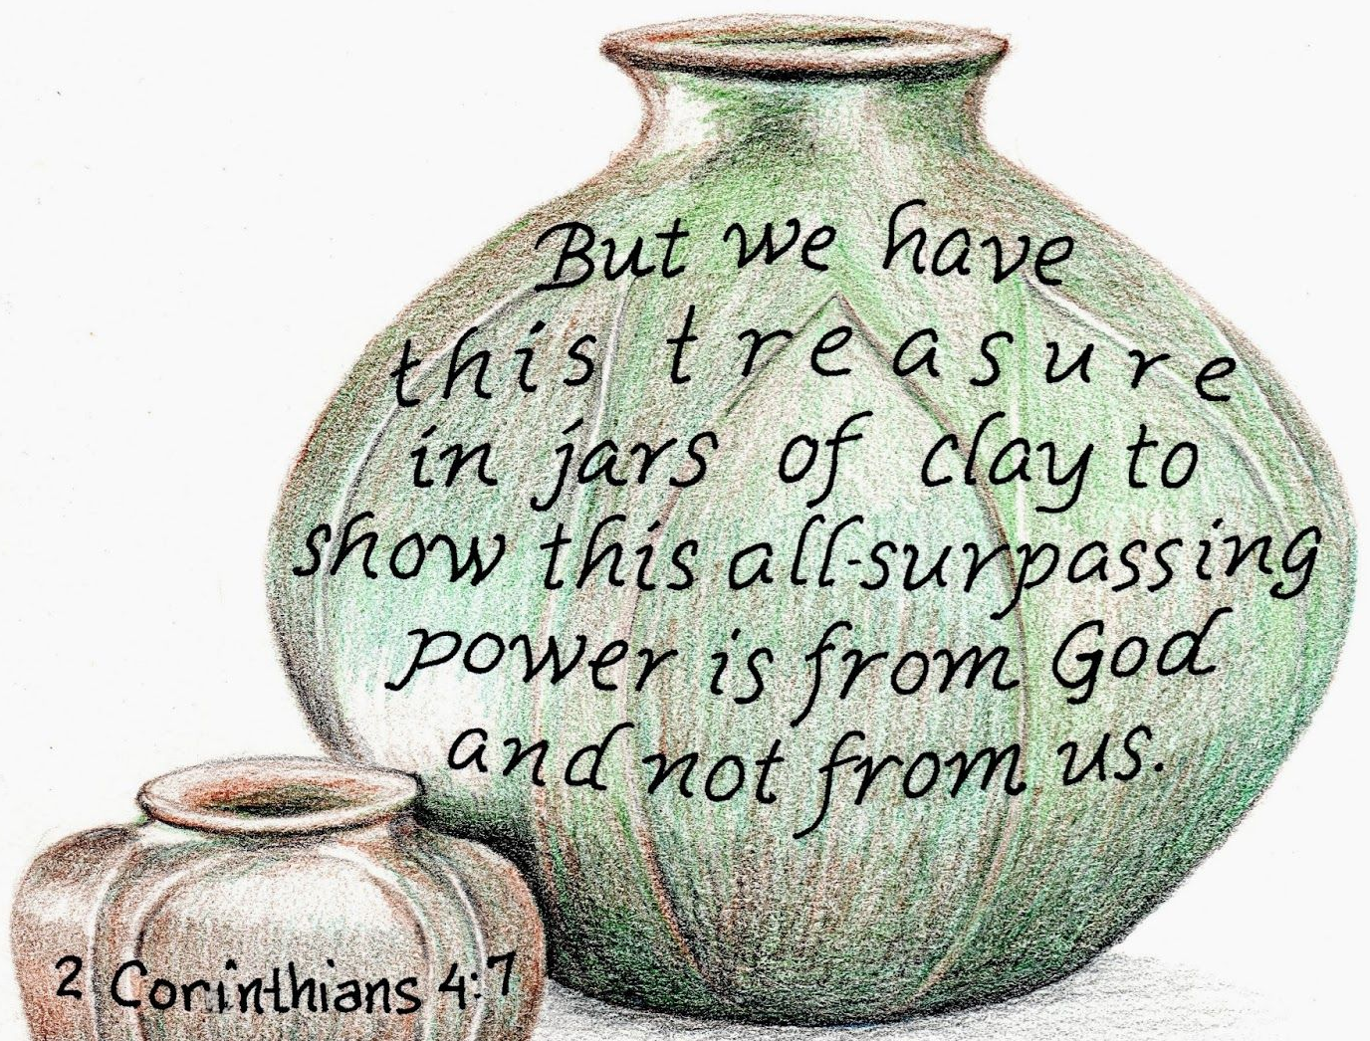
Series: “Beyond Our Four Walls” Part 7. “Just Ask Them!”
Guess who the Expert is…?
Gospel is put in the hands of mere mortals.
Expected to be ready.
Be ready.

Slide 8
Series: “Beyond Our Four Walls” Part 7. “Just Ask Them!”
Guess who the Expert is…?
Gospel is put in the hands of mere mortals.
Expected to be ready. So…
Be ready.

Slide 9
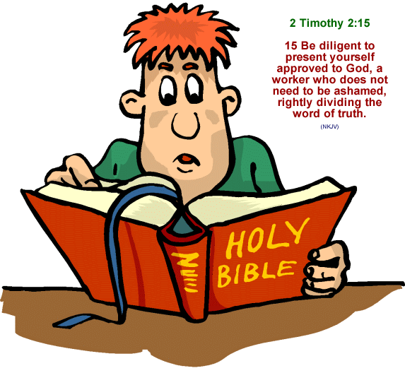
Series: “Beyond Our Four Walls” Part 7. “Just Ask Them!”
Guess who the Expert is…?
Gospel is put in the hands of mere mortals.
Expected to be ready.
Be ready.

Slide 10
Series: “Beyond Our Four Walls” Part 7. “Just Ask Them!”

Slide 11
Series: “Beyond Our Four Walls” Part 7. “Just Ask Them!”
As You Go…Confident!
All Authority—
This power is beyond ourselves.
Not our own.
Not limited to our ability to control or command.

Slide 12
Series: “Beyond Our Four Walls” Part 7. “Just Ask Them!”
As You Go…Confident!
All Authority—
This power is beyond ourselves.
Not our own.
Not limited to our ability to control or command.

Slide 13
Series: “Beyond Our Four Walls” Part 7. “Just Ask Them!”
As You Go…Confident!
All Authority—
This power is beyond ourselves.
Not our own.
Not limited to our ability to control or command.

Slide 14
Series: “Beyond Our Four Walls” Part 7. “Just Ask Them!”
As You Go…Confident!
All Authority—
This power is beyond ourselves.
Not our own.
Not limited to anyone’s ability to control, or command.

Slide 15
Series: “Beyond Our Four Walls” Part 7. “Just Ask Them!”
As You Go…Confident!
In Heaven and on Earth—
There’s nowhere that Jesus doesn’t rule.
No one and nothing is beyond his reach

Slide 16
Series: “Beyond Our Four Walls” Part 7. “Just Ask Them!”
As You Go…Confident!
In Heaven and on Earth—
There’s nowhere that Jesus doesn’t rule.
No one and nothing is beyond his reach

Slide 17
Series: “Beyond Our Four Walls” Part 7. “Just Ask Them!”
As You Go…Confident!
In Heaven and on Earth—
There’s nowhere that Jesus doesn’t rule.
No one and nothing is beyond his reach.

Slide 18
Series: “Beyond Our Four Walls” Part 7. “Just Ask Them!”
As You Go…Confident!
Has been given to me—
The Son of God submitted to the will of the father to come and save us.

Slide 19
Series: “Beyond Our Four Walls” Part 7. “Just Ask Them!”
As You Go…Confident!
Has been given to me—
The Son of God submitted to the will of the father to come and save us.

Slide 20
Series: “Beyond Our Four Walls” Part 7. “Just Ask Them!”
As You Go…Confident!
Therefore go—
Jesus went to the lost…
So must we.

Slide 21
Series: “Beyond Our Four Walls” Part 7. “Just Ask Them!”
As You Go…Confident!
Therefore go—
Jesus went to the lost…
So must we.

Slide 22
Series: “Beyond Our Four Walls” Part 7. “Just Ask Them!”
As You Go…Confident!
Therefore go—
Jesus went to the lost.
So must we.

Slide 23
Series: “Beyond Our Four Walls” Part 7. “Just Ask Them!”
As You Go…Confident!
Make disciples—

Slide 24
Series: “Beyond Our Four Walls” Part 7. “Just Ask Them!”
As You Go…Confident!
Make disciples—
Disciples of Jesus…

Slide 25
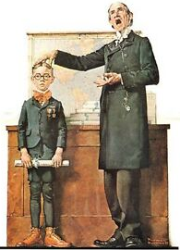
Series: “Beyond Our Four Walls” Part 7. “Just Ask Them!”
As You Go…Confident!
Make disciples—
Disciples of Jesus.
Not ours.

Slide 26
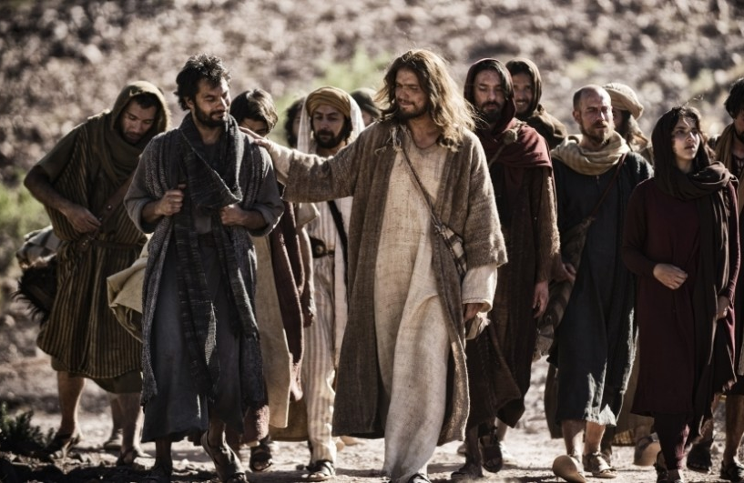
Series: “Beyond Our Four Walls” Part 7. “Just Ask Them!”
As You Go…Confident!
Make disciples—
Disciples of Jesus.
Not ours.
Matthew 10:25—It is enough for the disciple that he become like his teacher, and the slave like his master. (NASB95)

Slide 27
Series: “Beyond Our Four Walls” Part 7. “Just Ask Them!”
As You Go…Confident!
Baptising them—

Slide 28
Series: “Beyond Our Four Walls” Part 7. “Just Ask Them!”
As You Go…Confident!
Baptising them—

Slide 29
Series: “Beyond Our Four Walls” Part 7. “Just Ask Them!”
As You Go…Confident!
Teaching them to obey—

Slide 30
Series: “Beyond Our Four Walls” Part 7. “Just Ask Them!”
As You Go…Confident!
Teaching them to obey—
Creeds?

Slide 31
Series: “Beyond Our Four Walls” Part 7. “Just Ask Them!”
As You Go…Confident!
Teaching them to obey—
Creeds?
Traditions? (Bad)
Colossians 2:8—See to it that no one takes you captive through philosophy and empty deception, according to the tradition of men, according to the elementary principles of the world, rather than according to Christ. (NASB95)

Slide 32
Series: “Beyond Our Four Walls” Part 7. “Just Ask Them!”
As You Go…Confident!
Teaching them to obey—
Creeds?
Traditions? (Good)
2 Thessalonians 2:15—So then, brethren, stand firm and hold to the traditions which you were taught, whether by word of mouth or by letter from us. (NASB95)

Slide 33
Series: “Beyond Our Four Walls” Part 7. “Just Ask Them!”
As You Go…Confident!
Teaching them to obey—
Creeds?
Traditions?
Acts 20:27—For I did not shrink from declaring to you the whole purpose of God. (NASB95)

