Slide 1
Series: Going Home
Part 2. “On the Way.”
John Staiger
Morningside Church of Christ
Sunday 29 May 2022
AM Sermon
Broadcast live from 42 Leslie Ave, Auckland, Aotearoa/NZ.

Slide 2
Series: Going Home Part 2. “On the Way.”
Fixing my compass…

Slide 3
Series: Going Home Part 2. “On the Way.”
Fixing my compass…
What I don’t believe matters—
John 3:18
¹⁸He who believes in Him is not judged; he who does not believe has been judged already, because he has not believed in the name of the only begotten Son of God. (NASB95)

Slide 4
Series: Going Home Part 2. “On the Way.”
Fixing my compass
What I don’t believe matters—
John 3:18
¹⁸He who believes in Him is not judged; he who does not believe has been judged already, because he has not believed in the name of the only begotten Son of God. (NASB95)

Slide 5
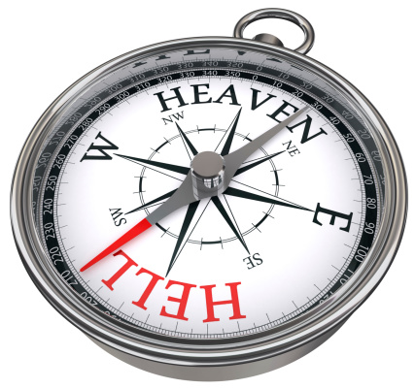
Series: Going Home Part 2. “On the Way.”
Fixing my compass
Not my Future
2 Thessalonians 1:9—
⁹These will pay the penalty of eternal destruction, away from the presence of the Lord and from the glory of His power, (NASB95)

Slide 6
Series: Going Home Part 2. “On the Way.”
Fixing my compass
Not my Future
2 Thessalonians 1:9—
⁹These will pay the penalty of eternal destruction, away from the presence of the Lord and from the glory of His power, (NASB95)

Slide 7
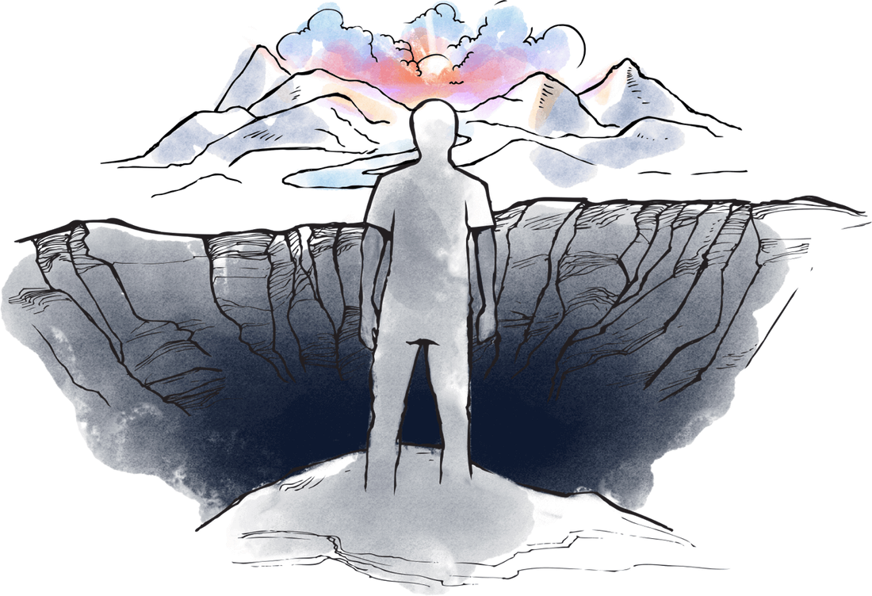
Series: Going Home Part 2. “On the Way.”
I was lost…

Slide 8
Series: Going Home Part 2. “On the Way.”
I was lost…
Ephesians 2:12—
¹²Remember that you were at that time separate from Christ, excluded from the commonwealth of Israel, and strangers to the covenants of promise, having no hope and without God in the world.

Slide 9
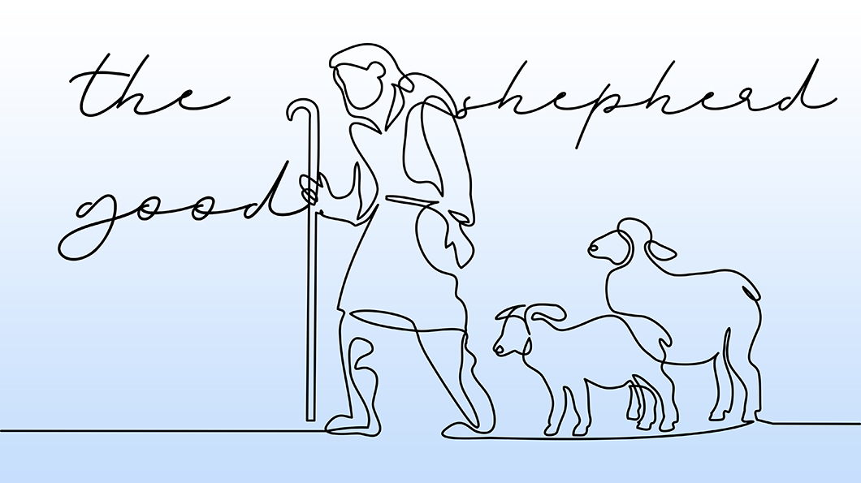
Series: Going Home Part 2. “On the Way.”
Now I’m Found…

Slide 10
Series: Going Home Part 2. “On the Way.”
Now I’m Found…
Not getting lost again…

Slide 11
Series: Going Home Part 2. “On the Way.”
Now I’m Found…
Not getting lost again…
Jesus said that we WERE like sheep without a SHEPHERD. (Mt.9:36)

Slide 12
Series: Going Home Part 2. “On the Way.”
Now I’m Found…
Not getting lost again…
Jesus said that we WERE like sheep without a SHEPHERD.
His COMPASSION rescued us. (Luke 15:3-7)

Slide 13
Series: Going Home Part 2. “On the Way.”
Now I’m Found…
Not getting lost again…
Jesus said that we WERE like sheep without a SHEPHERD.
His COMPASSION rescued us.
We know his VOICE and FOLLOW him. (Jn.10:4)

Slide 14
Series: Going Home Part 2. “On the Way.”
Now I’m Found…
Not getting lost again…

Slide 15
Series: Going Home Part 2. “On the Way.”
Now I’m Found…
Not getting lost again…
Don’t get caught up in SHEEP-OLOGY.

Slide 16
Series: Going Home Part 2. “On the Way.”
Now I’m Found…
Not getting lost again…
Don’t get caught up in SHEEP-OLOGY
“The study of the Sheep.”

Slide 17
Series: Going Home Part 2. “On the Way.”
Now I’m Found…
Not getting lost again…
Don’t get caught up in SHEEP-OLOGY
“The study of the Sheep.”
Christians studying Christians.

Slide 18
Series: Going Home Part 2. “On the Way.”
Now I’m Found…
Not getting lost again…
Don’t get caught up in SHEEP-OLOGY
“The study of the Sheep.”
Christians studying Christians.

Slide 19
Series: Going Home Part 2. “On the Way.”
Now I’m Found…
Not getting lost again…
Hebrews 12:2—
Fixing our eyes on Jesus, the pioneer and perfecter of faith. (NIV)

Slide 20
Series: Going Home Part 2. “On the Way.”
Carrying my cross…

Slide 21
Series: Going Home Part 2. “On the Way.”
Carrying my cross…
Luke 9:23—
²³And He was saying to them all, “If anyone wishes to come after Me, he must deny himself, and take up his cross daily and follow Me. (NASB95)

Slide 22
Series: Going Home Part 2. “On the Way.”
Carrying my cross…
Galatians 2:20—
²⁰ I have been crucified with Christ; and it is no longer I who live, but Christ lives in me; and the life which I now live in the flesh I live by faith in the Son of God, who loved me and gave Himself up for me. (NASB95)

Slide 23
Series: Going Home Part 2. “On the Way.”
Carrying my cross…
Romans 8:12-14—
¹² So then, brethren, we are under obligation, not to the flesh, to live according to the flesh—

Slide 24
Series: Going Home Part 2. “On the Way.”
Carrying my cross…
Romans 8:12-14—
¹² So then, brethren, we are under obligation, not to the flesh, to live according to the flesh—
¹³ for if you are living according to the flesh, you must die;

Slide 25
Series: Going Home Part 2. “On the Way.”
Carrying my cross…
Romans 8:12-14—
¹² So then, brethren, we are under obligation, not to the flesh, to live according to the flesh—
¹³ for if you are living according to the flesh, you must die;
but if by the Spirit you are putting to death the deeds of the body, you will live.

Slide 26
Series: Going Home Part 2. “On the Way.”
Carrying my cross…
Romans 8:12-14—
¹² So then, brethren, we are under obligation, not to the flesh, to live according to the flesh—
¹³ for if you are living according to the flesh, you must die;
but if by the Spirit you are putting to death the deeds of the body, you will live.
¹⁴ For all who are being led by the Spirit of God, these are sons of God.
(NASB95)

Slide 27
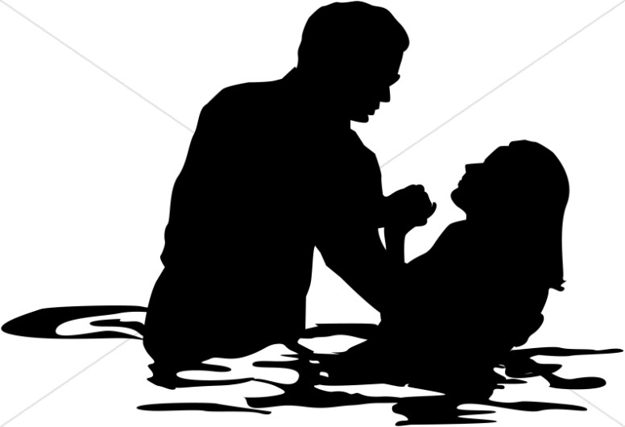
Series: Going Home Part 1. “Nazareth Bound.”
Galatians 3:27—
For all of you who were baptized into Christ have clothed yourselves with Christ. (NASB95)

