Slide 1
Series: Going Home
Part 3. At Home in the Body
John Staiger
Morningside Church of Christ
Sunday 5 June 2022
AM Sermon
Broadcast live from 42 Leslie Ave, Auckland, Aotearoa/NZ.

Slide 2
Series: Going Home
Part 3.
At Home in the Body

Slide 3
Series: Going Home Part 3. At Home in the Body
2 Corinthians 5:6
Therefore,
being always of
good courage,
and knowing that
while we are
at home in the body
we are
absent from the Lord—

Slide 4
Series: Going Home Part 3. At Home in the Body
Life for the Christian is to be enjoyed…

Slide 5
Series: Going Home Part 3. At Home in the Body
Proverbs 18:22—
He who finds a wife finds a good thing
And obtains favour from the Lord.

Slide 6
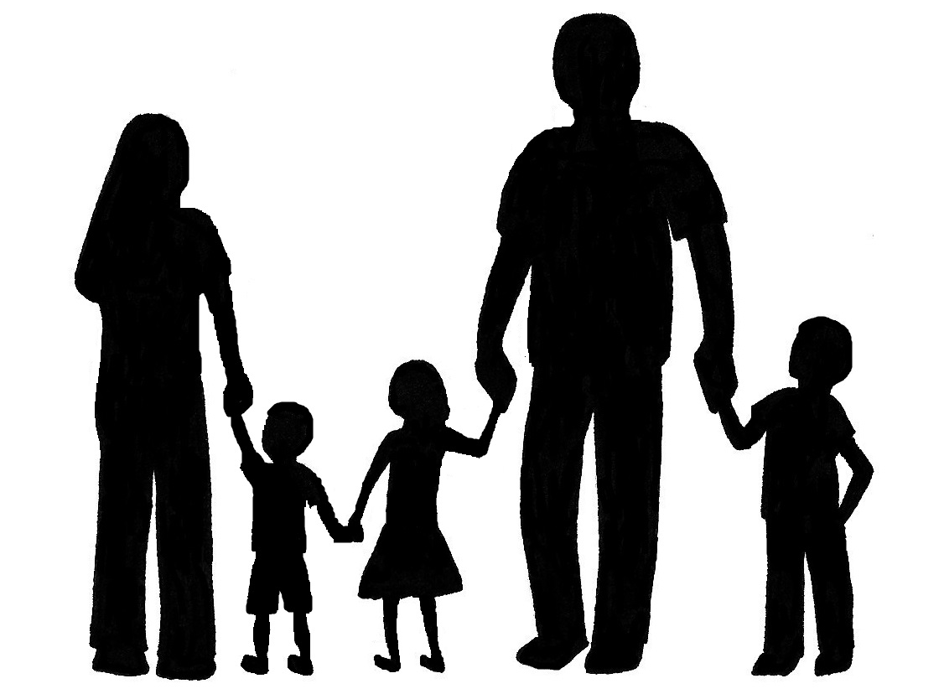
Series: Going Home Part 3. At Home in the Body
But first memories are somewhere back here…
Psalm 127:4-5—
⁴ Like arrows in the hand of a warrior, So are the children of one’s youth. ⁵ How blessed is the man whose quiver is full of them;

Slide 7
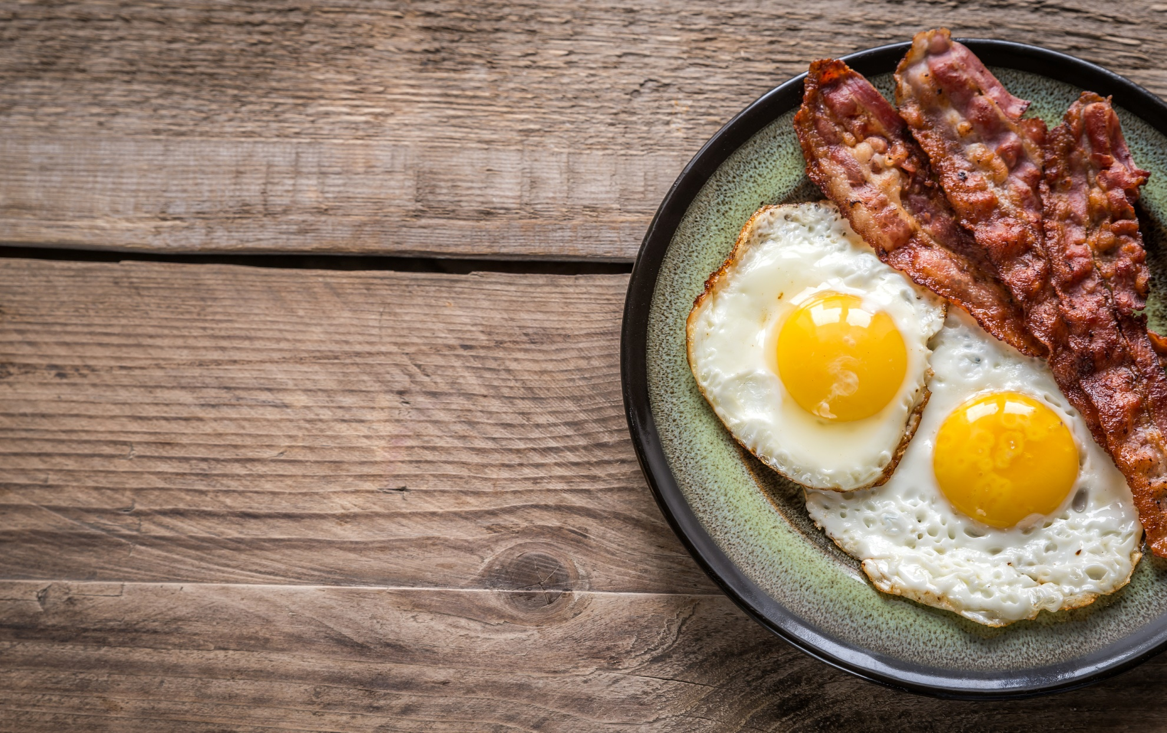
Series: Going Home Part 3. At Home in the Body
Counting Myself Blessed…
You probably got up this morning with plenty of:

Slide 8
Series: Going Home Part 3. At Home in the Body
Counting Myself Blessed…
You probably got up this morning with plenty of:
Food

Slide 9
Series: Going Home Part 3. At Home in the Body
Counting Myself Blessed…
You probably got up this morning with plenty of:
Food
Clothing

Slide 10
Series: Going Home Part 3. At Home in the Body
Counting Myself Blessed…
You probably got up this morning with plenty of:
Food
Clothing
Shelter

Slide 11
Series: Going Home Part 3. At Home in the Body
Counting Myself Blessed…
You probably got up this morning with plenty of:
Food
Clothing
Shelter
Medicine

Slide 12
Series: Going Home Part 3. At Home in the Body
Counting Myself Blessed…
You probably got up this morning with plenty of:
Food
Clothing
Shelter
Medicine
Friends

Slide 13
Series: Going Home Part 3. At Home in the Body
Counting Myself Blessed…
You probably got up this morning with plenty of:
Food
Clothing
Shelter
Medicine
Friends
Opportunities

Slide 14
Series: Going Home Part 3. At Home in the Body
Counting Myself Blessed…
Many,
many
people
do not.
So…

Slide 15
Series: Going Home Part 3. At Home in the Body
Counting Myself Blessed…

Slide 16
Series: Going Home Part 3. At Home in the Body
Psalm 127:3—
Behold, children are a gift of the Lord
The sound of a child in church is life.
We are blessed to know them.
We help their parents by mirroring Christ.
Joy of the Lord
Hope
Strength
Courage
Generosity

Slide 17
Series: Going Home Part 3. At Home in the Body
Psalm 127:3—
Behold, children are a gift of the Lord
The sound of a child in church is life.
We are blessed to know them.
We help their parents by mirroring Christ.
Joy of the Lord
Hope
Strength
Courage
Generosity

Slide 18
Series: Going Home Part 3. At Home in the Body
Psalm 127:3—
Behold, children are a gift of the Lord
The sound of a child in church is life.
We are blessed to know them.
We help their parents by mirroring Christ.
Joy of the Lord
Hope
Strength
Courage
Generosity

Slide 19
Series: Going Home Part 3. At Home in the Body
Psalm 127:3—
Behold, children are a gift of the Lord
The sound of a child in church is life.
We are blessed to know them.
We help their parents by mirroring Christ.

Slide 20
Series: Going Home Part 3. At Home in the Body
Psalm 127:3—
Behold, children are a gift of the Lord
The sound of a child in church is life.
We are blessed to know them.
We help their parents by mirroring Christ.
Joy of the Lord

Slide 21
Series: Going Home Part 3. At Home in the Body
Psalm 127:3—
Behold, children are a gift of the Lord
The sound of a child in church is life.
We are blessed to know them.
We help their parents by mirroring Christ.
Joy of the Lord
Hope

Slide 22
Series: Going Home Part 3. At Home in the Body
Psalm 127:3—
Behold, children are a gift of the Lord
The sound of a child in church is life.
We are blessed to know them.
We help their parents by mirroring Christ.
Joy of the Lord
Hope
Strength

Slide 23
Series: Going Home Part 3. At Home in the Body
Psalm 127:3—
Behold, children are a gift of the Lord
The sound of a child in church is life.
We are blessed to know them.
We help their parents by mirroring Christ.
Joy of the Lord
Hope
Strength
Courage

Slide 24
Series: Going Home Part 3. At Home in the Body
Psalm 127:3—
Behold, children are a gift of the Lord
The sound of a child in church is life.
We are blessed to know them.
We help their parents by mirroring Christ.
Joy of the Lord
Hope
Strength
Courage
Generosity

Slide 25
Series: Going Home Part 3. At Home in the Body
Psalm 127:3—
Behold, children are a gift of the Lord
The sound of a child in church is life.
We are blessed to know them.
We help their parents by mirroring Christ.
Joy of the Lord
Hope
Strength
Courage
Generosity
Love for all

Slide 26
Series: Going Home Part 3. At Home in the Body
Proverbs 31:10—
For her worth is far above jewels.

Slide 27
Series: Going Home Part 3. At Home in the Body
Proverbs 31:10—
For her worth is far above jewels.
Proverbs 31:27-29—
²⁷She looks well to the ways of her household, And does not eat the bread of idleness. (NASB95)

Slide 28
Series: Going Home Part 3. At Home in the Body
Proverbs 31:10—
For her worth is far above jewels.
Proverbs 31:27-29
²⁸Her children rise up and bless her; Her husband also, and he praises her, saying:

Slide 29
Series: Going Home Part 3. At Home in the Body
Proverbs 31:10—
For her worth is far above jewels.
Proverbs 31:27-29—
²⁹“Many daughters have done nobly, But you excel them all.” (NASB95)

Slide 30
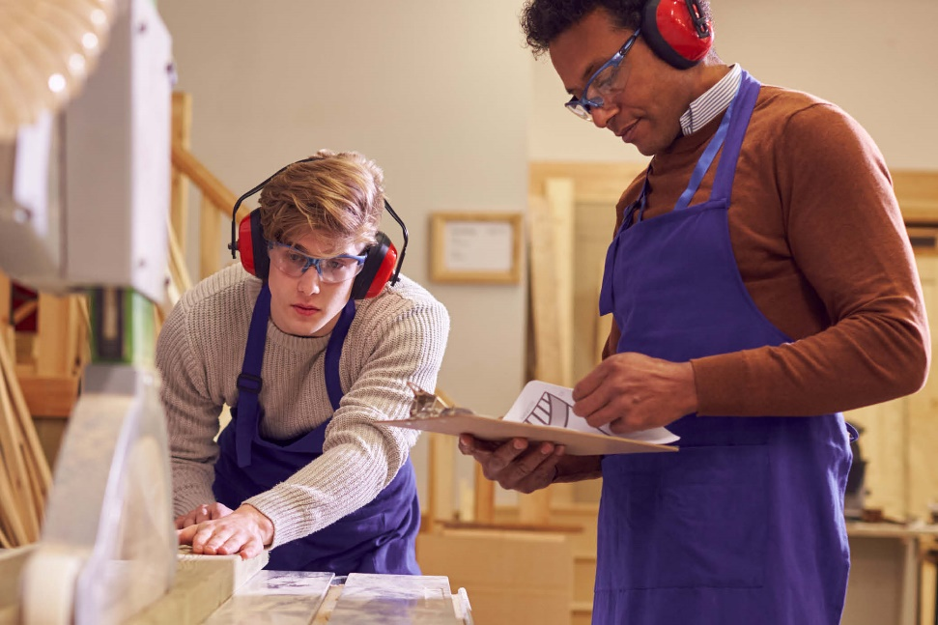
Series: Going Home Part 3. At Home in the Body
Preparation is vital…

Slide 31
Series: Going Home Part 3. At Home in the Body
Preparation is vital…
Psalm 90:17—
Let the favour of the Lord our God be upon us;
And confirm for us the work of our hands;
Yes, confirm the work of our hands.

Slide 32
Series: Going Home Part 3. At Home in the Body
Ecclesiastes 2:26—
For to a person who is good in God’s sight He has given wisdom and knowledge and joy,
while to the sinner He has given the task of gathering and collecting so that he may give to one who is good in God’s sight.
This too is vanity and striving after wind.

Slide 33
Series: Going Home Part 3. At Home in the Body
Don’t get carried away…

Slide 34
Series: Going Home Part 3. At Home in the Body
Don’t get carried away…
Ecclesiastes 12:12—
¹²But beyond this, my son, be warned: the writing of many books is endless, and excessive devotion to books is wearying to the body. (NASB95)

Slide 35
Series: Going Home Part 3. At Home in the Body
Deuteronomy 8:3—
He humbled you and let you be hungry, and fed you with manna… that He might make you understand that man does not live by bread alone, but man lives by everything that proceeds out of the mouth of the Lord.

Slide 36
Series: Going Home Part 3. At Home in the Body
There’s a great Day Coming…

Slide 37
Series: Going Home Part 3
Galatians 3:27—
For all of you who were baptized into Christ have clothed yourselves with Christ. (NASB95)

