Slide 1
Series: Just Fix It! (Part 2).
“Forewarned is Forearmed.”
John Staiger
Morningside Church of Christ
Wednesday 1 June2022
Bible Class
Broadcast from 42 Leslie Avenue, Auckland, Aotearoa/NZ.
www.morningsidechurchofchrist.org.nz

Slide 2
Series: Just Fix It!
(Part 2).
“Forewarned is Forearmed.”

Slide 3
Series: Just Fix It! (Part 2). “Forewarned is Forearmed.”
Problem with Self-righteousness?

Slide 4
Series: Just Fix It! (Part 2). “Forewarned is Forearmed.”
Problem with Self-righteousness?
What to do?

Slide 5
Series: Just Fix It! (Part 2). “Forewarned is Forearmed.”
Problem with Self-righteousness?
What to do?

Slide 6
Series: Just Fix It! (Part 2). “Forewarned is Forearmed.”
Problem with Self-righteousness?
What to do?

Slide 7
Series: Just Fix It! (Part 2). “Forewarned is Forearmed.”
Problem with Self-righteousness?
What to do?

Slide 8
Series: Just Fix It! (Part 2). “Forewarned is Forearmed.”
Problem with Self-righteousness?
What to do?

Slide 9
Series: Just Fix It! (Part 2). “Forewarned is Forearmed.”
Problem with Self-righteousness?
What to do?

Slide 10
Series: Just Fix It! (Part 2). “Forewarned is Forearmed.”
Problem with Self-righteousness?
What to do?

Slide 11
Series: Just Fix It! (Part 2). “Forewarned is Forearmed.”
Problem with Self-righteousness?
What to do?
2 Corinthians 5:21—
²¹God made him who had no sin to be sin for us, so that in him we might become the righteousness of God. (NIV)

Slide 12
Series: Just Fix It! (Part 2). “Forewarned is Forearmed.”
Problem with Anger?

Slide 13
Series: Just Fix It! (Part 2). “Forewarned is Forearmed.”
Problem with Anger?
What to do?

Slide 14
Series: Just Fix It! (Part 2). “Forewarned is Forearmed.”
Problem with Anger?
What to do?
Angry words
Oh, let them never
From the tongue
Unbridled slip…

Slide 15
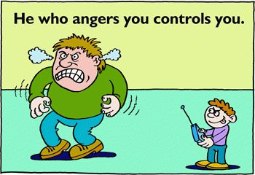
Series: Just Fix It! (Part 2). “Forewarned is Forearmed.”
Problem with Anger?
What to do?

Slide 16
Series: Just Fix It! (Part 2). “Forewarned is Forearmed.”
Problem with Anger?
What to do?
Proverbs 16:32—
³²He who is slow to anger is better than the mighty, And he who rules his spirit, than he who captures a city.

Slide 17
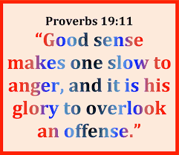
Series: Just Fix It! (Part 2). “Forewarned is Forearmed.”
Problem with Anger?
What to do?

Slide 18
Series: Just Fix It! (Part 2). “Forewarned is Forearmed.”
Problem with Anger?
What to do?

Slide 19
Series: Just Fix It! (Part 2). “Forewarned is Forearmed.”
Problem with Anger?
What to do?

Slide 20
Series: Just Fix It! (Part 2). “Forewarned is Forearmed.”
Problem with Anger?
What to do?
Proverbs 16:32—
³²He who is slow to anger is better than the mighty, And he who rules his spirit, than he who captures a city.

Slide 21
Series: Just Fix It! (Part 2). “Forewarned is Forearmed.”
Problem with Anger?
What to do?
Proverbs 19:11—
A person’s insight gives him patience, and his virtue is to overlook an offense. (CSB)

Slide 22
Series: Just Fix It! (Part 2). “Forewarned is Forearmed.”
Problem with Anger?
What to do?
Proverbs 29:11— A fool vents all his feelings, But a wise man holds them back. (NKJV)

Slide 23
Series: Just Fix It! (Part 2). “Forewarned is Forearmed.”
Problem with Anger?
What to do?

Slide 24
Series: Just Fix It! (Part 2). “Forewarned is Forearmed.”
Problem with Anger?
What to do?
James 1:19-20—
¹⁹My dear brothers and sisters, take note of this: Everyone should be quick to listen, slow to speak and slow to become angry, ²⁰because human anger does not produce the righteousness that God desires.

Slide 25
Series: Just Fix It! (Part 2). “Forewarned is Forearmed.”
Problem with Anger?
What to do?

Slide 26
Series: Just Fix It! (Part 2). “Forewarned is Forearmed.”
Problem with Anger?
What to do?
James 4:1-2—
What is the source of quarrels and conflicts among you? Is not the source your pleasures that wage war in your members? ²You lust and do not have; so you commit murder. You are envious and cannot obtain; so you fight and quarrel. You do not have because you do not ask. (NASB95)

Slide 27
Series: Just Fix It! (Part 2). “Forewarned is Forearmed.”
Problem with Anger?
What to do?
Ephesians 4:26—
Be ye angry, and sin not: let not the sun go down upon your wrath: (KJV)

Slide 28
Series: Just Fix It! (Part 2). “Forewarned is Forearmed.”
Problem with Anger?
What to do?

Slide 29
Series: Just Fix It! (Part 2). “Forewarned is Forearmed.”
Problem with Anger?
What to do?
Ephesians 4:27—
Do not give the devil an opportunity. (NASB95)

Slide 30
Series: Just Fix It! (Part 2). “Forewarned is Forearmed.”
Problem with Money?

Slide 31
Series: Just Fix It! (Part 2). “Forewarned is Forearmed.”
Problem with Money?
What to do?

Slide 32
Series: Just Fix It! (Part 2). “Forewarned is Forearmed.”
Problem with Money?
What to do?
Not just your problem.

Slide 33
Series: Just Fix It! (Part 2). “Forewarned is Forearmed.”
Problem with Money?
What to do?
Not just your problem.
It pays to talk about it.

Slide 34
Series: Just Fix It! (Part 2). “Forewarned is Forearmed.”
Problem with Money?
What to do?
Not just your problem.
It pays to talk about it.
Causes a multitude of stresses if not checked.

Slide 35
Series: Just Fix It! (Part 2). “Forewarned is Forearmed.”
Problem with Money?
What to do?
Not just your problem.
It pays to talk about it.
Causes a multitude of stresses if not checked.
Budgets are wise.

Slide 36
Series: Just Fix It! (Part 2). “Forewarned is Forearmed.”
Problem with Money?
What to do?

Slide 37
Series: Just Fix It! (Part 2). “Forewarned is Forearmed.”
Problem with Money?
What to do?
Can be your worst enemy.
Satisfaction = Contentment.

Slide 38
Series: Just Fix It! (Part 2). “Forewarned is Forearmed.”
Problem with Money?
What to do?
Satisfaction = Contentment.

Slide 39
Series: Just Fix It! (Part 2). “Forewarned is Forearmed.”
Problem with Money?
What to do?

Slide 40
Series: Just Fix It! (Part 2). “Forewarned is Forearmed.”
Problem with Money?
What to do?
1 Timothy 6:8—
⁸If we have food and covering, with these we shall be content. (NASB95)

Slide 41
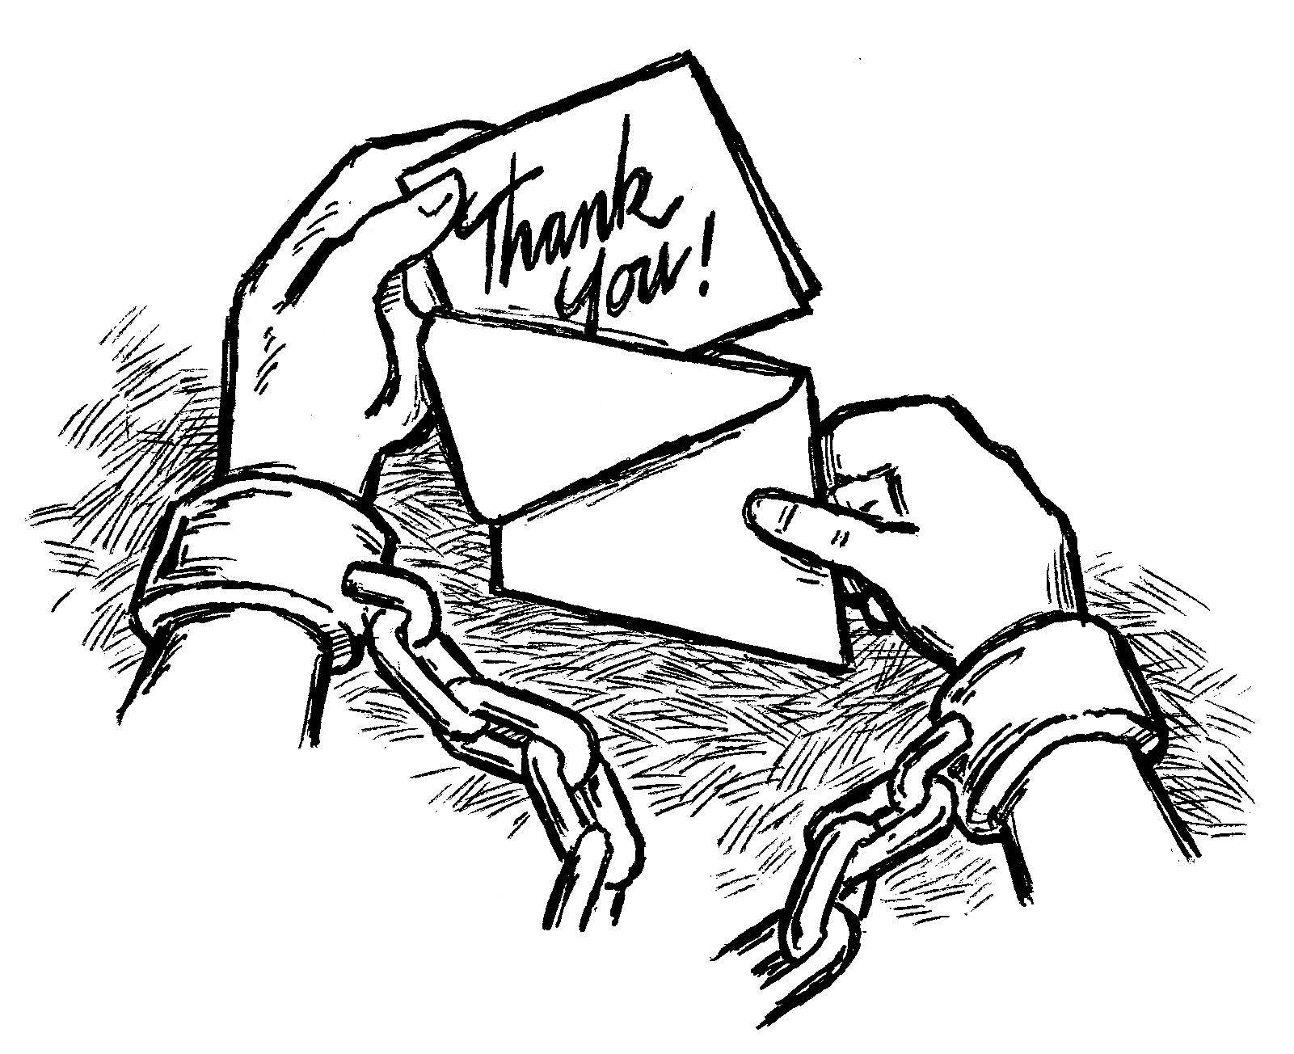
Series: Just Fix It! (Part 2). “Forewarned is Forearmed.”
Problem with Money?
What to do?
1 Timothy 6:8—
⁸If we have food and covering, with these we shall be content. (NASB95)

Slide 42
Series: Just Fix It! (Part 2). “Forewarned is Forearmed.”
Problem with
Temptation?

Slide 43
Series: Just Fix It! (Part 2). “Forewarned is Forearmed.”
Problem with
Temptation?

Slide 44
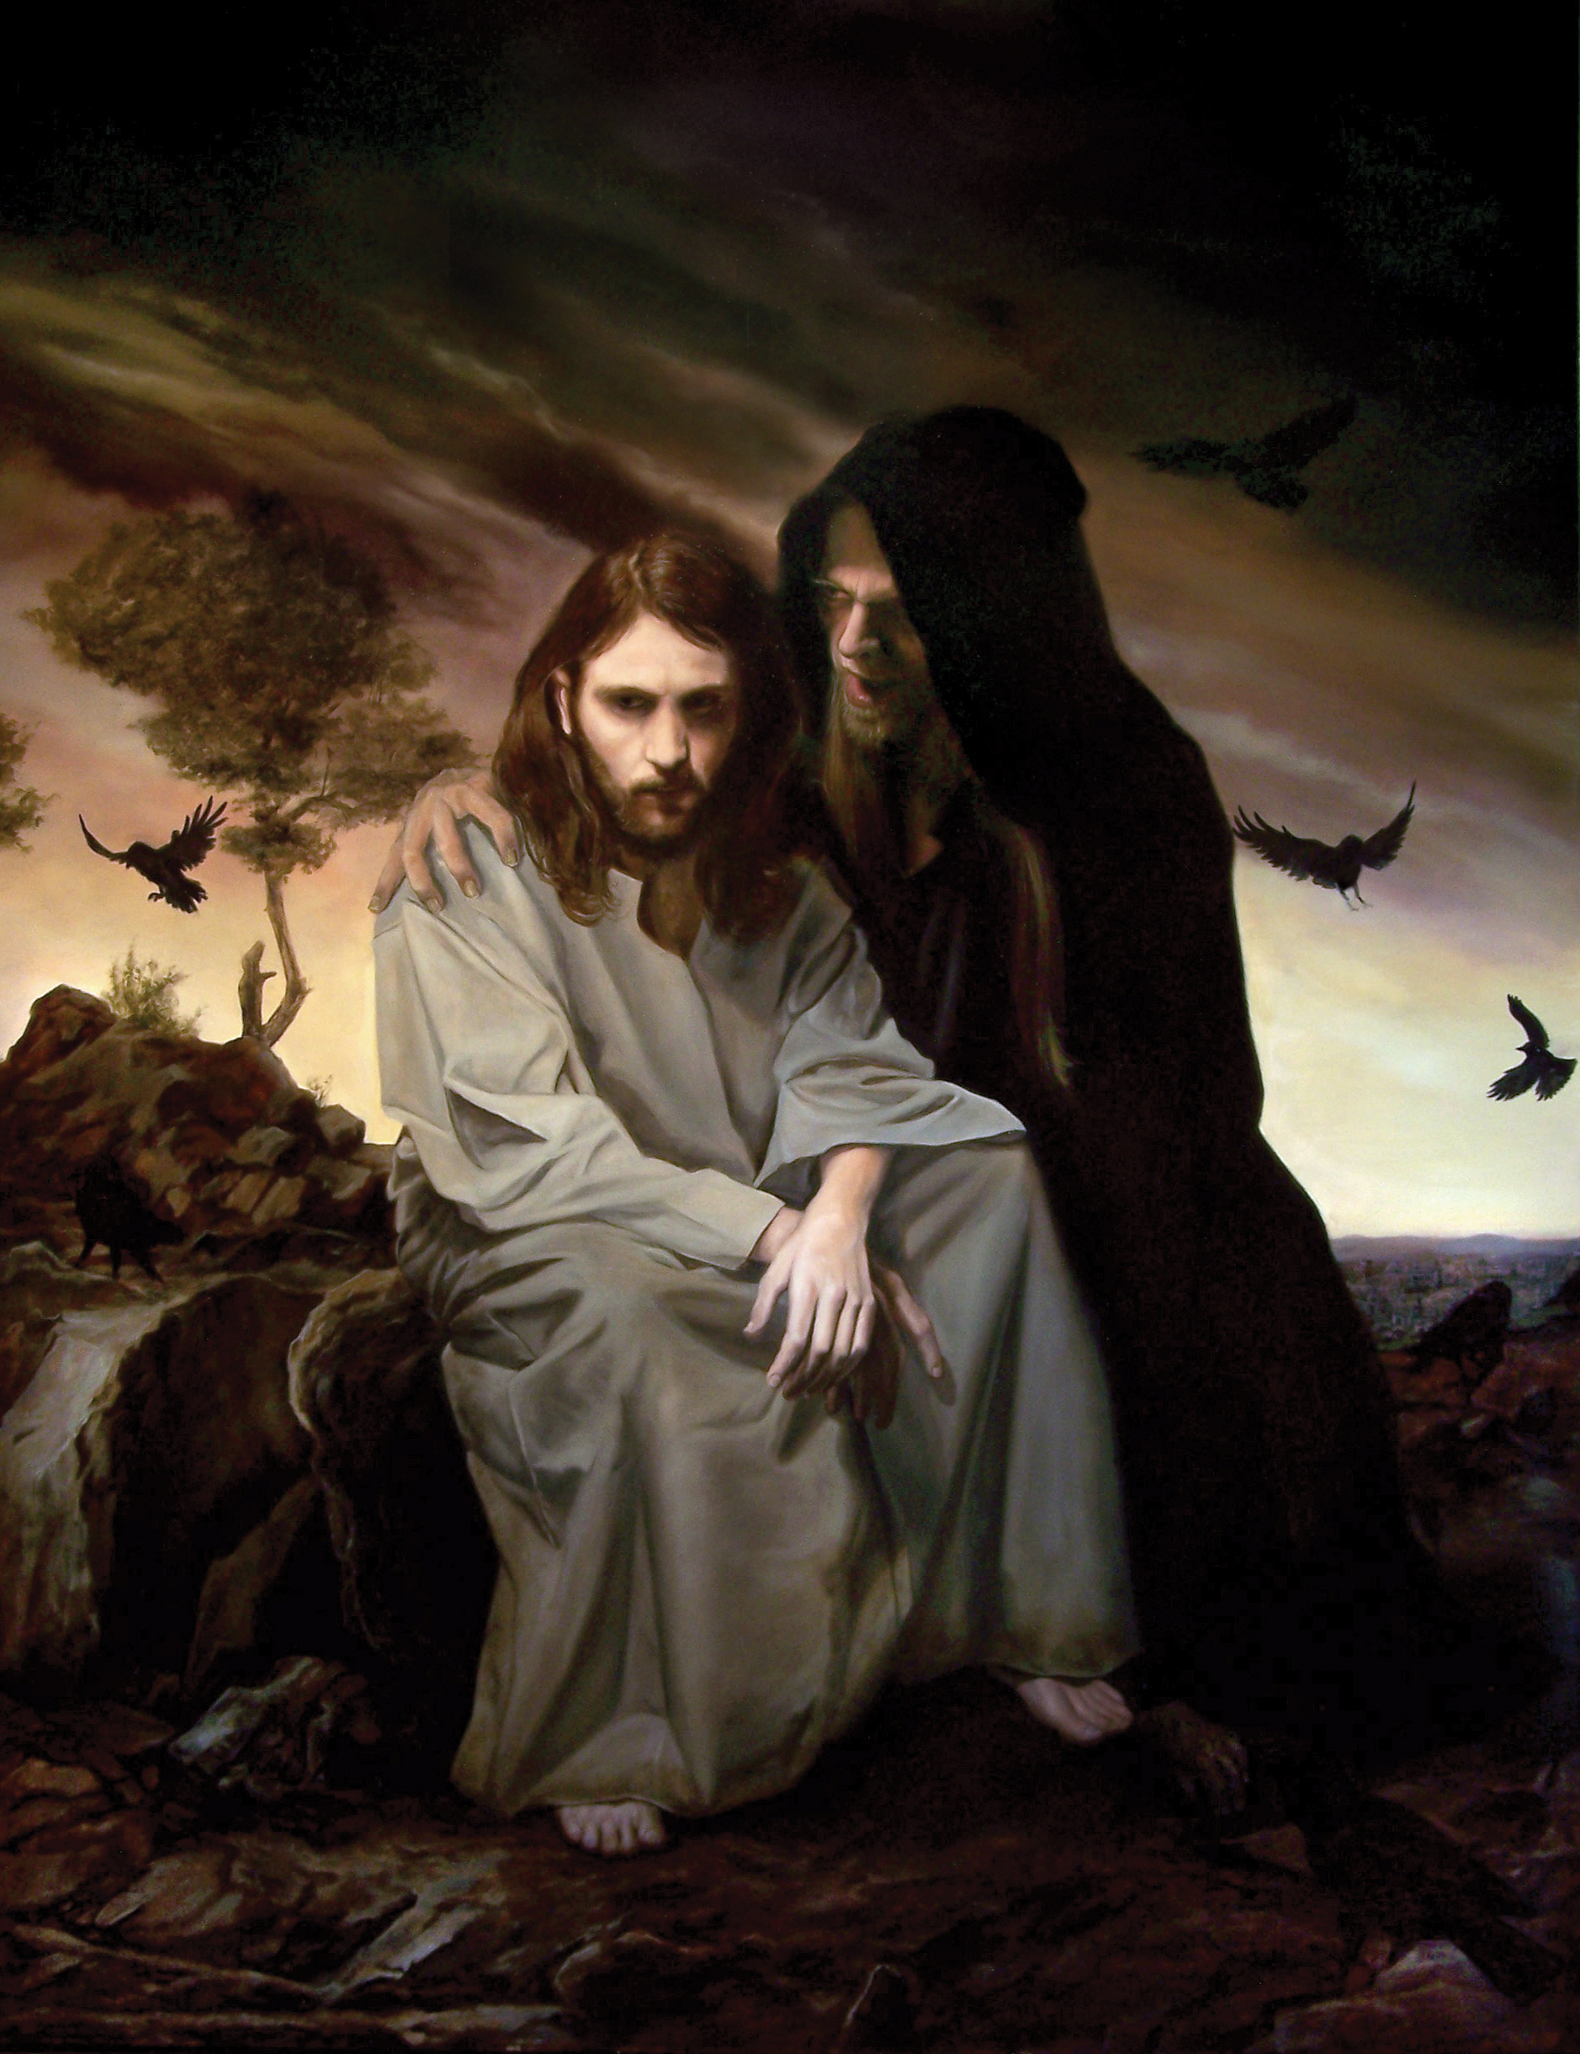
Series: Just Fix It! (Part 2). “Forewarned is Forearmed.”
Problem with
Temptation?

Slide 45
Series: Just Fix It! (Part 2). “Forewarned is Forearmed.”
Problem with
Temptation?
Matthew 4:3—
³ And the tempter came and said to Him, “If You are the Son of God, command that these stones become bread.”

Slide 46
Series: Just Fix It! (Part 2). “Forewarned is Forearmed.”
Problem with
Temptation?
What to do?
Matthew 4:4 He answered, “It is written: Man must not live on bread alone but on every word that comes from the mouth of God.” (CSB)
(Deut.8:3)

Slide 47
Series: Just Fix It! (Part 2). “Forewarned is Forearmed.”
Problem with
Temptation?
What to do?
Matthew 4:4 He answered, “It is written: Man must not live on bread alone but on every word that comes from the mouth of God.” (CSB)
(Deut.8:3)

Slide 48
Series: Just Fix It! (Part 2). “Forewarned is Forearmed.”
Problem with
Temptation?
Matthew 4:6— ⁶ and said to him, “If you are the Son of God, throw yourself down. For it is written:
He will give his angels orders concerning you, and they will support you with their hands so that you will not strike your foot against a stone. (CSB)
(Psalm 9111-12)

Slide 49
Series: Just Fix It! (Part 2). “Forewarned is Forearmed.”
Problem with
Temptation?
What to do?

Slide 50
Series: Just Fix It! (Part 2). “Forewarned is Forearmed.”
Problem with
Temptation?
What to do?
Matthew 4:7— Jesus told him, “It is also written: Do not test the Lord your God.” (CSB)
(Deuteronomy 6:16)

Slide 51
Series: Just Fix It! (Part 2). “Forewarned is Forearmed.”
Problem with
Temptation?
Matthew 4:9— ⁹ And he said to him, “I will give you all these things if you will fall down and worship me.” (CSB)

Slide 52
Series: Just Fix It! (Part 2). “Forewarned is Forearmed.”
Problem with
Temptation?
What to do?
Matthew 4:10— Then Jesus told him, “Go away, Satan! For it is written: Worship the Lord your God, and serve only him.”(CSB)
(Deuteronomy 6:13)

Slide 53
Series: Just Fix It! (Part 2). “Forewarned is Forearmed.”
Problem with
Temptation?
What to do?
Matthew 4:10— Then Jesus told him, “Go away, Satan! For it is written: Worship the Lord your God, and serve only him.”(CSB)
(Deuteronomy 6:13)

Slide 54
Series: Just Fix It! (Part 2). “Forewarned is Forearmed.”
Problem with
Temptation?
What to do?

Slide 55
Series: Just Fix It! (Part 2). “Forewarned is Forearmed.”
Problem with Temptation?
What to do?

