Slide 1
Series: Going Home
Part 1. “Nazareth Bound.”
John Staiger
Morningside Church of Christ
Sunday 22 May 2022
AM Sermon
Broadcast live from 42 Leslie Ave, Auckland, Aotearoa/NZ.

Slide 2
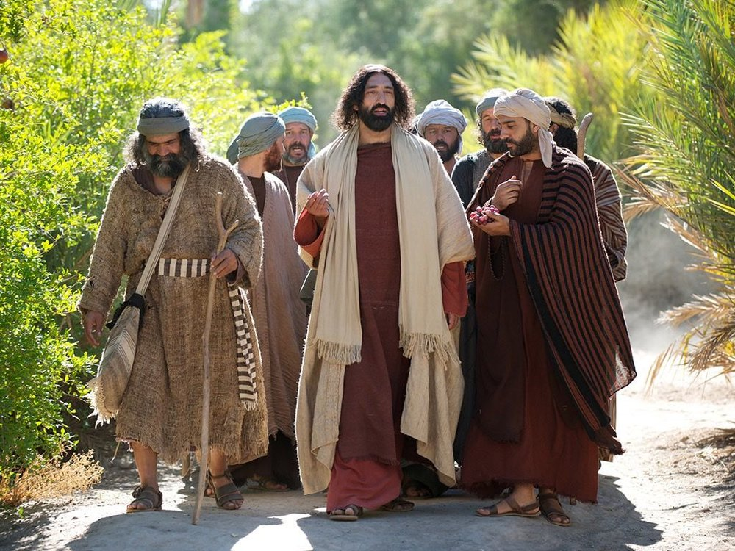
Series: Going Home Part 1. “Nazareth Bound.”
Going Home…
Mark 6:1-6 (NASB95)
¹Jesus went out from there and came into His…

Slide 3
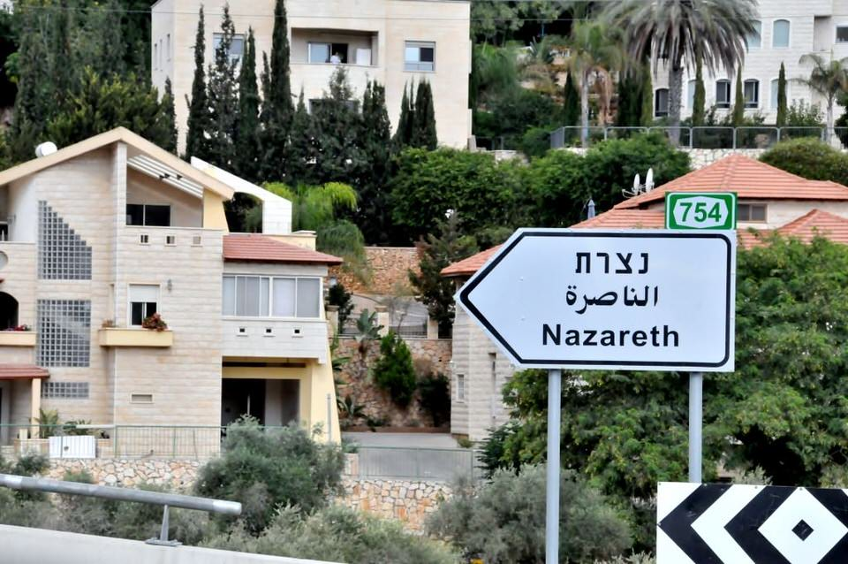
Series: Going Home Part 1. “Nazareth Bound.”
Welcome Home, Jesus!
Mark 6:1-6 (NASB95)
¹Jesus went out from there and came into His hometown; and His disciples followed Him.

Slide 4
Series: Going Home Part 1. “Nazareth Bound.”
Welcome Home, Jesus!
Mark 6:1-6 (NASB95)
¹Jesus went out from there and came into His hometown; and His disciples followed Him.

Slide 5
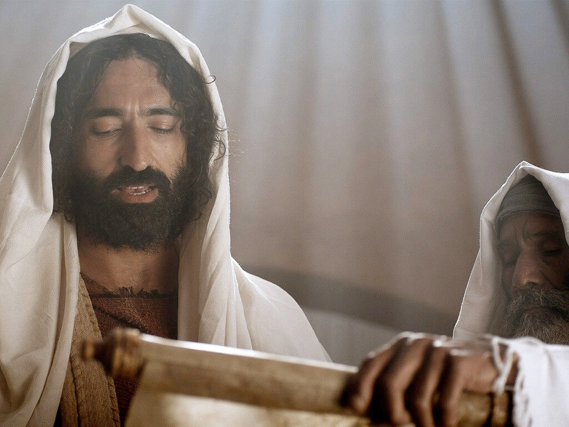
Series: Going Home Part 1. “Nazareth Bound.”
Preaching at My Home Congregation…
Mark 6:1-6 (NASB95)
²When the Sabbath came, He began to teach in the synagogue; and the many listeners were astonished…

Slide 6
Series: Going Home Part 1. “Nazareth Bound.”
Preaching at My Home Congregation…
Mark 6:1-6 (NASB95)
²…saying, “Where did this man get these things, and what is this wisdom given to Him, and such miracles as these performed by His hands?

Slide 7
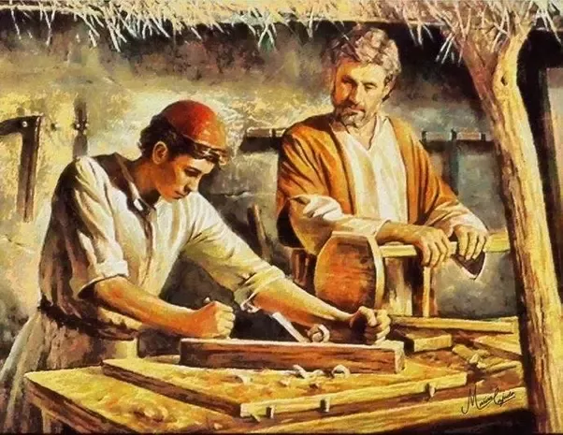
Series: Going Home Part 1. “Nazareth Bound.”
Scrolling through the Snapshots…
Mark 6:1-6 (NASB95)
³Is not this the carpenter, the son of Mary, and brother of James and Joses and Judas and Simon? Are not His sisters here with us?” And they took offense at Him.

Slide 8
Series: Going Home Part 1. “Nazareth Bound.”
Scrolling through the Snapshots…
1. Jesus had read
Isaiah 61:1-2.
Luke 4:18-19
¹⁸ “The Spirit of the Lord is upon Me, Because He anointed Me to preach the gospel to the poor. He has sent Me to proclaim release to the captives, And recovery of sight to the blind, To set free those who are oppressed, ¹⁹ To proclaim the favourable year of the Lord.”

Slide 9
Series: Going Home Part 1. “Nazareth Bound.”
Scrolling through the Snapshots…
1. Jesus had read
Isaiah 61:1-2.
2. Elijah and the widow at Zarephath, Sidon. (1 Kings 17).

Slide 10
Series: Going Home Part 1. “Nazareth Bound.”
Scrolling through the Snapshots…
1. Jesus had read
Isaiah 61:1-2.
2. Elijah and the widow at Zarephath, Sidon. (1 Kings 17).
3. Elisha and Naaman the Syrian (2 Kings 5)

Slide 11
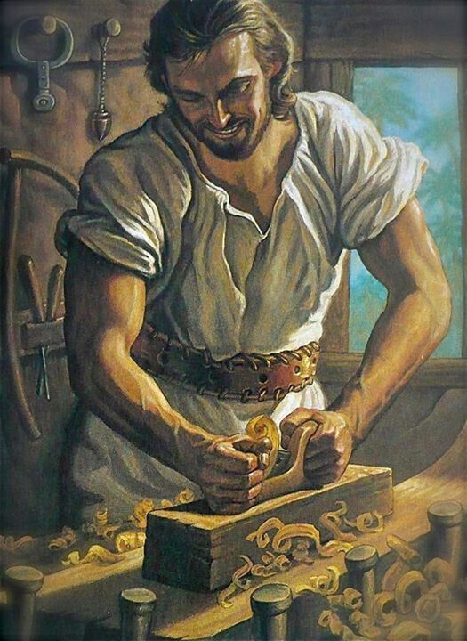
Series: Going Home Part 1. “Nazareth Bound.”
“We Know You!”
Mark 6:1-6 (NASB95)
⁴Jesus said to them, “A prophet is not without honour except in his hometown and among his own relatives and in his own household.”

Slide 12
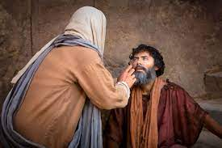
Series: Going Home Part 1. “Nazareth Bound.”
Hardness of Heart blocked blessings…
Mark 6:1-6 (NASB95)
⁵And He could do no miracle there except that He laid His hands on a few sick people and healed them.

Slide 13
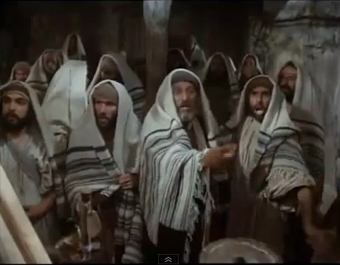
Series: Going Home Part 1. “Nazareth Bound.”
The Blessings of God can be for ALL—always has been…
Mark 6:1-6 (NASB95)
⁶And He wondered at their unbelief.

Slide 14
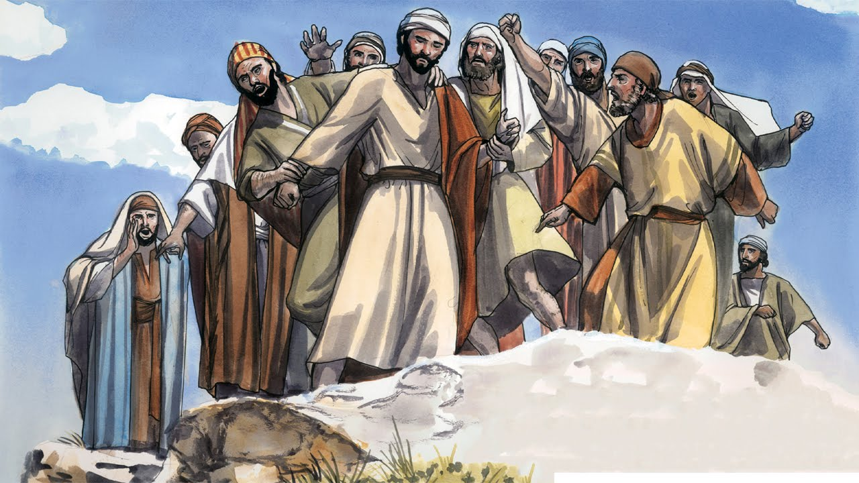
Series: Going Home Part 1. “Nazareth Bound.”
Luke 4:29—
²⁹and they got up and drove Him out of the city, and led Him to the brow of the hill on which their city had been built, in order to throw Him down the cliff. (NASB95)

Slide 15
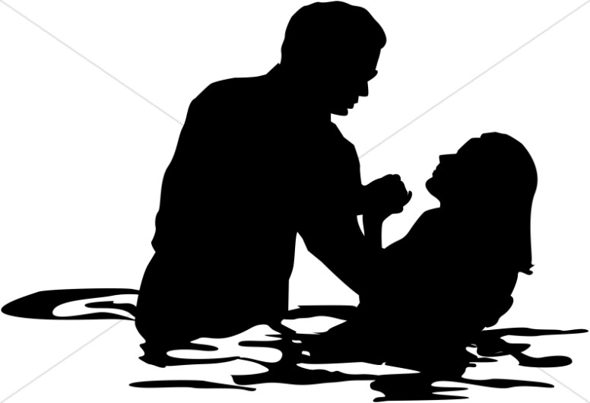
Series: Going Home Part 1. “Nazareth Bound.”
Galatians 3:27—
For all of you who were baptized into Christ have clothed yourselves with Christ. (NASB95)

