Slide 1
Series: Hope – Full.
Part 1. “Hold on Tight!”
John Staiger
Morningside Church of Christ
Sunday 24 April 2022
PM Sermon
Broadcast live from 42 Leslie Ave, Auckland, Aotearoa/NZ.

Slide 2
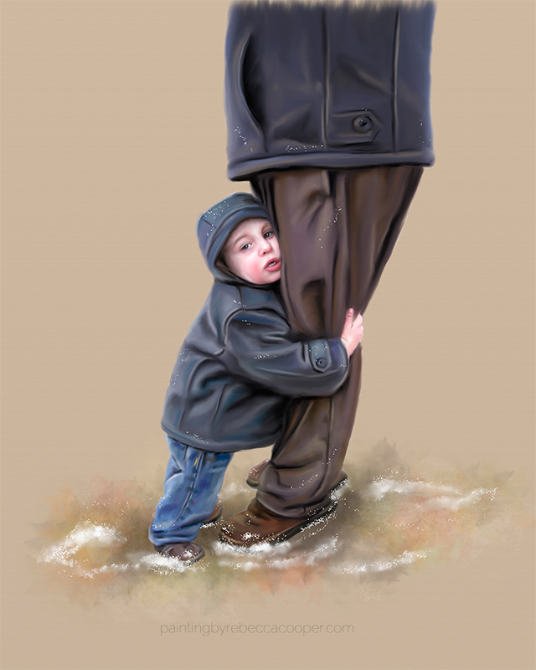
Hope – Hold on tight!
Series: Hope – Full. Part 1. “Hold on Tight!”

Slide 3
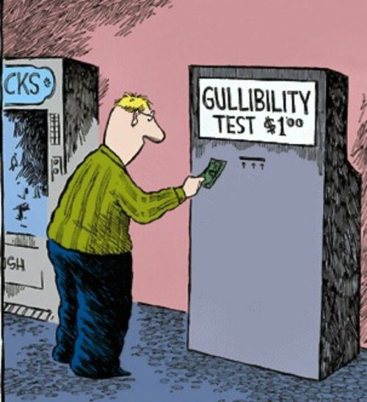
Series: Hope – Full. Part 1. “Hold on Tight!”
“Church”—The realm of the simple.

Slide 4
Series: Hope – Full. Part 1. “Hold on Tight!”
“Church”—The realm of the simple.
Have you ever gotten the feeling that people think that you are naïve being a Christian?

Slide 5
Series: Hope – Full. Part 1. “Hold on Tight!”
“Church”—The realm of the simple
Church of the “Losers!”

Slide 6
Series: Hope – Full. Part 1. “Hold on Tight!”
“Church”—The realm of the simple
Church of the “Losers!”
Church is for:

Slide 7
Series: Hope – Full. Part 1. “Hold on Tight!”
“Church”—The realm of the simple
Church of the “Losers!”
Church is for:
Old people.

Slide 8
Series: Hope – Full. Part 1. “Hold on Tight!”
“Church”—The realm of the simple
Church of the “Losers!”
Church is for:
Old people.
The Lonely.

Slide 9
Series: Hope – Full. Part 1. “Hold on Tight!”
“Church”—The realm of the simple
Church of the “Losers!”
Church is for:
Old people.
The Lonely.
The Emotionally infirm.

Slide 10
Series: Hope – Full. Part 1. “Hold on Tight!”
“Church”—The realm of the simple
Church of the “Losers!”
Church is for:
Old people.
The Lonely.
The Emotionally infirm.
Kids.

Slide 11
Series: Hope – Full. Part 1. “Hold on Tight!”
“Church”— The place to be a kid again.

Slide 12
Series: Hope – Full. Part 1. “Hold on Tight!”
“Church”— The place to be a kid again.
Mark 10:15—
Truly, I say to you, whoever does not receive the kingdom of God like a child shall not enter it.”

Slide 13
Series: Hope – Full. Part 1. “Hold on Tight!”
Hope—On Solid Ground

Slide 14
Series: Hope – Full. Part 1. “Hold on Tight!”
Hope—On Solid Ground
How are your confidence levels?

Slide 15
Series: Hope – Full. Part 1. “Hold on Tight!”
Hope—On Solid Ground
How are your confidence levels?
Doubts is unnecessary and destructive.

Slide 16
Series: Hope – Full. Part 1. “Hold on Tight!”
Hope—On Solid Ground
How are your confidence levels?
Doubts is unnecessary and destructive.
Faith is our focus.

Slide 17
Series: Hope – Full. Part 1. “Hold on Tight!”
Hope—What it is Not!

Slide 18
Series: Hope – Full. Part 1. “Hold on Tight!”
Hope—What it is Not!
Not founded upon:
Fables
Fiction, or
Feelings.
2 Peter 1:16— Eyewitnesses
For we did not follow cleverly devised tales when we made known to you the power and coming of our Lord Jesus Christ, but we were eyewitnesses of His majesty.

Slide 19
Series: Hope – Full. Part 1. “Hold on Tight!”
Hope—What it is Not!
Not founded upon:
Fables
Fiction, or
Feelings.
2 Peter 1:16— Eyewitnesses
For we did not follow cleverly devised tales when we made known to you the power and coming of our Lord Jesus Christ, but we were eyewitnesses of His majesty.

Slide 20
Series: Hope – Full. Part 1. “Hold on Tight!”
Hope—What it is Not!
Not founded upon:
Fables
Fiction, or
Feelings.
2 Peter 1:16— Eyewitnesses
For we did not follow cleverly devised tales when we made known to you the power and coming of our Lord Jesus Christ, but we were eyewitnesses of His majesty.

Slide 21
Series: Hope – Full. Part 1. “Hold on Tight!”
Hope—What it is Not!
Not founded upon:
Fables
Fiction, or
Feelings.
2 Peter 1:16— Eyewitnesses
For we did not follow cleverly devised tales when we made known to you the power and coming of our Lord Jesus Christ, but we were eyewitnesses of His majesty.

Slide 22
Series: Hope – Full. Part 1. “Hold on Tight!”
Hope—What it is Not!
Not founded upon:
Fables
Fiction, or
Feelings.
2 Peter 1:16— Eyewitnesses
For we did not follow cleverly devised tales when we made known to you the power and coming of our Lord Jesus Christ, but we were eyewitnesses of His majesty.

Slide 23
Series: Hope – Full. Part 1. “Hold on Tight!”
Hope—What it is Not!
Hope is not:
Wishful thinking.
Whistling in the dark.
A wimpy way of thinking.
Not some Pollyanna approach to life.
But…

Slide 24
Series: Hope – Full. Part 1. “Hold on Tight!”
Hope—What it is Not!
Hope is not:
Wishful thinking.
Whistling in the dark.
A wimpy way of thinking.
Not some Pollyanna approach to life.
But…

Slide 25
Series: Hope – Full. Part 1. “Hold on Tight!”
Hope—Founded upon facts.

Slide 26
Series: Hope – Full. Part 1. “Hold on Tight!”
Hope—Founded upon facts.
The fact that God Is.
Fact of an Historical Jesus.
The fact that Jesus did miracles.
The fact of His death, burial and resurrection—proving to be the Son of God.
The fact that the Bible is the Word of God.

Slide 27
Series: Hope – Full. Part 1. “Hold on Tight!”
Hope—Founded upon facts.
The fact that God Is.
Fact of an Historical Jesus.
The fact that Jesus did miracles.
The fact of His death, burial and resurrection—proving to be the Son of God.
The fact that the Bible is the Word of God.

Slide 28
Series: Hope – Full. Part 1. “Hold on Tight!”
Hope—Founded upon facts.
The fact that God Is.
Fact of an Historical Jesus.
The fact that Jesus did miracles.
The fact of His death, burial and resurrection—proving to be the Son of God.
The fact that the Bible is the Word of God.

Slide 29
Series: Hope – Full. Part 1. “Hold on Tight!”
Hope—Founded upon facts.
The fact that God Is.
Fact of an Historical Jesus.
The fact that Jesus did miracles.
The fact of His death, burial and resurrection—proving to be the Son of God.
The fact that the Bible is the Word of God.

Slide 30
Series: Hope – Full. Part 1. “Hold on Tight!”
Hope—Founded upon facts.
The fact that God Is.
Fact of an Historical Jesus.
The fact that Jesus did miracles.
The fact of His death, burial and resurrection—proving to be the Son of God.
The fact that the Bible is the Word of God.

Slide 31
Series: Hope – Full. Part 1. “Hold on Tight!”
Hope—What it is
Hope is a confident outlook.
A happy expectation.
A favourable anticipation.
Our hope is based on a solid faith that is rooted in the facts of the gospel.

Slide 32
Series: Hope – Full. Part 1. “Hold on Tight!”
Hope—What it is
Hope is a confident outlook.
A happy expectation.
A favourable anticipation.
Our hope is based on a solid faith that is rooted in the facts of the gospel.

Slide 33
Series: Hope – Full. Part 1. “Hold on Tight!”
Hope—What it is
Hope is a confident outlook.
A happy expectation.
A favourable anticipation.
Our hope is based on a solid faith that is rooted in the facts of the gospel.

Slide 34
Series: Hope – Full. Part 1. “Hold on Tight!”
Hope—What it is
Hope is a confident outlook.
A happy expectation.
A favourable anticipation.
Our hope is based on a solid faith that is rooted in the facts of the gospel.

Slide 35
Series: Hope – Full. Part 1. “Hold on Tight!”
Hope—What it is
Hope is a confident outlook.
A happy expectation.
A favourable anticipation.
Our hope is based on a solid faith that is rooted in the facts of the gospel.

Slide 36
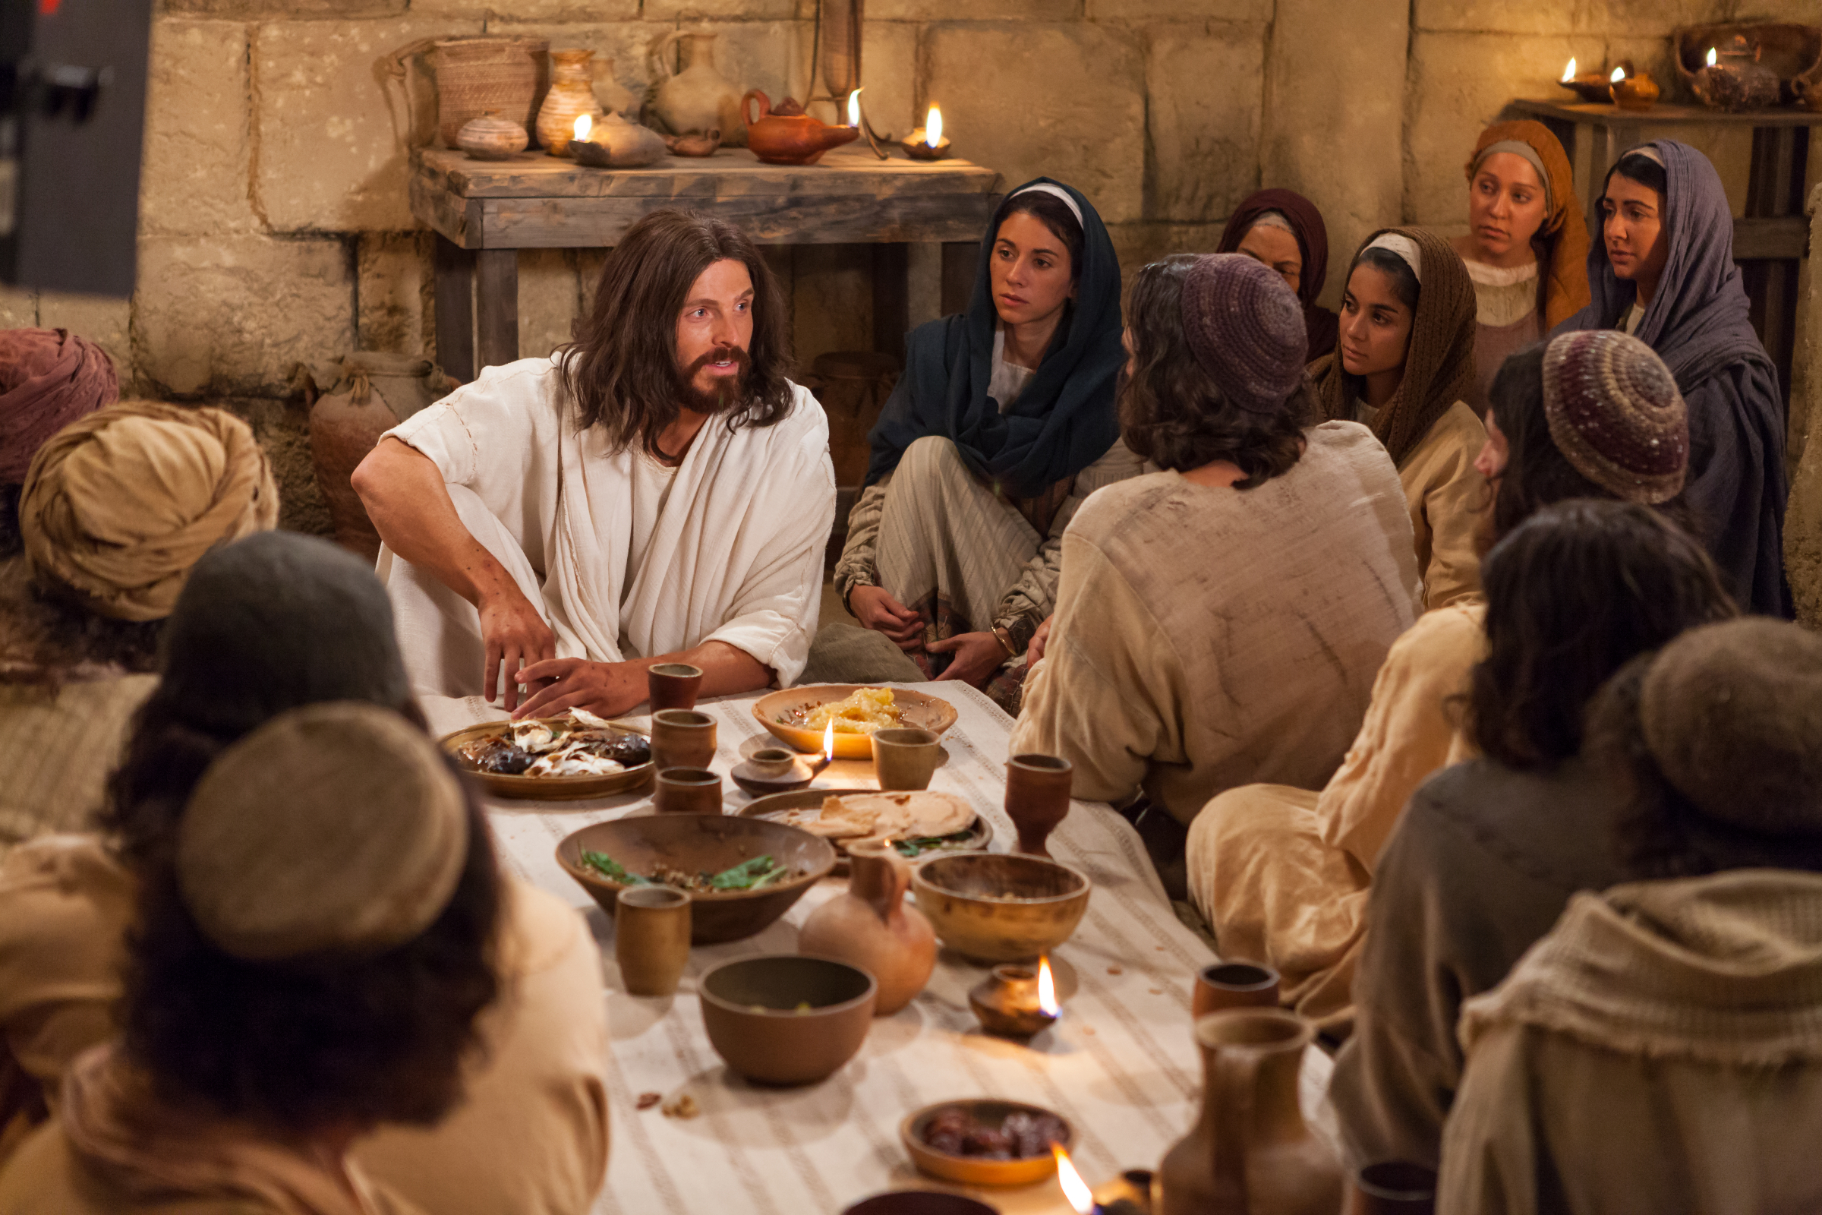
Series: Hope – Full. Part 1. “Hold on Tight!”
Hope—What it is
Acts 1:3—³He presented himself alive to them after his suffering by many proofs, appearing to them during forty days and speaking about the kingdom of God. (ESV)

Slide 37
Malcolm Forbes

Slide 38
Malcolm Forbes
Died in 1990 as one of the wealthiest people to have lived in our time.
Forbes enjoyed all the symbols of status that one can achieve in this life.
Prosperity
Possessions
Power
Privilege
And a pleasurable lifestyle that comes with it.

Slide 39
Malcolm Forbes
Died in 1990 as one of the wealthiest people to have lived in our time.
Forbes enjoyed all the symbols of status that one can achieve in this life.
Prosperity
Possessions
Power
Privilege
And a pleasurable lifestyle that comes with it.

Slide 40
Malcolm Forbes
Died in 1990 as one of the wealthiest people to have lived in our time.
Forbes enjoyed all the symbols of status that one can achieve in this life.
Prosperity
Possessions
Power
Privilege
And a pleasurable lifestyle that comes with it.

Slide 41
Malcolm Forbes
After viewing the tomb of King Tut, Forbes turned to one of his associates and sincerely asked…

Slide 42
Malcolm Forbes
…“Do you think I’ll be remembered after I die?”

Slide 43
Malcolm Forbes
The billionaire publisher who said,
“He who dies with the most toys wins.”
Lots of toys:
Hot air balloons.
Motorcycles
Boats
Planes.
Castles
Art
In fact, he once paid over a million dollars for a Faberge egg.

Slide 44
Malcolm Forbes
The billionaire publisher who said,
“He who dies with the most toys wins.”
Lots of toys:
Hot air balloons.
Motorcycles
Boats
Planes.
Castles
Art
In fact, he once paid over a million dollars for a Faberge egg.

Slide 45
Malcolm Forbes
The billionaire publisher who said,
“He who dies with the most toys wins.”
Lots of toys:
Hot air balloons.
Motorcycles
Boats
Planes.
Castles
Art
In fact, he once paid over a million dollars for a Faberge egg.

Slide 46
Malcolm Forbes
However, consider a different point of view from Jesus’ question in
Mark 8:36. “For what will it profit a man if he gains the whole world, and loses his own soul?”

Slide 47
Romans 15:13

Slide 48
Acts 2:38
Peter said to them, “Repent, and each of you be baptized in the name of Jesus Christ for the forgiveness of your sins; and you will receive the gift of the Holy Spirit. (NASB)

