Slide 1
Series: Just Fix It! (Part 1).
“Forewarned is Forearmed.”
John Staiger
Morningside Church of Christ
Wednesday 25 May 2022
Bible Class
Broadcast from 42 Leslie Avenue, Auckland, Aotearoa/NZ.
www.morningsidechurchofchrist.org.nz

Slide 2
Series: Just Fix It!
(Part 1).
“Forewarned is Forearmed.”

Slide 3
Series: Just Fix It! (Part 1). “Forewarned is Forearmed.”
The Sin of Judas

Slide 4
Series: Just Fix It! (Part 1). “Forewarned is Forearmed.”
The Sin of Judas—Betrayal!

Slide 5
Series: Just Fix It! (Part 1). “Forewarned is Forearmed.”
The Sin of Judas—Betrayal!
Was Judas warned?

Slide 6
Series: Just Fix It! (Part 1). “Forewarned is Forearmed.”
The Sin of Judas—Betrayal!
Was Judas warned?
General warnings to the 12—

Slide 7
Series: Just Fix It! (Part 1). “Forewarned is Forearmed.”
The Sin of Judas—Betrayal!
Was Judas warned?
General warnings to the 12—
“Did I Myself not choose you, the twelve, and yet one of you is a devil?” (Jn.6:70).

Slide 8
Series: Just Fix It! (Part 1). “Forewarned is Forearmed.”
The Sin of Judas—Betrayal!
Was Judas warned?
A Public “specific” warning at Last Supper—

Slide 9
Series: Just Fix It! (Part 1). “Forewarned is Forearmed.”
The Sin of Judas—Betrayal!
Was Judas warned?
A Public “specific” warning at Last Supper—
“Did I Myself not choose you, the twelve, and yet one of you is a devil?” And Judas, who was betraying Him, said, “Surely it is not I, Rabbi?” Jesus said to him, “You have said it yourself.” (Mt.26:23-24)

Slide 10
Series: Just Fix It! (Part 1). “Forewarned is Forearmed.”
The Sin of Judas—Betrayal!
Was Judas warned?
Warned him privately—

Slide 11
Series: Just Fix It! (Part 1). “Forewarned is Forearmed.”
The Sin of Judas—Betrayal!
Was Judas warned?
Warned him privately—
“What thou doest, do quickly.” (Jn.13:27)

Slide 12
Series: Just Fix It! (Part 1). “Forewarned is Forearmed.”
The Sin of Judas—Betrayal!
What could have been done?
Jesus
Never chosen Judas as a disciple?
Spoken to him everyday?
Named and shamed Judas earlier?
Kicked him our of the 12?
Told everyone Judas was a thief?

Slide 13
Series: Just Fix It! (Part 1). “Forewarned is Forearmed.”
The Sin of Judas—Betrayal!
What could have been done?
Jesus
Never chosen Judas as a disciple?
Spoken to him everyday?
Named and shamed Judas earlier?
Kicked him our of the 12?
Told everyone Judas was a thief?

Slide 14
Series: Just Fix It! (Part 1). “Forewarned is Forearmed.”
The Sin of Judas—Betrayal!
What could have been done?
Jesus
Never chosen Judas as a disciple?
Spoken to him everyday?
Named and shamed Judas earlier?
Kicked him our of the 12?
Told everyone Judas was a thief?

Slide 15
Series: Just Fix It! (Part 1). “Forewarned is Forearmed.”
The Sin of Judas—Betrayal!
What could have been done?
Jesus
Never chosen Judas as a disciple?
Spoken to him everyday?
Named and shamed Judas earlier?
Kicked him our of the 12?
Told everyone Judas was a thief?

Slide 16
Series: Just Fix It! (Part 1). “Forewarned is Forearmed.”
The Sin of Judas—Betrayal!
What could have been done?
Jesus
Never chosen Judas as a disciple?
Spoken to him everyday?
Named and shamed Judas earlier?
Kicked him our of the 12?
Told everyone Judas was a thief?

Slide 17
Series: Just Fix It! (Part 1). “Forewarned is Forearmed.”
The Sin of Judas—Betrayal!
What could have been done?
Jesus
Never chosen Judas as a disciple?
Spoken to him everyday?
Named and shamed Judas earlier?
Kicked him out of the 12?
Told everyone Judas was a thief?

Slide 18
Series: Just Fix It! (Part 1). “Forewarned is Forearmed.”
The Sin of Judas—Betrayal!
What could have been done?
Jesus
Never chosen Judas as a disciple?
Spoken to him everyday?
Named and shamed Judas earlier?
Kicked him out of the 12?
Told everyone Judas was a thief?

Slide 19
Series: Just Fix It! (Part 1). “Forewarned is Forearmed.”
The Sin of Judas—Betrayal!
What could have been done?
Judas
Was chosen for God’s reasons
His evil was used as a part of God’s plan to save man
He had complete freewill
Knew the consequences
The disciples saw Jesus let freewill happen
We all learn from it—Grow from it

Slide 20
Series: Just Fix It! (Part 1). “Forewarned is Forearmed.”
The Sin of Judas—Betrayal!
What could have been done?
Judas
Was chosen for God’s reasons
His evil was used as a part of God’s plan to save man
He had complete freewill
Knew the consequences
The disciples saw Jesus let freewill happen
We all learn from it—Grow from it

Slide 21
Series: Just Fix It! (Part 1). “Forewarned is Forearmed.”
The Sin of Judas—Betrayal!
What could have been done?
Judas
Was chosen for God’s reasons
His evil was used as a part of God’s plan to save man
He had complete freewill
Knew the consequences
The disciples saw Jesus let freewill happen
We all learn from it—Grow from it

Slide 22
Series: Just Fix It! (Part 1). “Forewarned is Forearmed.”
The Sin of Judas—Betrayal!
What could have been done?
Judas
Was chosen for God’s reasons
His evil was used as a part of God’s plan to save man
He had complete free will
Knew the consequences
The disciples saw Jesus let freewill happen
We all learn from it—Grow from it

Slide 23
Series: Just Fix It! (Part 1). “Forewarned is Forearmed.”
The Sin of Judas—Betrayal!
What could have been done?
Judas
Was chosen for God’s reasons
His evil was used as a part of God’s plan to save man
He had complete free will
Knew the consequences
The disciples saw Jesus let freewill happen
We all learn from it—Grow from it

Slide 24
Series: Just Fix It! (Part 1). “Forewarned is Forearmed.”
The Sin of Judas—Betrayal!
What could have been done?
Judas
Was chosen for God’s reasons
His evil was used as a part of God’s plan to save man
He had complete free will
Knew the consequences
The disciples saw Jesus let free will happen
We all learn from it—Grow from it

Slide 25
Series: Just Fix It! (Part 1). “Forewarned is Forearmed.”
The Sin of Judas—Betrayal!
What could have been done?
Judas
Was chosen for God’s reasons
His evil was used as a part of God’s plan to save man
He had complete free will
Knew the consequences
The disciples saw Jesus let free will happen
We all learn—Grow from it
.

Slide 26
Series: Just Fix It! (Part 1). “Forewarned is Forearmed.”
The Sins of Absalom
Killed his brother, Amnon.
Banished
David didn’t see him
Back to Jerusalem, but wouldn’t see him
Absalom attempted to take the kingdom
Defeated and killed by Joab

Slide 27
Series: Just Fix It! (Part 1). “Forewarned is Forearmed.”
The Sins of Absalom
Killed his brother, Amnon (2 Samuel 13).
Banished
David didn’t see him
Back to Jerusalem, but wouldn’t see him
Absalom attempted to take the kingdom
Defeated and killed by Joab

Slide 28
Series: Just Fix It! (Part 1). “Forewarned is Forearmed.”
The Sins of Absalom
Killed his brother, Amnon.
Banished
David didn’t see him
Back to Jerusalem, but wouldn’t see him
Absalom attempted to take the kingdom
Defeated and killed by Joab

Slide 29
Series: Just Fix It! (Part 1). “Forewarned is Forearmed.”
The Sins of Absalom
Killed his brother, Amnon.
Banished
David didn’t see him
Back to Jerusalem, but wouldn’t see him
Absalom attempted to take the kingdom
Defeated and killed by Joab

Slide 30
Series: Just Fix It! (Part 1). “Forewarned is Forearmed.”
The Sins of Absalom
Killed his brother, Amnon.
Banished
David didn’t see him
Back to Jerusalem David but wouldn’t see him (2 Samuel 14).
Absalom attempted to take the kingdom
Defeated and killed by Joab

Slide 31
Series: Just Fix It! (Part 1). “Forewarned is Forearmed.”
The Sins of Absalom
Killed his brother, Amnon.
Banished
David didn’t see him
Back to Jerusalem, but wouldn’t see him
Absalom attempted to take the kingdom (2 Samuel 15).
Defeated and killed by Joab

Slide 32
Series: Just Fix It! (Part 1). “Forewarned is Forearmed.”
The Sins of Absalom
Killed his brother, Amnon.
Banished
David didn’t see him
Back to Jerusalem, but wouldn’t see him
Absalom attempted to take the kingdom
Defeated and killed by Joab (2 Samuel 18).

Slide 33
Series: Just Fix It! (Part 1). “Forewarned is Forearmed.”
The Sins of Absalom
What could David have done?

Slide 34
Series: Just Fix It! (Part 1). “Forewarned is Forearmed.”
The Sins of Absalom
What could David have done?
Watched his children
Punished Amnon
Kept Absalom close

Slide 35
Series: Just Fix It! (Part 1). “Forewarned is Forearmed.”
The Sins of Absalom
What could David have done?
Watched his children
Punished Amnon

Slide 36
Series: Just Fix It! (Part 1). “Forewarned is Forearmed.”
The Sins of Absalom
What could David have done?
Watched his children
Punished Amnon
Kept Absalom close

Slide 37
Series: Just Fix It! (Part 1). “Forewarned is Forearmed.”
The Sins of Absalom
Absalom

Slide 38
Series: Just Fix It! (Part 1). “Forewarned is Forearmed.”
The Sins of Absalom
Absalom
God used his evil to punish David’s sin

Slide 39
Series: Just Fix It! (Part 1). “Forewarned is Forearmed.”
The Sins of Absalom
Absalom
God used his evil to punish David’s sin
Needed the firm hand of his father

Slide 40
Series: Just Fix It! (Part 1). “Forewarned is Forearmed.”
The Sins of Absalom
Absalom
God used his evil to punish David’s sin
Needed the firm hand of his father
He was accountable for his actions before God and man.

Slide 41
Series: Just Fix It! (Part 1). “Forewarned is Forearmed.”
The Sins of Absalom
Absalom
God used his evil to punish David’s sin
Needed the firm hand of his father
He was accountable for his actions before God and man.
Chosen a path of righteousness.

Slide 42
Series: Just Fix It! (Part 1). “Forewarned is Forearmed.”
Your Opponent at Law wants to sue you!

Slide 43
Series: Just Fix It! (Part 1). “Forewarned is Forearmed.”
Your Opponent at Law wants to sue you!

Slide 44
Series: Just Fix It! (Part 1). “Forewarned is Forearmed.”
Your Opponent at Law wants to sue you!

Slide 45
Series: Just Fix It! (Part 1). “Forewarned is Forearmed.”
Your Opponent at Law wants to sue you!
What to do?

Slide 46
Series: Just Fix It! (Part 1). “Forewarned is Forearmed.”
Your Opponent at Law wants to sue you!
What to do?
Matthew 5:25—

Slide 47
Series: Just Fix It! (Part 1). “Forewarned is Forearmed.”
Your Opponent at Law wants to sue you!
What to do?
Matthew 5:25—
Make friends quickly with your opponent at law while you are with him on the way, so that your opponent may not hand you over to the judge, and the judge to the officer, and you be thrown into prison. ²⁶ Truly I say to you, you will not come out of there until you have paid up the last cent. (NASB)

Slide 48
Series: Just Fix It! (Part 1). “Forewarned is Forearmed.”
If anyone wants to sue you and take your shirt…?

Slide 49
Series: Just Fix It! (Part 1). “Forewarned is Forearmed.”
If anyone wants to sue you and take your shirt…?
What to do?

Slide 50
Series: Just Fix It! (Part 1). “Forewarned is Forearmed.”
If anyone wants to sue you and take your shirt…?
What to do?
Matthew 5:40

Slide 51
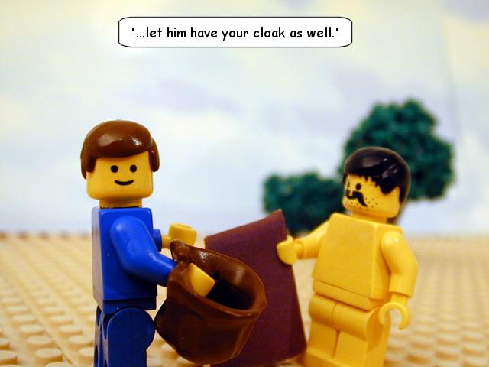
Series: Just Fix It! (Part 1). “Forewarned is Forearmed.”
If anyone wants to sue you and take your shirt…?
What to do?
Matthew 5:40

Slide 52
Series: Just Fix It! (Part 1). “Forewarned is Forearmed.”
Problem with Self-righteousness?

Slide 53
Series: Just Fix It! (Part 1). “Forewarned is Forearmed.”
Problem with Self-righteousness?
What to do?

Slide 54
Series: Just Fix It! (Part 1). “Forewarned is Forearmed.”
Problem with Self-righteousness?
What to do?

Slide 55
Series: Just Fix It! (Part 1). “Forewarned is Forearmed.”
Problem with Self-righteousness?
What to do?

Slide 56
Series: Just Fix It! (Part 1). “Forewarned is Forearmed.”
Problem with Self-righteousness?
What to do?

Slide 57
Series: Just Fix It! (Part 1). “Forewarned is Forearmed.”
Problem with Self-righteousness?
What to do?

Slide 58
Series: Just Fix It! (Part 1). “Forewarned is Forearmed.”
Problem with Self-righteousness?
What to do?
2 Corinthians 5:21—
²¹God made him who had no sin to be sin for us, so that in him we might become the righteousness of God. (NIV)

Slide 59
Series: Just Fix It! (Part 1). “Forewarned is Forearmed.”
Problem with Anger?

Slide 60
Series: Just Fix It! (Part 1). “Forewarned is Forearmed.”
Problem with Anger?
What to do?

Slide 61
Series: Just Fix It! (Part 1). “Forewarned is Forearmed.”
Problem with Anger?
What to do?
Angry words
Oh, let them never
From the tongue
Unbridled slip…

Slide 62
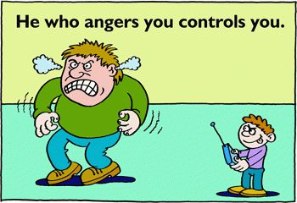
Series: Just Fix It! (Part 1). “Forewarned is Forearmed.”
Problem with Anger?
What to do?

Slide 63
Series: Just Fix It! (Part 1). “Forewarned is Forearmed.”
Problem with Anger?
What to do?
Proverbs 16:32—
³²He who is slow to anger is better than the mighty, And he who rules his spirit, than he who captures a city.

Slide 64
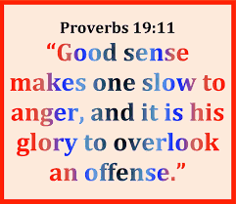
Series: Just Fix It! (Part 1). “Forewarned is Forearmed.”
Problem with Anger?
What to do?

Slide 65
Series: Just Fix It! (Part 1). “Forewarned is Forearmed.”
Problem with Anger?
What to do?

Slide 66
Series: Just Fix It! (Part 1). “Forewarned is Forearmed.”
Problem with Money?

Slide 67
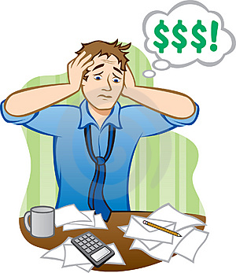
Series: Just Fix It! (Part 1). “Forewarned is Forearmed.”
Problem with Money?
What to do?

Slide 68
Series: Just Fix It! (Part 1). “Forewarned is Forearmed.”
Problem with Money?
What to do?
Not just your problem.

Slide 69
Series: Just Fix It! (Part 1). “Forewarned is Forearmed.”
Problem with Money?
What to do?
Not just your problem.
It pays to talk about it.

Slide 70
Series: Just Fix It! (Part 1). “Forewarned is Forearmed.”
Problem with Money?
What to do?
Not just your problem.
It pays to talk about it.
Causes a multitude of stresses if not checked.

Slide 71
Series: Just Fix It! (Part 1). “Forewarned is Forearmed.”
Problem with Money?
What to do?
Not just your problem.
It pays to talk about it.
Causes a multitude of stresses if not checked.
Budgets are wise.

Slide 72
Series: Just Fix It! (Part 1). “Forewarned is Forearmed.”
Problem with Money?
What to do?
Can be your worst enemy.

Slide 73
Series: Just Fix It! (Part 1). “Forewarned is Forearmed.”
Problem with Money?
What to do?
Can be your worst enemy.
Satisfaction = Contentment.

Slide 74
Series: Just Fix It! (Part 1). “Forewarned is Forearmed.”
Problem with Money?
What to do?

Slide 75
Series: Just Fix It! (Part 1). “Forewarned is Forearmed.”
Problem with Temptation?

Slide 76
Series: Just Fix It! (Part 1). “Forewarned is Forearmed.”
Problem with Temptation?
What to do?

Slide 77
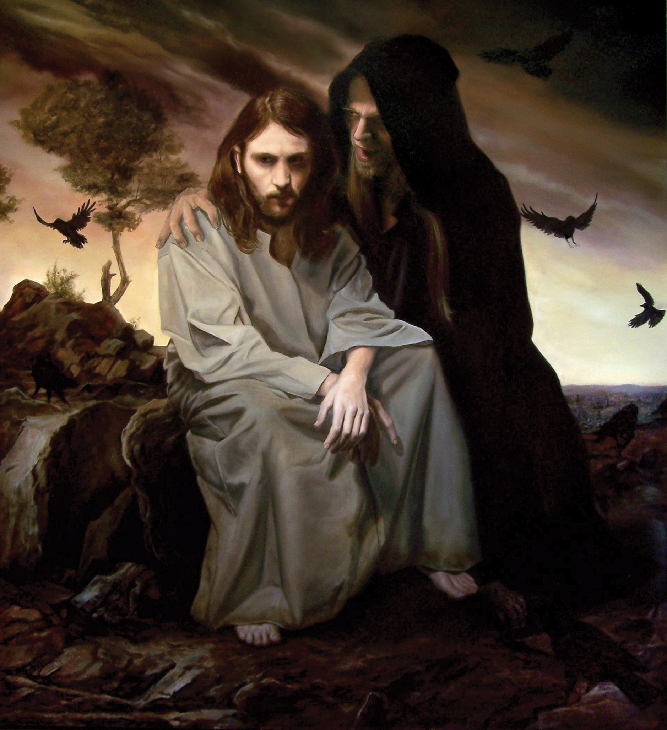
Series: Just Fix It! (Part 1). “Forewarned is Forearmed.”
Problem with Temptation?
What to do?

Slide 78
Series: Just Fix It! (Part 1). “Forewarned is Forearmed.”
Problem with Temptation?
What to do?

Slide 79
Series: Just Fix It! (Part 1). “Forewarned is Forearmed.”
Problem with Temptation?
What to do?

Slide 80
Series: Just Fix It! (Part 1). “Forewarned is Forearmed.”
Problem with Temptation?
What to do?

