Slide 1
Series: Making Progress
Part 1.
John Staiger
Morningside Church of Christ
Sunday 10 April 2022
AM Sermon
Broadcast live from 42 Leslie Ave, Auckland, Aotearoa/NZ.

Slide 2
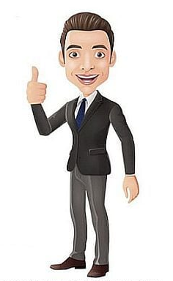
Series: Making Progress
Part 1.

Slide 3
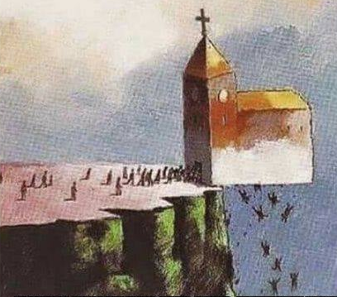
Series: Making Progress Part 1.
Not Us…!

Slide 4
Series: Making Progress Part 1.
Not Us…!
Though grim…

Slide 5
Series: Making Progress Part 1.
Not Us…!
Though grim.
This is the Devil’s Sunday job.

Slide 6
Series: Making Progress Part 1.
Not Us…!
Though grim.
This is the Devil’s Sunday job.
Examine ourselves…
2 Corinthians 13:5
Test yourselves to see if you are in the faith; examine yourselves! Or do you not recognize this about yourselves, that Jesus Christ is in you—unless indeed you fail the test?

Slide 7
Series: Making Progress Part 1.
Not Us…!
Though grim.
This is the Devil’s Sunday job.
Examine ourselves
2 Corinthians 13:5
Test yourselves to see if you are in the faith; examine yourselves! Or do you not recognize this about yourselves, that Jesus Christ is in you—unless indeed you fail the test?

Slide 8
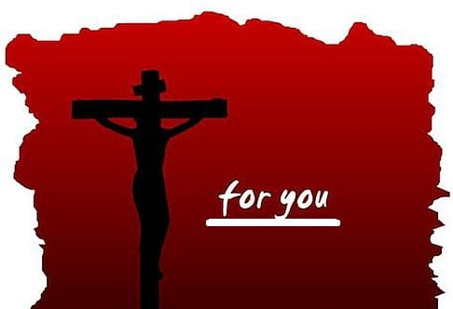
Series: Making Progress Part 1.
We the Victorious…

Slide 9
Series: Making Progress Part 1.
We the Victorious…
Romans 8:31-32—
…If God is for us, who is against us? (NASB95)

Slide 10
Series: Making Progress Part 1.
We the Victorious…
Romans 8:31-32—
³² He who did not spare His own Son, but delivered Him over for us all, how will He not also with Him freely give us all things? (NASB95)

Slide 11

Series: Making Progress Part 1.
Road of Progress…
1 Timothy 4:11-16—
¹¹Prescribe and teach these things.

Slide 12

Series: Making Progress Part 1.
Road of Progress…
1 Timothy 4:11-16—
¹²Let no one look down on your youthfulness, but rather in speech, conduct, love, faith and purity, show yourself an example of those who believe.

Slide 13
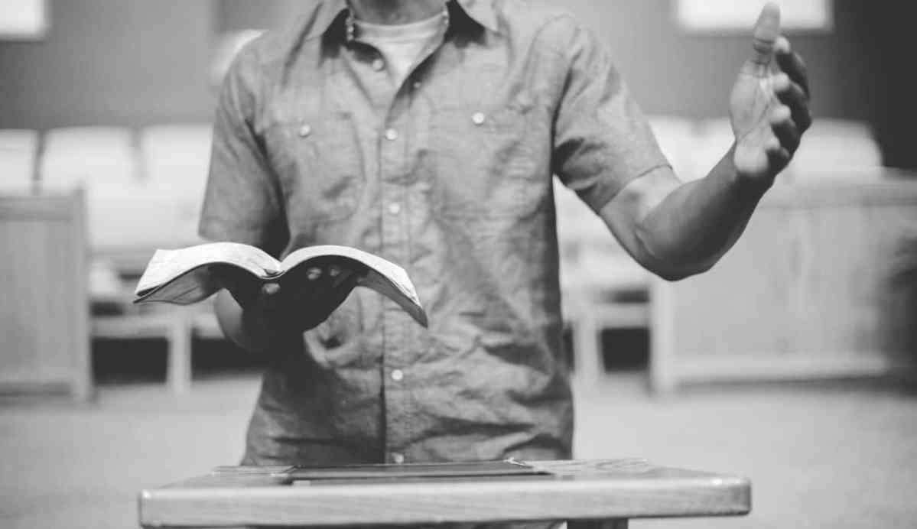
Series: Making Progress Part 1.
Road of Progress…
1 Timothy 4:11-16—
¹³Until I come, give attention to the public reading of Scripture, to exhortation and teaching.

Slide 14
Series: Making Progress Part 1.
Road of Progress…
1 Timothy 4:11-16—
¹⁴Do not neglect the spiritual gift within you, which was bestowed on you through prophetic utterance with the laying on of hands by the presbytery.

Slide 15
Series: Making Progress Part 1.
Road of Progress…
1 Timothy 4:11-16—
¹⁵ Take pains with these things; be absorbed in them, so that your progress will be evident to all.

Slide 16
Series: Making Progress Part 1.
Road of Progress…
1 Timothy 4:11-16—
¹⁶Pay close attention to yourself and to your teaching; persevere in these things, for as you do this you will ensure salvation both for yourself and for those who hear you. (NASB95)

Slide 17
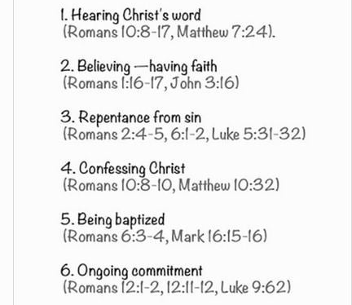
Series: Making Progress Part 1.
Where to Start—Be added to the church…

Slide 18
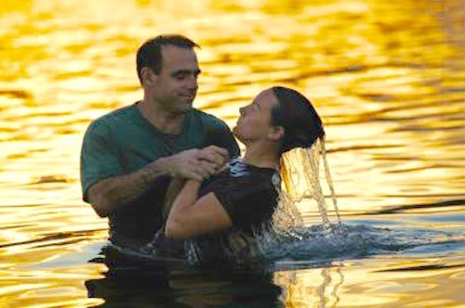
Series: Making Progress Part 1.
Where to Start—Be added to the church…
John 3:5—
⁵Jesus answered, “Truly, truly, I say to you, unless one is born of water and the Spirit he cannot enter into the kingdom of God. (NASB95)

