Slide 1
Series: Making Progress
Part 3. Never Alone!
John Staiger
Morningside Church of Christ
Sunday 24 April 2022
AM Sermon
Broadcast live from 42 Leslie Ave, Auckland, Aotearoa/NZ.

Slide 2
Series: Making Progress
Part 3.
Never Alone!

Slide 3
Series: Making Progress Part 3. Never Alone!
Preparation for battle

Slide 4
Series: Making Progress Part 3. Never Alone!
Preparation for battle
Deuteronomy 31:6—
⁶Be strong and courageous, do not be afraid or tremble at them, for the Lord your God is the one who goes with you. He will not fail you or forsake you.” (NASB95)

Slide 5
Series: Making Progress Part 3. Never Alone!
Fighting the battle

Slide 6
Series: Making Progress Part 3. Never Alone!
Fighting the battle
God’s presence is not just “Him and me.”

Slide 7
Series: Making Progress Part 3. Never Alone!
Fighting the battle
God’s presence is not just “Him and me.”
Being alone in prayer is faith building for the battles.

Slide 8
Series: Making Progress Part 3. Never Alone!
Fighting the battle
God’s presence is not just “Him and me.”
Being alone in prayer is faith building for the battles.
God is not left behind when we re-join the world.

Slide 9
Series: Making Progress Part 3. Never Alone!
Fighting the battle
God’s presence is not just “Him and me.”
Being alone in prayer is faith building for the battles.
God is not left behind when we re-join the world.
Not just, “Take the name of Jesus with you…”

Slide 10
Series: Making Progress Part 3. Never Alone!
Engaging with the People

Slide 11
Series: Making Progress Part 3. Never Alone!
Engaging with the People
Hebrews 13:1—
¹Let love of the brethren continue. (NASB95)

Slide 12
Series: Making Progress Part 3. Never Alone!
Engaging with the People
Hebrews 13:1—
¹Let love of the brethren continue. (NASB95)
“Continues” only as long as we tend to it.

Slide 13
Series: Making Progress Part 3. Never Alone!
Engaging with the People
Hebrews 13:1—
¹Let love of the brethren continue. (NASB95)
“Continues” only as long as LOVE is properly defined.

Slide 14
Series: Making Progress Part 3. Never Alone!
Engaging with the People
Hebrews 13:1—
¹Let love of the brethren continue. (NASB95)
1 John 3:16—¹⁶ We know love by this, that He laid down His life for us; and we ought to lay down our lives for the brethren. (NASB95)

Slide 15
Series: Making Progress Part 3. Never Alone!
Fighting the battle

Slide 16
Series: Making Progress Part 3. Never Alone!
Fighting the battle
Hebrews 13:2—
²Do not neglect to show hospitality to strangers, for by this some have entertained angels without knowing it. (NASB95)

Slide 17
Series: Making Progress Part 3. Never Alone!
Fighting the battle
Hebrews 13:2—
²Do not neglect to show hospitality to strangers, for by this some have entertained angels without knowing it. (NASB95)
Your “Angels” will come without wings

Slide 18
Series: Making Progress Part 3. Never Alone!
Fighting the battle
Hebrews 13:2—
²Do not neglect to show hospitality to strangers, for by this some have entertained angels without knowing it. (NASB95)
Make sure you invite them to eat.

Slide 19
Series: Making Progress Part 3. Never Alone!
Fighting the battle
Hebrews 13:2—
²Do not neglect to show hospitality to strangers, for by this some have entertained angels without knowing it. (NASB95)
This necessitates a change of lifestyle.

Slide 20
Series: Making Progress Part 3. Never Alone!
Fighting the battle
Hebrews 13:2—
²Do not neglect to show hospitality to strangers, for by this some have entertained angels without knowing it. (NASB95)
This necessitates a change of lifestyle.
Sacrifice:

Slide 21
Series: Making Progress Part 3. Never Alone!
Fighting the battle
Hebrews 13:2—
²Do not neglect to show hospitality to strangers, for by this some have entertained angels without knowing it. (NASB95)
This necessitates a change of lifestyle.
Sacrifice:
What you are doing.

Slide 22
Series: Making Progress Part 3. Never Alone!
Fighting the battle
Hebrews 13:2—
²Do not neglect to show hospitality to strangers, for by this some have entertained angels without knowing it. (NASB95)
This necessitates a change of lifestyle.
Sacrifice:
What you are doing.
Time.

Slide 23
Series: Making Progress Part 3. Never Alone!
Fighting the battle
Hebrews 13:2—
²Do not neglect to show hospitality to strangers, for by this some have entertained angels without knowing it. (NASB95)
This necessitates a change of lifestyle.
Sacrifice:
What you are doing.
Time.
Money.

Slide 24
Series: Making Progress Part 3. Never Alone!
Fighting the battle

Slide 25
Series: Making Progress Part 3. Never Alone!
Fighting the battle
Hebrews 13:3—
³Remember the prisoners, as though in prison with them, and those who are ill-treated, since you yourselves also are in the body. (NASB95)

Slide 26
Series: Making Progress Part 3. Never Alone!
Fighting the battle
Hebrews 13:3—
³Remember the prisoners, as though in prison with them, and those who are ill-treated, since you yourselves also are in the body. (NASB95)
Brings humility to those “First-world” problems.

Slide 27
Series: Making Progress Part 3. Never Alone!
Fighting the battle
Hebrews 13:3—
³Remember the prisoners, as though in prison with them, and those who are ill-treated, since you yourselves also are in the body. (NASB95)
That can be us!

Slide 28
Series: Making Progress Part 3. Never Alone!
Fighting the battle
Hebrews 13:3—
³Remember the prisoners, as though in prison with them, and those who are ill-treated, since you yourselves also are in the body. (NASB95)
God was with Paul and Silas (Acts 16).

Slide 29
Series: Making Progress Part 3. Never Alone!
Fighting the battle
Hebrews 13:3—
³Remember the prisoners, as though in prison with them, and those who are ill-treated, since you yourselves also are in the body. (NASB95)
Paul and Silas worked while in jail.

Slide 30
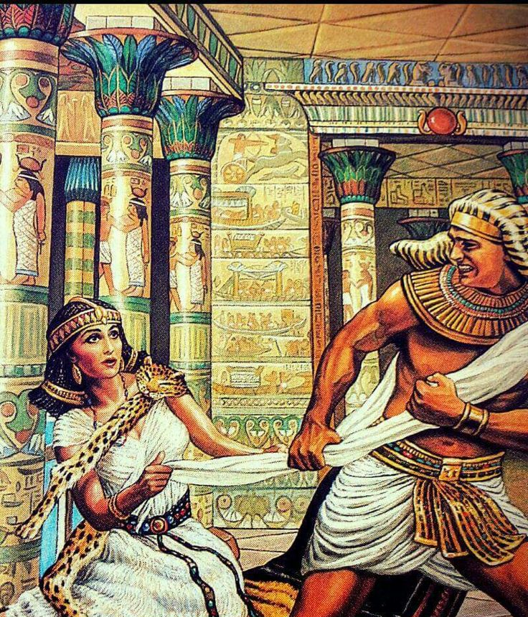
Series: Making Progress Part 3. Never Alone!
Fighting the battle

Slide 31
Series: Making Progress Part 3. Never Alone!
Fighting the battle
Hebrews 13:4—
⁴Marriage is to be held in honour among all, and the marriage bed is to be undefiled; for fornicators and adulterers God will judge. (NASB95)

Slide 32
Series: Making Progress Part 3. Never Alone!
Fighting the battle
Hebrews 13:4—
⁴Marriage is to be held in honour among all, and the marriage bed is to be undefiled; for fornicators and adulterers God will judge. (NASB95)
Joseph knew the presence of God.

Slide 33
Series: Making Progress Part 3. Never Alone!
Fighting the battle
Hebrews 13:4—
⁴Marriage is to be held in honour among all, and the marriage bed is to be undefiled; for fornicators and adulterers God will judge. (NASB95)
He knew the consequences of that sin would follow him.

Slide 34
Series: Making Progress Part 3. Never Alone!
Fighting the battle

Slide 35
Series: Making Progress Part 3. Never Alone!
Fighting the battle
Hebrews 13:5—
⁵Make sure that your character is free from the love of money,…

Slide 36
Series: Making Progress Part 3. Never Alone!
Fighting the battle
Hebrews 13:5—
⁵Make sure that your character is free from the love of money,…
If your
“CHARACTER”
is free from the
love of money
you need not
concern
yourself
any further.

Slide 37
Series: Making Progress Part 3. Never Alone!
Fighting the battle
Hebrews 13:5—
…being content with what you have; for He Himself has said, “I will never desert you, nor will I ever forsake you,” (NASB95)

Slide 38
Series: Making Progress Part 3. Never Alone!
Fighting the battle
Hebrews 13:5—
…being content with what you have; for He Himself has said, “I will never desert you, nor will I ever forsake you,” (NASB95)
Do a
“Contentment Test.”

Slide 39
Series: Making Progress Part 3. Never Alone!
Fighting the battle
Hebrews 13:5—
…being content with what you have; for He Himself has said, “I will never desert you, nor will I ever forsake you,” (NASB95)
Do a
“Contentment Test.”
It will equate to your concept of God’s presence.

Slide 40
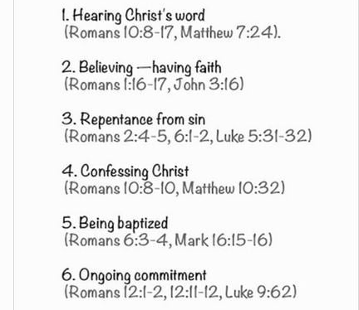
Series: Making Progress Part 3. Never Alone!
Where to Start—Be added to the church…

Slide 41
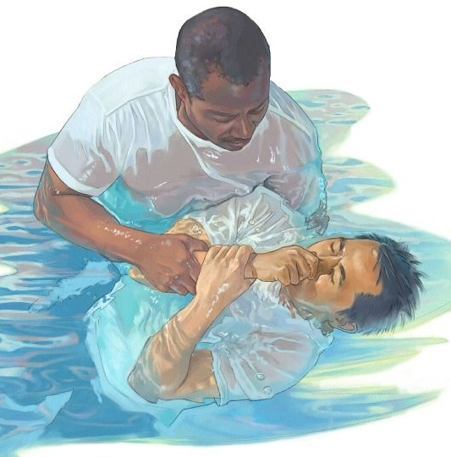
Series: Making Progress Part 3. Never Alone!
Where to Start—Be added to the church…
John 3:5—
⁵Jesus answered, “Truly, truly, I say to you, unless one is born of water and the Spirit he cannot enter into the kingdom of God. (NASB95)

