Slide 1
Series: Making Progress
Part 5. “Clearing the Way.”
John Staiger
Morningside Church of Christ
Sunday 8 May 2022
AM Sermon
Broadcast live from 42 Leslie Ave, Auckland, Aotearoa/NZ.

Slide 2
Series: Making Progress
Part 5.
“Clearing the Way.”

Slide 3
Series: Making Progress Part 5. “Clearing the Way.”
1. The Way has been Paved!

Slide 4
Series: Making Progress Part 5. “Clearing the Way.”
The Way has been Paved!

Slide 5
Series: Making Progress Part 5. “Clearing the Way.”
The Way has been Paved!

Slide 6
Series: Making Progress Part 5. “Clearing the Way.”
Progress is Messy!

Slide 7
Series: Making Progress Part 5. “Clearing the Way.”
Progress is Messy!
We left the mess on The Broad Way.

Slide 8
Series: Making Progress Part 5. “Clearing the Way.”
Progress is Messy!
We left the mess on The Broad Way.
We brought ourselves.

Slide 9
Series: Making Progress Part 5. “Clearing the Way.”
Progress is Messy!
We left the mess on The Broad Way.
We brought ourselves.
We brought baggage.

Slide 10
Series: Making Progress Part 5. “Clearing the Way.”
Progress is Messy!
We left the mess on The Broad Way.
We brought ourselves.
We brought baggage.
Satan will make a mess wherever he can.

Slide 11
Series: Making Progress Part 5. “Clearing the Way.”
Progress is Messy!
We left the mess on The Broad Way.
We brought ourselves.
We brought baggage.
Satan will make a mess wherever he can.
Ruin our friendships.

Slide 12
Series: Making Progress Part 5. “Clearing the Way.”
Progress is Messy!
We left the mess on The Broad Way.
We brought ourselves.
We brought baggage.
Satan will make a mess wherever he can.
Ruin our friendships.
Break up everything into piles of rubbish.

Slide 13
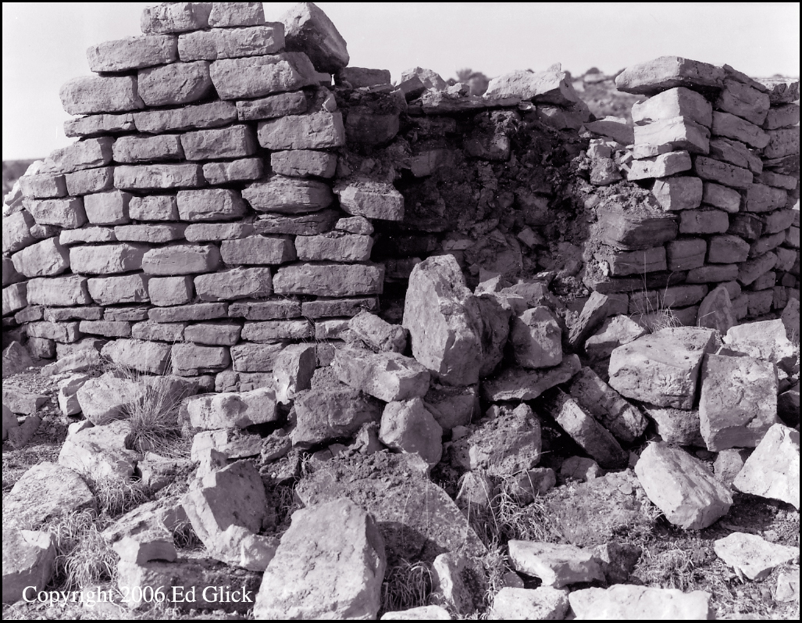
Series: Making Progress Part 5. “Clearing the Way.”
Getting rid of the Rubbish!
Nehemiah 4:10—
Meanwhile, the people in Judah said, “The strength of the laborers is giving out, and there is so much rubble that we cannot rebuild the wall.”

Slide 14
Series: Making Progress Part 5. “Clearing the Way.”
Getting rid of the Rubbish!
Nehemiah 4:10—
Meanwhile, the people in Judah said, “The strength of the laborers is giving out, and there is so much rubble that we cannot rebuild the wall.”

Slide 15
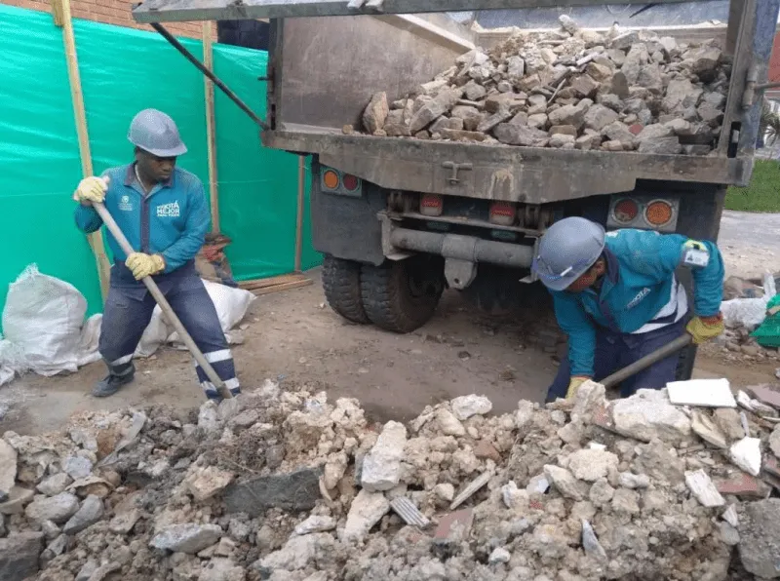
Series: Making Progress Part 5. “Clearing the Way.”
Getting rid of the Rubbish!
Ephesians 4:31—
³¹Get rid of all…
bitterness,
rage
and anger,
brawling
and slander,
along with every form of malice. (NIV)

Slide 16
Series: Making Progress Part 5. “Clearing the Way.”
Getting rid of the Rubbish!
Ephesians 4:31—
³¹Get rid of all…
bitterness,
rage
and anger,
brawling
and slander,
along with every form of malice. (NIV)

Slide 17
Series: Making Progress Part 5. “Clearing the Way.”
Getting rid of the Rubbish!
Ephesians 4:31—
³¹Get rid of all…
bitterness,
rage
and anger,
brawling
and slander,
along with every form of malice. (NIV)

Slide 18
Series: Making Progress Part 5. “Clearing the Way.”
Getting rid of the Rubbish!
Ephesians 4:31—
³¹Get rid of all…
bitterness,
rage
and anger,
brawling
and slander,
along with every form of malice. (NIV)

Slide 19
Series: Making Progress Part 5. “Clearing the Way.”
Getting rid of the Rubbish!
Ephesians 4:31—
³¹Get rid of all…
bitterness,
rage
and anger,
brawling
and slander,
along with every form of malice. (NIV)

Slide 20
Series: Making Progress Part 5. “Clearing the Way.”
Getting rid of the Rubbish!
Ephesians 4:31—
³¹Get rid of all…
bitterness,
rage
and anger,
brawling
and slander,
along with every form of malice. (NIV)

Slide 21
Series: Making Progress Part 5. “Clearing the Way.”
Getting rid of the Rubbish!
Ephesians 4:31—
³¹Get rid of all…
bitterness,
rage
and anger,
brawling
and slander,
along with every form of malice. (NIV)

Slide 22
Series: Making Progress Part 5. “Clearing the Way.”
Getting rid of the Rubbish!
Colossians 3:8—
⁸But now you must also rid yourselves of all such things as these:
anger,
rage,
malice,
slander,
and filthy language from your lips. (NIV)

Slide 23
Series: Making Progress Part 5. “Clearing the Way.”
Getting rid of the Rubbish!
Colossians 3:8—
⁸But now you must also rid yourselves of all such things as these:
anger,
rage,
malice,
slander,
and filthy language from your lips. (NIV)

Slide 24
Series: Making Progress Part 5. “Clearing the Way.”
Getting rid of the Rubbish!
Colossians 3:8—
⁸But now you must also rid yourselves of all such things as these:
anger,
rage,
malice,
slander,
and filthy language from your lips. (NIV)

Slide 25
Series: Making Progress Part 5. “Clearing the Way.”
Getting rid of the Rubbish!
Colossians 3:8—
⁸But now you must also rid yourselves of all such things as these:
anger,
rage,
malice,
slander,
and filthy language from your lips. (NIV)

Slide 26
Series: Making Progress Part 5. “Clearing the Way.”
Getting rid of the Rubbish!
Colossians 3:8—
⁸But now you must also rid yourselves of all such things as these:
anger,
rage,
malice,
slander,
and filthy language from your lips. (NIV)

Slide 27
Series: Making Progress Part 5. “Clearing the Way.”
Getting rid of the Rubbish!
Colossians 3:8—
⁸But now you must also rid yourselves of all such things as these:
anger,
rage,
malice,
slander,
and filthy language from your lips. (NIV)

Slide 28
Series: Making Progress Part 5. “Clearing the Way.”
Getting rid of the Rubbish!

Slide 29
Series: Making Progress Part 5. “Clearing the Way.”
Getting rid of the Rubbish!
A brother like this is going to:
Pile up of mountains of resentment.

Slide 30
Series: Making Progress Part 5. “Clearing the Way.”
Getting rid of the Rubbish!
A brother like this is going to:
Pile up of mountains of resentment.

Slide 31
Series: Making Progress Part 5. “Clearing the Way.”
Getting rid of the Rubbish!
1 Peter 4:15-16—

Slide 32
Series: Making Progress Part 5. “Clearing the Way.”
Getting rid of the Rubbish!
1 Peter 4:15-16—
¹⁵Make sure that none of you suffers as… a murderer,
or thief,
or evildoer,
or a troublesome meddler; (NASB95)

Slide 33
Series: Making Progress Part 5. “Clearing the Way.”
Getting rid of the Rubbish!
1 Peter 4:15-16—
¹⁵Make sure that none of you suffers as… a murderer,
or thief,
or evildoer,
or a troublesome meddler; (NASB95)

Slide 34
Series: Making Progress Part 5. “Clearing the Way.”
Getting rid of the Rubbish!
1 Peter 4:15-16—
¹⁵Make sure that none of you suffers as… a murderer,
or thief,
or evildoer,
or a troublesome meddler; (NASB95)

Slide 35
Series: Making Progress Part 5. “Clearing the Way.”
Getting rid of the Rubbish!
1 Peter 4:15-16—
¹⁵Make sure that none of you suffers as… a murderer,
or thief,
or evildoer,
or a troublesome meddler; (NASB95)

Slide 36
Series: Making Progress Part 5. “Clearing the Way.”
Getting rid of the Rubbish!
1 Peter 4:15-16—
¹⁶but if anyone suffers as a Christian, he is not to be ashamed, but is to glorify God in this name. (NASB95)

Slide 37
Series: Making Progress Part 5. “Clearing the Way.”
No Road to be on…!

Slide 38
Series: Making Progress Part 5. “Clearing the Way.”
No Road to be on…!
"Hell is full of good meanings,
but heaven is full of good works".

Slide 39
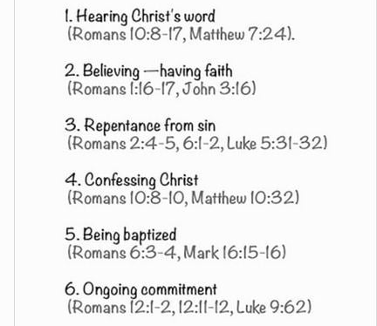
Series: Making Progress Part 4. “Freely given all things.”
Where to Start—Be added to the church…

Slide 40
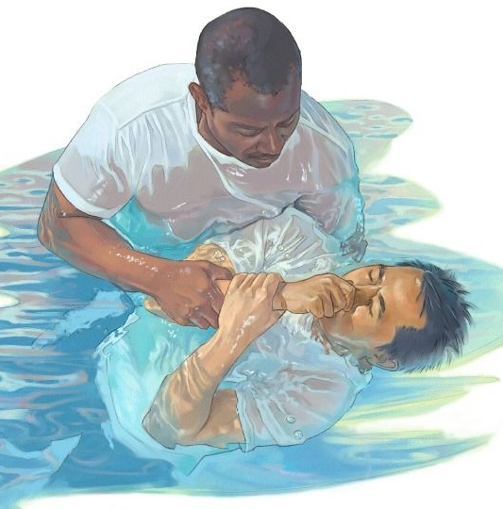
Series: Making Progress Part 4. “Freely given all things.”
Where to Start—Be added to the church…
John 3:5—
⁵Jesus answered, “Truly, truly, I say to you, unless one is born of water and the Spirit he cannot enter into the kingdom of God. (NASB95)

