Slide 1
Series: Going Home
Part 4. Absent from the Lord
John Staiger
Morningside Church of Christ
Sunday 12 June 2022
AM Sermon
Broadcast live from 42 Leslie Ave, Auckland, Aotearoa/NZ.

Slide 2
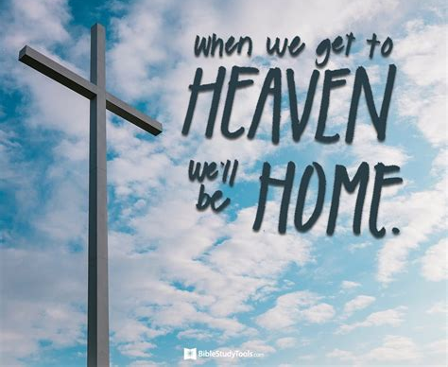
Series: Going Home
Part 4.
“Absent from the Lord.”

Slide 3
Series: Going Home Part 4. Absent from the Lord
2 Corinthians 5:6
Therefore,
being always of
good courage,
and knowing that
while we are
at home in the body
we are
absent from the Lord—

Slide 4
Series: Going Home Part 4. Absent from the Lord
State of absence…
For all Christians this is our first thought.
Our governing principle.
Standing “This side of Heaven” in relation to our Lord.
Our “earthly state”
A fact not to be grieved over, but to be recognized and felt.

Slide 5
Series: Going Home Part 4. Absent from the Lord
State of absence…
For all Christians this is our first thought.
Our governing principle.
Standing “This side of Heaven” in relation to our Lord.
Our “earthly state”
A fact not to be grieved over, but to be recognized and felt.

Slide 6
Series: Going Home Part 4. Absent from the Lord
State of absence…
For all Christians this is our first thought.
Our governing principle.
Standing “This side of Heaven” in relation to our Lord.
Our “earthly state”
A fact not to be grieved over, but to be recognized and felt.

Slide 7
Series: Going Home Part 4. Absent from the Lord
State of absence…
For all Christians this is our first thought.
Our governing principle.
Standing “This side of Heaven” in relation to our Lord.
Our “earthly state”
A fact not to be grieved over, but to be recognized and felt.

Slide 8
Series: Going Home Part 4. Absent from the Lord
State of absence…
For all Christians this is our first thought.
Our governing principle.
Standing “This side of Heaven” in relation to our Lord.
Our “earthly state”
A fact not to be grieved over, but to be recognized and felt.

Slide 9
Series: Going Home Part 4. Absent from the Lord
State of absence…
For all Christians this is our first thought.
Our governing principle.
Standing “This side of Heaven” in relation to our Lord.
Our “earthly state”
A fact not to be grieved over, but to be recognized and felt.

Slide 10
Series: Going Home Part 4. Absent from the Lord
He has gone to prepare a place for us…

Slide 11
Series: Going Home Part 4. Absent from the Lord
He has gone to prepare a place for us…
John 14:1-2—
¹“Do not let your heart be troubled; believe in God, believe also in Me.
²In My Father’s house are many dwelling places; if it were not so, I would have told you; for I go to prepare a place for you. (NASB95)

Slide 12
Series: Going Home Part 4. Absent from the Lord
He has gone to prepare a place for us…
Jesus’ aim is to lead us into a life of faith.

Slide 13
Series: Going Home Part 4. Absent from the Lord
He has gone to prepare a place for us…
Jesus’ aim is to lead us into a life of faith.
To excite our confidence in him as Lord and Saviour.

Slide 14
Series: Going Home Part 4. Absent from the Lord
He has gone to prepare a place for us…
Jesus’ aim is to lead us into a life of faith.
To excite our confidence in him as Lord and Saviour.
To prepare us for a place with him.

Slide 15
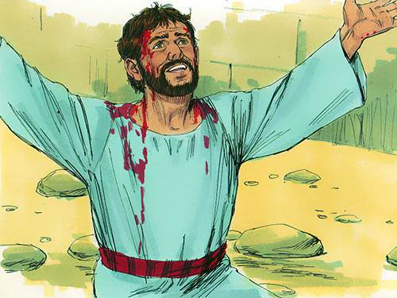
Series: Going Home Part 4. Absent from the Lord
Seeing that which is…

Slide 16
Series: Going Home Part 4. Absent from the Lord
Seeing that which is…
Acts 7:55-56—
⁵⁵But being full of the Holy Spirit, he gazed intently into heaven and saw the glory of God, and Jesus standing at the right hand of God;
⁵⁶and he said, “Behold, I see the heavens opened up and the Son of Man standing at the right hand of God.” (NASB95)

Slide 17
Series: Going Home Part 4. Absent from the Lord
Away from Home for a Purpose…

Slide 18
Series: Going Home Part 4. Absent from the Lord
Away from Home for a Purpose…
John 17:1—
¹⁷Jesus spoke these things; and lifting up His eyes to heaven, He said, “Father, the hour has come; glorify Your Son, that the Son may glorify You, (NASB95)

Slide 19
Series: Going Home Part 4. Absent from the Lord
THIS ABSENCE IS NOT SPIRITUAL, BUT BODILY.

Slide 20
Series: Going Home Part 4. Absent from the Lord
THIS ABSENCE IS NOT SPIRITUAL, BUT BODILY.
1 Peter 1:8-9—
⁸and though you have not seen Him,
you love Him,
and though you do not see Him now,
but believe in Him,
you greatly rejoice with joy inexpressible and full of glory,
⁹obtaining as the outcome of your faith the salvation of your souls. (NASB95)

Slide 21
Series: Going Home Part 4. Absent from the Lord
THIS ABSENCE IS NOT SPIRITUAL, BUT BODILY.
1 Peter 1:8-9—
⁸and though you have not seen Him,
you love Him,
and though you do not see Him now,
but believe in Him,
you greatly rejoice with joy inexpressible and full of glory,
⁹obtaining as the outcome of your faith the salvation of your souls. (NASB95)

Slide 22
Series: Going Home Part 4. Absent from the Lord
THIS ABSENCE IS NOT SPIRITUAL, BUT BODILY.
1 Peter 1:8-9—
⁸and though you have not seen Him,
you love Him,
and though you do not see Him now,
but believe in Him,
you greatly rejoice with joy inexpressible and full of glory,
⁹obtaining as the outcome of your faith the salvation of your souls. (NASB95)

Slide 23
Series: Going Home Part 4. Absent from the Lord
THIS ABSENCE IS NOT SPIRITUAL, BUT BODILY.
1 Peter 1:8-9—
⁸and though you have not seen Him,
you love Him,
and though you do not see Him now,
but believe in Him,
you greatly rejoice with joy inexpressible and full of glory,
⁹obtaining as the outcome of your faith the salvation of your souls. (NASB95)

Slide 24
Series: Going Home Part 4. Absent from the Lord
THIS ABSENCE IS NOT SPIRITUAL, BUT BODILY.
1 Peter 1:8-9—
⁸and though you have not seen Him,
you love Him,
and though you do not see Him now,
but believe in Him,
you greatly rejoice with joy inexpressible and full of glory,
⁹obtaining as the outcome of your faith the salvation of your souls. (NASB95)

Slide 25
Series: Going Home Part 4. Absent from the Lord
We walk by faith, not by sight—
THIS ABSENCE IS NOT SPIRITUAL, BUT BODILY.
1 Peter 1:8-9—
⁸and though you have not seen Him,
you love Him,
and though you do not see Him now,
but believe in Him,
you greatly rejoice with joy inexpressible and full of glory,
⁹obtaining as the outcome of your faith the salvation of your souls. (NASB95)

Slide 26
Series: Going Home Part 4. Absent from the Lord
THIS ABSENCE IS NOT SPIRITUAL, BUT BODILY.
1 Peter 1:8-9—
⁸and though you have not seen Him,
you love Him,
and though you do not see Him now,
but believe in Him,
you greatly rejoice with joy inexpressible and full of glory,
⁹obtaining as the outcome of your faith the salvation of your souls. (NASB95)

Slide 27
Series: Going Home Part 4. Absent from the Lord
Where our Ambitions Lie…

Slide 28
Series: Going Home Part 4. Absent from the Lord
Where our Ambitions Lie…
2 Corinthians 5:9—
⁹ Therefore we also have as our ambition, whether at home or absent, to be pleasing to Him. (NASB95)

Slide 29
Series: Going Home Part 4. Absent from the Lord
This World is NOT my Home…

Slide 30
Series: Going Home Part 4. Absent from the Lord
This World is NOT my Home…
1 Peter 2:11—
¹¹Beloved, I urge you as aliens and strangers to abstain from fleshly lusts which wage war against the soul. (NASB95)

Slide 31
Series: Going Home Part 4. Absent from the Lord
This World is NOT my Home…
Stop investing in the corruption of the soul, and…

Slide 32
Series: Going Home Part 4. Absent from the Lord
This World is NOT my Home…
Stop investing in the corruption of the soul, and Dust!

Slide 33
Series: Going Home Part 4. Absent from the Lord
There’s a great Day Coming…

Slide 34
Series: Going Home Part 4. Absent from the Lord
Galatians 3:27—
For all of you who were baptized into Christ have clothed yourselves with Christ. (NASB95)

