Slide 1
Series: Just Fix It!.
“Forewarned is Forearmed.” (Part 3)
John Staiger
Morningside Church of Christ
Wednesday 8 June2022
Bible Class
Broadcast from 42 Leslie Avenue, Auckland, Aotearoa/NZ.
www.morningsidechurchofchrist.org.nz

Slide 2
Series: Just Fix It!
“Forewarned
is
Forearmed”
(Part 3).

Slide 3
Series: Just Fix It! “Forewarned is Forearmed” (Part 3).
The Problem of Unforgiveness—
Few things this side of heaven will impact your wellbeing more than…

Slide 4
Series: Just Fix It! “Forewarned is Forearmed” (Part 3).
The Problem of Unforgiveness—
Few things this side of heaven will impact your wellbeing more than…

Slide 5
Series: Just Fix It! “Forewarned is Forearmed” (Part 3).
The Problem of Unforgiveness—
Few things this side of heaven will impact your wellbeing more than…

Slide 6
Series: Just Fix It! “Forewarned is Forearmed” (Part 3).
The Problem of Unforgiveness—
Few things this side of heaven will impact your wellbeing more than…

Slide 7
Series: Just Fix It! “Forewarned is Forearmed” (Part 3).
The Problem of Unforgiveness—
Few things this side of heaven will impact your wellbeing more than forgiveness.
Either:

Slide 8
Series: Just Fix It! “Forewarned is Forearmed” (Part 3).
The Problem of Unforgiveness—
Few things this side of heaven will impact your wellbeing more than forgiveness.
Either:
Someone else forgiving you…

Slide 9
Series: Just Fix It! “Forewarned is Forearmed” (Part 3).
The Problem of Unforgiveness—
Few things this side of heaven will impact your wellbeing more than forgiveness.
Either:
Someone else forgiving you…
Or, you forgiving someone else.

Slide 10
Series: Just Fix It! “Forewarned is Forearmed” (Part 3).
The Problem of Unforgiveness—
All of us are victims of others’ evil.

Slide 11
Series: Just Fix It! “Forewarned is Forearmed” (Part 3).
The Problem of Unforgiveness—
All of us are victims of others’ evil.
Left bewildered

Slide 12
Series: Just Fix It! “Forewarned is Forearmed” (Part 3).
The Problem of Unforgiveness—
All of us are victims of others’ evil.
Left bewildered
Distressed

Slide 13
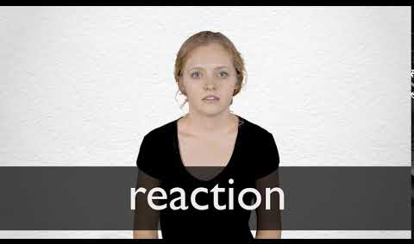
Series: Just Fix It! “Forewarned is Forearmed” (Part 3).
The Problem of Unforgiveness—
All of us are victims of others’ evil.
Left bewildered
Distressed

Slide 14
Series: Just Fix It! “Forewarned is Forearmed” (Part 3).
The Problem of Unforgiveness—
All of us are victims of others’ evil.
Left bewildered
Distressed
Knee-jerk reaction…

Slide 15
Series: Just Fix It! “Forewarned is Forearmed” (Part 3).
The Problem of Unforgiveness—
All of us are victims of others’ evil.
Left bewildered
Distressed
Knee-jerk reaction…
Indignant

Slide 16
Series: Just Fix It! “Forewarned is Forearmed” (Part 3).
The Problem of Unforgiveness—
All of us are victims of others’ evil.
Left bewildered
Distressed
Knee-jerk reaction…
Indignant
Bitter

Slide 17
Series: Just Fix It! “Forewarned is Forearmed” (Part 3).
The Problem of Unforgiveness—
All of us are victims of others’ evil.
Left bewildered
Distressed
Knee-jerk reaction…
Indignant
Bitter
Retaliatory

Slide 18
Series: Just Fix It! “Forewarned is Forearmed” (Part 3).
The Problem of Unforgiveness—
All of us are victims of others’ evil.
Left bewildered
Distressed
Knee-jerk reaction…
Indignant
Bitter
Retaliatory
Vengeful

Slide 19
Series: Just Fix It! “Forewarned is Forearmed” (Part 3).
The Problem of Unforgiveness—
All of us are victims of others’ evil.
Left bewildered
Distressed
Knee-jerk reaction…
Indignant
Bitter
Retaliatory
Vengeful

Slide 20
Series: Just Fix It! “Forewarned is Forearmed” (Part 3).
The Problem of Unforgiveness—
All of us are victims of others’ evil.
Left bewildered
Distressed
Forgive

Slide 21
Series: Just Fix It! “Forewarned is Forearmed” (Part 3).
The Problem of Unforgiveness—
All of us are victims of others’ evil.
Left bewildered
Distressed
Forgive
Ephesians 4:32—And be kind to one another, tender-hearted, forgiving one another, just as God in Christ also forgave you.–

Slide 22
Series: Just Fix It! “Forewarned is Forearmed” (Part 3).
The Problem of Unforgiveness—
All of us are victims of others’ evil.
Left bewildered
Distressed
Forgive
Matthew 18:21-22—²¹Then Peter came and said to Him, “Lord, how often shall my brother sin against me and I forgive him? Up to seven times?” ²²Jesus *said to him, “I do not say to you, up to seven times, but up to seventy times seven.

Slide 23
Series: Just Fix It! “Forewarned is Forearmed” (Part 3).
The Problem of Unforgiveness—
All of us are victims of others’ evil.
Left bewildered
Distressed
Forgive
Seek clarification

Slide 24
Series: Just Fix It! “Forewarned is Forearmed” (Part 3).
The Problem of Unforgiveness—
All of us are victims of others’ evil.
Left bewildered
Distressed
Forgive
Seek clarification
Matthew 18:15-17—
¹⁵“If your brother sins, go and show him his fault in private; if he listens to you, you have won your brother.

Slide 25
Series: Just Fix It! “Forewarned is Forearmed” (Part 3).
The Problem of Unforgiveness—
All of us are victims of others’ evil.
Left bewildered
Distressed
Forgive
Seek clarification
Matthew 18:15-17—
¹⁶But if he does not listen to you, take one or two more with you, so that by the mouth of two or three witnesses every fact may be confirmed.

Slide 26
Series: Just Fix It! “Forewarned is Forearmed” (Part 3).
The Problem of Unforgiveness—
All of us are victims of others’ evil.
Left bewildered
Distressed
Forgive
Seek clarification
Matthew 18:15-17—
¹⁷If he refuses to listen to them, tell it to the church; and if he refuses to listen even to the church, let him be to you as a Gentile and a tax collector.

Slide 27
Series: Just Fix It! “Forewarned is Forearmed” (Part 3).
The Problem of Unforgiveness—
All of us are victims of others’ evil.
Left bewildered
Distressed
Forgive
Seek clarification
Pray for them

Slide 28
Series: Just Fix It! “Forewarned is Forearmed” (Part 3).
The Problem of Unforgiveness—
All of us are perpetrators of evil.

Slide 29
Series: Just Fix It! “Forewarned is Forearmed” (Part 3).
The Problem of Unforgiveness—
All of us are perpetrators of evil.
Knowingly

Slide 30
Series: Just Fix It! “Forewarned is Forearmed” (Part 3).
The Problem of Unforgiveness—
All of us are perpetrators of evil.
Knowingly
Unknowingly

Slide 31
Series: Just Fix It! “Forewarned is Forearmed” (Part 3).
The Problem of Unforgiveness—
All of us are perpetrators of evil.
Knowingly
Unknowingly
Someone has NOT forgiven you

Slide 32
Series: Just Fix It! “Forewarned is Forearmed” (Part 3).
The Problem of Unforgiveness—
All of us are perpetrators of evil.
Knowingly
Unknowingly
Someone has NOT forgiven you

Slide 33
Series: Just Fix It! “Forewarned is Forearmed” (Part 3).
The Problem of Unforgiveness—
All of us are perpetrators of evil.
Knowingly
Unknowingly
Someone has NOT forgiven you
Ignore it

Slide 34
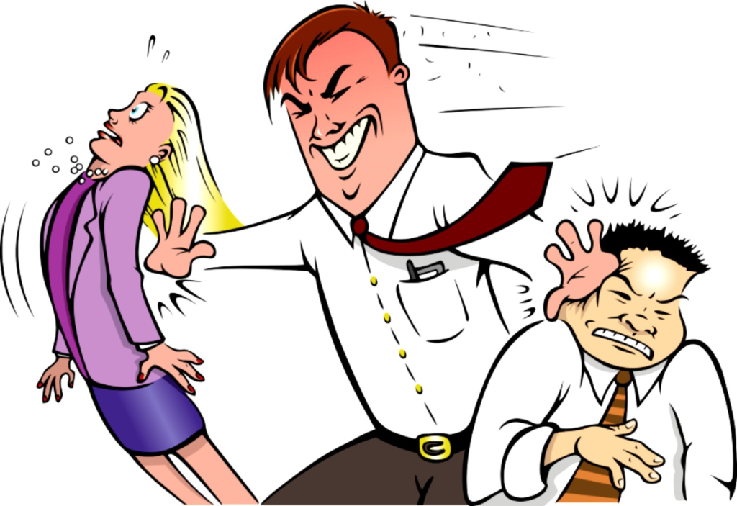
Series: Just Fix It! “Forewarned is Forearmed” (Part 3).
The Problem of Unforgiveness—
All of us are perpetrators of evil.
Knowingly
Unknowingly
Someone has NOT forgiven you
Ignore it

Slide 35
Series: Just Fix It! “Forewarned is Forearmed” (Part 3).
The Problem of Unforgiveness—
All of us are perpetrators of evil.
Knowingly
Unknowingly
Someone has NOT forgiven you
Seek forgiveness

Slide 36
Series: Just Fix It! “Forewarned is Forearmed” (Part 3).
The Problem of Unforgiveness—
Matthew 5:23-24—²³Therefore if you are presenting your offering at the altar, and there remember that your brother has something against you…
All of us are perpetrators of evil.
Knowingly
Unknowingly
Someone has NOT forgiven you
Seek forgiveness

Slide 37
Series: Just Fix It! “Forewarned is Forearmed” (Part 3).
The Problem of Unforgiveness—
Matthew 5:23-24—²⁴leave your offering there before the altar and go; first be reconciled to your brother, and then come and present your offering.
All of us are perpetrators of evil.
Knowingly
Unknowingly
Someone has NOT forgiven you
Seek forgiveness

Slide 38
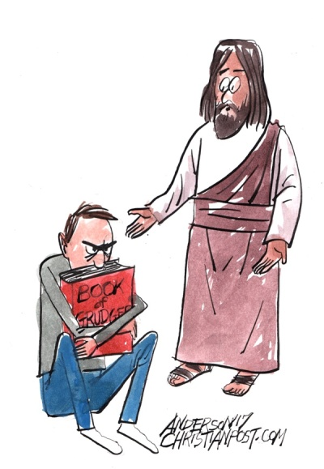
Series: Just Fix It! “Forewarned is Forearmed” (Part 3).
The Problem of Unforgiveness—
Its time to hand over that “Book of Grudges” to the Lord.

Slide 39
Series: Just Fix It! “Forewarned is Forearmed” (Part 3).
The Problem of Unforgiveness—
Its time to hand over that “Book of Grudges” to the Lord.
IT’S HARD…

Slide 40
Series: Just Fix It! “Forewarned is Forearmed” (Part 3).
The Problem of Unforgiveness—

Slide 41
Series: Just Fix It! “Forewarned is Forearmed” (Part 3).
The Problem of Unforgiveness—

Slide 42
Series: Just Fix It! “Forewarned is Forearmed” (Part 3).
The Problem of Unforgiveness—

Slide 43
Series: Just Fix It! “Forewarned is Forearmed” (Part 3).
The Problem of Unforgiveness—
Matthew 6:14-15—¹⁴For if you forgive others for their transgressions, your heavenly Father will also forgive you. ¹⁵But…

Slide 44
Series: Just Fix It! “Forewarned is Forearmed” (Part 3).
The Problem of Unforgiveness—
Matthew 6:14-15—¹⁴For if you forgive others for their transgressions, your heavenly Father will also forgive you. ¹⁵But if you do not forgive others, then your Father will not forgive your transgressions. (NASB95)

Slide 45
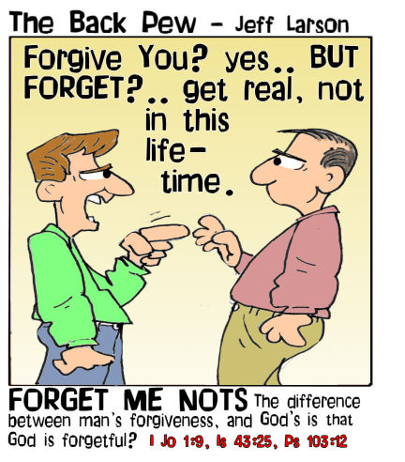
Series: Just Fix It! “Forewarned is Forearmed” (Part 3).
The Problem of Unforgiveness—
Isaiah 43:25—
²⁵ “I, even I, am the one who wipes out your transgressions for My own sake, And I will not remember your sins.
(NASB95)

